Slide 1
Pruning Algorithm
Chia-Hsuan Chou
Venkata Prudhvi Raj Indana
Jing Wang

Slide 2
Goal
Implement Felsenstein’s pruning algorithm on aligned sequences

Slide 3
Procedure
Input
Multiple alignment of sequences
A phylogenetic tree in Newick Standard format
Three base substitution matrix
Algorithm
Pruning Algorithm
Output
The best predicted ancestor sequence
The likelihood of the column given the tree
The total probability of having the predicted ancestor sequence

Slide 4
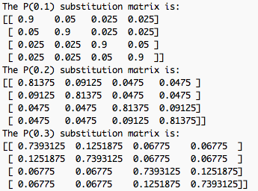
Results
Three base substitution matrix:
The likelihood of each column given the tree:
The best alignment is:
['A', 'G', 'T', 'T', 'G', 'C']
The best probability for each column is:
[0.4008449362199708, 0.036733105999023449,
0.037671009987304702, 0.40084493621997097,
0.070396016461669944, 0.4008449362199708]
The total probability is:
6.27396664108e-06

