Slide 1
BJP | WEEKLY MEDIA & SOCIAL SENTIMENT
Bandi Sanjay Kumar
Union Minister of State for Home Affairs | MP, Karimnagar
Print / Digital News Report
Week of 5-11 June 2026

Slide 2
OVERVIEW
Press coverage at a glance
22
7
36%
31%
Articles tracked
Publications
Positive share
Neutral share
• Press was more balanced than social: governance stories positive, POCSO thread negative.
• The POCSO case gave the opposition a sustained negative hook through the week.
• Bandi anchored the BJP's '12 Years of Modi' anniversary outreach across the state.
• A bipartisan moment (crediting Revanth Reddy) briefly cut through the negativity.

Slide 3
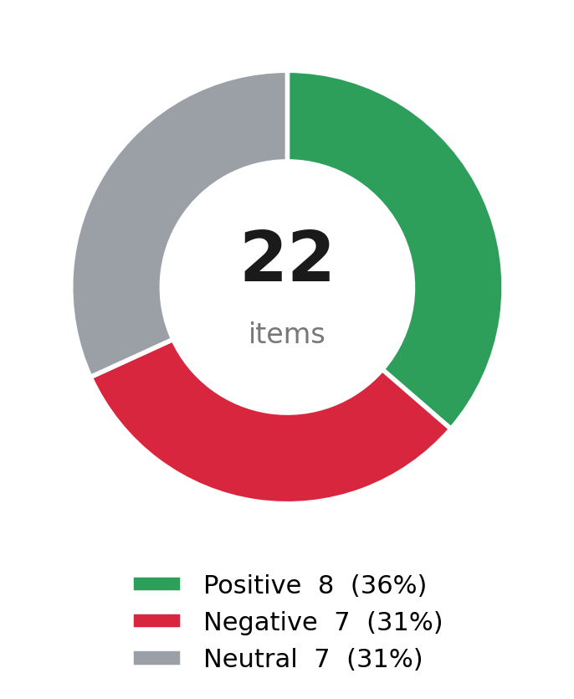
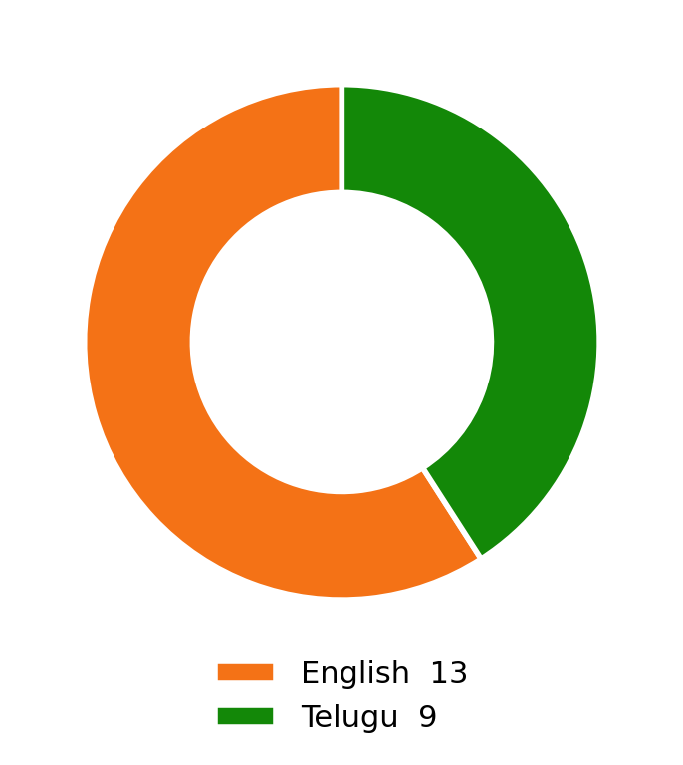
SENTIMENT
Tone & language of coverage

Slide 4
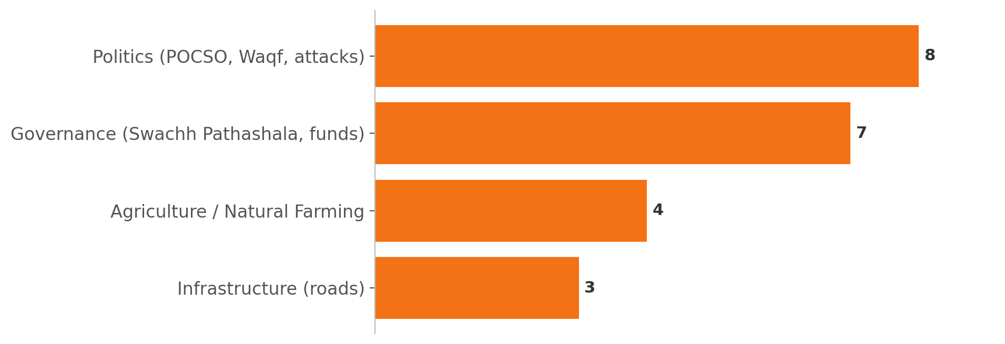
TOPICS
What the press covered
• Politics dominated print, split between the POCSO controversy and his Waqf / Hindutva messaging.
• Governance and agriculture coverage (Swachh Pathashala, Rythu Sammelanam) ran largely positive.
• A rare cross-party note: he credited CM Revanth Reddy for unlocking central road funds.
• The pothole-convoy episode gave a light-negative infrastructure angle.

Slide 5
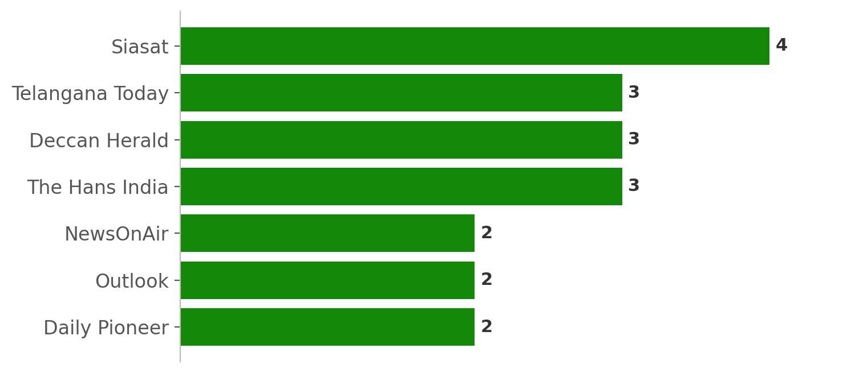
PUBLICATIONS
Where coverage appeared

Slide 6
STORIES
Defining stories of the week
Son's POCSO case dominates
Bandi Bhageerath Sai arrested; BRS's RS Praveen Kumar demands why the minister was not questioned, driving a heavy negative cluster online.
12 Years of Modi Seva outreach
Bandi anchors the BJP anniversary blitz: Rythu Sammelanam on natural farming in Jammikunta and the Swachh Pathashala school-cleaning drive.
Rare cross-party credit
He publicly thanks CM Revanth Reddy for helping unlock central funds for rural roads in his constituency.
Pothole convoy embarrassment
His vehicle stuck on the Karimnagar-Sircilla road becomes a mocking talking point a day before he lays a road-widening foundation stone.
Communal / political sparring
Accuses the Congress of backing the AIMIM protest against the Waqf Act, keeping the Hindutva plank active.

