Slide 1
BJP | WEEKLY MEDIA & SOCIAL SENTIMENT
Bandi Sanjay Kumar
Union Minister of State for Home Affairs | MP, Karimnagar
X / Social Listening Report
Week of 5-11 June 2026

Slide 2
OVERVIEW
The week on X at a glance
16
38
57%
21%
Posts from official handle
Conversation items sampled
Negative share
Positive share
• The week's online conversation skewed strongly negative (about 58% of the mention sample), driven almost entirely by the POCSO case involving his son, not by policy.
• His own handle stayed rigorously on-message - 12 Years of Modi Seva, natural farming and the school-cleaning campaign - with the Jhalmuri-with-NDA post his highest-reach item (about 11K views).
• Press coverage was more balanced than social: governance and outreach stories ran positive, while the POCSO thread gave the opposition a sustained negative hook.
• Off-handle name-variant conversation was markedly harsher than handle-tagged mentions, mirroring the KTR finding.

Slide 3
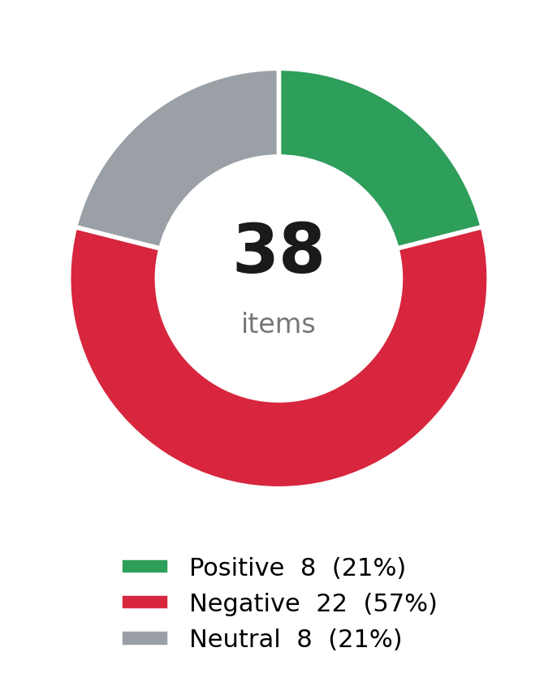
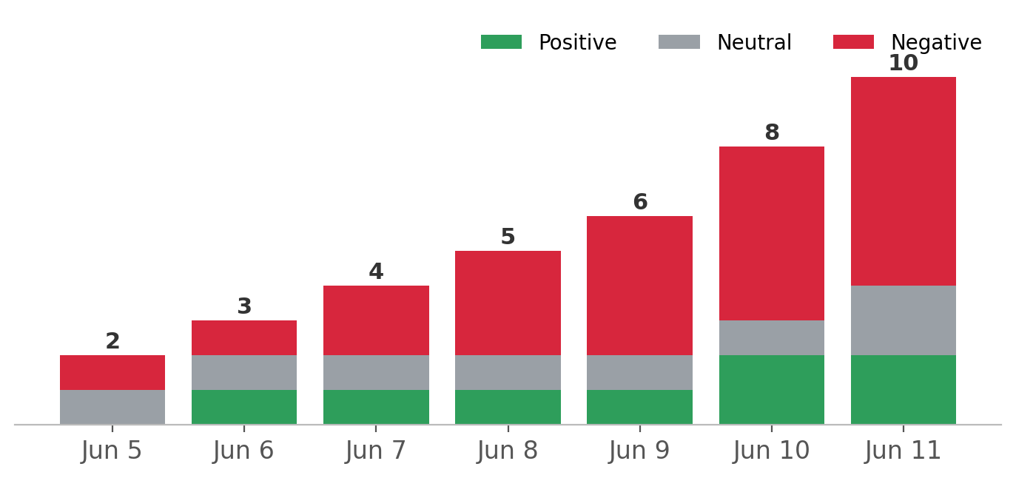
SENTIMENT
Sentiment split & daily volume

Slide 4
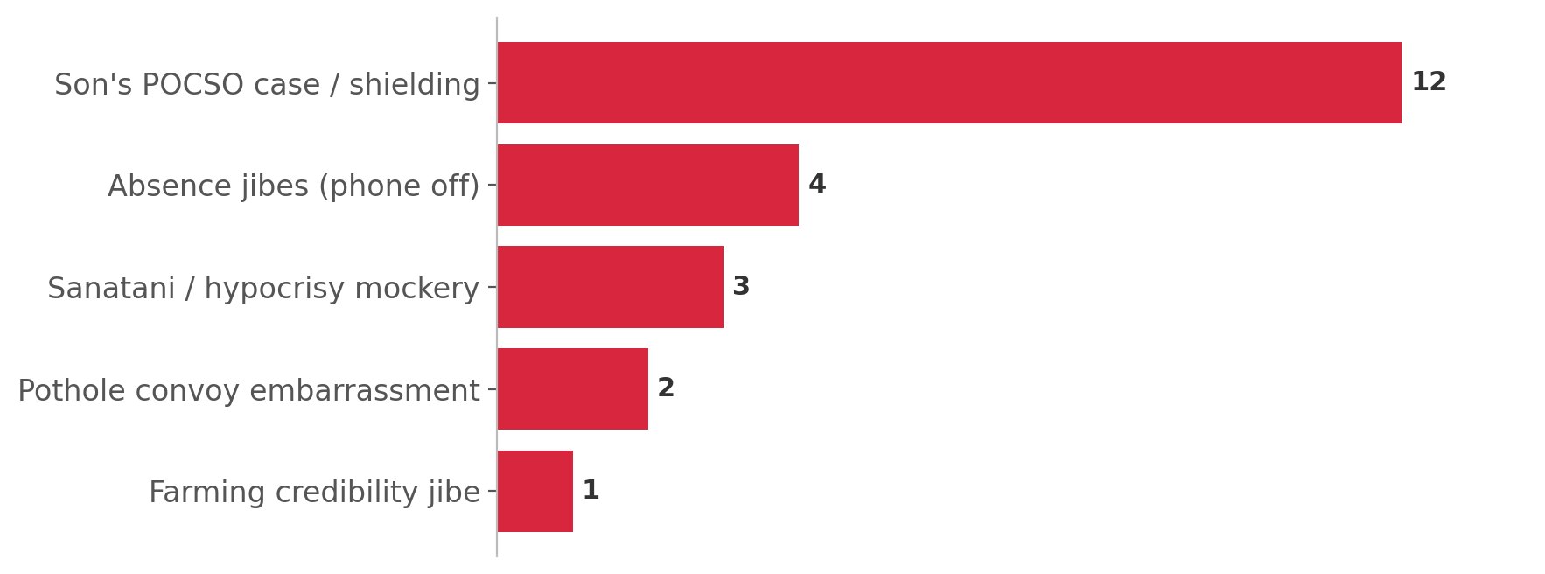
ISSUES
What drove negative conversation
• Son's POCSO case and alleged shielding was the single largest negative driver.
• A 'where is Bandi / phone unavailable' absence narrative gained traction.
• Sanatani-hypocrisy mockery recycled older jibes against him.
• His own posts stayed strictly on the 12-Years-of-Modi-Seva message.

Slide 5
TOP POSTS
Highest-reach posts this week
Next Sarvapindi calling - PM Modi enjoying Jhalmuri with NDA leaders at the alliance meeting, Bharat Mandapam, Delhi.
11,000 views
12 Years of Seva: Mana Badi - Mana Badhyatha. Not every act of nation-building needs a stage; sometimes it begins with a broom and a classroom.
4,000 views
Future generations will read about the greatness of this period of India in textbooks. (12 Years of Seva)
3,600 views
Rythu Sammelanam on Natural Farming at the Krishi Vigyan Kendra, Jammikunta, marking 12 Years of Seva.
2,883 views

