Slide 1
INC | WEEKLY MEDIA & SOCIAL SENTIMENT
A. Revanth Reddy
Chief Minister of Telangana | Congress (TPCC)
Print / Digital News Report
Week of 5-11 June 2026

Slide 2
OVERVIEW
Press coverage at a glance
23
7
56%
26%
Articles tracked
Publications
Positive share
Neutral share
• The NITI Aayog Governing Council with PM Modi was the week's defining national moment.
• Bharat Future City ('rival Tokyo/New York by 2034') drove an aspirational narrative.
• Negativity was diffuse civic grievance, not a single dominant scandal.
• Net sentiment was more balanced than Bandi Sanjay's controversy-hit week.

Slide 3
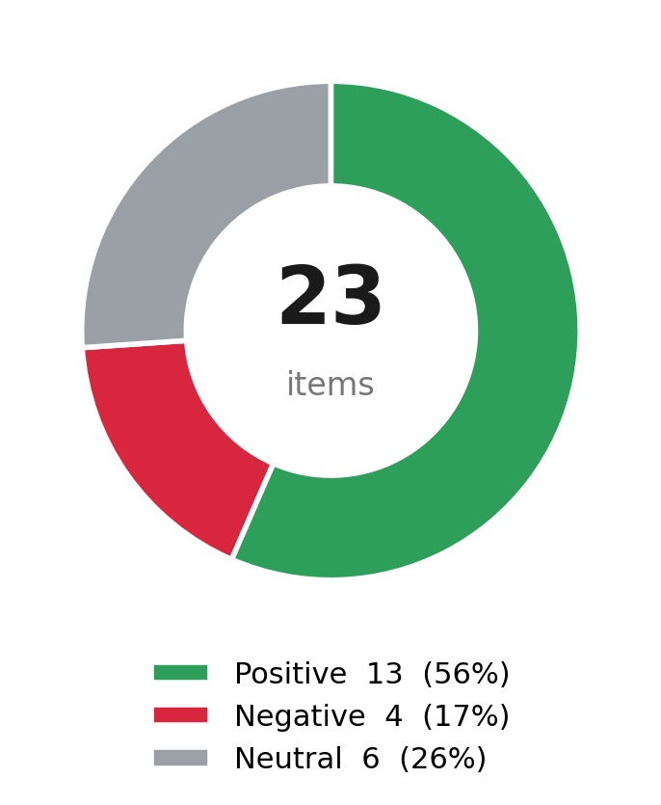
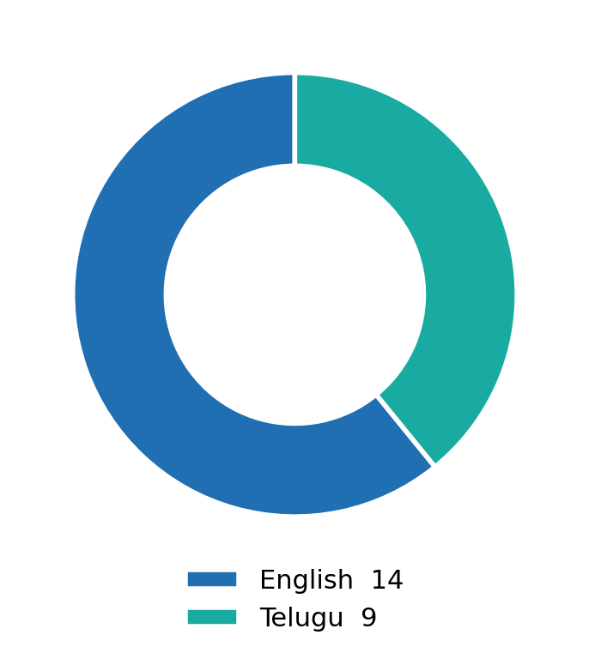
SENTIMENT
Tone & language of coverage

Slide 4
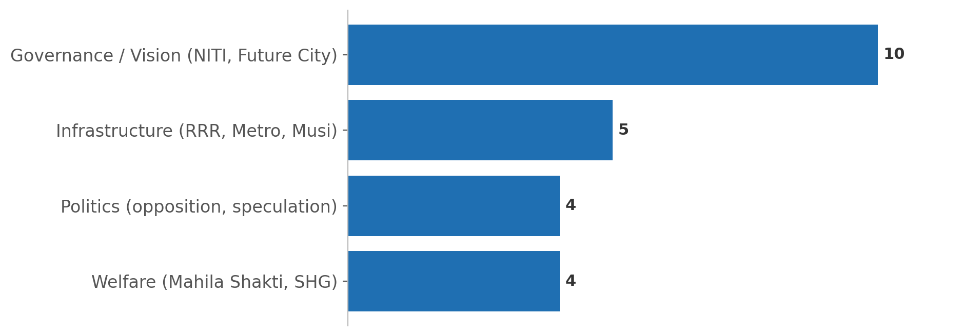
TOPICS
What the press covered
• Governance and vision dominated: the NITI Aayog pitch and Future City launch.
• He sought Centre support for RRR, Metro Phase-II, Musi rejuvenation and an IIM.
• An education-first growth model (built on the SEEEPC caste survey) framed his pitch.
• Coverage skewed strongly positive, with only light opposition counter-framing.

Slide 5
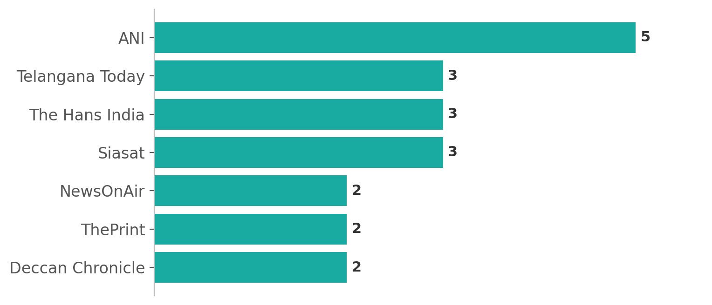
PUBLICATIONS
Where coverage appeared

Slide 6
STORIES
Defining stories of the week
NITI Aayog - Revanth's national moment
Pitches an 'M-6 Cities Task Force' (Rs 6 lakh cr) and an education-first growth model to PM Modi, seeking funds for RRR, Metro-II, Musi and an IIM in Hyderabad.
Bharat Future City becomes reality
Inaugurates the FCDA headquarters (built in under six months); frames a Net-Zero city to rival Tokyo and New York by 2034.
Women's welfare push
Mahila Shakti SHG events and asset distribution headline his Telangana-side week.
Civic grievance pile-up
Citizens flood his handle over power cuts, sewage and water - the daily friction of governing.
Opposition counter-fire
BJP and BRS voices push a 'Centre's funds, Revanth's lies' line and float CM-replacement speculation.

