Slide 1
INC | WEEKLY MEDIA & SOCIAL SENTIMENT
A. Revanth Reddy
Chief Minister of Telangana | Congress (TPCC)
X / Social Listening Report
Week of 5-11 June 2026

Slide 2
OVERVIEW
The week on X at a glance
15
42
38%
33%
Posts from official handle
Conversation items sampled
Negative share
Positive share
• Revanth's week was defined by a high-profile national moment: the NITI Aayog Governing Council with PM Modi, where his M-6 Task Force and education-first pitch dominated coverage.
• Bharat Future City was the second engine of positive sentiment - the FCDA launch and 'rival Tokyo/New York by 2034' framing drove an aspirational narrative.
• Unlike Bandi Sanjay's controversy-driven week, Revanth's negativity was diffuse civic grievance (power, sewage, water) rather than a single scandal.
• His highest-reach post - meeting PM Modi at about 28K views - outperformed everything else, showing national-stage content travels furthest.

Slide 3
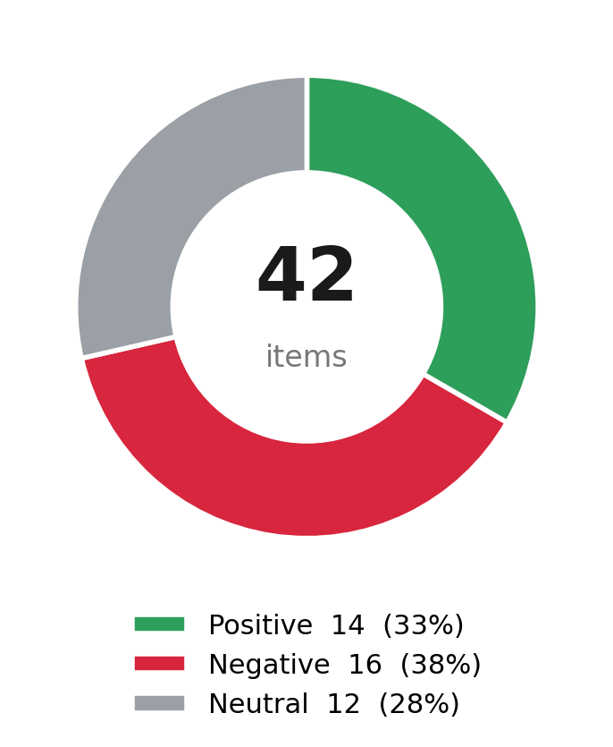
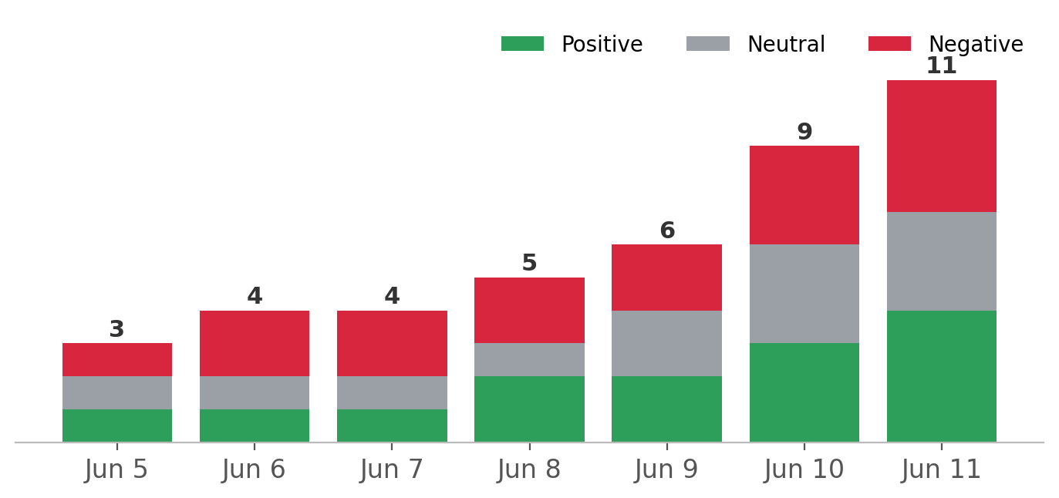
SENTIMENT
Sentiment split & daily volume

Slide 4
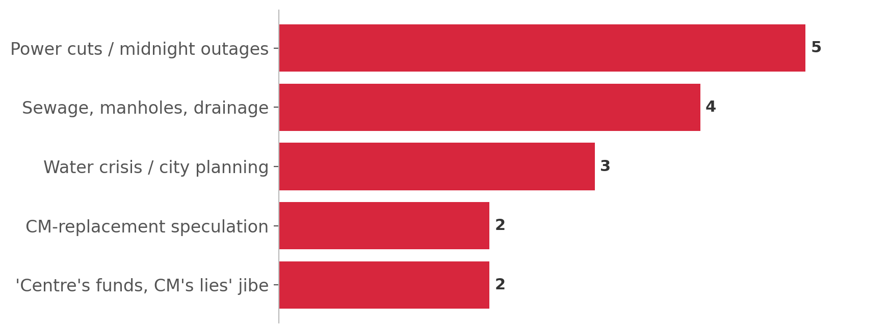
ISSUES
What drove negative conversation
• Negativity was diffuse civic grievance (power, sewage, water), not one scandal.
• Citizens used his handle as a direct complaints channel to the CM.
• Opposition pushed a 'Centre gave funds, Revanth lied' counter-narrative.
• Some chatter floated CM-replacement speculation, without traction.

Slide 5
TOP POSTS
Highest-reach posts this week
Met Hon'ble PM Shri Narendra Modi ji on the sidelines of the 11th NITI Aayog Governing Council Meet, New Delhi, and pitched Telangana's growth agenda.
28,000 views
Inaugurated the Future City Development Authority (FCDA) building at Bharat Future City - a milestone in Telangana's development.
17,000 views
Rain or shine, day or night - re-dedicated to the welfare of our women. #MahilaShakti
12,000 views
Launched the FCDA logo and website; Future City to rival global metros as a Net-Zero hub of AI, pharma and education.
7,500 views

