Slide 1
Linux USB Mass Storage Device Driver
Linux Kernel Driver — Block Layer, SCSI and USB Bulk-Only Transport — Raspberrypi 4
Field | Details
Project Title | Linux USB Mass Storage Device Driver
Team | P1 Team 1
presented by | A Prudhvi
Platform | Linux Kernel — C Programming
Tools | Raspberry pi 4, Transcend Card reader ,micro sd card

Slide 2
Project Objective
What is USB Mass Storage, and what this driver does
What is USB Mass Storage?
What the Driver Does
A USB standard that lets storage devices such as pen drives and card readers appear to the computer as normal block storage, using SCSI commands over USB.
Detects the USB storage device when connected
Identifies it using the INQUIRY SCSI command
Reads device capacity and block size
Creates a block device: /dev/myusbX
Handles read and write requests from the OS
Handles errors and safe removal on disconnect
Purpose of the Project
Build a Linux kernel driver that talks to a USB storage device using the Bulk-Only Transport protocol and exposes it to the OS as a normal block device.
USB Mass Storage Device Driver
2

Slide 3
Driver Architecture
How a request travels from the application to the USB drive
Application
User program (mount, dd, cp) issues a file read or write
VFS (Virtual File System)
Routes the request to the correct block/file system driver
Block Layer / blk-mq
Converts the request into queued I/O work for the device
USB Mass Storage Driver
Our driver converts the block request into SCSI commands
SCSI Commands
Commands like READ(10) / WRITE(10) describe the operation
USB Bulk-Only Transport
Command and data are exchanged as CBW → Data → CSW
USB Flash Drive
Physical device executes the command and returns data/status
USB Mass Storage Device Driver
3

Slide 4
USB Mass Storage Protocol
Command flow and the SCSI commands used in the driver
CBW
Command Block Wrapper
Data Transfer
CSW
Command Status Wrapper
sends the command
read or write payload
reports success/failure
SCSI Commands Used
INQUIRY
Identifies the device (vendor, product, revision)
TEST UNIT READY
Checks if the device is ready for use
REQUEST SENSE
Gets error details after a failed command
READ CAPACITY(10)
Reads block size and last LBA (total capacity)
READ(10)
Reads data blocks from the device
WRITE(10)
Writes data blocks to the device
USB Mass Storage Device Driver
4

Slide 5
Device Detection and Removal
What happens when the USB drive is connected and disconnected
On Connect (Probe Flow)
On Disconnect
USB Device Connected
Kernel detects a new device on the USB bus
USB drive is unplugged
Probe Function Runs
The kernel calls the driver's disconnect() function
Kernel calls our driver's probe() function
Find Bulk IN / Bulk OUT Endpoints
Device marked as disconnected
Driver locates the endpoints used for data transfer
An atomic flag stops any new I/O from starting
INQUIRY
Identifies the device (vendor, product, revision)
In-progress I/O finishes safely
TEST UNIT READY
The driver waits on the I/O mutex before removing the disk
Checks that the device is ready for use
READ CAPACITY
Block device is removed
Reads block size and total capacity
del_gendisk() and put_disk() take /dev/myusbX offline
Create Block Device
Sets up blk-mq and registers a gendisk
Resources are freed
/dev/myusbX Ready
USB device reference and driver memory (kfree) are released
Device is now usable like any other disk
USB Mass Storage Device Driver
5

Slide 6
Read and Write Operation
How data moves between the application and the USB drive
READ Operation
WRITE Operation
Application requests READ
Application requests WRITE
e.g. dd or cat calls the read() system call
e.g. dd or cp calls the write() system call
Block layer creates a request
Block layer creates a request
blk-mq dispatches it by calling queue_rq()
blk-mq dispatches it by calling queue_rq()
Sector is converted to LBA
Data copied from the request
READ(10) SCSI command is built for the driver
kmap_local_page() maps pages into memory
CBW sent, data returned via Bulk IN
WRITE(10) sent as CBW, data via Bulk OUT
usb_bulk_msg() carries out the transfer
usb_bulk_msg() carries out the transfer
Data copied into the request
CSW confirms completion
blk_mq_end_request() completes the I/O
blk_mq_end_request() completes the I/O
USB Mass Storage Device Driver
6

Slide 7
Error Handling
How the driver deals with failures and unexpected conditions
USB Transfer Failure
Endpoint Halt
Bulk transfer errors are detected and reported
A stalled endpoint is cleared with usb_clear_halt()
CSW Validation
Invalid LBA / Block Size
Signature, tag and status are checked before accepting the result
Read/write requests outside device capacity are rejected
Device Disconnect
Reset Recovery
In-progress I/O is stopped safely if the device is removed
A mass-storage reset is issued to recover from protocol errors
USB Mass Storage Device Driver
8

Slide 8
Testing
Commands used to load, verify, and use the driver
insmod / rmmod
Load / remove the driver module
dmesg
View kernel driver logs
lsusb / lsusb -t
List USB devices and their driver tree
mount / umount
Mount and unmount the USB drive
dd
Read/write test data to measure speed
lsblk / blkid / fdisk
Inspect the block device and partitions
USB Mass Storage Device Driver
9

Slide 9
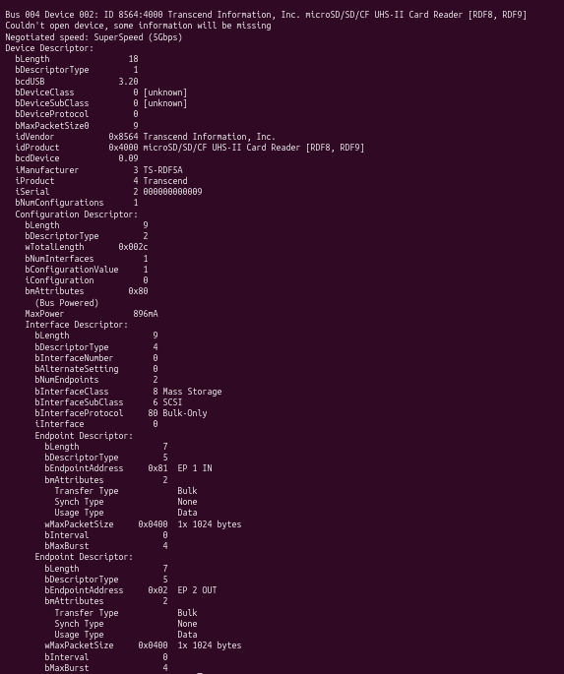
lsusb -v output: device identified as Mass Storage, SCSI, Bulk-Only
USB Mass Storage Device Driver
9

Slide 10
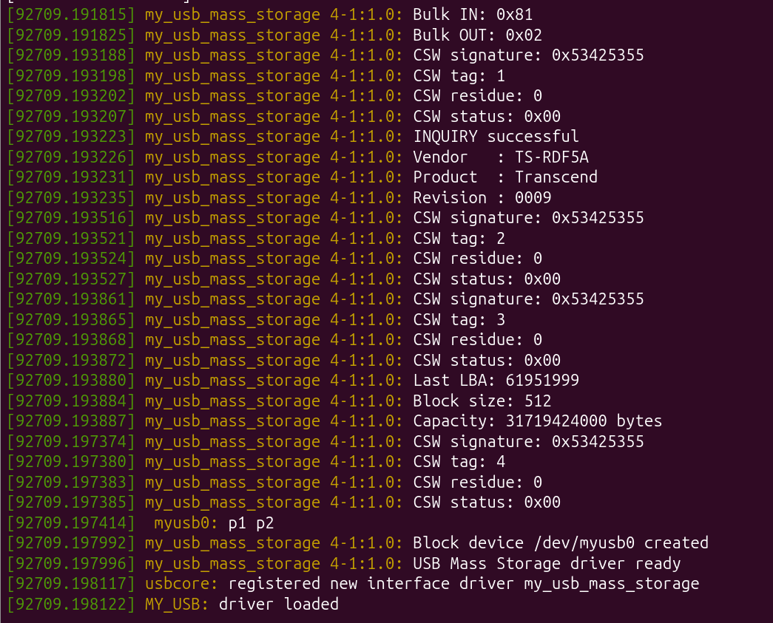
USB Device Detection
USB Mass Storage Device Driver
9

Slide 11

Test Results
Driver verified with a real USB flash drive
What the Results Show
lsusb confirmed the device as Mass Storage, SCSI, Bulk-Only — our driver's probe() matched and loaded
Block device /dev/myusb0 was created; mount succeeded and files were listed normally, proving read requests work
dd write test: 100 MB written at 34 MB/s — confirms the WRITE(10) path works end-to-end
dd read test: 390 MB read at 97 MB/s — confirms the READ(10) path works end-to-end
No crashes or hangs during repeated mount/unmount and disconnect, showing error handling works as designed
Mount and file listing on /dev/myusb0p2
Write test: 100 MB written at 34 MB/s (dd)
Conclusion
Read test: 390 MB read at 97 MB/s (dd)
The driver successfully implements USB Mass Storage over Bulk-Only Transport, from device detection to block-level read/write, using the Linux blk-mq framework. All results shown above are from testing with a real USB flash drive.
USB Mass Storage Device Driver
10

