Slide 1

USED CAR PRICE ANALYSIS
Kakunuri Prudhvi
BATCH NO:436
Innomatics Research Labs, Dilsukhnagar

Slide 2

About me:
I am K. Prudhvi
I am a Computer Science Engineering graduate from Aurora’s Scientific and Technological Institute.
I see Data Science & AI as the future of Technologies and Businesses.
Portfolio Website: prudhvikakkunuri.github.io
LinkedIn: www.linkedin.com/in/prudhvi-k-387257222
GitHub: https://github.com/prudhvikakkunuri

Slide 3
INTRODUCTION
The Indian used-car market is rapidly growing, yet buyers often face ambiguity and lack of transparency in pricing, distance travelled, fuel preference, and resale value.
This project applies data-driven analysis to help users make informed and confident used-car purchasing decisions.
The dataset was collected through web scraping the Spinny marketplace using BeautifulSoup and Selenium.
Using data cleaning, EDA and hypothesis testing to identify key price drivers and reduce ambiguity.

Slide 4
PROBLEM STATEMENT
The used-car market presents high price variability and limited transparency, making it difficult for buyers to evaluate whether a vehicle is fairly priced.
Buyers often lack clarity on how critical factors such as manufacturing year, km travelled, fuel type, transmission, brand, and location influence used-car prices.
Purchasing decisions are frequently based on intuition, seller claims, or limited comparisons, increasing the risk of overpaying.
This project aims to enhance decision-making for users planning to buy a used car by eliminating ambiguity through data-driven insights and price prediction.

Slide 5
CONTENTS
Data Collection
Data overview
Data Cleaning
Detecting & Treating Outliers
Detecting & Treating Null values
Numerical Analysis
Categorical Analysis
Price Analysis
Geographical Analysis
Correlation Analysis
Hypothesis Testing
Conclusion

Slide 6
DATA COLLECTION
Collected real-world used-car listing data by web scraping the Spinny used-car marketplace.
Used Selenium to handle dynamic page loading and infinite scrolling on the Spinny website.
Applied BeautifulSoup to parse HTML content and extract structured details such as price, year, mileage, fuel type, transmission, and location.
Compiled the scraped data into a clean, structured dataset for analysis and modeling.

Slide 7
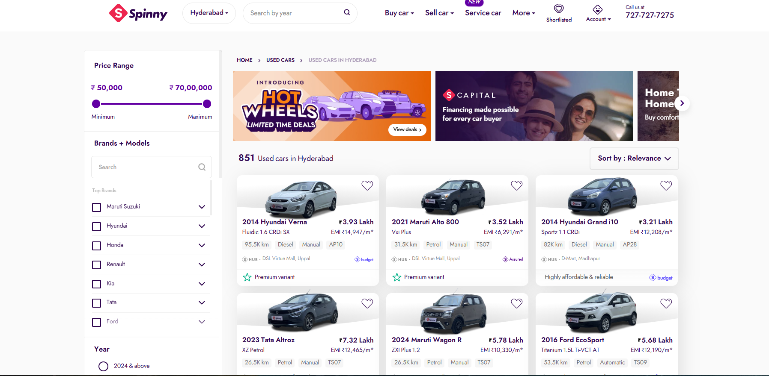

Slide 8
DATA OVERVIEW & UNDERSTANDING
year - The year that the car was brought
brand - The company the car belongs to
model - Model of the car(Thar, Scorpio)
variant - Variant of the car(Base, Middle, High end)
km - No of kilometers travelled
fuel - Type of the fuel(petrol, diesel)
transmission - Transmission of the car (Manual, automatic, semi-automatic)
registration - State of registration
price - Cost of the car
location - Location of the seller/showroom
city - Current city

Slide 9
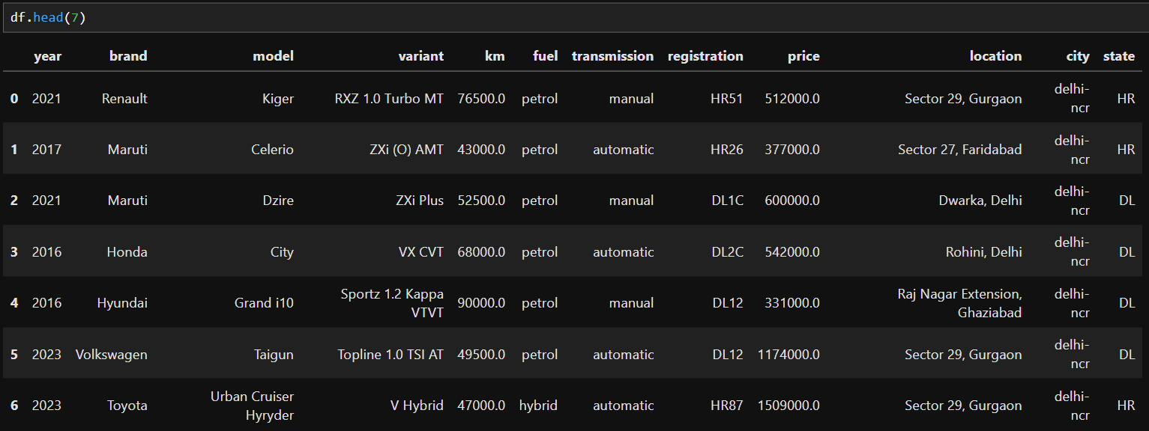

Slide 10
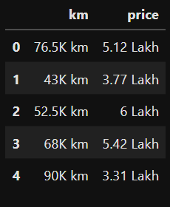
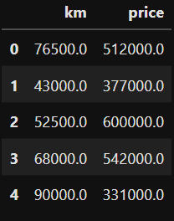
DATA CLEANING
Initially, all columns were in nominal (object) format; quantitative features such as price and kilometers driven were identified and converted into numeric data types.
Applied string processing techniques including replace(), strip(), and mul() to remove units and standardize values.
This transformation enabled accurate analysis, visualization, and modeling by ensuring numerical consistency.

Slide 11
DETECTING & TREATING OUTLIERS
Performed outlier detection using the Interquartile Range (IQR) method to identify extreme values in numerical columns such as price and kilometers driven.
Defined lower and upper bounds using Q1 − 1.5×IQR and Q3 + 1.5×IQR to isolate abnormal observations.
The Interquartile Range (IQR) focuses on the middle 50% of the data
Removed extreme values to reduce skewness and prevent distortion in statistical analysis and model performance.

Slide 12
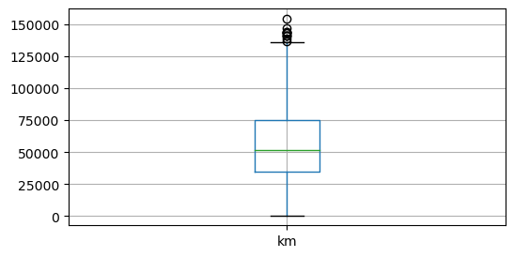
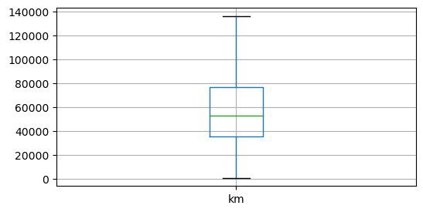
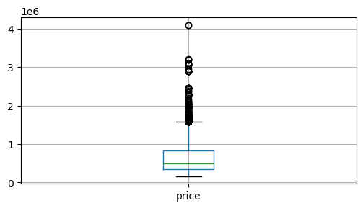
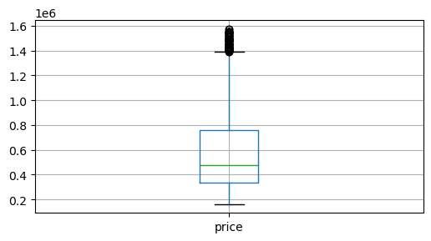

Slide 13
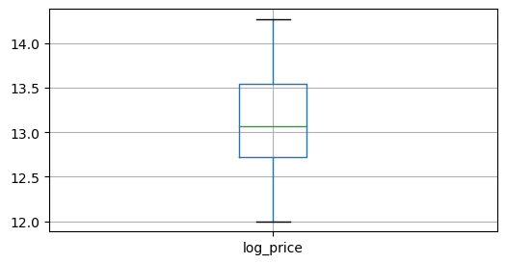
Even after treating the outliers price column still has some extreme values present because the price column is extremely right skewed.
It is treated by applying logarithmic transformation and created a duplicated column named as log_price

Slide 14
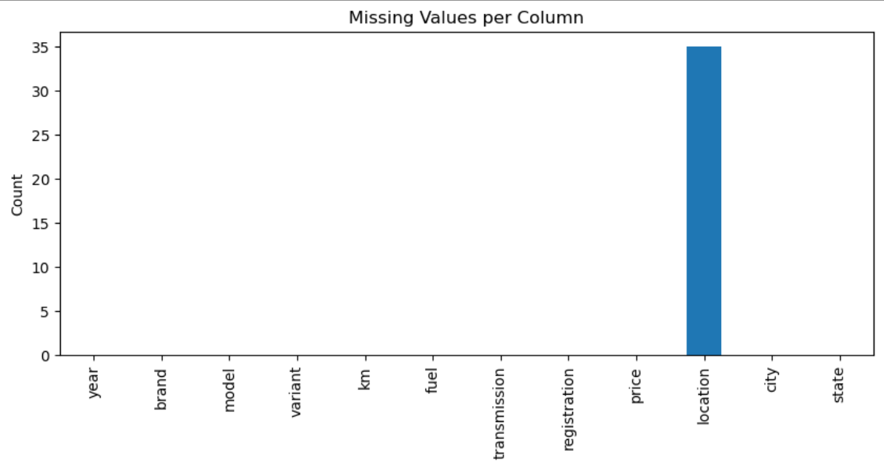
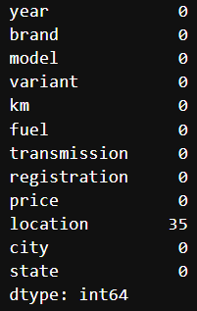
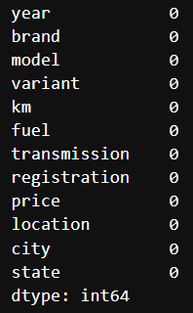
DETECTING & TREATING NULL VALUES
Except for location column all the columns have no null values.
The null values of location were imputed with “Location not found” because as we have extracted city and state column it is negligible but dropping those rows might effect mean of price.

Slide 15
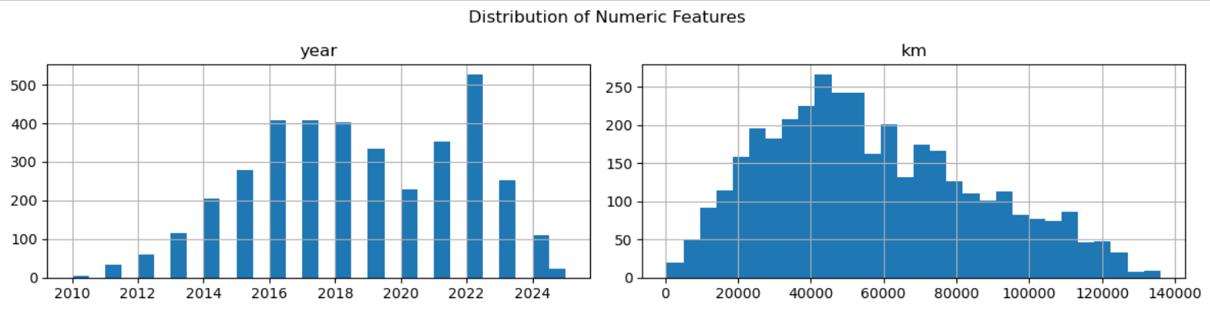
NUMERICAL ANALYSIS
Most listings are concentrated between 2015 and 2023, indicating a higher availability of relatively newer used cars.
Very few cars are listed from earlier years, showing lower retention and resale of older vehicles.
KM values are right-skewed, with most cars driven between 20,000 and 70,000 km.
Fewer cars appear at very high km travelled levels, reflecting lower resale demand for heavily used vehicles.

Slide 16
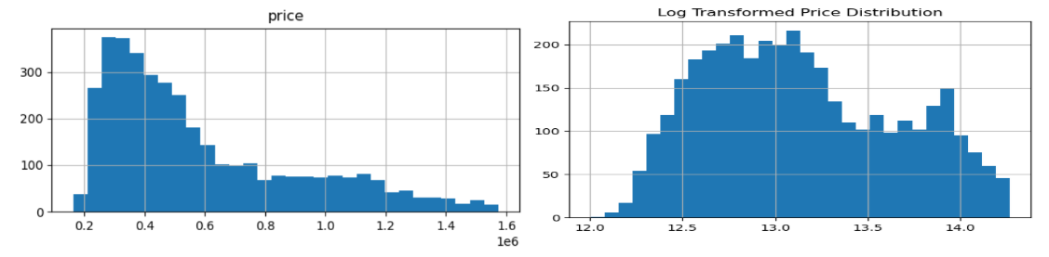
Price distribution is strongly right-skewed, with most cars priced in the lower to mid range.
A small number of high-priced cars create a long tail, indicating premium or newer models.
After log transformation, the price distribution becomes more symmetric and closer to normal.
This confirms that log transformation is effective for reducing skewness and improving suitability for statistical modeling.

Slide 17
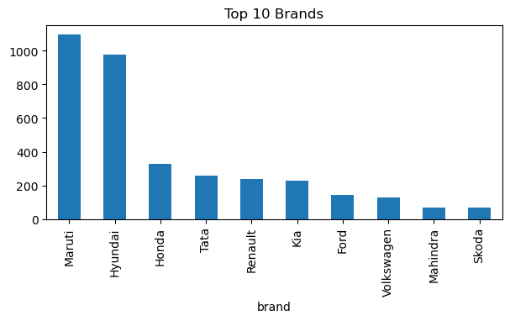
CATEGORICAL ANALYSIS
Maruti and Hyundai dominate the used-car market, indicating high resale volume and customer trust.
Other brands have significantly fewer listings, showing a long-tail distribution in brand availability.

Slide 18
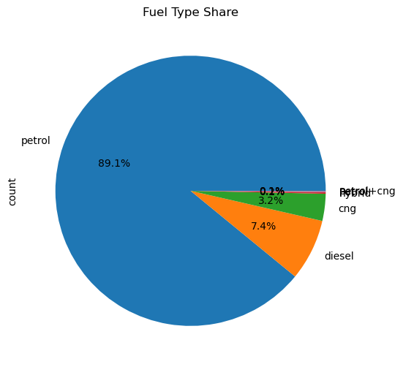
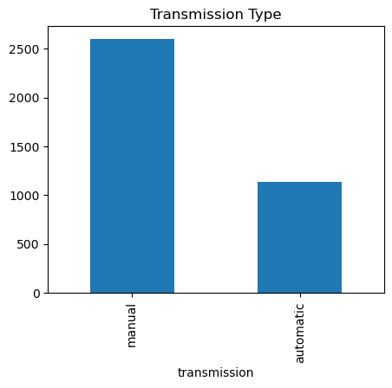
Manual cars dominate the listings, reflecting buyer preference for affordability and fuel efficiency.
Automatic cars form a smaller share, suggesting higher prices and lower resale volume.
Petrol cars account for the majority of listings (~90%), making them the most common choice in the used-car market.
Diesel and CNG contribute a much smaller share, indicating limited availability and niche demand.

Slide 19
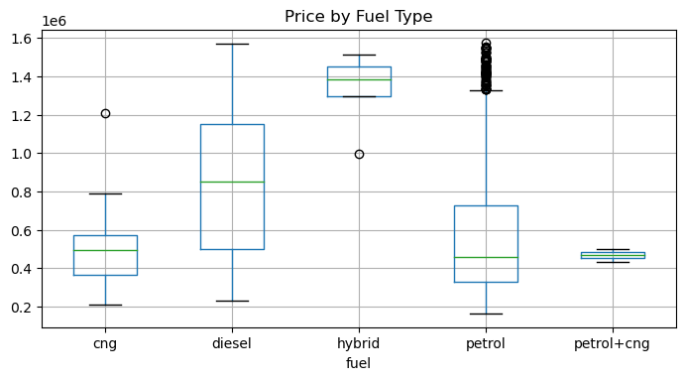
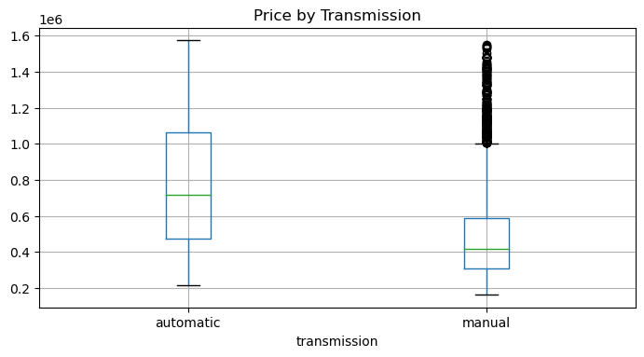
PRICE ANALYSIS
Hybrid and diesel cars show higher median prices, reflecting better fuel efficiency and higher upfront value.
Petrol cars have a wider price spread, indicating availability across both budget and premium segments.
Automatic cars have a higher median price compared to manual cars.
Manual cars show lower prices with tighter distribution, highlighting their budget-friendly nature.

Slide 20
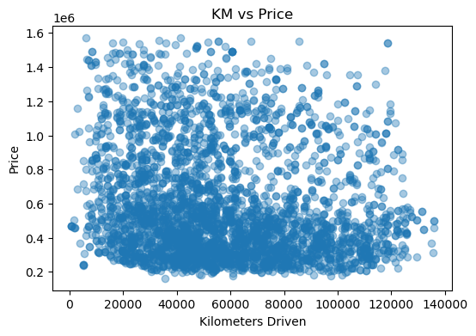
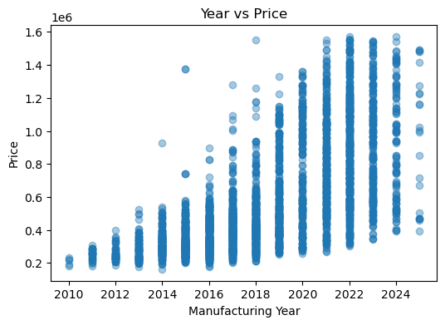
Price generally decreases as kilometers driven increase, confirming the depreciation effect of mileage.
High-priced cars are mostly concentrated at lower mileage levels.
Clear upward trend between manufacturing year and price, showing that newer cars command higher value.
Older cars are clustered at lower prices, confirming age-based depreciation.

Slide 21
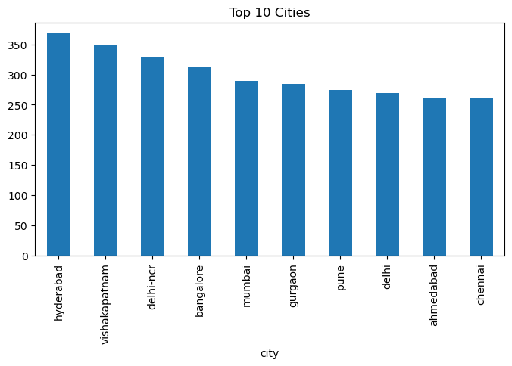
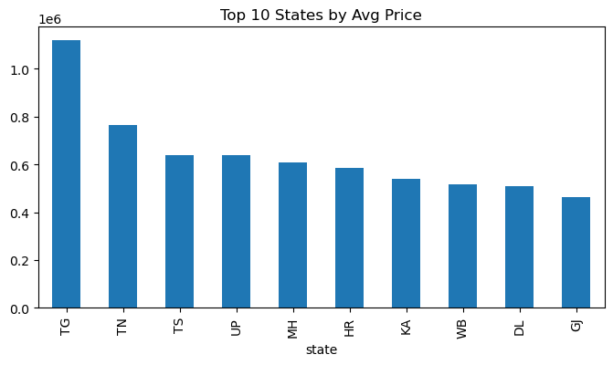
Location & Geography Analysis
Hyderabad and Visakhapatnam have the highest number of listings, indicating strong used-car market activity in these cities.
Major metro cities dominate the list, suggesting higher supply and demand concentration in urban regions.
Telangana (TG) has the highest average used-car prices, possibly due to newer inventory or higher-end vehicle demand.
States show noticeable variation in average prices, highlighting geographical influence on used-car valuation.

Slide 22
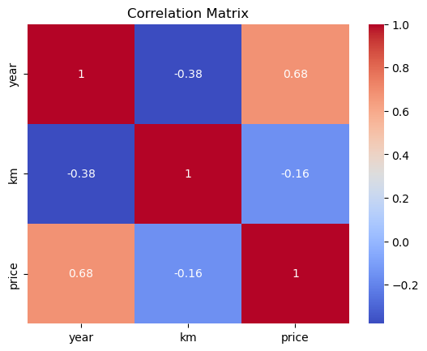
Correlation Analysis
Price shows a strong positive correlation with year (0.68), indicating that newer cars tend to be priced higher.
Kilometers driven has a negative relationship with price (-0.16), confirming that higher mileage generally reduces car value.

Slide 23
HYPOTHESIS TESTING
Is car price correlated with kilometers driven?
KM driven vs Price
H₀: No correlation between km and price
H₁: Significant correlation exists
Pearson’s Correlation test is performed to check whether the relationship between KM driven and Price exists.
Since p-value>0.05 Relationship is statistically significant. Hence, failed to reject Alternative Hypothesis H₁.
Price decreases as km increases i.e. The Negative relationship exists

Slide 24
Does fuel type affect being expensive?
Chi Square test:
H₀: Fuel type and Price category are independent.
H₁: Fuel type affects likelihood of high price
Chi square test is performed on price by encoding into high_price category column, as chi square test requires only categorical columns
Since p-value>0.05 Failed to Reject Alternative Hypothesis H₁.
Fuel type and price category are dependent.

Slide 25
Do automatic cars have higher price?
Chi Square test:
H₀: There is no significant relationship between price and Transmission.
H₁: Automatic cars are more expensive.
Chi square test is performed on price category and transmission to check whether transmission effects price or not.
Since p-value>0.05 Failed to Reject Alternative Hypothesis H₁.
Transmission type affects price category and Automatic cars are expensive.

Slide 26
Do new cars(>=2018) have higher prices than older cars?
Z-test:
H₀: Mean price of new cars and old cars are same.
H₁: Mean price of new cars > Mean price of older cars.
Z-test is performed on price by splitting into newer and older cars to check whether mean price of new cars > mean price of older cars.
Since p-value<0.05 Failed to Reject Alternative Hypothesis H₁.
Newer cars (>=2018) have higher prices than older cars.

Slide 27
CONCLUSION
Successfully transformed raw web-scraped data from a used-car marketplace into a clean, structured dataset suitable for analysis.
Identified and quantified the key factors influencing used-car prices, including year of manufacture, kilometers driven, transmission type, fuel type, and location.
Applied exploratory data analysis and hypothesis testing to validate common pricing assumptions using statistical evidence.
Delivered a data-driven decision-support framework that reduces uncertainty, improves transparency, and enables smarter used-car purchasing decisions.

Slide 28
THANK
YOU

Slide 29
Q&A

