Slide 1
Image compression using SVD and dimensionality reduction using PCA
By Mitul Rakholiya
Prudhvi Kotamarthy

Slide 2
Singular Value Decomposition (svd)
Singular Value Decomposition (SVD) states that every (m × n)‑matrix A can be written as a product
m×m
m×n
V is n×n
The columns of U are orthogonal eigenvectors of AA^{T}.
The columns of V are orthogonal eigenvectors of A^{T}A.
Eigenvalues λ₁ … λ_{r} of AA^{T} are the eigenvalues of A^{T}A.
Singular values.

Slide 3
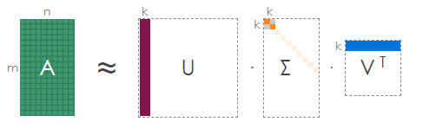
SVD for image compression
We can decompose a given image into the three color channels red, green and blue. Each channel can be represented as a (m × n)‑matrix with values ranging from 0 to 255. We will now compress the matrix A representing one of the channels.
compressed size = m × k + k + k × n = k × (1 + m + n)

Slide 4
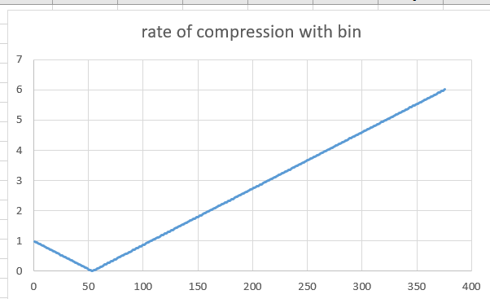
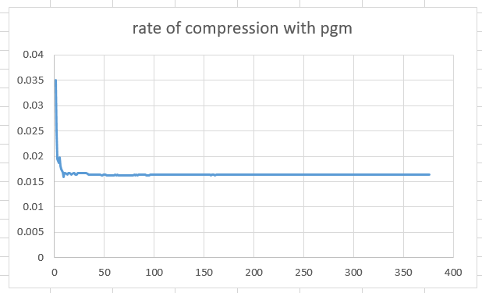
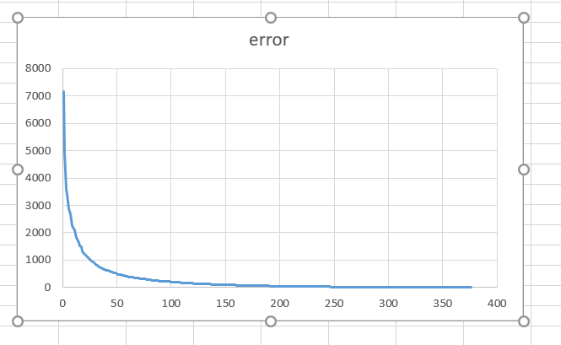
Test CAS.pgm
Fig 2

Slide 5
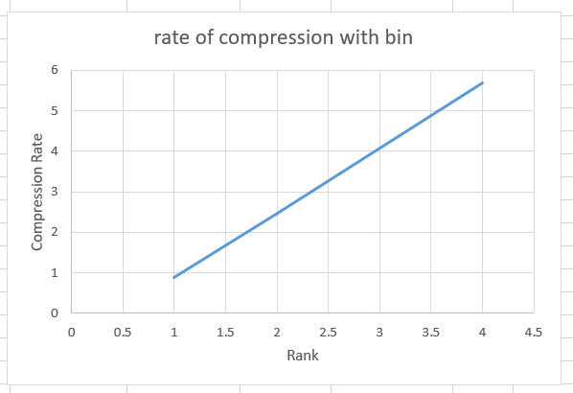
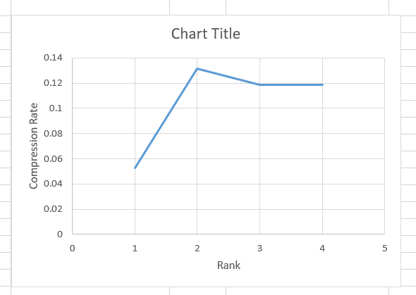
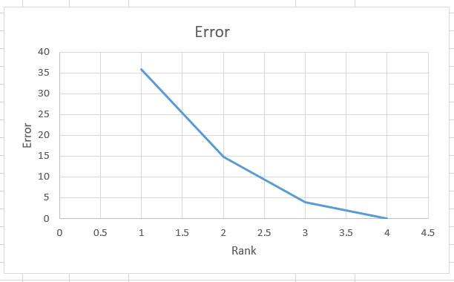
Test Image
Fig 3

Slide 6
Conclusion
1. We can see that with the small image fig 3 that we are not getting any compression because saving floating values for SVD matrices outweighed saving a fewer number of pixels.
2. For large image fig2. We can see the rate of compression decreases with increasing rank initially then it starts increasing because later floating values outweighed saving pixels.
3. Rate of error is decreasing with increasing with the rank.
So for compressing an image with SVD, It depends on the size of the image, and required to choose precisely rank with it need to be compressed so we can better accuracy and compression.

Slide 7
Principal Component Analysis (PCA)
Principal Component Analysis (PCA) is a linear dimensionality reduction technique that can be utilized for extracting information from a high-dimensional space by projecting it into a lower-dimensional sub-space. It tries to preserve the essential parts that have more variation of the data and remove the non-essential parts with fewer variation.

Slide 8
Breast Cancer data
- The Breast Cancer data set is a real-valued multivariate features of cell nuclei that consists of two classes malignant and benign
- It has 30 features shared across all classes: radius, texture, perimeter, area, smoothness, fractal dimension, etc
- We can download dataset from sklearn or UCI Machine Learning Repository.

Slide 9
PCA to Breast Cancer data
- It has 30 features (dimensions)
- It is difficult to visualize 30 dimension and main distinguish features among them.
- we will apply PCA to reduce dimension 2 and analyze and visualize it.

Slide 10
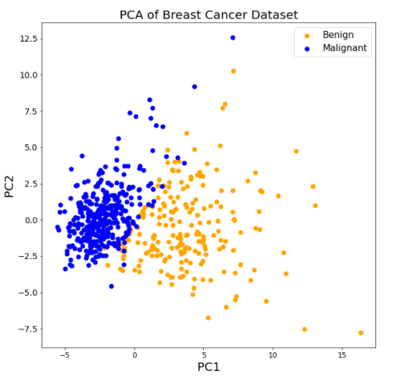
From the above graph, you can observe that the two classes benign and malignant, when projected to a two-dimensional space, can be linearly separable up to some extent. Other observations can be that the benign class is spread out as compared to the malignant class.
From the PCA output, we can observe that the PC1 holds 44.2% of the information while the PC2 holds only 19% of the information and other holds 36.8%

Slide 11
Customer's data
It consists of various customer’s annual spending amounts (reported in monetary units) of diverse product categories for internal structure.
Data has 440 samples composed of six important product categories: ‘Fresh’, ‘Milk’, ‘Grocery’, ‘Frozen’, ‘Detergents_Paper’, and ‘Delicatessen’.
Outliers do not add value to the algorithm (for eg: k-means) and make the algorithm perform worse in a few cases. An outlier step is calculated as 1.5 times the interquartile range (IQR).
A data point with a feature that is beyond an outlier step outside of the IQR for that feature is considered abnormal.

Slide 12
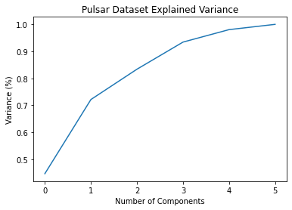
The above figure shows that the first three principal components explain 80% of the variance in the data.
This means we can reduce the data from six dimensions to 3 dimensions with 20% of information lost.
By adding the fourth PC we can achieve a 90% variance of the data.

Slide 13
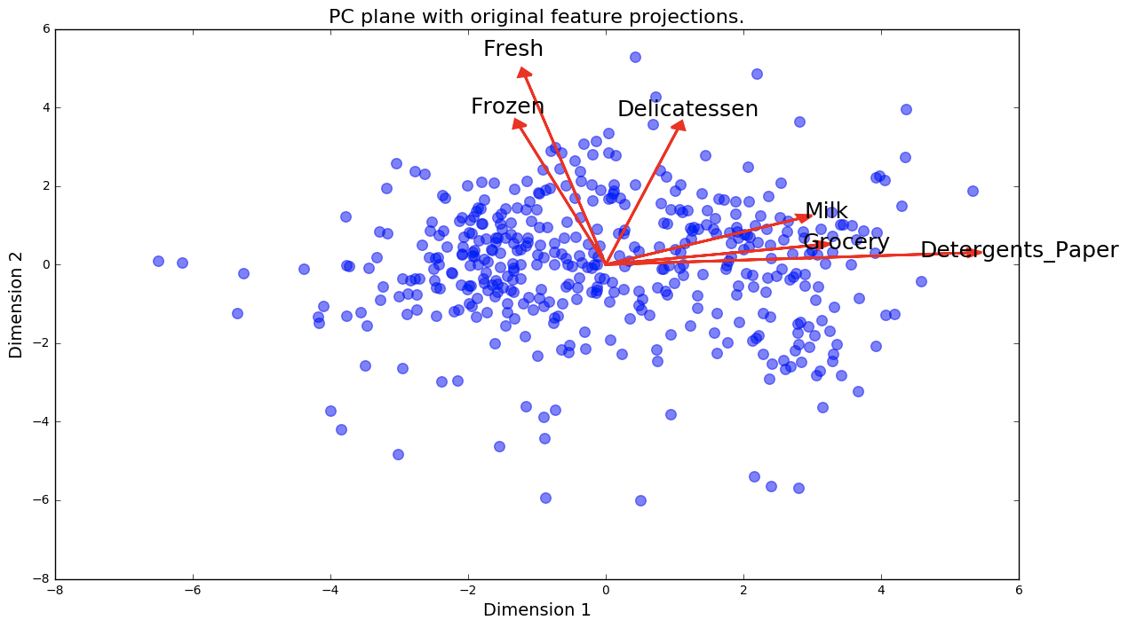
From the image, a point the lower right corner of the figure will likely correspond to a
customer that spends a lot on 'Milk', 'Grocery' and 'Detergents_Paper', but not so much on
the other product categories.

Slide 14
Demo

Slide 15
Thank you
Questions?

