Slide 1
Encoding fMRI signals from audio,text stimuli from Native Chinese Speakers Using "Le Petit Prince" Dataset
Geetri Satya Swaroop (2023202015)
Prudhvi (2022201007)
Shivang Sharma (2023201052)

Slide 2
Approach
Steps:
  Feature Extraction from speech signal (OpenAI Whisper model)
  Encoding Audio features to fMRI signals
  Multimodal Encoding(Audio features,Text Features) to fMRI signals (in progress)

Slide 3
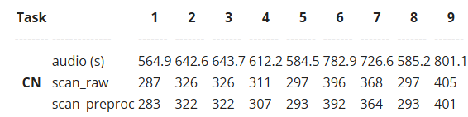
Dataset
Source: OpenNeuro (ds003643, v2.0.7) – "Le Petit Prince" fMRI corpus.
Subset: Chinese (35 participants, native speakers, (15 females, mean age=19.3, SD=1.6))
Data:
Multi-echo fMRI (TR = 2s, voxel size = 3.75 x 3.75 x 3.8 mm).
Stimulus: Audio narration of "The Little Prince" in Chinese.
Preprocessed derivatives available (ME-ICA, MNI space).
Availability:
Brain data: Functional scans (bold.nii.gz).
Stimulus data: Audio book [Le Petit Prince chinese] (.wav file)

Slide 4
Why we are not using PaddleSpeech
1. Limited Community and Developer Support: PaddleSpeech, while powerful, has a smaller community compared to more popular frameworks like PyTorch (used by Whisper) or TensorFlow. Our code already deals with complex dependencies (e.g., transformers), and adding PaddleSpeech’s dependency on PaddlePaddle were introducing more compatibility issues.
2. Unavailability of Active Support: The “actual PaddleSpeech support isn’t available now” which means that official support is limited. Our code runs in a kaggle environment, which uses Python 3.11 and has pre-installed libraries. Installing PaddleSpeech and PaddlePaddle caused conflicts and was requiring to downgrade the dependencies.
3. Models availability: Models are removed from their servers(http 404 “Not Found” error )
4. Fit for Use Case: So we used OpenAI Whisper audio model which also trained in chinese mandarin, audio feature extraction was done by using Whisper model.

Slide 5
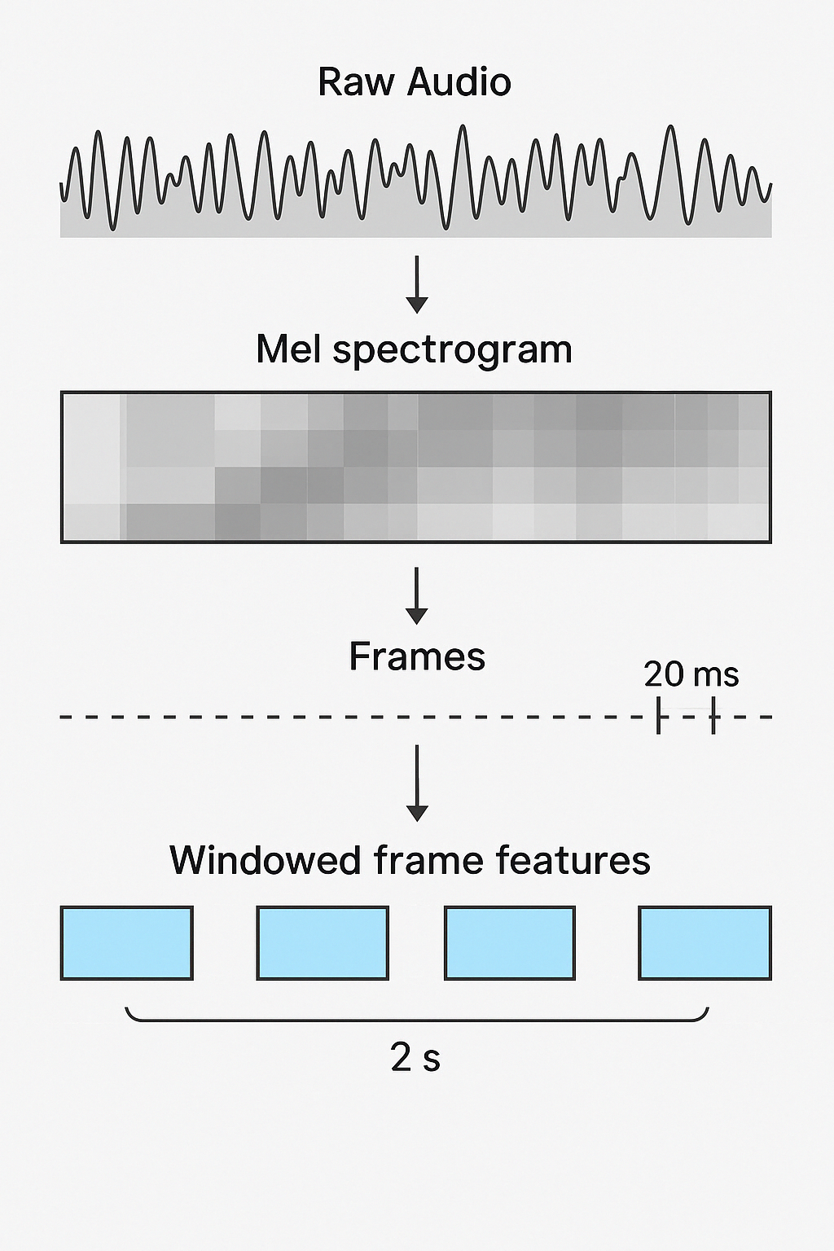
Feature Extraction
Pre-Trained Model Initialization
Audio Preprocessing with resampled to 16KHz
Chunking Audio for manageable extraction
Feature Extraction Per Chunk
Concatenation of features

Slide 6
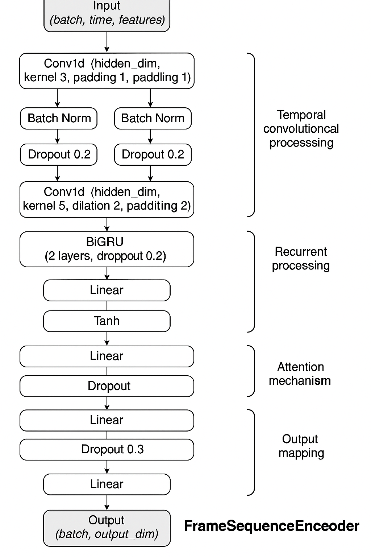
Encoding model
Conv layers reduce computation and enhance learning stability by
lowering redundancy before expensive RNN ops.
RNNs provide a better global context over time period
Attention improves interpretability and performance, especially when
only part of the sequence is relevant.

Slide 7
Results
  Overall Performance:
Mean Best Validation Correlation: 0.474
Median Best Validation Correlation: 0.469
Standard Deviation: 0.022
Minimum Best Validation Correlation: 0.416 (Subject CN001, Epoch 16)
Maximum Best Validation Correlation: 0.526 (Subject CN036, Epoch 8)
  Individual Subject Performance Highlights:
Top Performers (Best Val Corr > 0.50): CN004 (0.515), CN010 (0.506), CN017 (0.510), CN036 (0.526)
Lower Performers (Best Val Corr < 0.42): CN001 (0.416)
General Trend: Most subjects achieved their best validation correlation around epoch 20 which shows training is not saturated yet. The shared model approach allowed later subjects (like CN036) to potentially benefit from prior training, although performance still varied significantly.

