Slide 1
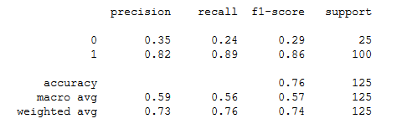
SVM

Slide 2

UNDER SAMPLING

