Slide 1
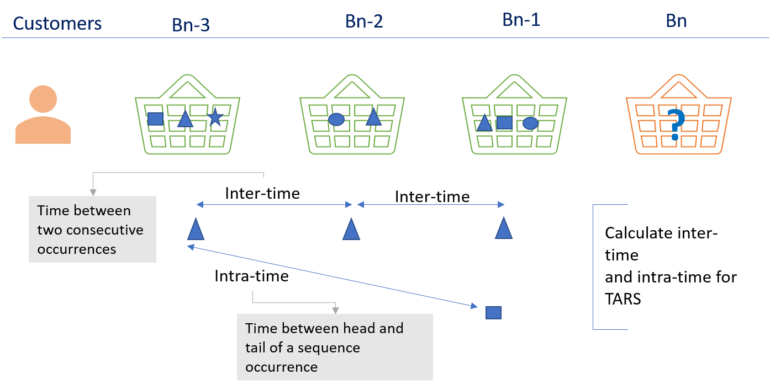
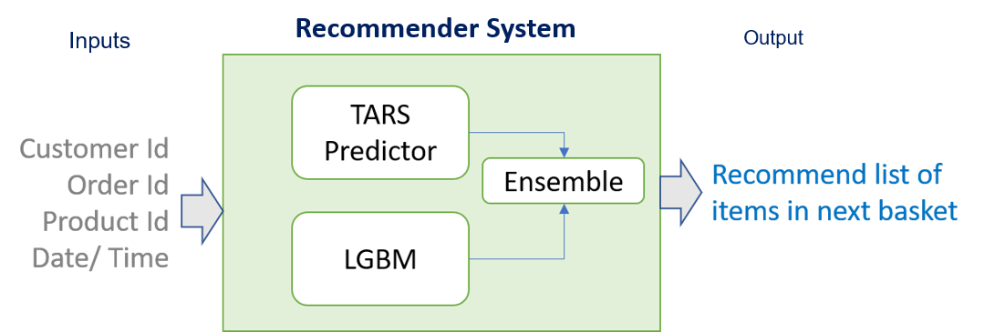
Client Overview: Our client is a comprehensive online grocery store in US. Customers have range of options to chose from. To enhance the customer experience they wanted to offer additional convenience and better selection of products
Our Solution We captured the underlying buying behavior of each customer and designed a recommender system that gives user-specific recommendation on the list of items user might buy. We –
Built two models –
Temporal Annotated Sequence Based Predictor
2. Light Gradient Boosting Machine
We created an ensemble of above models and predicted the next basket item for each user
Business Challenge
Identify the customers likely to repeat their purchases
Recommend a list of grocery items to the individual shopper that s/he might want to purchase in her/his next visit
Impact
We were able to recommend the next list of grocery items to individual customers with an accuracy of 80%

Slide 2
Technical Notes
TARS
Capture purchasing habits – using Frequent Pattern Growth algorithm
Derive the recurring base sequences and get the active sequences
Forecast the next basket – using the TARS based predictor
Select active sequences and compute the score for every item. Rank the item based on the score
Select top k items as the basket prediction for the customer
LGBM :
For each user transaction, target label (purchase/ no purchase) based on index
Calculate user level features and append to data frame
Calculate product level features and append to data frame
Train the data frame for classification and prediction
Run a FP growth on user level data
Based on threshold set and classification results, predict items in the next basket

