Slide 1
Next Basket Recommendation Engine for Online Groceries stores
Prudhvi P

Slide 2
Please !! This isn't Market Basket Analysis

Slide 3
Problem Statement
Users order groceries from online stores
Maintaining a grocery list is still a unsolved problem
How cool it would be if you visit an store/site, you would get a recommended list.

Slide 4
A quick look at EDA

Slide 5
What is the most ordered product
A . Milk B. Beer
C. Eggs D. Bananas

Slide 6
What algorithm will you use now ?
Clustering or Classification ?
What is the target label here ?

Slide 7


Multi Class Vs Multi Label Classification
House/Villa/High_rise

Slide 8
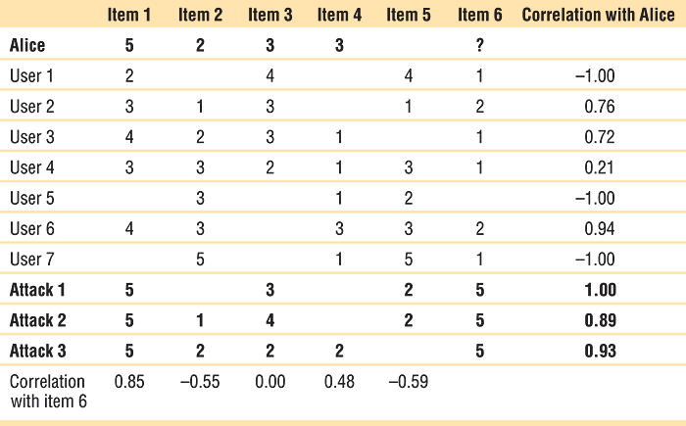
Is this colloborative filtering

Slide 9
Existing Approaches
General Recommenders - Colloborative based filtering approaches
(Issues : generic not user specific - no sequential approach)
Sequential models - Markov Chains -
(Issues : Independence of items in same basket )
Pattern Based - Frequent Itemsets
(Issues : No sequential approach ,no user centric approach)
Hybrid - Very efficient ( Issue :Interpretability)

Slide 10
Why Interpretability of Model
Marketing managers wants to best utilise model to boost sales utilising their expertise

Slide 11
Why user based approach
When small
When complex patterns are observed
Can be run even on mobile
There is no correct approach

Slide 12
The Model - TARS based Predictor (TBP)
Co Occurence
Sequentiality of Purchase
Periodicity of Purchase
Recurrence

Slide 13
Modelling

Slide 14
FP Growth for Item set mining

Slide 15
Other Models tried - LGBM
Features used :
'user_total_orders', 'user_total_items', 'total_distinct_items', 'user_average_days_between_orders', 'user_average_basket',
'order_hour_of_day', 'days_since_prior_order', 'days_since_ratio', 'aisle_id', 'department_id', 'product_orders', 'product_reorders', 'product_reorder_rate', 'UP_orders', 'UP_orders_ratio' 'UP_average_pos_in_cart', 'UP_reorder_rate', 'UP_orders_since_last',
'UP_delta_hour_vs_last'

Slide 16
LGBM User Specific

Slide 17
