Slide 1

Data Engineering Use Case

Slide 2
AGENDA:
ETL Structure
Improvements & Optimizations
Orchestration & Monitoring
Dream Architecture

Slide 3
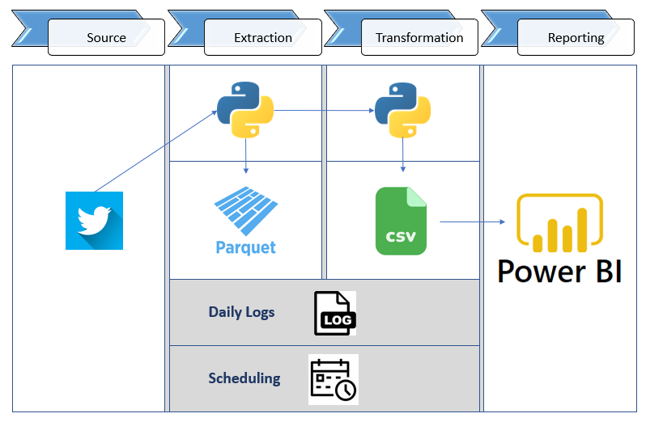
ETL STRUCTURE
ETL STRUCTURE

Slide 4
ETL STRUCTURE – Twitter API

Slide 5

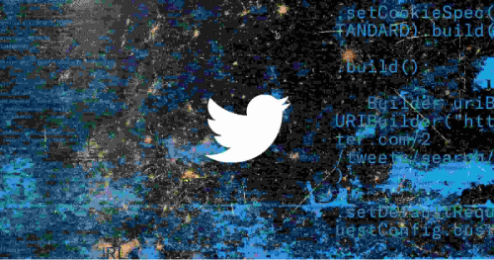
ETL STRUCTURE – Twitter API
 | Access Levels Essential Elevated Academic Research (Using) V2 Endpoint (GET /2/tweets/search/all) with Bearer token Tweepy Library for Python

Slide 6
ETL STRUCTURE – Extraction

Slide 7
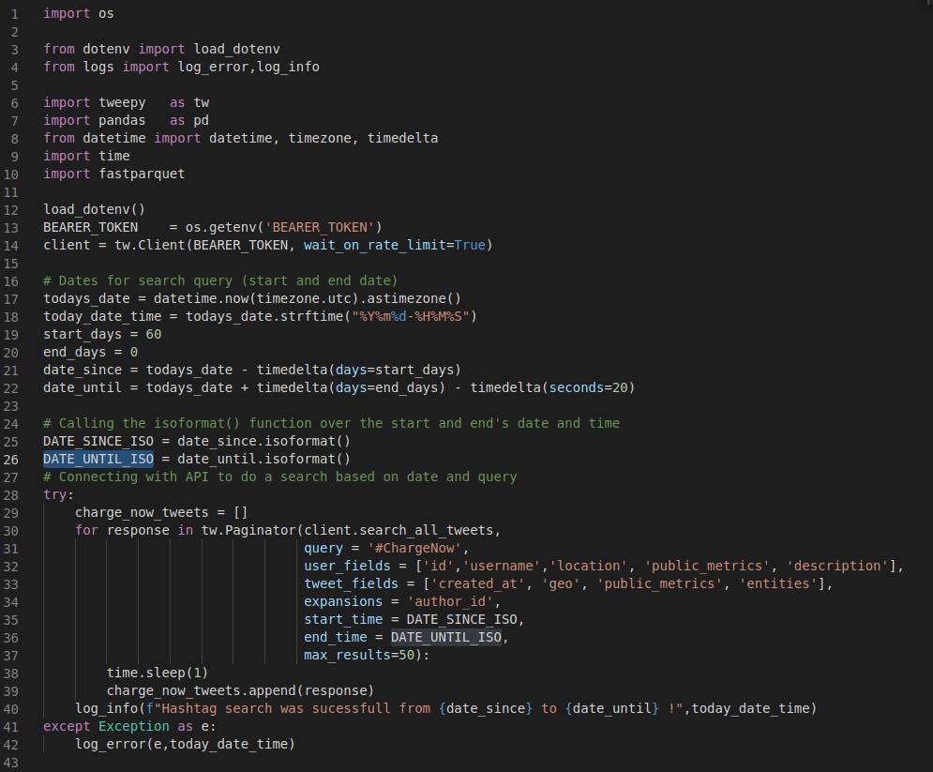
ETL STRUCTURE – Extraction
Tweepy client
Search Tweets

Slide 8
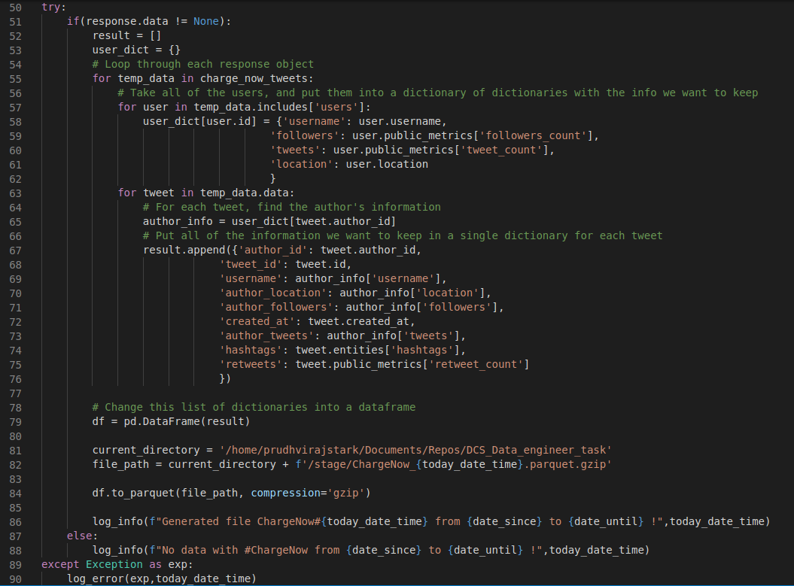
ETL STRUCTURE – Extraction
Extracting the data
Save to PARQUET format

Slide 9
ETL STRUCTURE – Transformation

Slide 10
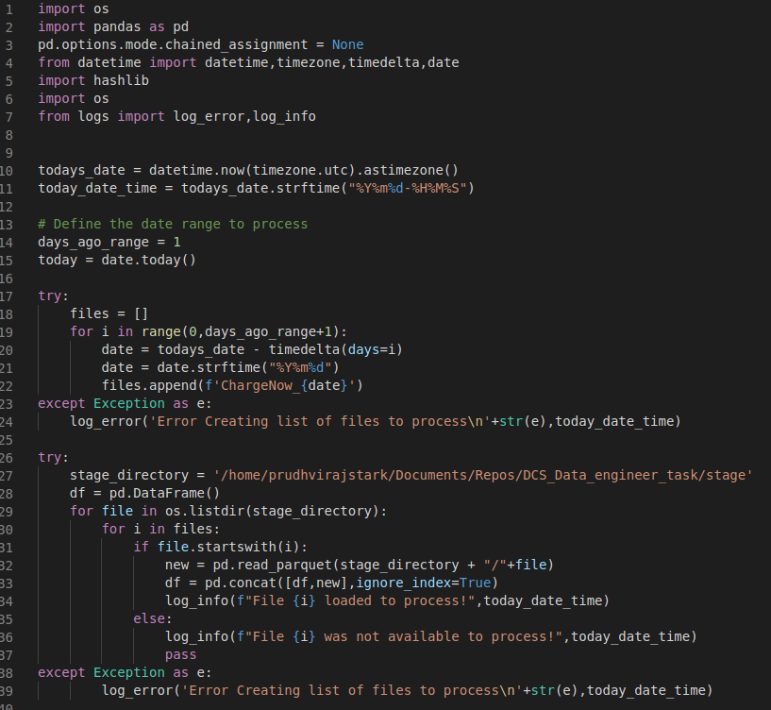
ETL STRUCTURE – Transformation
Loads the data to dataframe

Slide 11
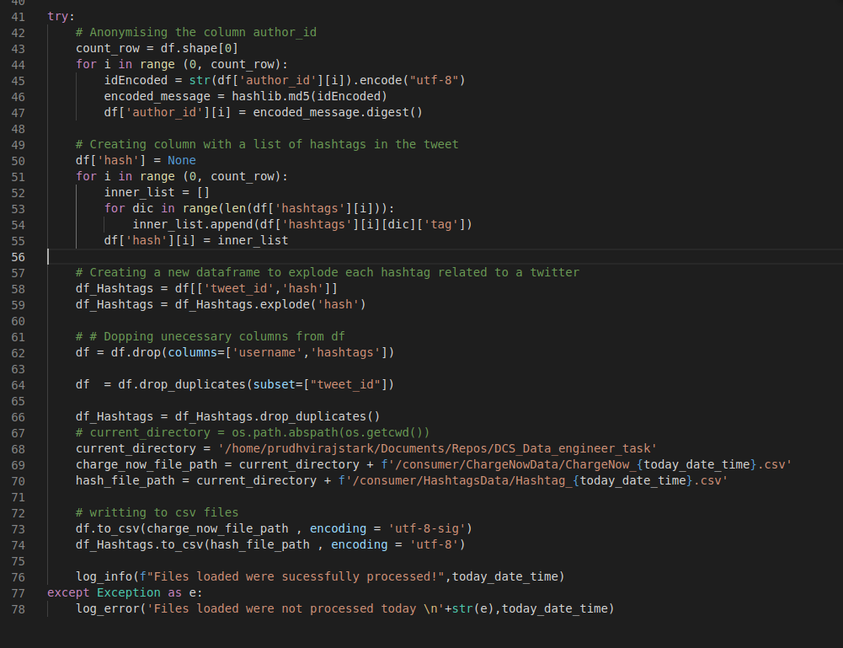
ETL STRUCTURE – Transformation
Encoding the UserID
Hashtags
Store in csv

Slide 12
ETL STRUCTURE – Reporting

Slide 13
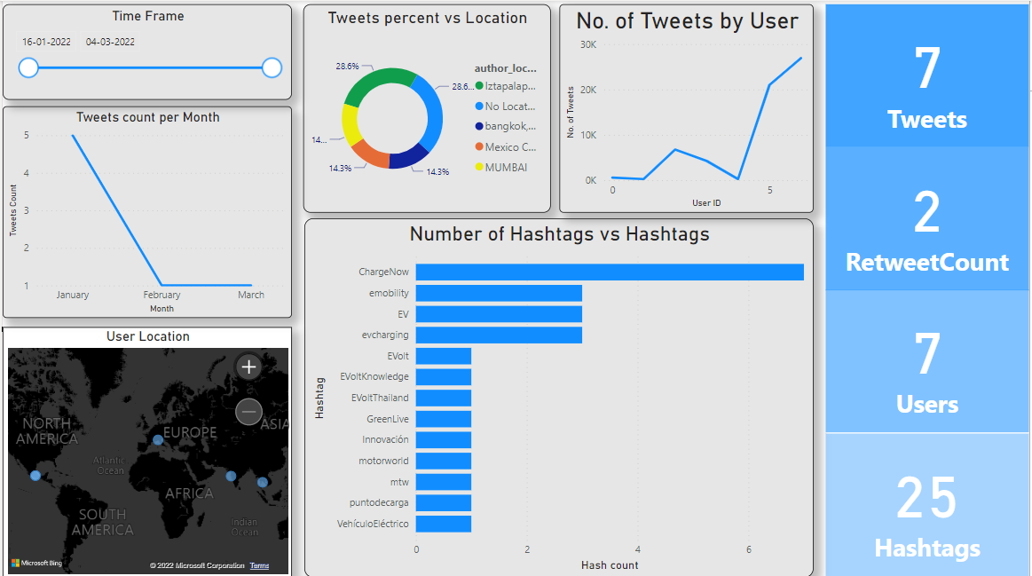
ETL STRUCTURE – Reporting

Slide 14
ETL STRUCTURE – Logs

Slide 15
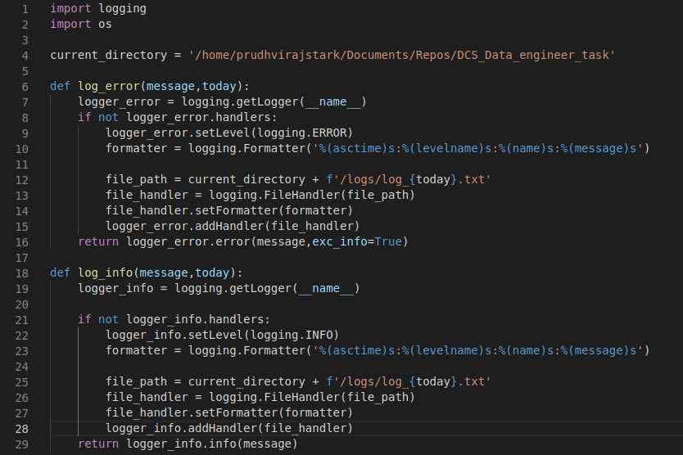

ETL STRUCTURE – Logs

Slide 16
ETL STRUCTURE – Scheduling
CronJobs

Slide 17
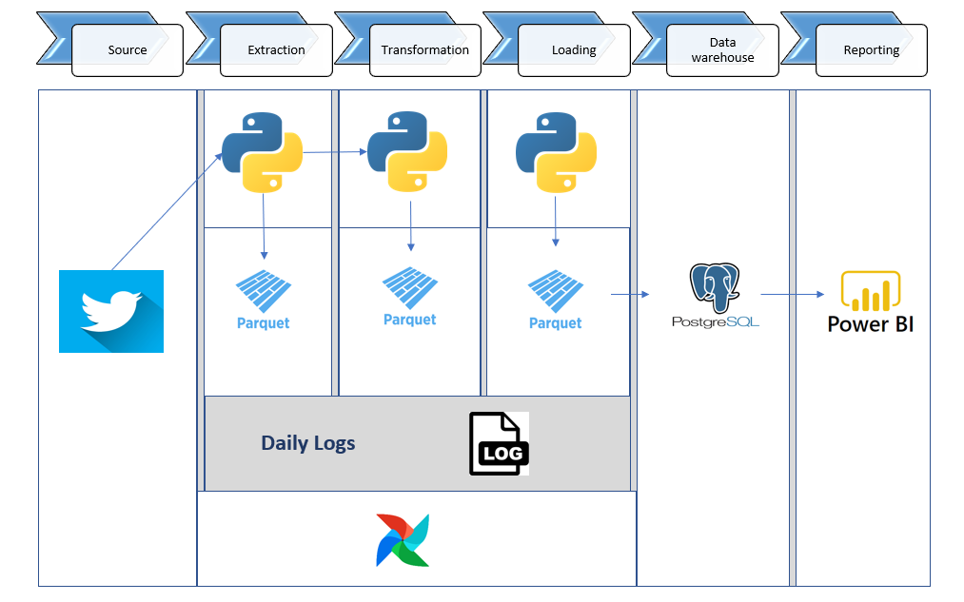
Improvements & Optimizations

Slide 18
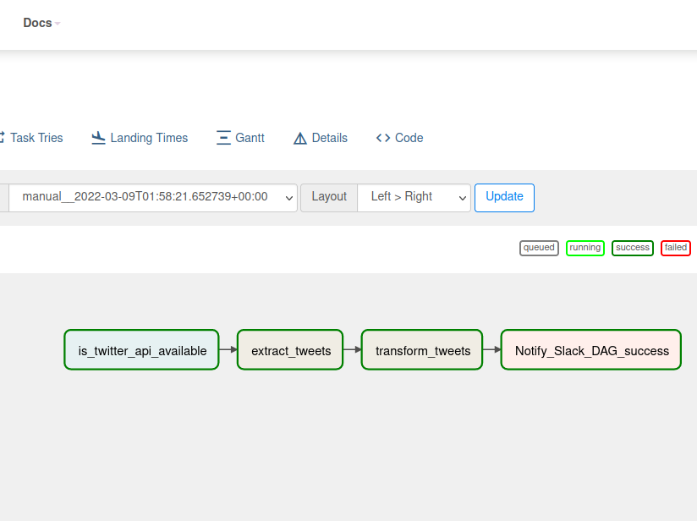
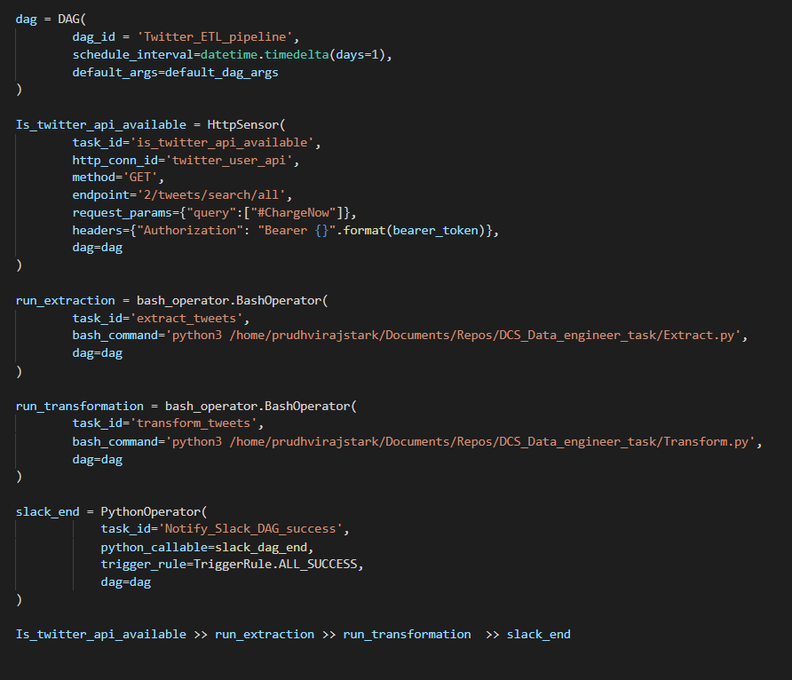
Improvements & Optimizations
DAGs Implementation

Slide 19
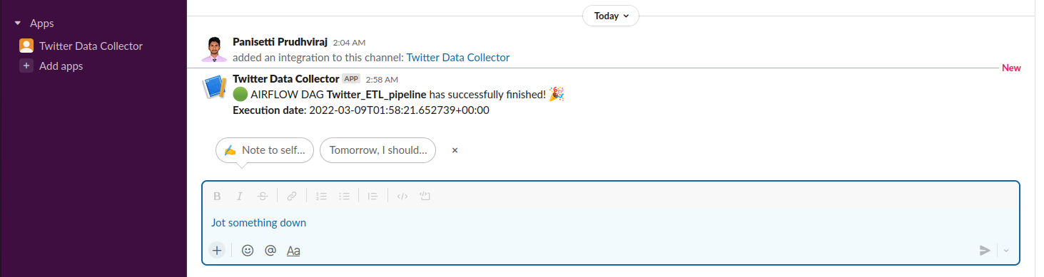
Improvements & Optimizations
Slack message Notification

Slide 20
Improvements & Optimizations
Implemented Pagination for the API Results when the Response data is huge.
Create Datawarehouse (postgres) for distributed data and partitioning.
Normalize data in DW
Can Implement metric monitoring for Airflow using Grafana and Prometheus.
Implemented Slack Message sfor Monitoring

Slide 21
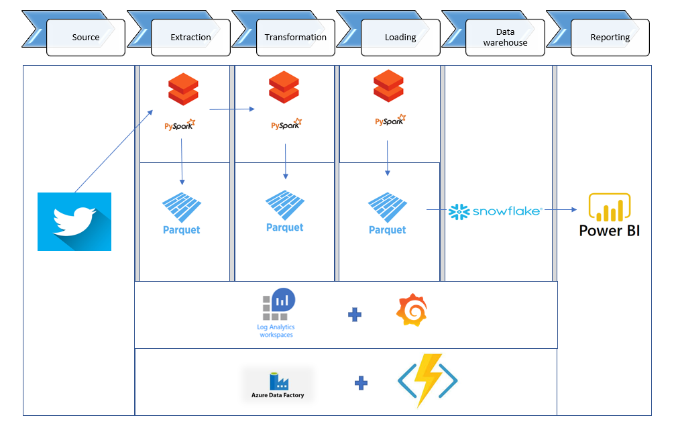
Dream Architecture (Stack)

Slide 22
Dream Architecture (Stack)
Azure Data factory with Azure functions for orchestration
Log analytics and Grafana for metrics monitoring
Parquet format in all the stages
Snowflake as a centralised dataware house
Databricks with running jupyter notebooks in pyspark and streaming.

Slide 23


