Slide 1
Yanmar Marine Engine Data Analysis Juniper Defect Data Analysis

Slide 2
Data statistics
Size of Data : 1.5 GB (6 Files –Year 2012, 2013,2014,2015,2016,2017) with 51 Features
Constant data features:
['P_ShipCode', 'S_DataCategory', 'V_DataColumnVersion', 'S_MachineState', 'A_TurbinSpeed', 'D_DigitalData2', 'D_DigitalData3', 'D_DigitalData4', 'D_DigitalData5', 'A_AnalogData_int5', 'A_AnalogData_float2', 'A_AnalogData_float4', 'A_AnalogData_float5', 'A_Temp_ExGas7', 'A_Temp_ExGas8', 'A_Temp_ExGasTCInL', 'A_Temp_LOEngOut', 'A_Temp_JWEngIn', 'A_Temp_BstAirICIn', 'A_Press_LOTCIn']
Feature connected strength:
A_AnalogData_float1: 1.000
['A_EngineSpeed', 'A_Press_FOEngIn', 'A_Press_JWEngIn', 'A_Press_LOEngIn', 'A_Temp_BstAirICOut', 'A_Temp_ExGas1', 'A_Temp_ExGas2', 'A_Temp_ExGas3', 'A_Temp_ExGas4', 'A_Temp_ExGas5', 'A_Temp_ExGas6', 'A_Temp_ExGasAvg', 'A_Temp_ExGasTCInU', 'A_Temp_ExGasTCOut', 'A_Temp_FOEngIn', 'A_Temp_JWEngOut', 'A_Temp_LOEngIn', 'D_DigitalData1', 'A_AnalogData_int2']: 0.986
'Output', 'A_Press_BstAir', 'A_LoadRatio': 0.986
A_Temp_EngineRoom: 0.976
A_AnalogData_float3: 0.960
A_AnalogData_int1: 0.806
A_AnalogData_int4: 0.778
A_AnalogData_int3: 0.135
A_Runhour_Total: 0.080
P_EngineSerial: 0.066
P_SamplingDateTime: 0.024

Slide 3
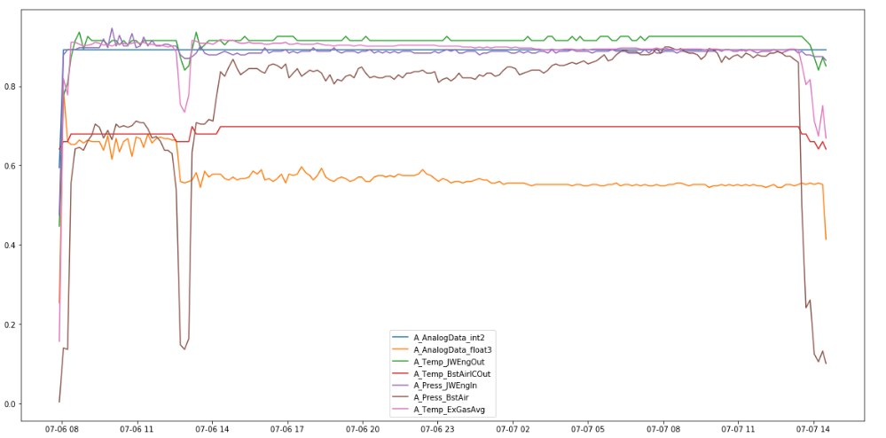
Features behavior in an engine operational run
The time interval when the engine is running we termed it as an operational instance
The Line graph shows how the feature characteristic vary in an operational instance.
Features in the Line graph Cylinder temperatures, Supply Air pressure, Super Charger Air pressure in the graph

Slide 4
Feature : Normal Engine operation vs Threshold values
Feature vs Normal Engine operation vs Threshold values
Engine Feature | Normal Operational Threshold | Lower Limit | Upper Limit
Exhaust air temperature(°C) | 324 ↑, 396 ↓ 324 - 396 | 309 ↑ | 413 ↓
Supply air pressure | -0.158 ↑, 0.265 ↓ | -0.0425 ↑ | 0.381 ↓
Super charger outlet temperature (°C) | 300.8 ↑, 384.5 ↓ | 269.0 ↑ | 416 ↓
Fuel flow rate | 52.3 ↑, 275.4 ↓ | 37.8 ↑ | 364.5 ↓
Load power | 67.0 ↑, 2715.0 ↓ | -926.0 ↑ | 3708.0 ↓

Slide 5
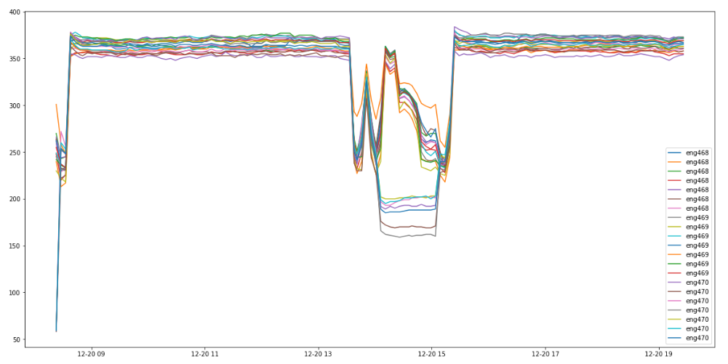
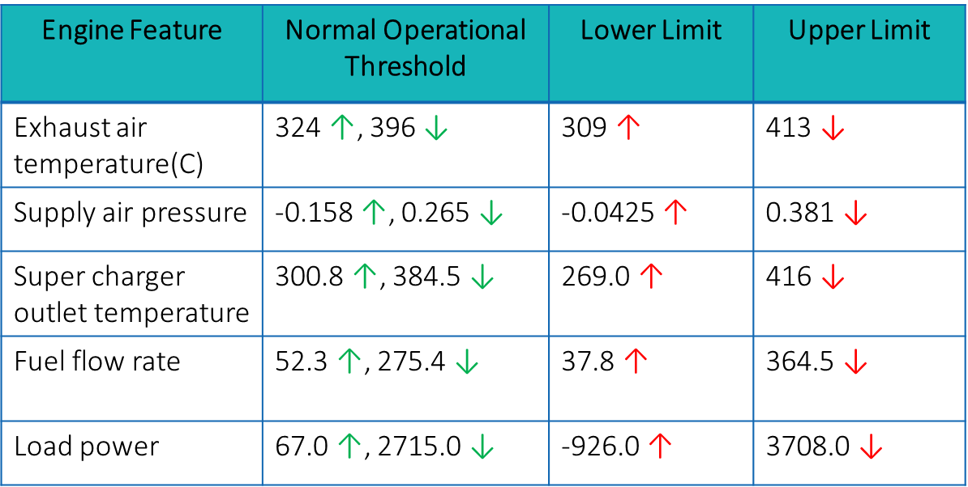
Engine cylinders feature analysis
Interesting scenario: When all the engines(468.469.470) run in parallel, engine cylinders temperature features follow a same trend.
But, this was one case where engine 470 cylinders temperature deviated, with all the other engine parameters following the same trend.

Slide 6
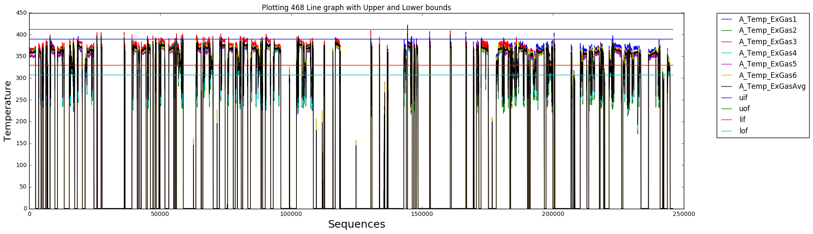
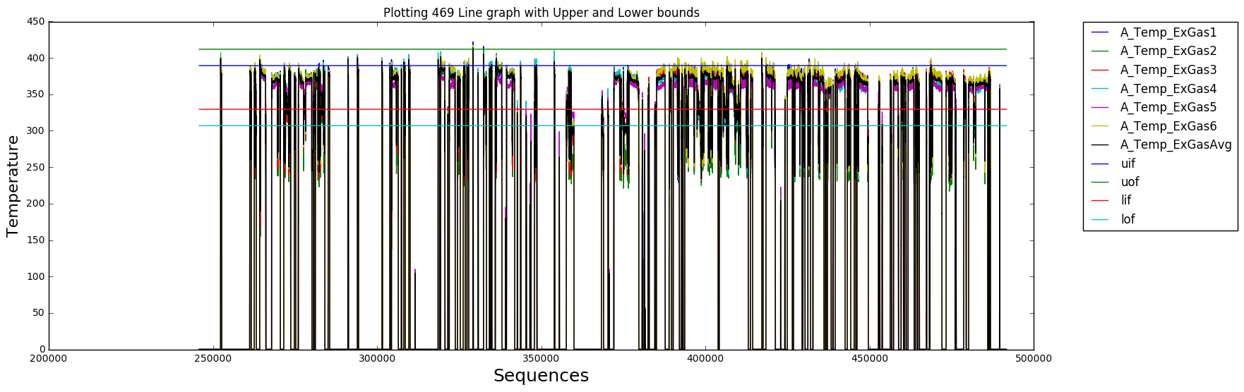
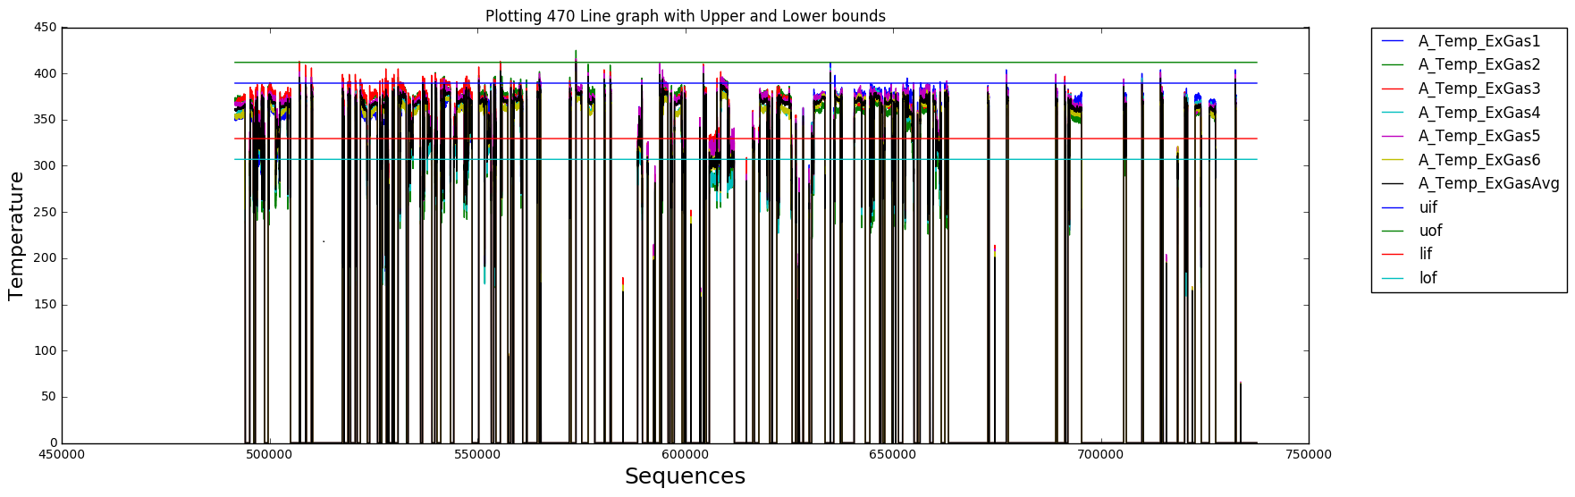
Engine cylinders feature analysis
We analyzed multiple features with the threshold limits (Upper Threshold Limit)
We could see there are instances where the feature (Cylinder Temperatures) exceeds the Upper Threshold Limit.

Slide 7
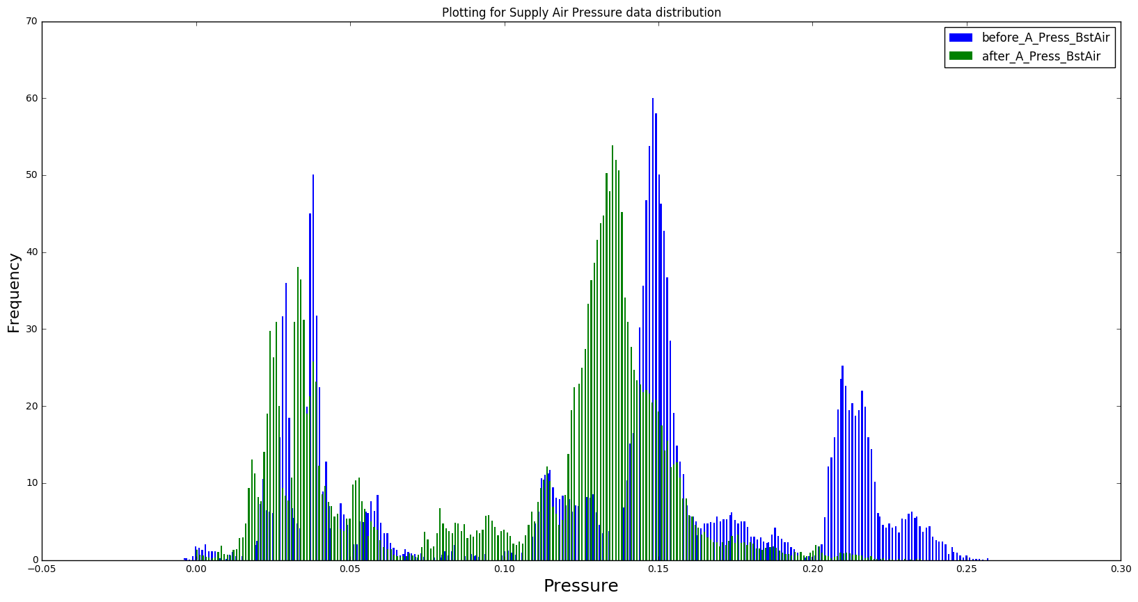
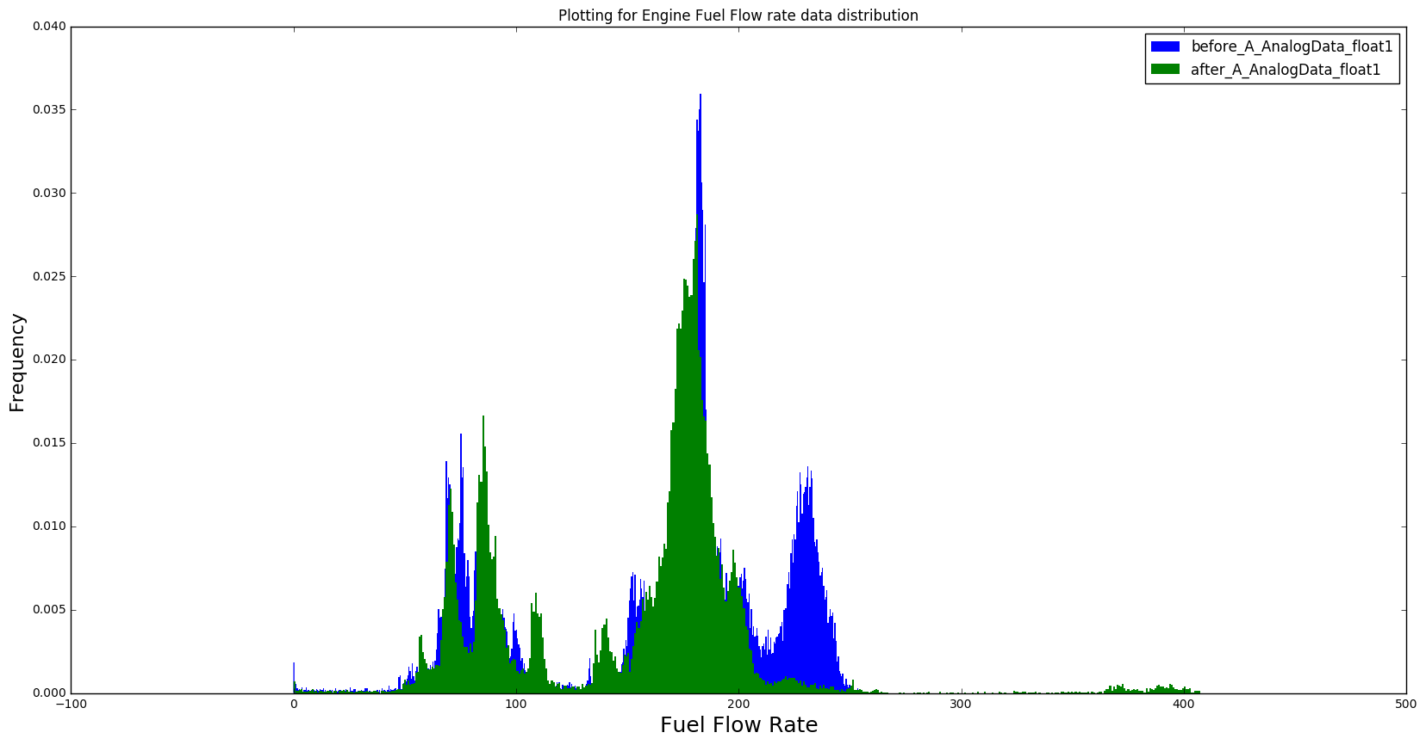
Variations in features statistics with time
Monthly histogram plots clearly indicate the change in data distribution with time. Features which exhibited this behavior where selected for predictive maintenance.
[Supply Air Pressure, Exhaust Air Temperature, Load Power, Super Charger Outlet Temperature, Fuel Flow rate]

Slide 8
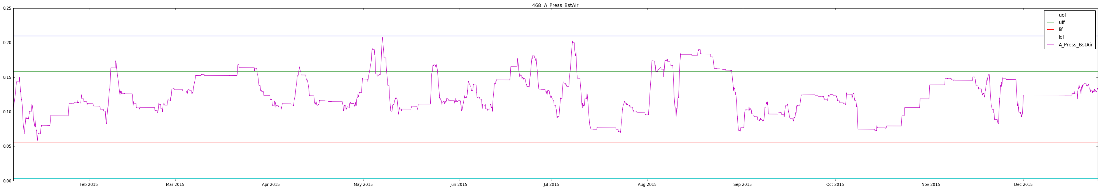
Preparing data for predictive maintenance – Supply Air Pressure Analysis
Feature Supply Air pressure
We applied the rolling Mean (rolling average) to understand the trend of feature with time to get the inference of Start and End of Maintenance
We could infer from the graph that, the last instance when the Supply Air pressure exceeds Upper Threshold Limit during the interval of August and Sept

Slide 9
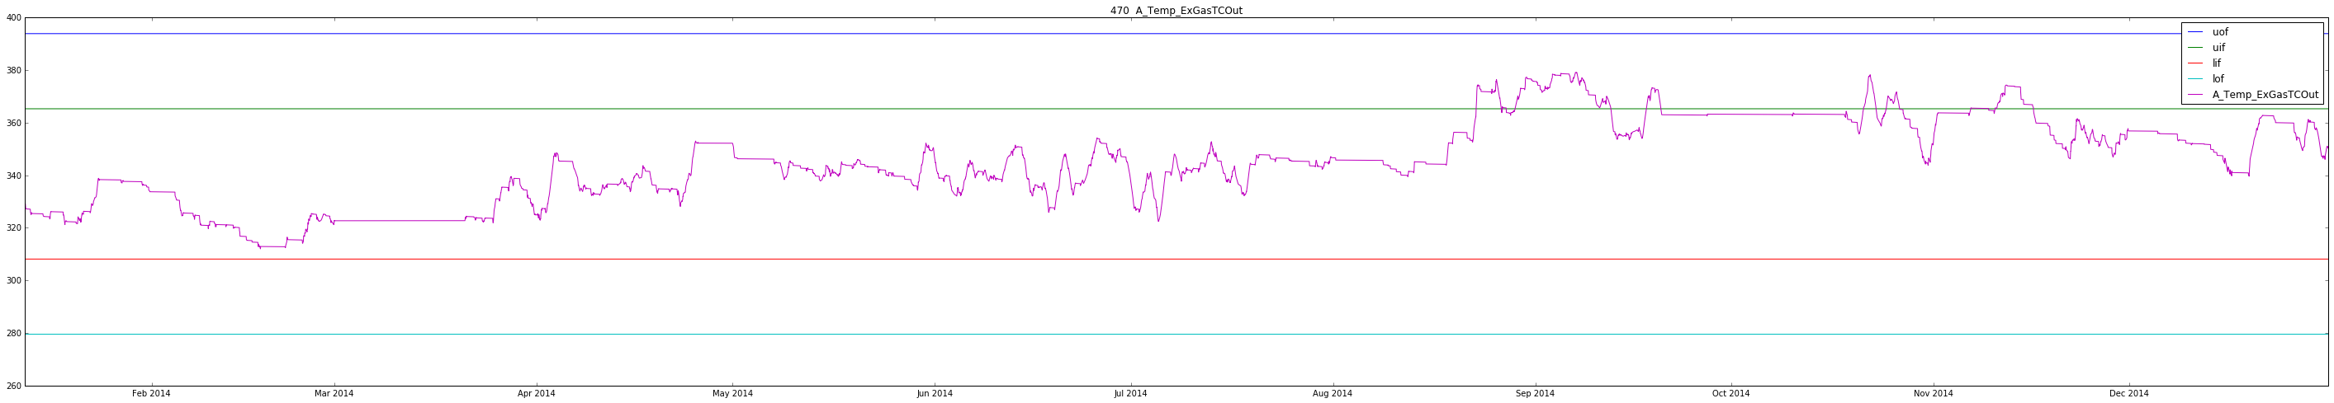
Preparing data for predictive maintenance – Super Charger Temperature
Feature super charger outlet temperature
We applied the rolling Mean (rolling average) to understand the trend of feature with time to get the inference of Start and End of Maintenance
We could infer from the graph that, the Super charger outlet temperature exceeds Upper Threshold Limit during the interval of August and Sept

Slide 10
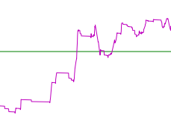
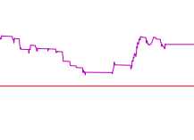
Preparing data for predictive maintenance
Detailed feature analysis using predicted maintenance date and actual maintenance date.
Training data
Training End Point
Training Start Point

Slide 11
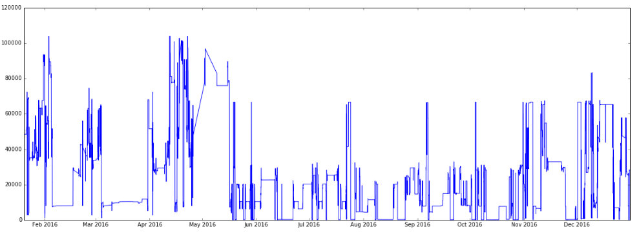
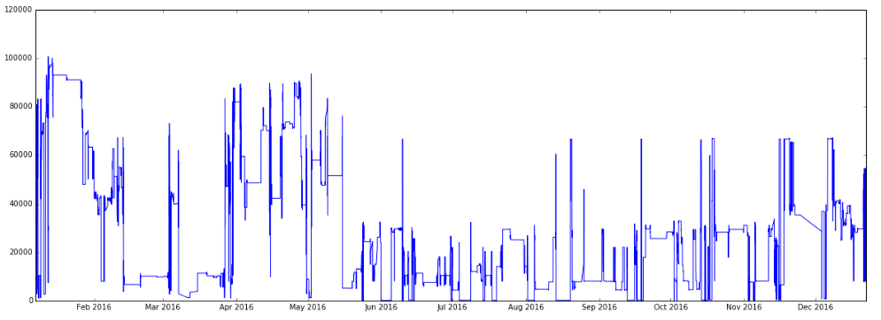
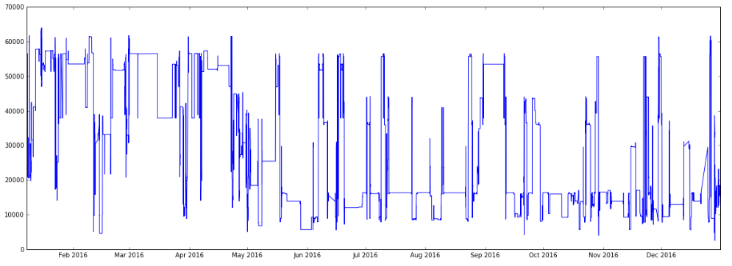
Building the model
We considered the features
Supply Air Pressure, Exhaust Air Temperature, Load Power, Super Charger Outlet Temperature, Fuel Flow rate to build the Prediction Model.
We applied multiple Analytical Model, like Linear Regression and Random Forest Regression.
Random Forest Exhibited better results
Engine 469
Engine 470
Engine 468

Slide 12
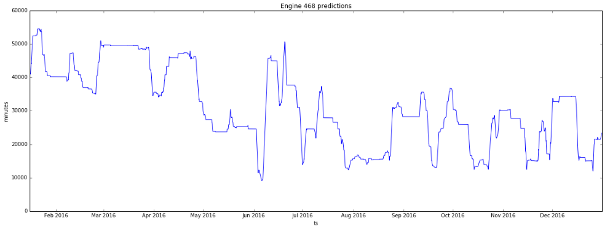
Comparison : Predicted vs Actual Dates of Maintenance
Actual
Predicted
Predicting remaining maintenance life for engine 468

Slide 13
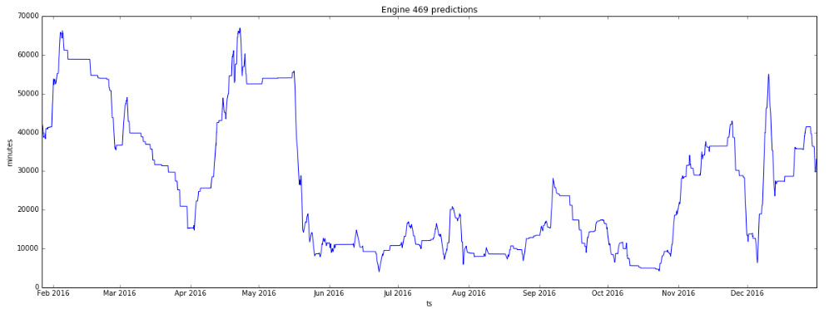
Comparison : Predicted vs Actual Dates of Maintenance
Actual
Predicted
Predicting remaining maintenance life for engine 469

Slide 14
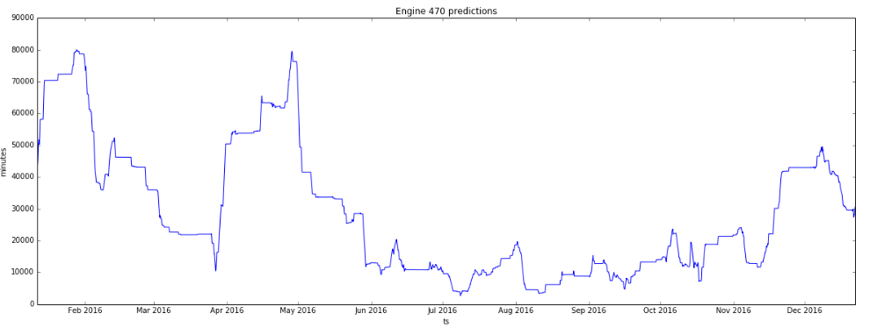
Comparison : Predicted vs Actual Dates of Maintenance
Actual
Predicted
Predicting remaining maintenance life for engine 470

Slide 15
Building the model
Table : Predicted and Actual Maintenance Dates
Engine | Predicted | Actual
468 | 06-06-2016 | 16-05-2016
469 | 22-06-2016 | 16-05-2016
470 | 08-07-2016 | 16-05-2016

