Slide 1
Data Structures and Algorithms -3 (25CS2103E)
Text Hack Pluse Intelligent
Language Query System
Team Members
JAKKE VIVEK (2520030180)
KUMMARI PARTHEEV PRANEETH (2520030197) KARI PRUDHVI SAI (2520030286)
Under the Esteemed Guidance of
MS D SWATHI
Assistant Professor, CSE

Slide 2
Contents
Abstract
Introduction
Literature survey
Problem Statement and Objectives
Hardware and Software requirements
Results
Conclusion
Future Scope

Slide 3
Abstract
TextHack+ is an advanced text analysis engine written in Java that is able to process large text datasets by implementing hand-built and highly complex algorithms. The system offers support for multiple querying types like exact pattern matching, fuzzy search with edit distance, document similarity that uses suffix structures, citation-flow analysis based on the max-flow algorithms, task scheduling illustrations for solving NP-hard problems, and probabilistic primality testing. Project implementation relies on a layered architecture starting from corpus ingestion, followed by manual algorithm engine, query services, and user interface. One of the major restrictions in the engine is that it is done from scratch without the use of java.util.* libraries which calls for custom implementation of all data structures. This aspect showcases deep understanding of algorithms and proves to be one of the biggest reason why more complex structures are essential for performing efficient text processing. By combining algorithms and their implementations into a single tool, TextHack+ is a practical application that demonstrates theoretical studies of algorithms. Each query is tied to an algorithm family in such system. Also, the system displays both results and algorithm information which makes it highly applicable as an educational tool, benchmarking tool, or research tool. The system is multi-lingual and works Mostly well in case of Indian-language Wikipedia corpora, On top of which it offers an option to do searches in the areas of medicine and domain applications with the help of TextHack+.

Slide 4
Introduction
TextHack+ is an advanced text analysis engine implemented in Java designed to process large-scale text datasets using custom-designed, highly complex algorithms. the system provides a comprehensive platform for executing various query types—including exact string matching, fuzzy search, document similarity, citation graph flow, task scheduling, and probabilistic primality testing.
A central highlight of TextHack+ is its strict architectural constraint: the system is constructed completely from scratch without utilizing standard utility libraries such as java.util.*. This design choice necessitates the manual implementation of all underlying data structures, serving as a practical demonstration of theoretical algorithmic principles. The architecture follows a layered model comprising corpus ingestion, a manual algorithm engine, query services, and a user interface. Additionally, it supports multi-lingual querying across Indian-language Wikipedia datasets as well as domain-specific searches in fields such as medicine.

Slide 5
Literature Survey
The theoretical foundation of TextHack+ synthesizes multiple core areas of computer science and algorithm design:
Exact & Approximate Pattern Matching: Traditional text retrieval relies on exact string-matching algorithms alongside edit distance models (e.g., Levenshtein distance) to support fuzzy search and fault-tolerant querying.
Suffix Structures & Document Similarity: Suffix trees and arrays are widely documented in literature as optimal structures for indexing, substring matching, and assessing similarity across large text documents.
Network Flow & Citation Analysis: Graph theory algorithms, particularly Max-Flow algorithms (such as Ford-Fulkerson or Edmonds-Karp), are applied to model and evaluate citation flow and structural dependencies within interconnected datasets.
Task Scheduling & Heuristics: Algorithmic strategies for addressing NP-hard task scheduling problems provide models for resource allocation and computational optimization.
Probabilistic Number Theory: Fast primality testing algorithms (such as Miller-Rabin) allow for probabilistic verification without the heavy performance overhead of deterministic factorization.

Slide 6
Problem Statement and Objectives
Standard high-level programming frameworks and built-in collections (e.g., Java's standard utility packages) abstract away the internal mechanics of data structures and memory management. When processing complex queries across multi-lingual datasets (such as Indian-language Wikipedia) or domain-specific data, relying on generic libraries can obscure computational trade-offs. The challenge lies in engineering a multi-functional text processing engine entirely from scratch without pre-built collections while maintaining algorithmic efficiency across diverse query types.

Slide 7
Problem Statement and Objectives
Custom Data Structure Implementation: Manually construct all data structures and algorithms in Java without importing java.util.* libraries.
Multi-Modal Query Services: Implement support for:
Exact pattern matching.
Fuzzy search using edit distance calculations.
Document similarity analysis via suffix structures.
Citation-flow analysis using max-flow graph algorithms.
Task scheduling illustrations for NP-hard problems.
Probabilistic primality testing.
Multi-Lingual & Domain Adaptation: Enable processing of Indian-language Wikipedia corpora and domain applications such as medical text analysis. Educational & Research Benchmarking: Design the engine to display both computational results and runtime algorithm execution metrics for educational, research, and benchmarking purposes.

Slide 8
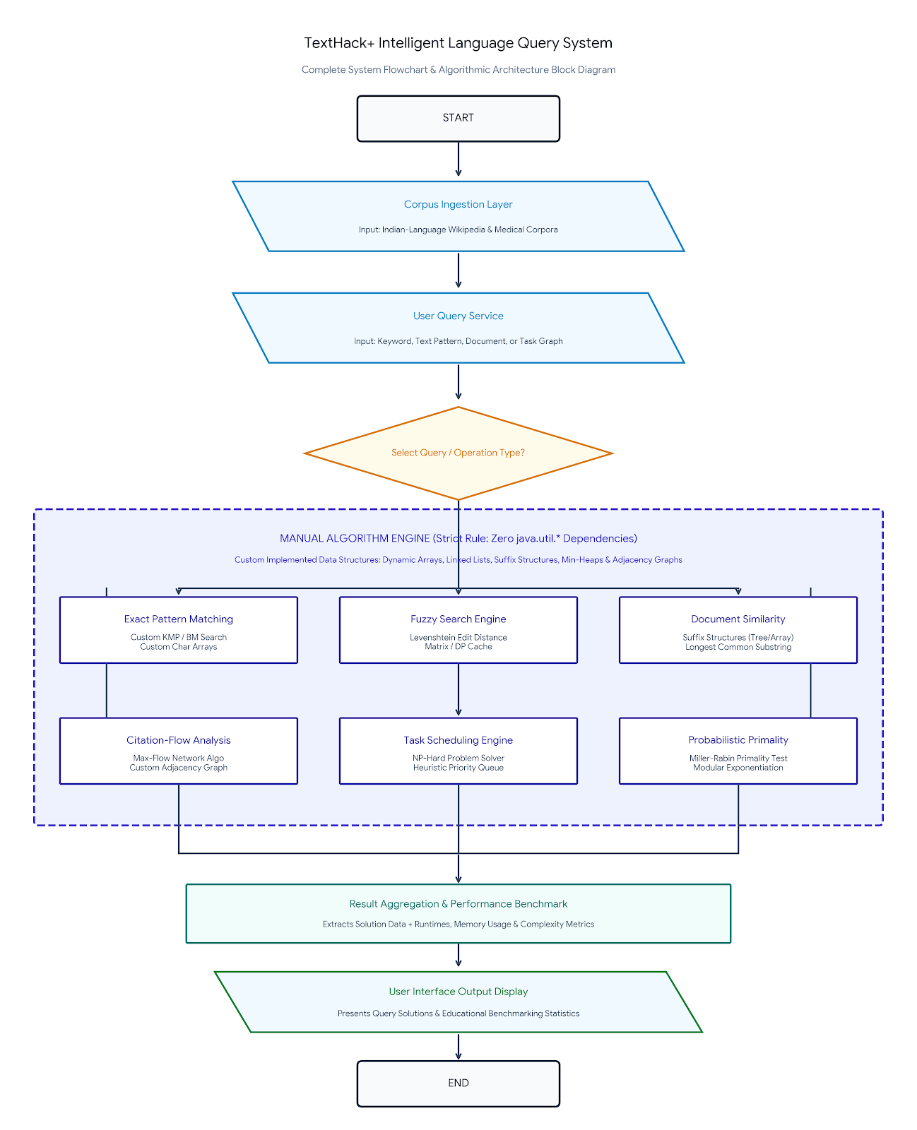
Flow Chart

Slide 9
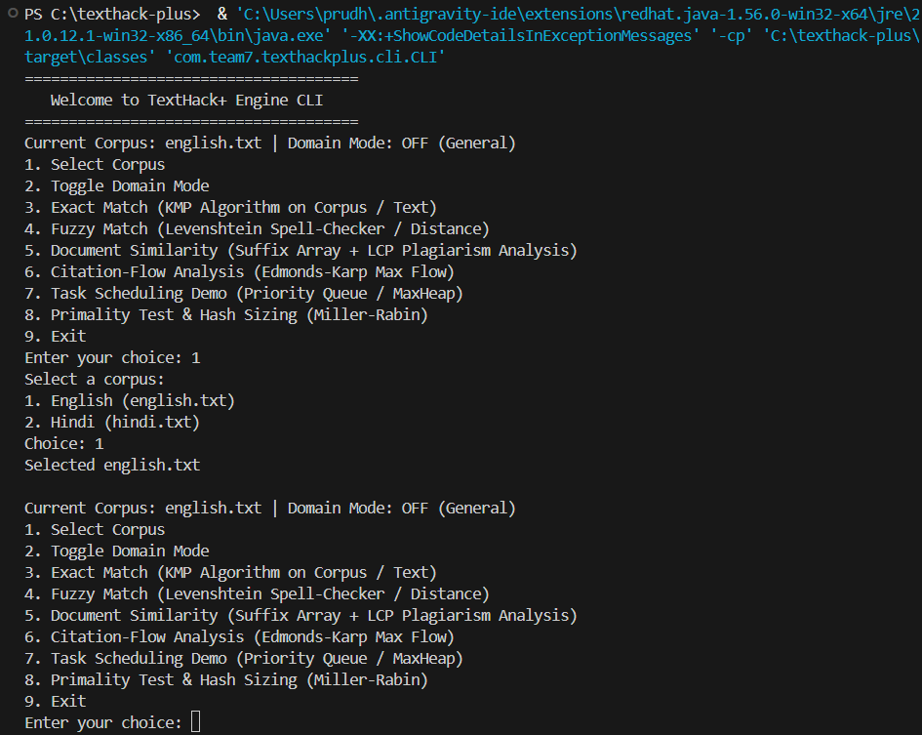
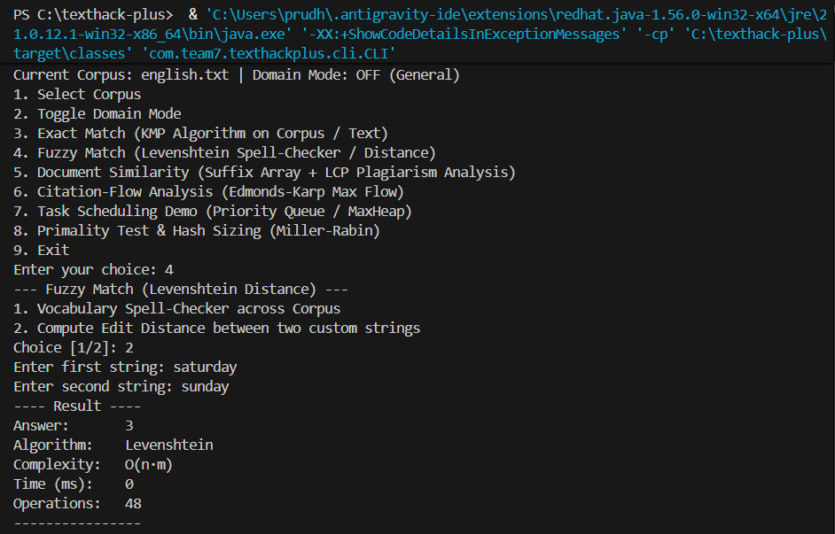
Results

Slide 10
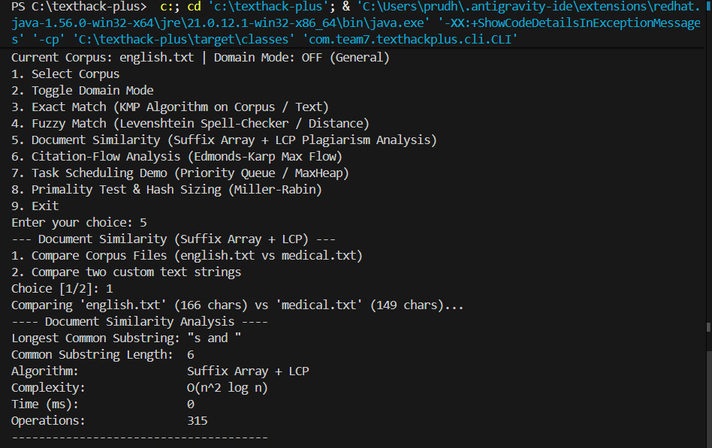
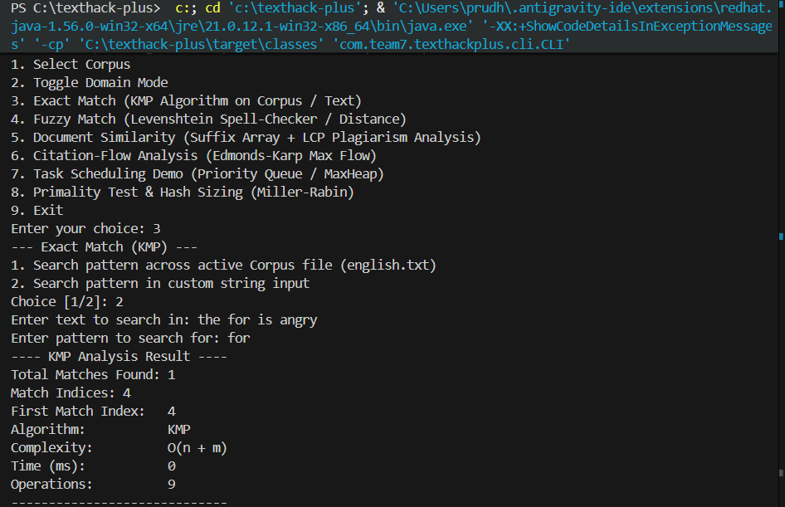
Results

Slide 11
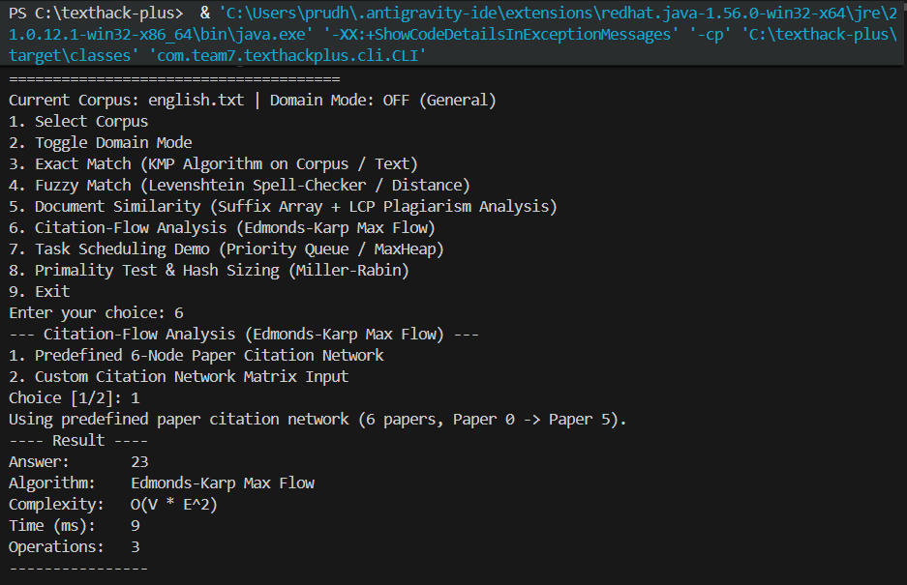
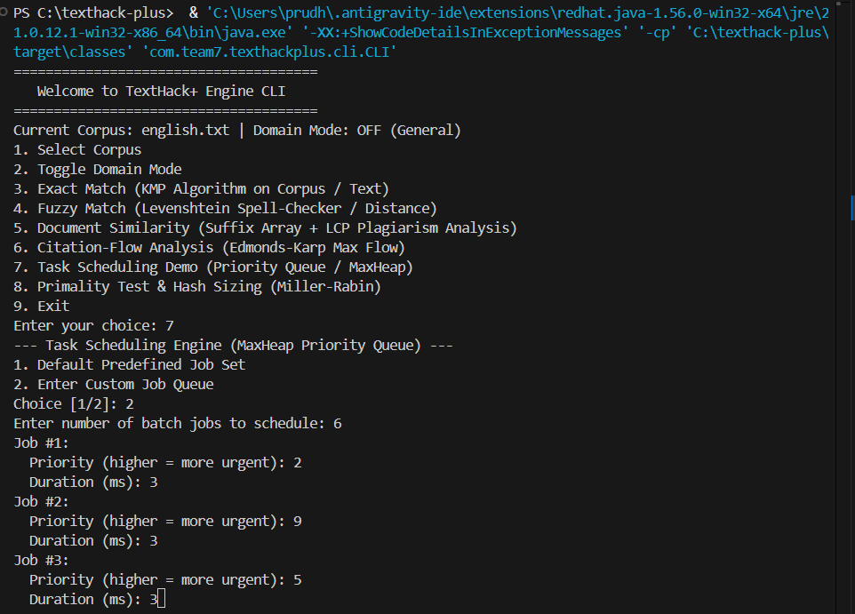
Results

Slide 12
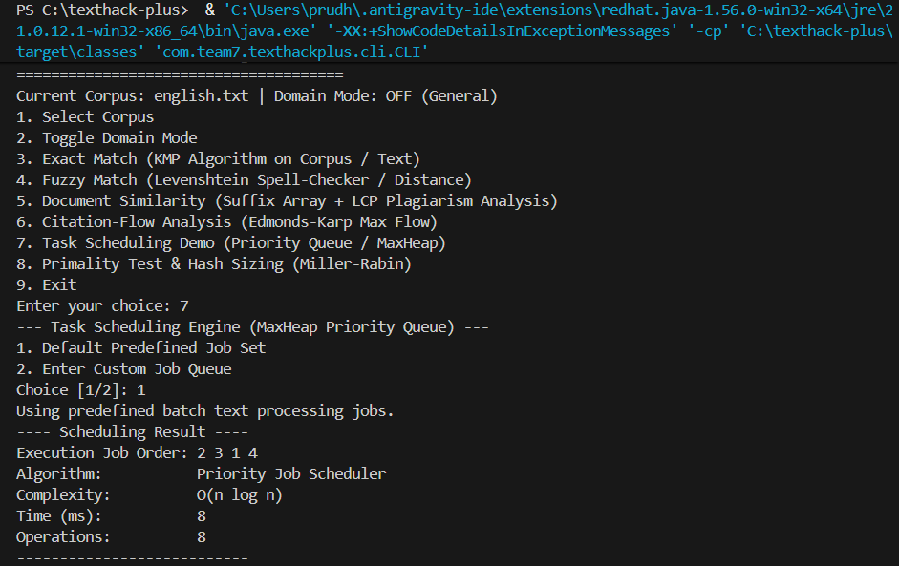
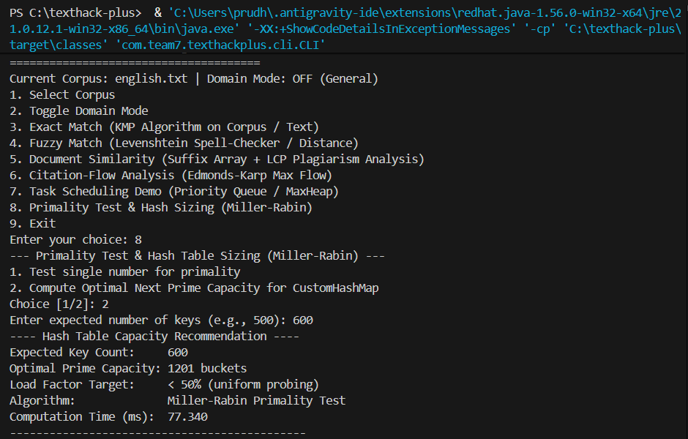
Results

Slide 13
Hardware and Software requirements
Programming Language: Java Development Kit (JDK 8 or higher).
Core Constraint: Strictly No java.util.* libraries allowed; custom implementations required for lists, maps, trees, queues, and stacks.
Operating System: Cross-platform (Windows, Linux, or macOS).
Target Datasets: Indian-language Wikipedia corpora and medical domain text datasets.
Processor: Multi-core Intel Core i5/i7 or equivalent CPU (to handle algorithm execution and corpus ingestion).
RAM: 8 GB minimum (16 GB recommended to support custom memory allocations for large datasets).
Storage: Standard SSD/HDD with space allocated for local text dataset ingestion

Slide 14
Conclusion
TextHack+ successfully integrates advanced theoretical algorithm concepts into a working text processing software system. By enforcing the custom implementation of all data structures without java.util.*, the system demonstrates a deep foundational understanding of algorithmic design and efficiency. Featuring a layered architecture and supporting specialized applications in medicine and Indian-language corpora, TextHack+ serves as an effective educational, benchmarking, and research tool.

Slide 15
Future Scope
Parallel & Distributed Processing: Enhancing custom data structures to support multi-threading and distributed dataset processing for even larger corpora.
Advanced Graphical Visualizations: Expanding the user interface to provide step-by-step visual graph execution for max-flow citation analysis and suffix tree construction.
Domain & Language Expansion: Extending specialized search modules to cover additional domains (e.g., legal or scientific literature) and refining tokenization for complex Indian scripts.

Slide 16
Thank you

