Slide 1
ELearn
D.Prudhvi Teja

Slide 2
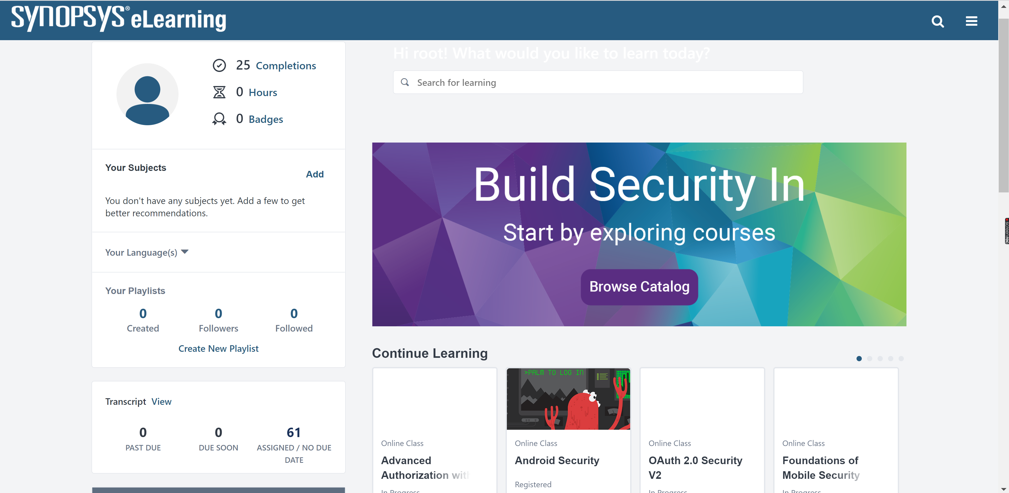
Introduction
ELearn is a for-profit Massive Open Online Course (MOOC) provider aimed at professionals (companies).
Professionals take courses primarily to improve job-related skills. All courses generate credit toward technical certification.
ELearn has made a special effort to attract corporate trainers seeking to create coursework for employees of their company, work culture, harassment at the work place etc.
ELearn is just a platform for the courses.
ELearn is E-learning Where CSOD is Cornerstone On Demand

Slide 3
Test Automation Framework
A testing framework is a set of guidelines or rules used for creating and designing test cases. A framework is comprised of a combination of practices and tools that are designed to help QA professionals test more efficiently. These guidelines could include coding standards, test-data handling methods, object repositories, processes for storing test results, or information on how to access external resources.
BENEFITS OF A TEST AUTOMATION FRAMEWORK
Improved test efficiency
Minimal manual intervention
Maximum test coverage
Reusability of code

Slide 4
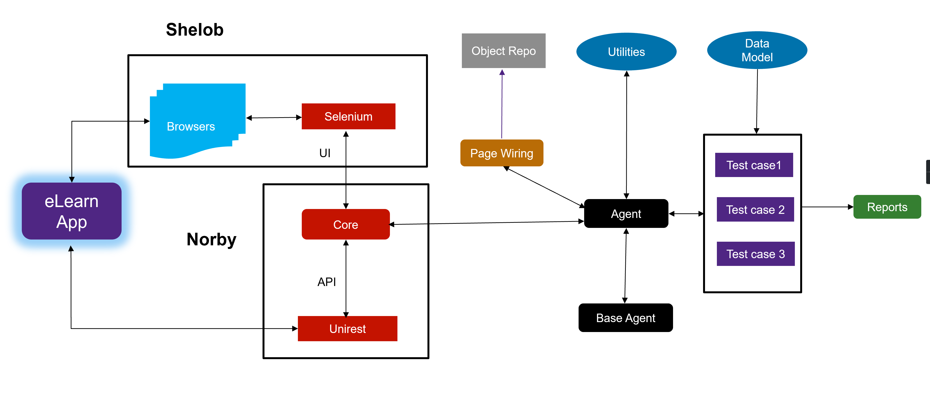
ELearn Test Automation

Slide 5
Technologies used…
Java - 1.8 Selenium - 3.9.1 Maven - 3.5 Unirest - 1.4.9 TestNG – 6.8 Eclipse Test Rail STS

Slide 6
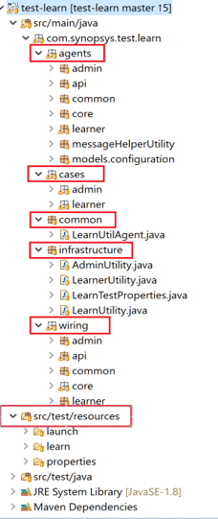
Project Structure
agents package contains methods that performs user actions on the page using wiring classes.
cases package contains the test cases.
common package contains application utility classes. i.e. emailUtility.
Infrastructure package contains the learn utility classes.
wiring (UI) package contains the classes to store the locators of the page.
wiring(API) package contains the classes to store the APIs responses.
resources package contains the files that are needed in the project like Courses, CVE/CSV file etc.

Slide 7
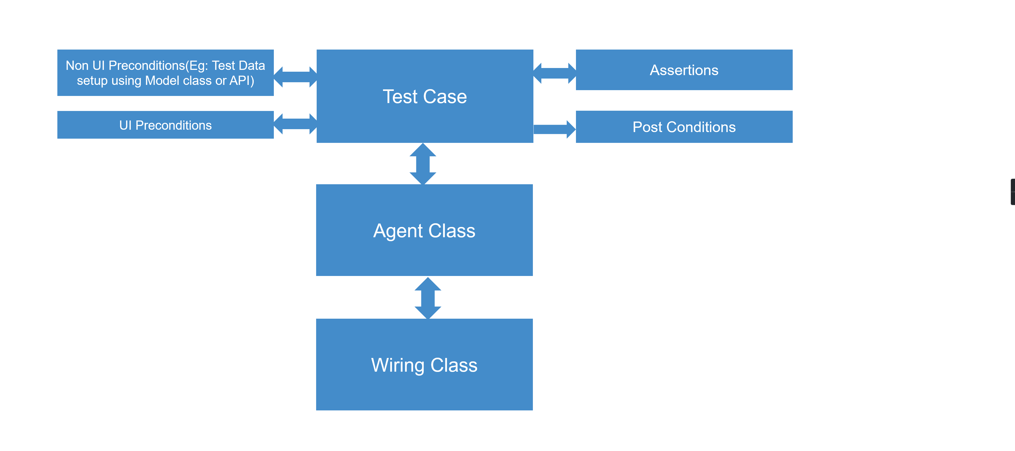
UI Test Workflow

Slide 8
How to Create UI Tests?
UI Wiring:
Capture the locators(ID, name, Xpath, etc.) from the web page
Different types of elements(Textbox, Dropdown etc.) are identified with their locator value and stored in a Element collection map
Agent methods access these elements to perform the UI actions on the page
UI Agents:
We have to set the page context according to the respective Agent in the Agent Constructor.
Agents contain the convenience methods to perform actions on the web page using the identified elements from the Wiring class
Agent methods return the next Agent once the method executes successfully.
Test Cases:
Test Cases needs to extend the Base Classes where necessary pre conditions and post conditions gets executed
Model Classes are used to manage the Test Data
Test Cases call the Agent methods to perform the Test steps
Test Cases contain the assertions which compares the actual and expected results.

Slide 9
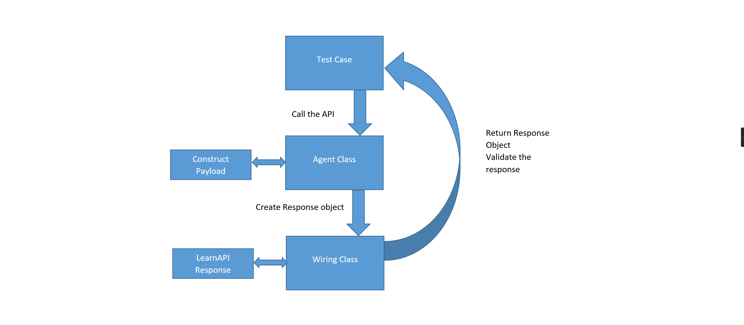
API Test Workflow

Slide 10
How to create API test cases?
Create methods in the Agent Class to call required API’s.
Each API has one or more methods.
Create methods to fetch required value from the API response in the wiring class.
Create test case class and call methods of Agent class and wiring class based on test scenarios.
Perform the assertions after calling agent and wiring class methods.
Log the steps.

Slide 11
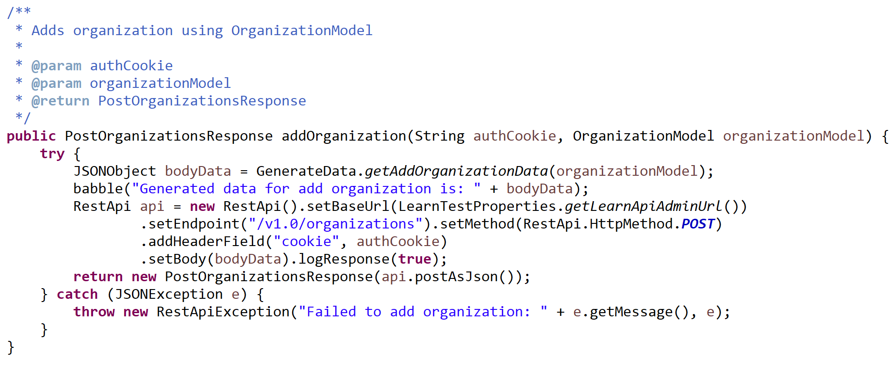
Agent Class - API
Construct the end point URL.
Generate data class helps in generating payload with pre-defined/run time values.

Slide 12
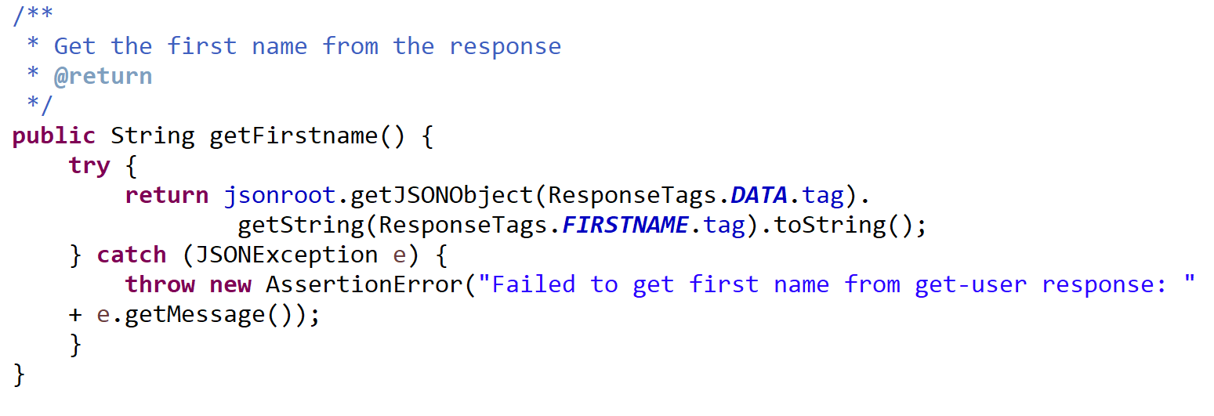
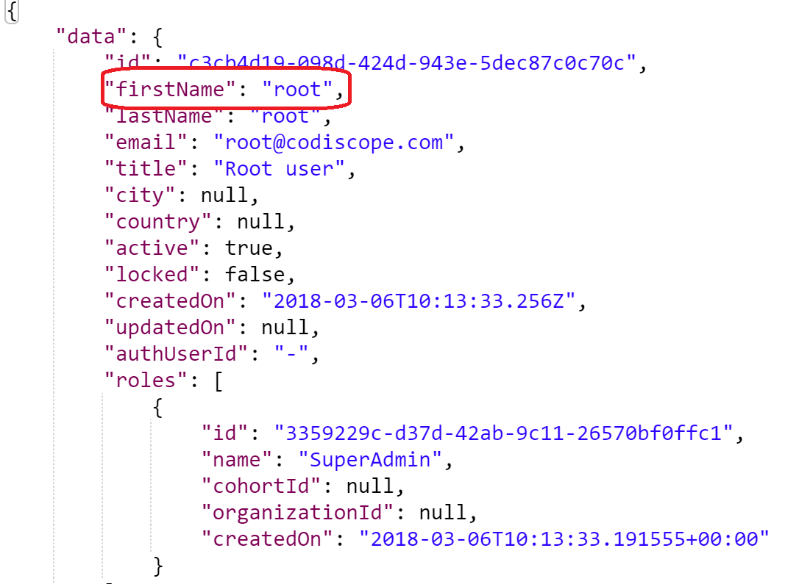
Wiring class - API
Store API response and retrieve the required value from the response.

Slide 13
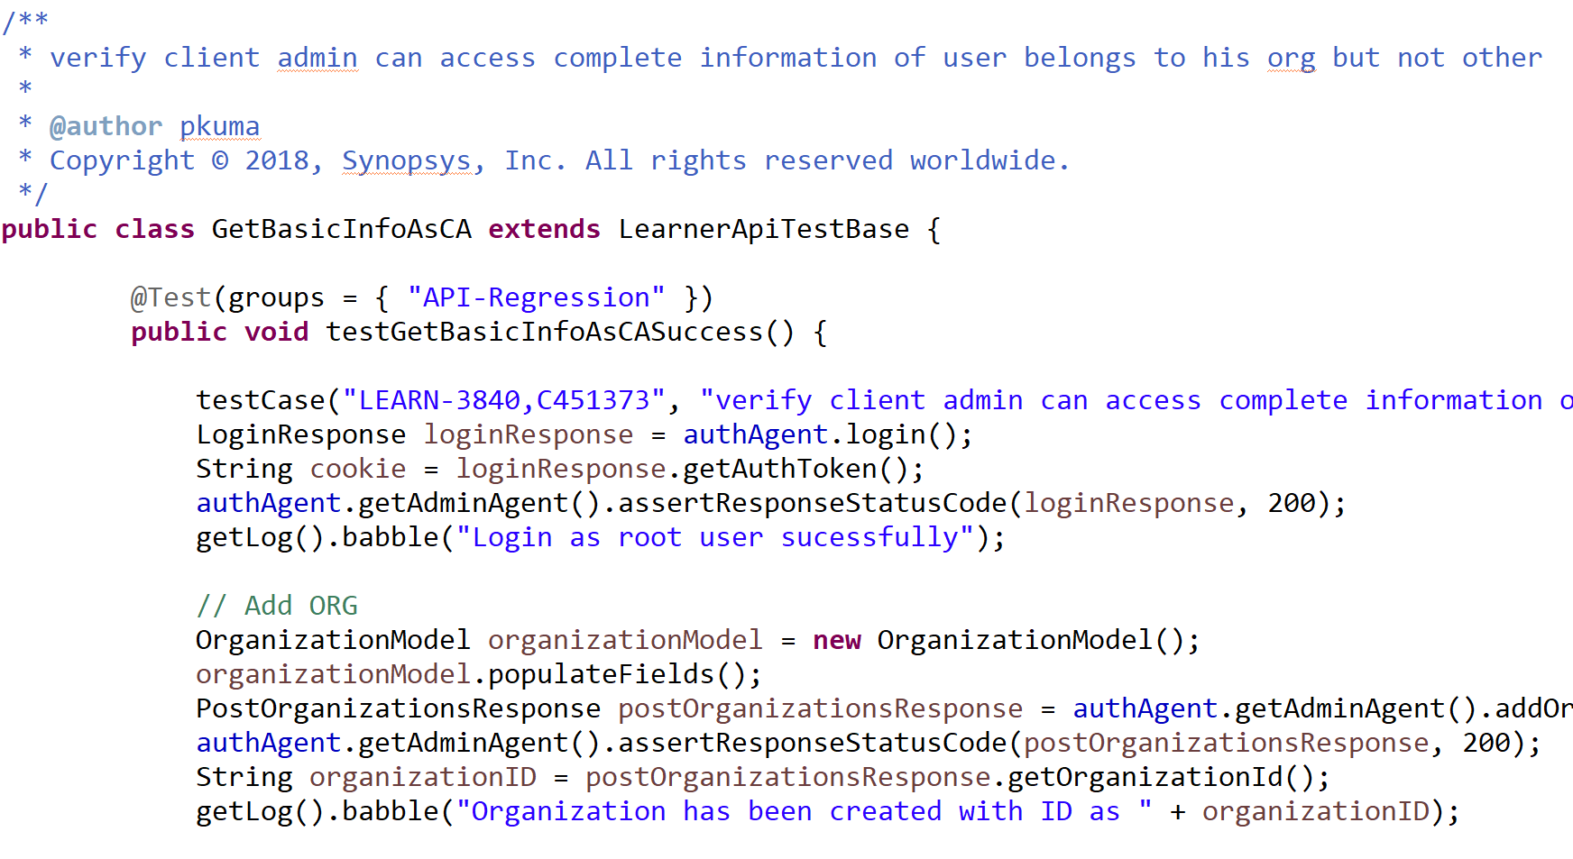
Test Class - API
Call Pre and post condition methods from base class.
Call agent and wiring class methods based on test scenarios.

Slide 14
Thank you
D.Prudhvi Teja

