Slide 1
Lab 1

Slide 2
What You will Learn

Slide 3
Some javascript basic syntax
Array
Mouse event
Convert mouse event position from browser space to WebGL drawing canvas space
Pass data to shaders

Slide 4
What We Want

Slide 5
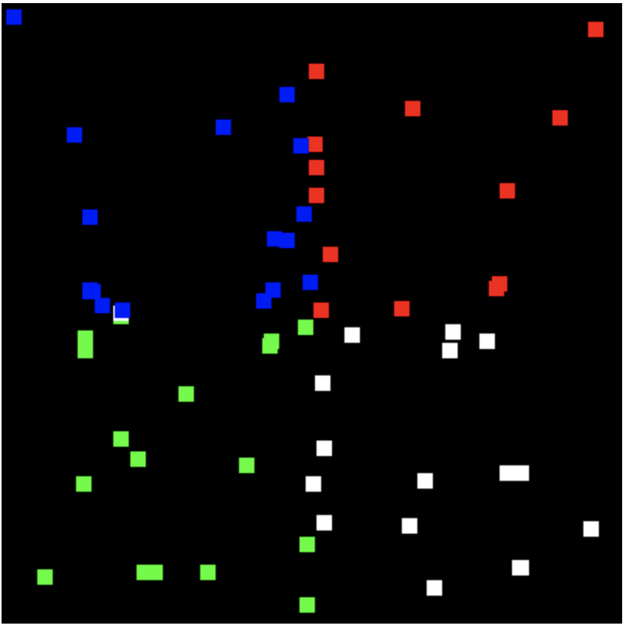
Virtually divide the canvas into 4 quadrants
When user clicks on the canvas, add one more point
The color of the point is determined by the location of the points
Top right quadrant: red
Top left quadrant: blue
Bottom left quadrant : green
Bottom right quadrant :white

Slide 6
What You Should Do Step by Step

Slide 7

1. Download and Run
Download the zip file which contains “index.html” and “WebGL.js” from Moodle (unzip the zip file)
Drag “index.html” to a browser (e.g. Chrome)
You suppose to see a black canvas

Slide 8
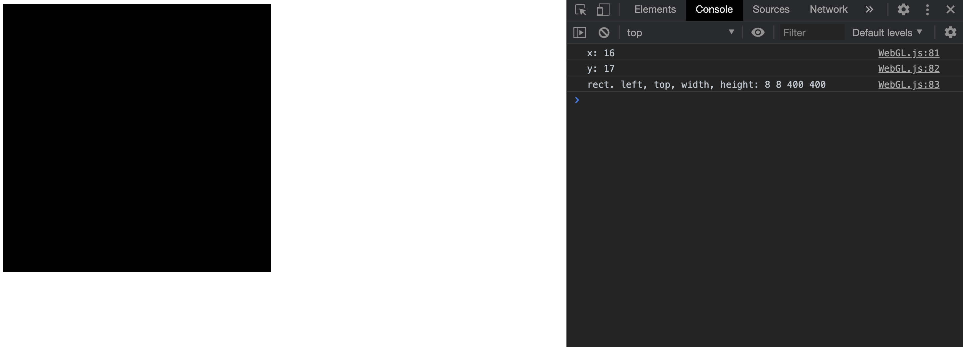
2. Coordinate System of Mouse Event
Read main() function in WebGL.js
Read the function “click()” in WebGL.js
Open the developer tool (and click the “console” tab)

Slide 9
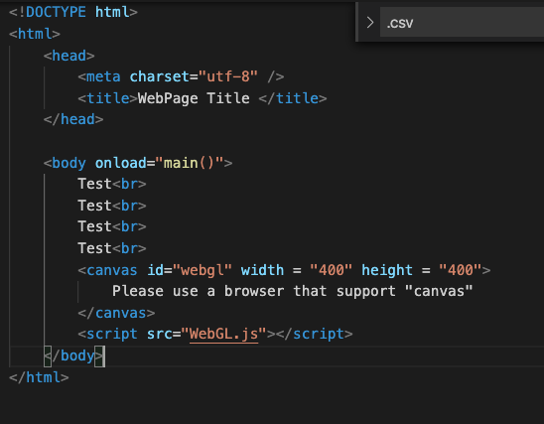

2. Coordinate System of Mouse Event
Click at the left-top corner of the canvas and check what text is printed in the developer tool
Change the position of the canvas by add multiple ”test <br>” in index.html
Click at the left-top corner of the black “canvas” again and check what text is printed in the developer tool

Slide 10
2. Coordinate System of Mouse Event
(rect.left, rect.top)
ev.clickX and ev.clickY return the coordinate according to the ”red” coordinate system
ev.target.getBoundingClientRect() returns information of the canvas (because you click on it)
Check here for more information
https://developer.mozilla.org/en-US/docs/Web/API/Element/getBoundingClientRect
rect.width
rect.height

Slide 11
3. TODO-1
(rect.left, rect.top)
When we draw in WebGL
The span of x-axis is -1 to +1
The span of y-axis is -1 to +1
Complete TODO-1 for this conversion
rect.width
rect.height

Slide 12
4. TODO-2
Fill out “???”
Calculate color for each point

Slide 13
5. TODO-3
Read the for loop
Fill out “???” to pass data to shader for drawing

Slide 14
What You Should Do for “Submission”

Slide 15
Submission Instruction
Create a folder
Put the html and js files in the folder
Rename the folder to your student ID
For example, if your student ID is “40312345s”, rename the folder to “40312345s”
Zip the folder
Rename the zip file to your student ID
For example, if your student ID is “40312345s”, rename the zip file to “40312345s.zip”
Submit the renamed zip file to Moodle
Make sure
you put all files in the folder to zip
You submit the zip file with correct name
You won’t get any point if
the submitted file does not follow the naming rule,
TA cannot run your code,
or cannot unzip your zip file.

