Slide 1
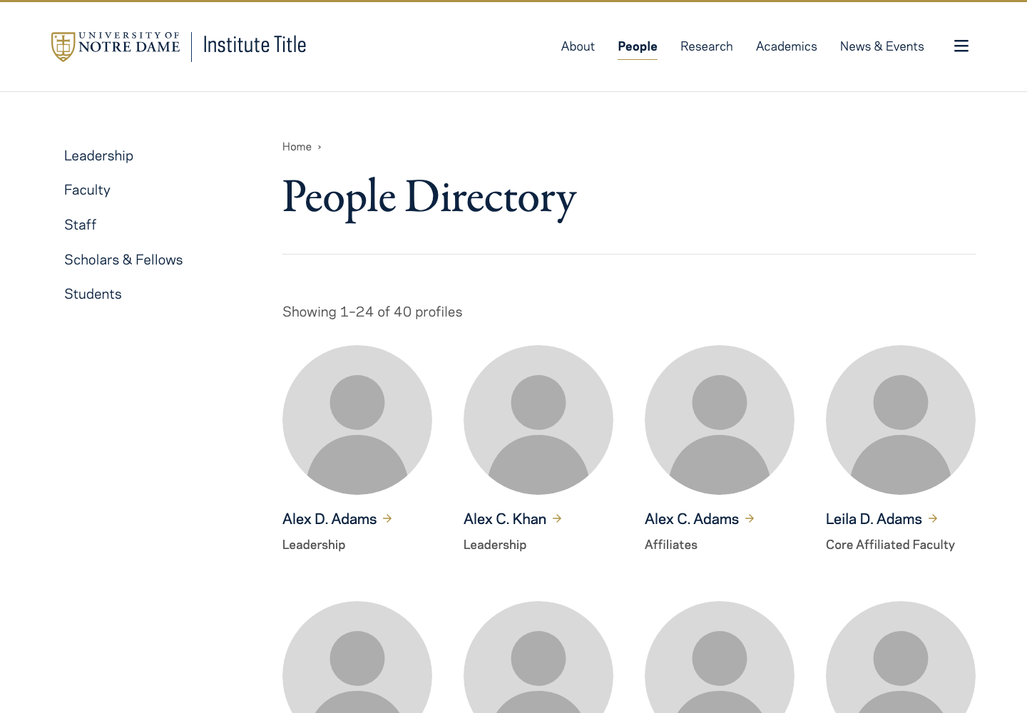
PROPOSED STANDARD / INSTITUTE PEOPLE PAGES
People opens the directory
1
1
People in the
main navigation
3
2
2
One clear title
People Directory
3
Five sidebar groups
4
None selected on the hub.
4
Four columns
Leadership first.
Then surname A–Z.
DRAFT FOR FEEDBACK · Start here
Open the live example
1 / 7
Notes:
Use People in top-level navigation. The landing title is People Directory. No category is selected on the hub. The five categories are Leadership, Faculty, Staff, Scholars & Fellows, and Students. Four columns on desktop adapt to smaller screens. Leadership comes first; everyone else follows alphabetically by surname. Show each person once. No inset hero or introductory photo. Screenshot uses the 40-profile NDT4 example.
Source / example: https://prugamba-nd.github.io/people-hub-mockup/screens/40/
Illustrative institute mockups. The underlying website components use NDT4. Screenshots may show fictional people; public profile examples cite their sources on the linked pages.

Slide 2
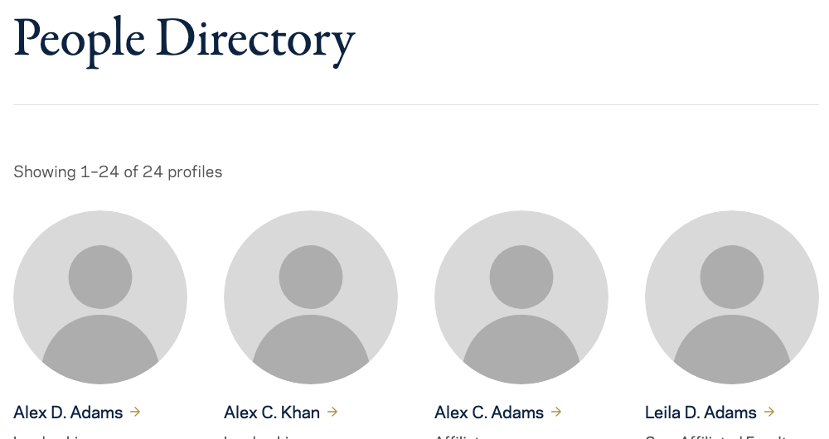

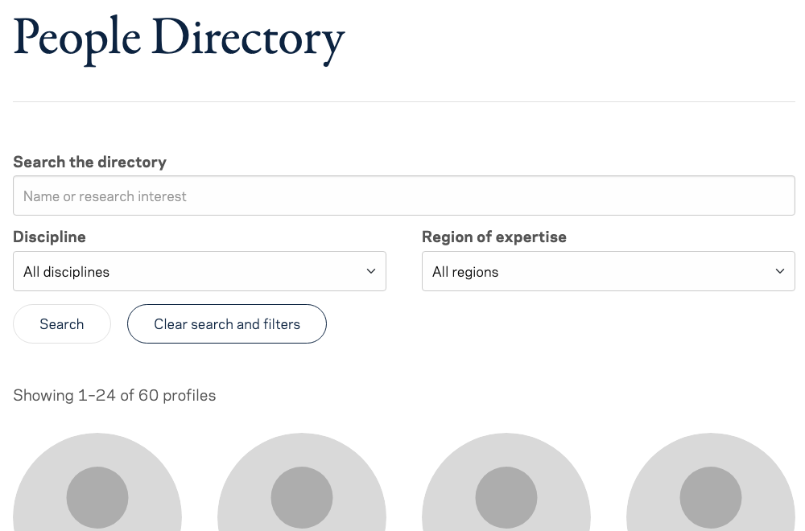


PROPOSED STANDARD / INSTITUTE PEOPLE PAGES
The number of profiles determines the controls
Up to 24 profiles
25–40 profiles
More than 40 profiles
All on one page
24 per page
24 per page + search / filters
BOTTOM OF THE LIST
BOTTOM OF THE LIST
No pagination.
No search or filters.
Numbered pagination below the grid
Numbered pagination below the grid
DRAFT FOR FEEDBACK · Directory + category listings
Open the live example
2 / 7
Notes:
Use these thresholds for the main directory, categories, and subcategories. Up to 24: all entries on one page, no pagination. 25–40: 24 per page, native pagination below the grid. More than 40: same pagination plus scoped search and relevant filters. 40 means two pages (24 and 16); 60 means three pages (24, 24, and 12). Screenshots intentionally show top-of-page and bottom-of-list excerpts rather than shrinking a whole long page. The 24-record illustration is rendered using the native NDT4 40-profile example reduced locally to 24 records for this deck. No live page was changed.
Source / example: https://prugamba-nd.github.io/people-hub-mockup/screens/
Illustrative institute mockups. The underlying website components use NDT4. Screenshots may show fictional people; public profile examples cite their sources on the linked pages.

Slide 3
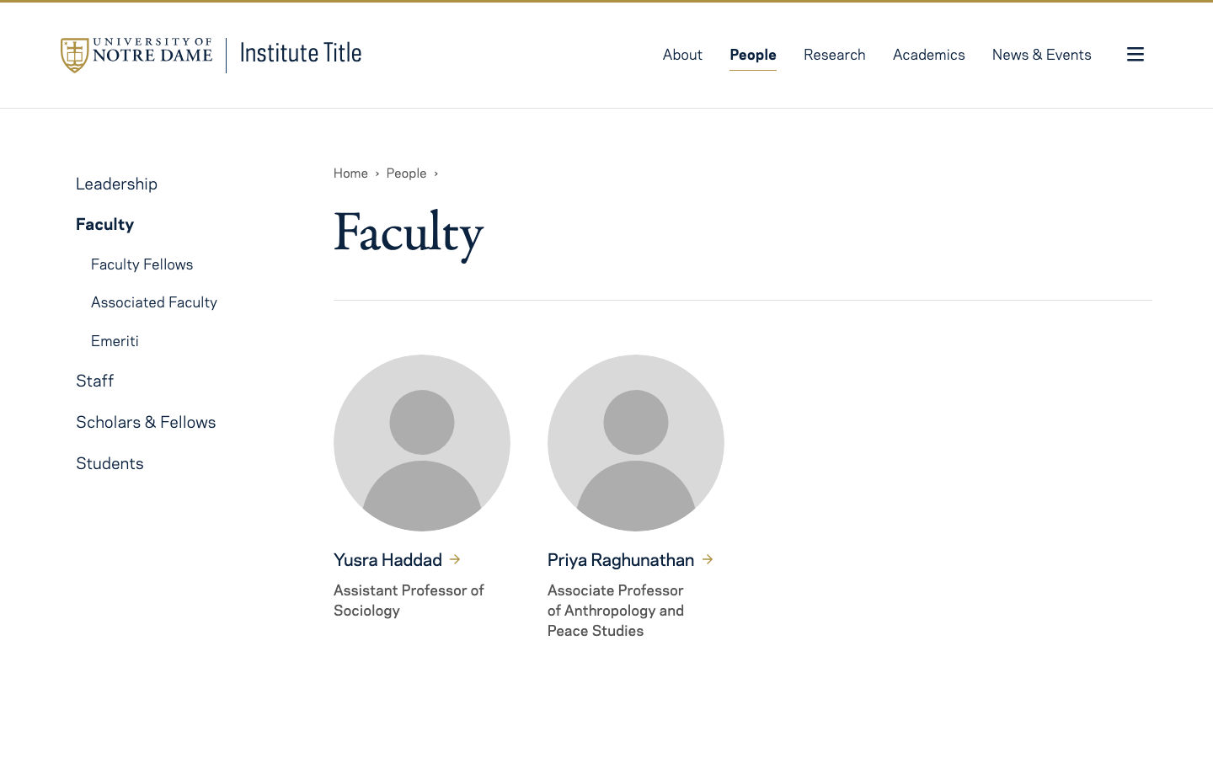
PROPOSED STANDARD / INSTITUTE PEOPLE PAGES
A category opens its default group
1
Just “Faculty”
No lede.
No repeated group heading.
1
2
2
Reveal its subgroups
3
Other categories
stay collapsed.
3
Show core affiliates
No separate “Core”
page or heading needed.
DRAFT FOR FEEDBACK · Browse by group
Open the live example
3 / 7
Notes:
Each category opens a dedicated page, with one title and no lede or additional section headings. The default group is implicit: Faculty displays core affiliated faculty. Additional groups appear only beneath the selected parent. This capture removes the old extra Core Affiliated Faculty heading and sorts profiles by surname locally to illustrate the proposed standard; the live category example may still contain it. Parent defaults: Leadership=institute leadership; Faculty=core affiliated faculty; Staff=institute staff; Scholars & Fellows=visiting scholars and fellows; Students=undergraduate and graduate, excluding PhD. The reviewed draft also lists PhDs on the market under Scholars & Fellows; retain for institute feedback.
Source / example: https://prugamba-nd.github.io/people-hub-mockup/faculty/
Illustrative institute mockups. The underlying website components use NDT4. Screenshots may show fictional people; public profile examples cite their sources on the linked pages.

Slide 4
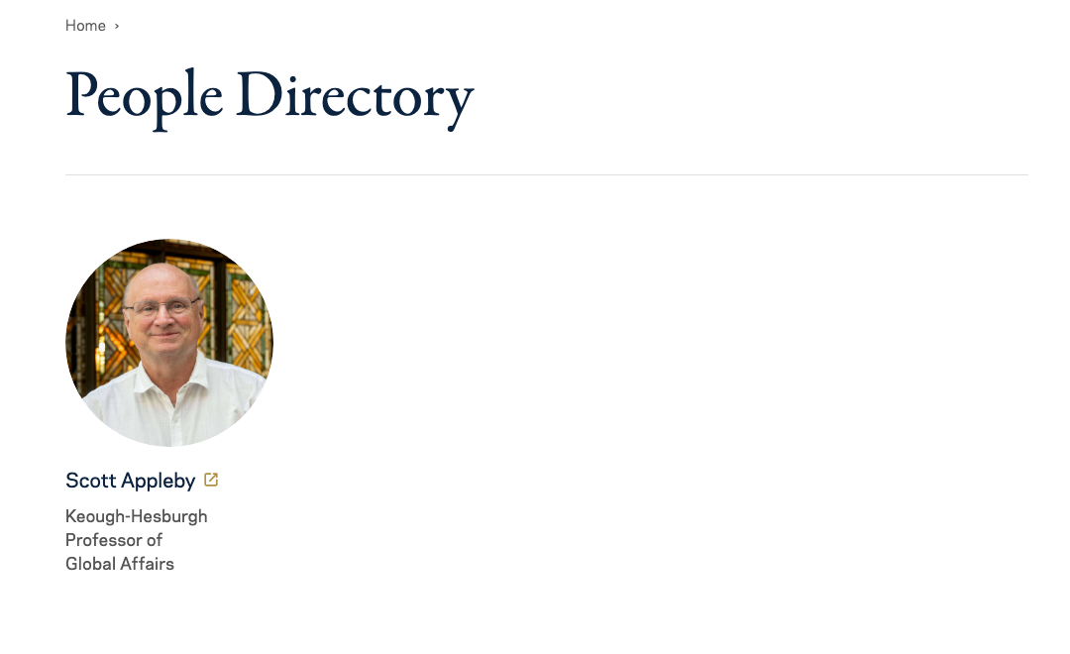
PROPOSED STANDARD / INSTITUTE PEOPLE PAGES
A school-hosted profile opens directly
1
The arrow signals
an offsite destination
Clicking the name opens
the school’s full profile.
No intermediate
institute bio page.
1
DRAFT FOR FEEDBACK · Profile destination 1
Open the live example
4 / 7
Notes:
When the full biography is maintained on the Keough School website, the directory card links directly to that profile. Do not create an intermediate institute biography page. NDT4 supplies the external-link arrow automatically for external card URLs. The public school example is Scott Appleby; the card’s link and photo source are recorded in the prototype.
Source / example: https://prugamba-nd.github.io/people-hub-mockup/profile-examples/external-profile/
Illustrative institute mockups. The underlying website components use NDT4. Screenshots may show fictional people; public profile examples cite their sources on the linked pages.

Slide 5

PROPOSED STANDARD / INSTITUTE PEOPLE PAGES
A full biography lives on the institute site
1
1
Name + role
2
3
2
Full biography
Maintained by the institute.
3
Photo + contact details
Keep office and email
with the portrait.
DRAFT FOR FEEDBACK · Profile destination 2
Open the live example
5 / 7
Notes:
Use the native biography layout shown on the Ann Firth page: name and role at the top, biography at left, portrait and contact details at right. The institute maintains the full biography. This example uses fictional Maren Okafor and reserved example.org contact details. Layout reference: https://president.nd.edu/about/leadership-and-staff/ann-firth/
Source / example: https://prugamba-nd.github.io/people-hub-mockup/profile-examples/full-bio/
Illustrative institute mockups. The underlying website components use NDT4. Screenshots may show fictional people; public profile examples cite their sources on the linked pages.

Slide 6
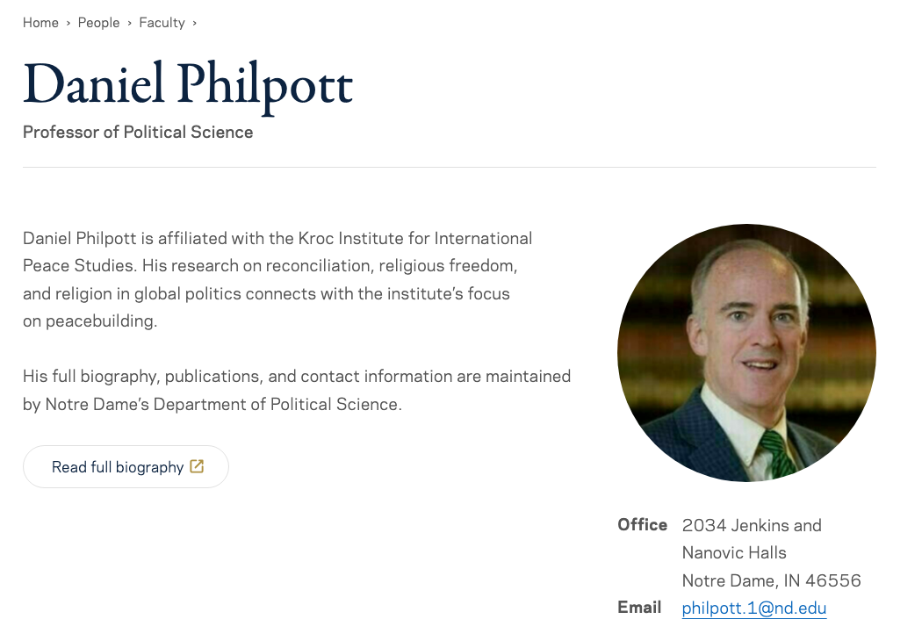
PROPOSED STANDARD / INSTITUTE PEOPLE PAGES
An abridged biography adds institute context
1
Short, institute-specific
biography
2
Photo + office + email
1
2
3
Button to the full bio
Hosted outside the
Keough School website.
3
DRAFT FOR FEEDBACK · Profile destination 3
Open the live example
6 / 7
Notes:
Use the same native biography layout. Keep the local text short and specific to the institute relationship. Retain office and email beneath the portrait. Link the button to the full biography maintained outside the Keough School website. The example uses Daniel Philpott’s public department profile. The complete biography, publications and contact information are maintained by the department; the local text explains the institute connection.
Source / example: https://prugamba-nd.github.io/people-hub-mockup/profile-examples/abridged-bio/
Illustrative institute mockups. The underlying website components use NDT4. Screenshots may show fictional people; public profile examples cite their sources on the linked pages.

Slide 7
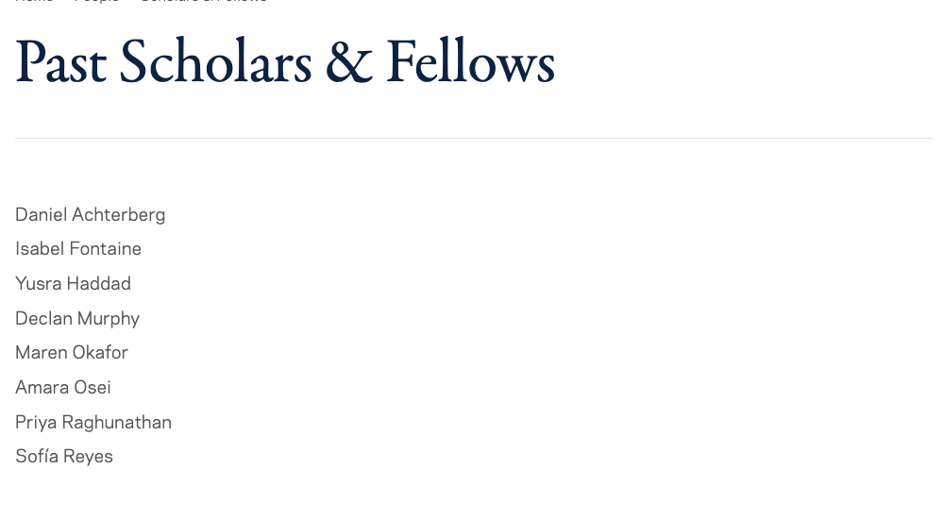
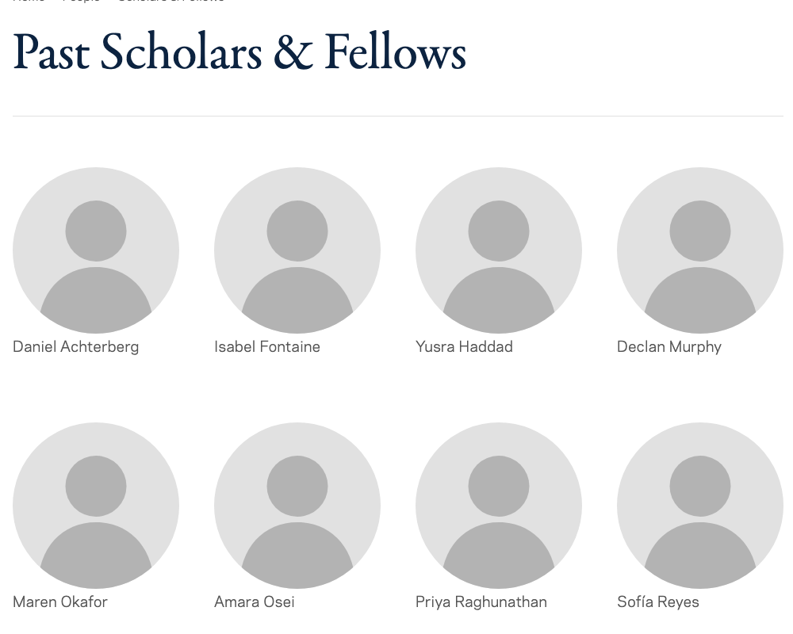
PROPOSED STANDARD / INSTITUTE PEOPLE PAGES
Past affiliation can be a simple list
Names only
Images + names
No profile links. No biography to keep current. Names and affiliations still need to be accurate.
DRAFT FOR FEEDBACK · Historical listings
Open the live example
7 / 7
Notes:
Use these for historical groups whose current biographies the institute cannot maintain, such as former visiting professors. Names only or images and names; entries are not linked by default and do not require a local biography. Do not reproduce biographies your team cannot keep current. Check basic accuracy of names and historical affiliation. No separate pagination threshold for simple historical lists is established by this proposal. Both examples use fictional names. Image-and-name example: https://prugamba-nd.github.io/people-hub-mockup/profile-examples/images-and-names/
Source / example: https://prugamba-nd.github.io/people-hub-mockup/profile-examples/names-only/
Illustrative institute mockups. The underlying website components use NDT4. Screenshots may show fictional people; public profile examples cite their sources on the linked pages.

