Slide 1
Chapter: 6 Investment Evaluation (Engineering Economics)
Topics to be covered
Introduction
Types of Cost/Benefit
Cash flow Diagram
Time Value of money
Interest Formulas and Applications
Project Selection

Slide 2
Introduction to Engineering Economics
From the organization’s point of view, efficient and effective functioning of the organization would certainly help it to provide goods/services at a lower cost which in turn will enable it to fix a lower price for its goods or services.
Engineering economics deals with the methods that enable one to take economic decisions towards minimizing costs and/or maximizing benefits to business organizations.
It deals with the concepts and techniques of analysis useful in evaluating the worth of systems, products, and services in relation to their costs.

Slide 3
Introduction to Engineering Economics
Economists, engineering managers, project managers, and indeed any person involved in decision making must be able to analyze the financial outcome of his or her decision.
The decision is based on analyzing and evaluating the activities involved in producing the outcome of the project.
These activities have either a cost or a benefit.
Financial analysis gives us the tools to perform this evaluation.
Often the decision to make is to proceed or not to proceed with a project.

Slide 4
Introduction to Engineering Economics
Why do engineers care about engineering economics?
Engineering designs are intended to produce good results.
They are accompanied by undesirables (costs).
If outcomes are evaluated in dollars, and “good” is defined as profit, then decisions will be guided by engineering economics.
This process maximizes goodness only if all outcomes are anticipated and can be monetized.

Slide 5
Introduction to Engineering Economics
It is used to answer many different questions:
Which engineering projects are worthwhile?
Which engineering projects should have a higher priority?
How should the engineering project be designed?

Slide 6
Accounting Vs. Engineering Economy
Evaluating past performance
Evaluating and predicting future events
Accounting
Engineering Economy
Past
Present
Future
Types of Strategic Engineering Economic Decisions in Manufacturing Sector:
Service Improvement.
Equipment and Process Selection.
Equipment Replacement.
New Product and Product Expansion.
Cost Reduction.

Slide 7
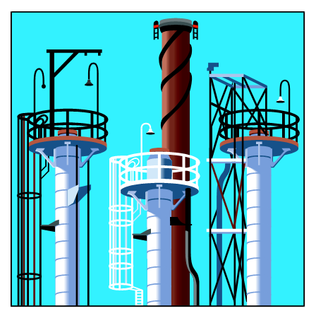
Types of Costs
There are usually two types of costs/Benefits associated with an engineering project, one-time costs, which include first costs and salvage costs, and annual costs (or benefits) that occur every year or several years of the project.
One time costs:
First Costs or Initial Costs are the costs necessary to implement a project, including:
Costs of new equipment, Costs of shipping and installation, Costs of renovations, Cost of engineering, Cost of permits, licenses, etc.

Slide 8
Types of Costs
Salvage value is the money that can be obtained at the end of the project by selling equipment. Salvage value is a benefit rather than a cost.
Annual Costs/Benefits:
Direct operating costs such as labor, supervision, supplies, maintenance, material, electricity, fuel, etc.
Indirect operating costs sometimes included, such as a portion of building rent, a portion of secretarial expenses, etc.
Depreciation of equipment.
Savings or profits from the project and tax.

Slide 9
Cash Flow Diagram
The graphic presentation of the costs and benefits over the time is called the cash flow diagram.
It is a presentation of what costs have to be incurred and what benefits are received at all points in time. CFD illustrates the size, sign, and timing of individual cash flows, and forms the basis for engineering economic analysis.
A CFD is created by first drawing a segmented time-based horizontal line, divided into appropriate time unit. Each time when there is a cash flow, a vertical arrow is added, pointing down for costs and up for revenues or benefits.

Slide 10
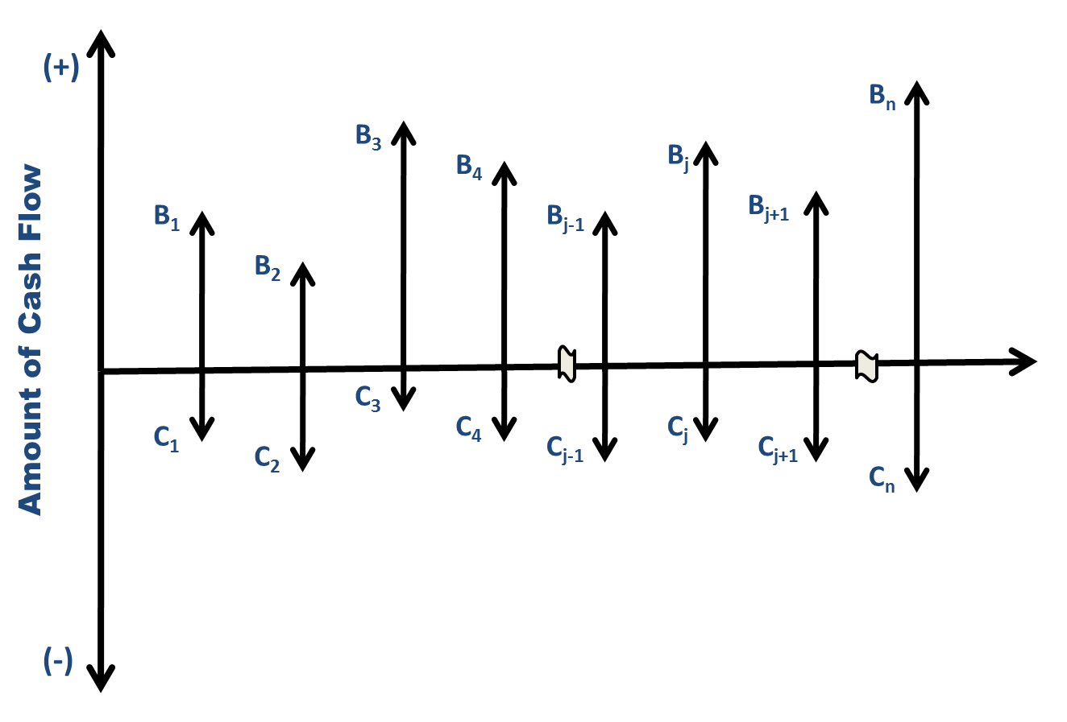
Cash Flow Diagram
Different cost flows are drawn to relative scale.
Horizontal axis = time; vertical axis = costs and benefits.

Slide 11
Drawing Cash Flow Diagram
In a cash flow diagram (CFD) the end of period t is the same as the beginning of period (t+1).
Beginning of period cash flows are: rent, lease, and insurance payments.
End-of-period cash flows are: salvages, revenues, overhauls.
The choice of time 0 is arbitrary. It can be when a project is analyzed, when funding is approved, or when construction begins.

Slide 12
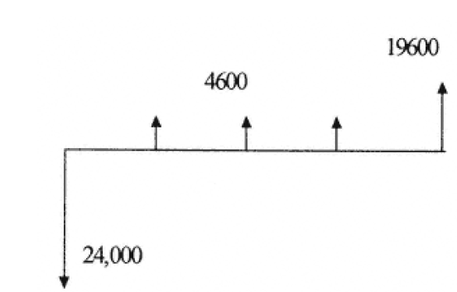
Drawing Cash Flow Diagram
Example 1: A car leasing (renting) company buys a car from a wholesaler for $24,000 and leases it to a customer for four years at $5,000 per year. Since the maintenance is not included in the lease, the leasing company has to spend $400 per year in servicing the car. At the end of the four years, the leasing company takes back the car and sells it to a secondhand car dealer for $15,000. For the moment, in constructing the cash flow diagram, we will not consider tax, inflation, and depreciation.
Solution:

Slide 13
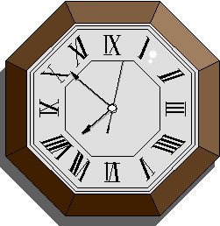
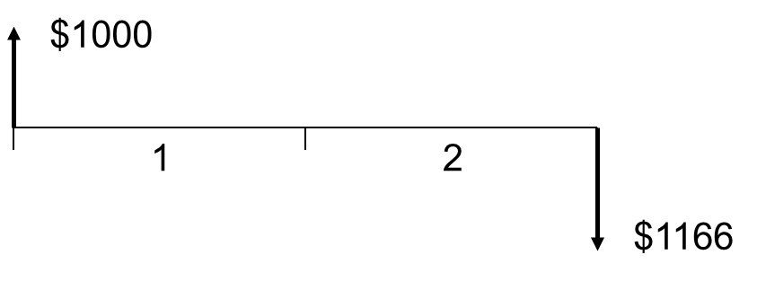
Time Value of Money
Money has value
Money can be leased or rented
The payment is called interest
If you put $100 in a bank at 9% interest for one time period you will receive back your original $100 plus $9.
Original amount to be returned = $100
Interest to be returned = $100 x .09 = $9
The “value” of money depends on the amount and when it is received or spent.
Example: What amount must be paid to settle a current debt of $1000 in two years at an interest rate of 8% ?
Solution: $1000 (1 + 0.08) (1 + 0.08) = $1166

Slide 14
Interest Formulas and Their Applications
Interest rate: is the rental value of money. It represents the growth of capital per unit period. The period may be a month, a quarter, semiannual or a year.
Interest formulas:
Simple interest: the interest is calculated, based on the initial deposit for every interest period. In this case, calculation of interest on interest is not applicable.
Compound interest: the interest for the current period is computed based on the amount (principal plus interest up to the end of the previous period) at the beginning of the current period.

Slide 15
Interest Formulas and Application
The notations which are used in various interest formulae are as follows:
P = principal amount (Initial amount).
n = No. of interest periods.
i = interest rate (It may be compounded monthly, quarterly, semiannually or annually).
F= future amount at the end of year n.
A = equal amount deposited at the end of every interest period.

Slide 16
Interest Formulas and Application
Single-Payment Compound Amount: Here, the objective is to find the single future sum (F) of the initial payment (P) made at time 0 after n periods at an interest rate i compounded every period.
The formula to obtain the single-payment compound amount is:
F= P(1 + i)^{n} = P(F| P, i, n)
Where (F|P, i, n) is called as single-payment compound amount factor.
Example: A person deposits a sum of $ 20,000 at the interest rate of 18% compounded annually for 10 years. Find the maturity value after 10 years.
Solution: P= $ 20,000, i = 18% compounded annually, n= 10 years
F= P(1 + i)^{n} = P(F|P, i, n)
= 20,000 (F|P, 18%, 10)
= 20,000 * 5.234 = $ 104,680

Slide 17

Interest Formulas and Application
Single-Payment Present Worth Amount: Here, the objective is to find the present worth amount (P) of a single future sum (F) which will be received after n periods at an interest rate of i compounded at the end of every interest period.
Example: A person wishes to have a future sum of $100,000 for his son’s education after 10 years from now. What is the single-payment that he should deposit now so that he gets the desired amount after 10 years? The bank gives 15% interest rate compounded annually.
Ans: $24,720

Slide 18
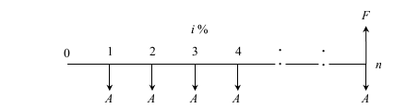
Interest Formulas and Application
Equal-Payment Series Future Worth Amount: In this type of investment mode, the objective is to find the future worth of n equal payments which are made at the end of every interest period till the end of the n-th interest period at an interest rate of i compounded at the end of each interest period.

Slide 19
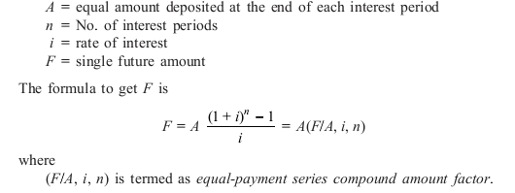
Interest Formulas and Application
Example: A person who is now 35 years old is planning for his retired life. He plans to invest an equal sum of $10,000 at the end of every year for the next 25 years starting from the end of the next year. The bank gives 20% interest rate, compounded annually. Find the maturity value of his account when he is 60 years old.
Ans: $ 4,719,810

Slide 20
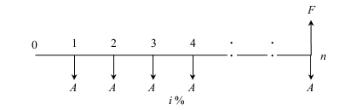
Interest Formulas and Application
Equal-Payment Series Sinking Fund: In this type of investment mode, the objective is to find the equivalent amount (A) that should be deposited at the end of every interest period for n interest periods to realize a future sum (F) at the end of the nth interest period at an interest rate of i.

Slide 21
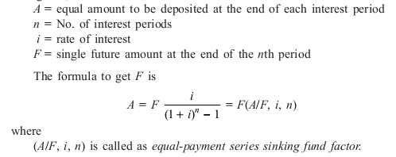
Interest Formulas and Application
Equal-Payment Series Sinking Fund:
Example: A company has to replace a present facility after 15 years at an outlay of $500,000. It plans to deposit an equal amount at the end of every year for the next 15 years at an interest rate of 18% compounded annually. Find the equivalent amount that must be deposited at the end of every year for the next 15 years.
Ans: $ 8,200.

Slide 22
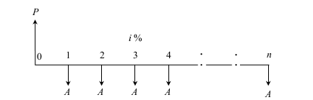
Interest Formulas and Application
Equal-Payment Series Present Worth Amount : The objective of this mode of investment is to find the present worth of an equal payment made at the end of every interest period for n interest periods at an interest rate of i compounded at the end of every interest period.

Slide 23
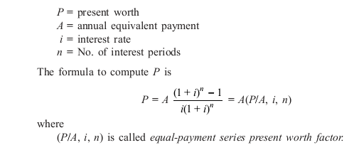
Interest Formulas and Application
Equal-Payment Series Present Worth Amount :
Example: A company wants to set up a reserve which will help the company to have an annual equivalent amount of $1,000,000 for the next 20 years towards its employees welfare measures. The reserve is assumed to grow at the rate of 15% annually. Find the single-payment that must be made now as the reserve amount.
Ans: $ 6,259,300

Slide 24
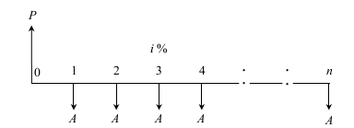
Interest Formulas and Application
Equal-Payment Series Capital Recovery Amount: The objective of this mode of investment is to find the annual equivalent amount (A) which is to be recovered at the end of every interest period for n interest periods for a loan (P) which is sanctioned now at an interest rate of i compounded at the end of every interest period.

Slide 25
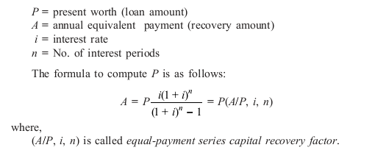
Interest Formulas and Application
Equal-Payment Series Capital Recovery Amount:
Example: A bank gives a loan to a company to purchase an equipment worth $ 1,000,000 at an interest rate of 18% compounded annually. This amount should be repaid in 15 yearly equal installments. Find the installment amount that the company has to pay to the bank.
Ans: $196,400

Slide 26
Project selection
The selection of the right project for future investment is a crucial decision for the long-term survival of your company.
The selection of the wrong project may well precipitate project failure leading to company liquidation.
Project selection is making a commitment for the future. The execution of a project will tie up company resources, and as an opportunity cost the selection of one project may preclude your company from pursuing another project.

Slide 27
We live in a world of finite resources and therefore cannot carry out all the projects we may want or need.
Therefore a process is required to select and rank projects on the basis of beneficial change to your company.
Project Selection Models
A numeric model is usually financially focused and quantifies the project in terms of either time to repay the investment (payback) or return on investment. While non­numeric models look at a much wider view of the project considering items from market share to environmental issues.

Slide 28
The main purpose of these models is to aid decision-making leading to project selection.
When choosing a selection model the points to consider are: realism, capability, ease of use, flexibility and low cost. Most importantly the model must evaluate projects by how well they meet a company's strategic goals and corporate mission.
The following sub-headings indicate the type of questions to ask:

Slide 29
Will the project maximize profits?
Will the project maintain market share, increase market share or consolidate market position?
Will the project enable the company to enter new markets?
Will the project maximize the utilization of plant and equipment?
Will the project improve the company's image?
Will the project satisfy the needs of the stakeholders and political aspirations?

Slide 30
Numeric Models
The numeric selection models may be sub-divided into financial models and scoring models. The financial models are:
payback period
return on investment (ROI)
net present value (NPV)
internal rate of return (IRR)

Slide 31

Payback Period
The payback period is the time taken to gain a financial return equal to the original investment, neglecting the time value of money. The time period is usually expressed in years and months.
To calculate the payback period, simply work out how long it will take to recover the initial outlay. It is given by as follow

Slide 32
Example: Determine the payback period for a proposed investment as follows:
The sum of the first three yearly cash inflows, $37 000, is less than the initial investment, $50 000; but the sum of the first four yearly cash inflows, $55 000, exceeds the initial investment. Hence the payback period will be somewhere between 3 and 4 years. Linear interpolation yields
PBP= 3 + {(50,000 – 37,000)/(55,000 – 37,000)}*(4 – 3) = 3.72 years
Because it ignores the time value of money
End of Year | 0 | 1 | 2 | 3 | 4 | 5
Cash Flow, $1000 | -50 | 10 | 12 | 15 | 18 | 20

Slide 33
Advantages of the payback method are:
It is simple and easy to use.
It uses readily available accounting data to determine cash-flows.
It reduces the project's exposure to risk and uncertainty by selecting the project that has the shortest payback period.
The uncertainty of future cash-flow is reduced.
It is an appropriate technique to evaluate high technology projects where the technology is changing quickly and the project could run the risk of being left holding out of date stock.

Slide 34
It is an appropriate technique for fashion projects where the market demand tends to change seasonally.
Faster payback has a favorable short-term effect on earnings per share.
The payback period quantifies the selection criteria in terms the decision-makers are familiar with.

Slide 35
Disadvantages of the payback period are:-
It does not consider the time value of money. It is indifferent to the timing of the cash-flow. The project with a high, early income (cash­ inflow) would be ranked equally with a project which had late income if their payback periods were the same.
It does not look at the total project. What happens to the cash-flow after the payback period is not considered. A project that built up slowly to give excellent returns would be rejected in favor of project with low early returns if the payback period was shorter.
It is not a suitable technique to evaluate long term projects where the effects of differential inflation and interest rates could significantly change the results.

Slide 36
Cont.
The figures are based on project cash-flow only. All other financial data are ignored.
Although payback period would reduce the duration of risk, it does not quantify the risk exposure.
The payback period is the most widely used project selection calculation, even if this is an initial filter. Its main strength is that it is simple and quick……

Slide 37
Return on Investment (ROI)
This method first calculates the average annual profit, which is simply the project outlay deducted from the total gains, divided by the number of years the investment will run. The profit is then converted into a percentage of the total outlay using the following equations
Average Annual Profit = (Total Gains) – (Total outlay)
Number of years
Return on Investment = Average Annual Profit X 100
Original Investment

Slide 38
Advantage:
a simple technique like back period,
it considers the cash-flow over the whole project.
The total outcome of the investment is expressed as a profit and percentage return on investment, both parameters readily understood by management.
The main criticism of return on investment is that it averages out the profit over successive years. An investment with high initial profits would be ranked equally with a project with high profits later if the average profit was the same. Clearly the project with high initial profits should take preference……..

Slide 39
Discounted Cash-Flow (DCF)
To address the short-coming of both return on investment and payback period, the time value of money must be considered using a discounted cash-flow technique. This is particularly desirable where interest rates and inflation are high.
The discounted cash-flow (DCF) technique takes into consideration the time value of money. There are two basic DCF techniques which can model this effect, net present value (NPV) and internal rate of return (lRR).
These discounting techniques enable the project manager to compare two projects with different investment and cash-flow profiles.

Slide 40
Net Present Value (NPV)
Where the cash-flow timing is expressed in years from the start date of the project, the inflation effect is assumed to act at the end of the first year or beginning of the second year, therefore all cash-flows in the first year are at present value.
Project cash-flow = income - expenditure
Present value = discount factor x cash-flow
The discount factor is derived from the reciprocal of the compound interest formula.
Discount factor = 1 / (1 + i) n
Where i = the forecast interest rate
n = the number of years from start date

Slide 41
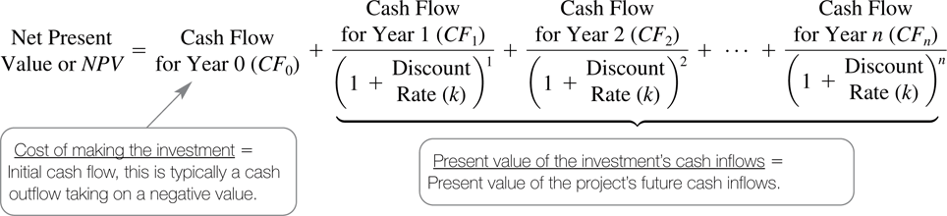

The NPV of an investment proposal can be defined as follows:

Slide 42
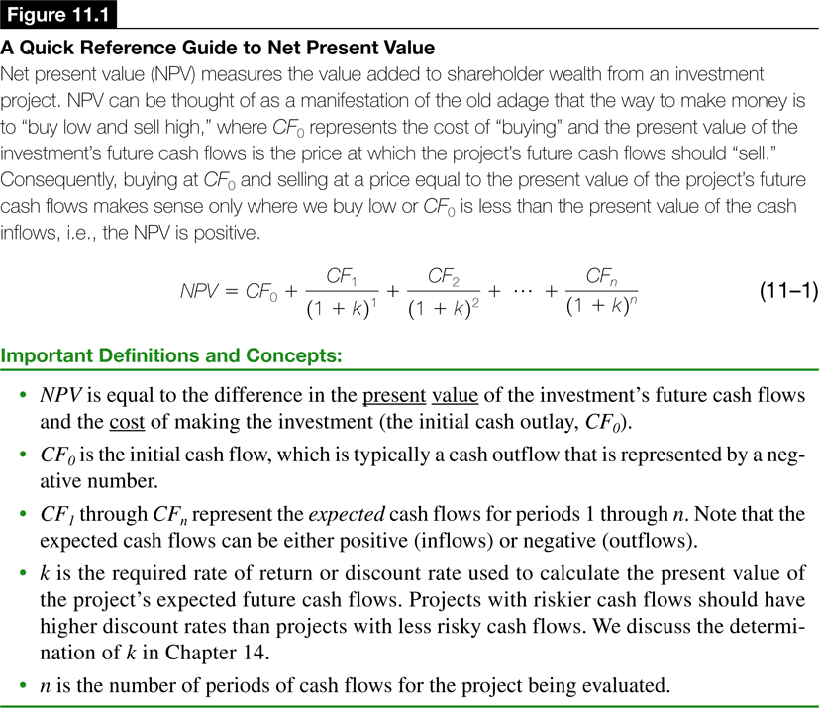

Slide 43
Example:- Saber Electronics provides specialty manufacturing services to defense contractors. The initial outlay is $3 million and, management estimates that the firm might generate cash flows for years one through five equal to $500,000; $750,000; $1,500,000; $2,000,000; and $2,000,000. Saber uses a 20% discount rate for projects of this type. Is this a good investment opportunity?
Soln: We need to analyze if this is a good investment opportunity. We can do that by computing the Net Present Value (NPV), which requires computing the present value of all cash flows.

Slide 44
NPV = -$3m + $.5m/(1.2) + $.75m/(1.2)² + $1.5m/(1.2)³ + $2m/(1.2)⁴ + $2m/(1.2)⁴
NPV = -$3,000,000 + $416,666.67 + $520,833.30 + $868,055.60 + $964,506 + $803,755.10
NPV = $573,817
The project requires an initial investment of $3,000,000 and generates futures cash flows that have a present value of $3,573,817. Consequently, the project cash flows are $573,817 more than the required investment.
Since the NPV is positive, the project is an acceptable project.

Slide 45
The NPV is a measure of the value or worth added to the company by carrying out the project. If the NPV is positive the project merits further consideration. When ranking projects, preference should be given to the project with the highest NPV.
The steps are as follows:
insert the cash-flow
transfer the discounting factors from the table
calculate present value : multiplying cash-flow by discount factor
aggregate the present values to give the NPV

Slide 46
The advantages of using NPV are:
It introduces the time value of money.
It expresses all future cash-flows in today's values, which enables direct comparisons.
It allows for inflation and escalation.
It looks at the whole project from start to finish.
It can simulate project what-if analysis using different values.
It gives a more accurate profit and loss forecast than non DCF calculations.

Slide 47
The disadvantages are:-
Its accuracy is limited by the accuracy of the predicted future cash-flows and interest rates.
It is biased towards short run projects.
It excludes non financial data e.g. market potential.
It uses a fixed interest rate over the duration of the project. The technique can, however, accommodate a varying interest rate.

Slide 48
Internal Rate of Return (IRR)
The internal rate of return is also called DCF yield or DCF return on investment.
The IRR is the value of the discount factor when the NPV is zero.
The IRR is calculated by either a trial and error method or plotting NPV against IRR. It is assumed that the costs are committed at the end of the year and these are the only costs during the year.
The IRR analysis is a measure of the return on investment, therefore, select the project with the highest IRR. This allows the manager to compare IRR with the current interest rates.

Slide 49
One of the limitations with IRR is that it uses the same interest rate throughout the project, therefore as the project's duration extends this limitation will become more significant. This problem can be addressed, however, using a modified version of the DCF method……..
Steps to determine rate of return for a single stand-alone investment
Step 1: Take the dollar amounts to the same point in time using the compound interest formulas
Step 2: Equate the sum of the revenues to the sum of the costs at that point in time and solve for i.

Slide 50
Example: An initial investment of $500 is being considered. The revenues from this investment are $300 at the end of the first year, $300 at the end of the second, and $200 at the end of the third. If the desired return on investment is 15%, is the project acceptable?
In this example we will take benefits and costs to the present time and their present values are then equated

Slide 51
$500 = $300(P|F, i, n=1) + 300(P|F, i, n=2) + $200(P|F, i, n=3)
Now solve for i using trial and error method
Try 10%: $500 = ? $272 + $247 + $156 = $669 (not equal)
Try 20%: $500 = ? $250 + $208 + $116 = $574 (not equal)
Try 30%: $500 = ? $231 + $178 + $91 = $500 (equal) ⇒ i = 30%
The desired return on investment is 15%, the project returns 30%, so it should be implemented

Slide 52
Exercise
In a housing project the following sequence of events occurs.
At the start of the project (time zero), land is bought at $1,000,000.
Two months later, $100,000 is paid to the architect for preparing the design.
In month 4, construction is started and the cost of construction (labor and material) is $150,000 per month.
Every month, one house is built (a total of 12 houses); the first one is ready for sale after 6 months, one house is sold for a price of $900,000 each.
After all of the houses are built and before all are sold, the cost of maintaining the site is $10,000 per month.
Draw the cash flow diagram that describes all the events. (Further more determine whether it is a worthy investment or not considering interest rate of 12%.)

Slide 53
END

