Slide 1




SMART INDIA HACKATHON 2026
  Problem Statement ID – SIH26058
  Problem Statement Title – Development of a Low-Power, Real-
  Time Adaptive Software-Defined Sonar Transmitter Payload for Autonomous Underwater Vehicles (AUVs)
  Theme- Robotics and Drones
  PS Category- Hardware
  Team ID- 162817
  Team Name- Team Hermes

Slide 2







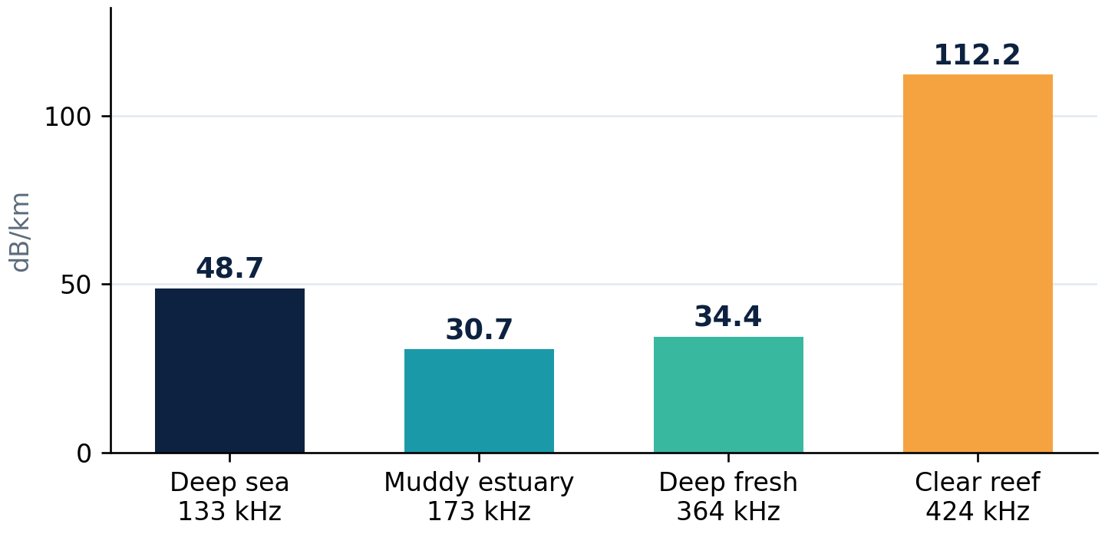
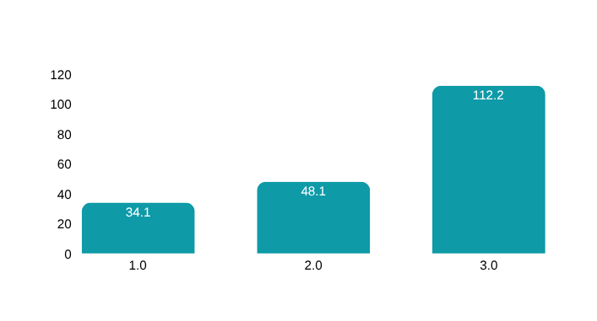
ADAPTIVE SD-SONAR TRANSMITTER
Proposed Solution
A battery-powered AUV payload pod that senses the water and reshapes every sonar ping in real time.
Sense
Adapt
Generate
Stream
Convert
Transmit
Depth, turbidity, temperature, salinity
FPGA picks f, B, T and power
LFM, geometric or Barker-13 + window
DDS + BRAM ROMs, 10 MS/s, pure RTL
R-2R DAC + NE5532 low-pass
Transducer (scope FFT on the bench)
1
Detailed explanation
How it addresses the problem
Innovation and uniqueness
2
3
  Physical payload: Artix-7 XC7A35T FPGA, R2R resistor-ladder DAC and NE5532 op-amp front end in a 3D-printed pod
  Senses: 4 pots read by the Artix-7’s built-in XADC, latched once per ping
  Decides: centre frequency (100–500 kHz), bandwidth, pulse length and power
  Transmits: DDS reads sine + window ROMs in BRAM and streams 10 MS/s to the R-2R DAC
Absorption at each scenario’s chosen frequency (dB/km, Francois–Garrison)
Physics-driven, not preset-driven: every ping comes from Francois–Garrison + Medwin models held in on-chip ROMs.
5×
94 %
tunable band, 100–500 kHz
less energy per ping on a clear reef
≈23 dB
−43.8 dB
pulse-compression gain (B·T ≈ 200, deep sea)
range sidelobes, Hann (−13.9 dB unwindowed)
≈19 dB more absorption (two-way, 150 m) at the reef’s 424 kHz than at 133 kHz, so the payload drops frequency when range matters.
0.89 cm
25
range resolution, 84 kHz reef sweep
5 modulations × 5 windows
2
Notes:
2

Slide 3
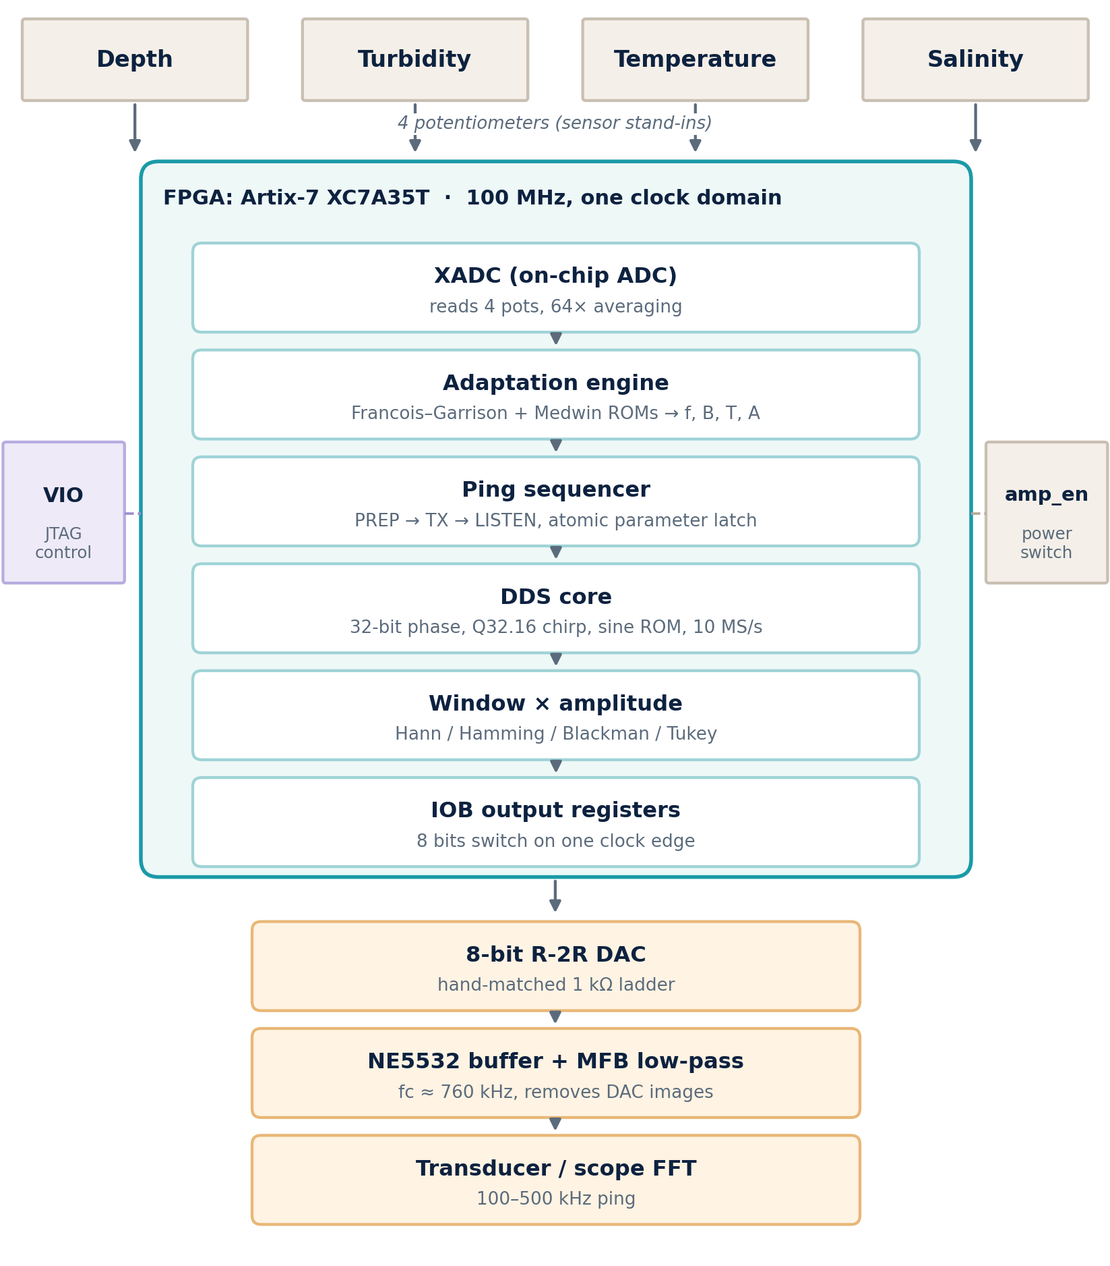
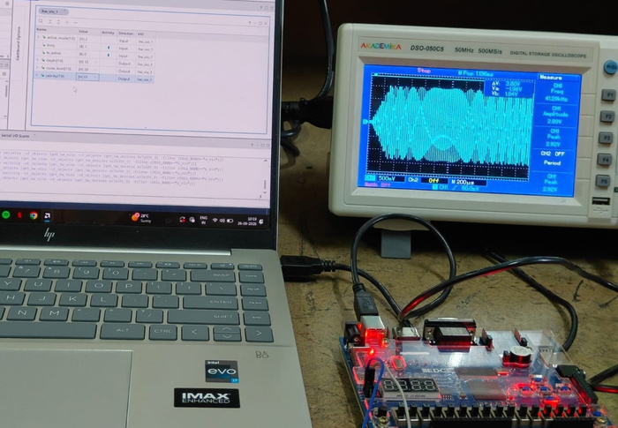
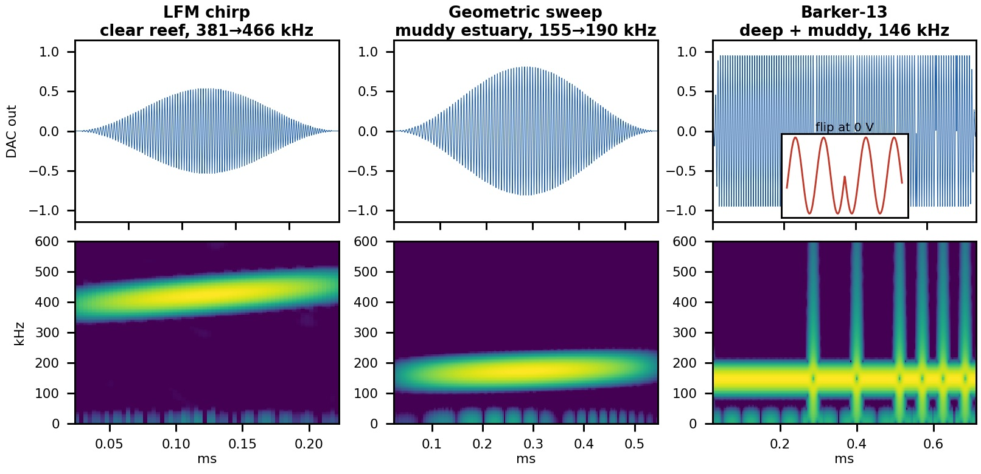
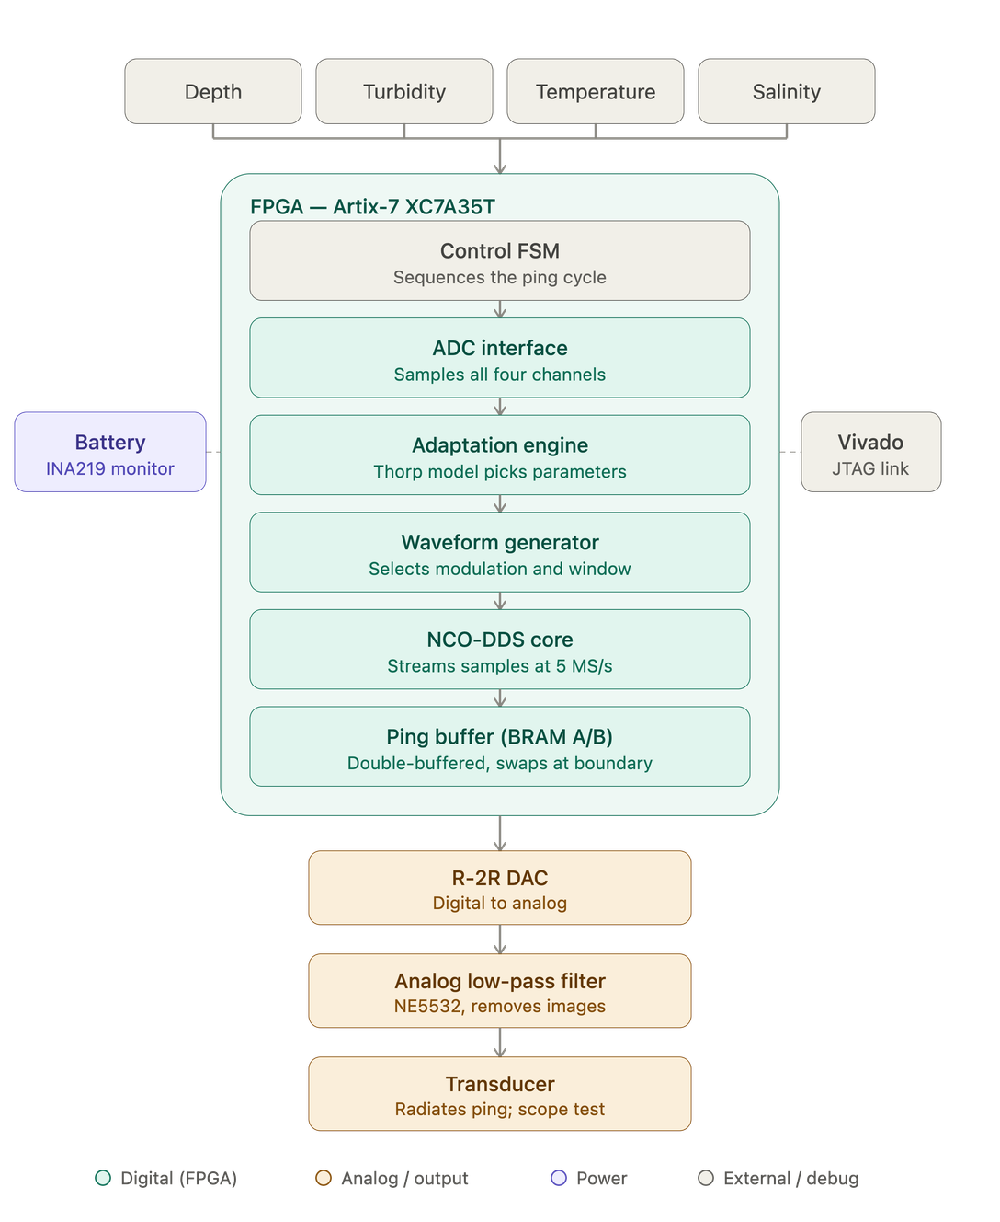
TECHNICAL APPROACH
Technologies to be used
−43.8
dB range sidelobes, Hann window
Hardware
Firmware
Artix-7 XC7A35T (EDGE), XADC + 4 pots, 8-bit R-2R DAC, NE5532 + MFB filter
Verilog RTL in Vivado: 32-bit DDS, Q32.16 chirps, BRAM ROMs, VIO
110
mW FPGA on-chip power (Vivado)
Signal processing
Modelling
LFM, geometric sweep, Barker-13; Hann, Hamming, Blackman, Tukey
Francois–Garrison absorption, Medwin sound speed, NE5532 filter model
2,538
LUTs (12.2 %); timing met at 100 MHz
Validation & build
XSIM testbench (159/159 pass), Python (NumPy, SciPy), scope FFT, 3D-printed pod
Working prototype evidence
MEASURED ON HARDWARE
DAC output on a 500 MS/s scope; inputs set live from Vivado VIO
Vivado RTL simulation of the DDS core: LFM, geometric and Barker-13 pulses with spectrograms
3
Notes:
3

Slide 4
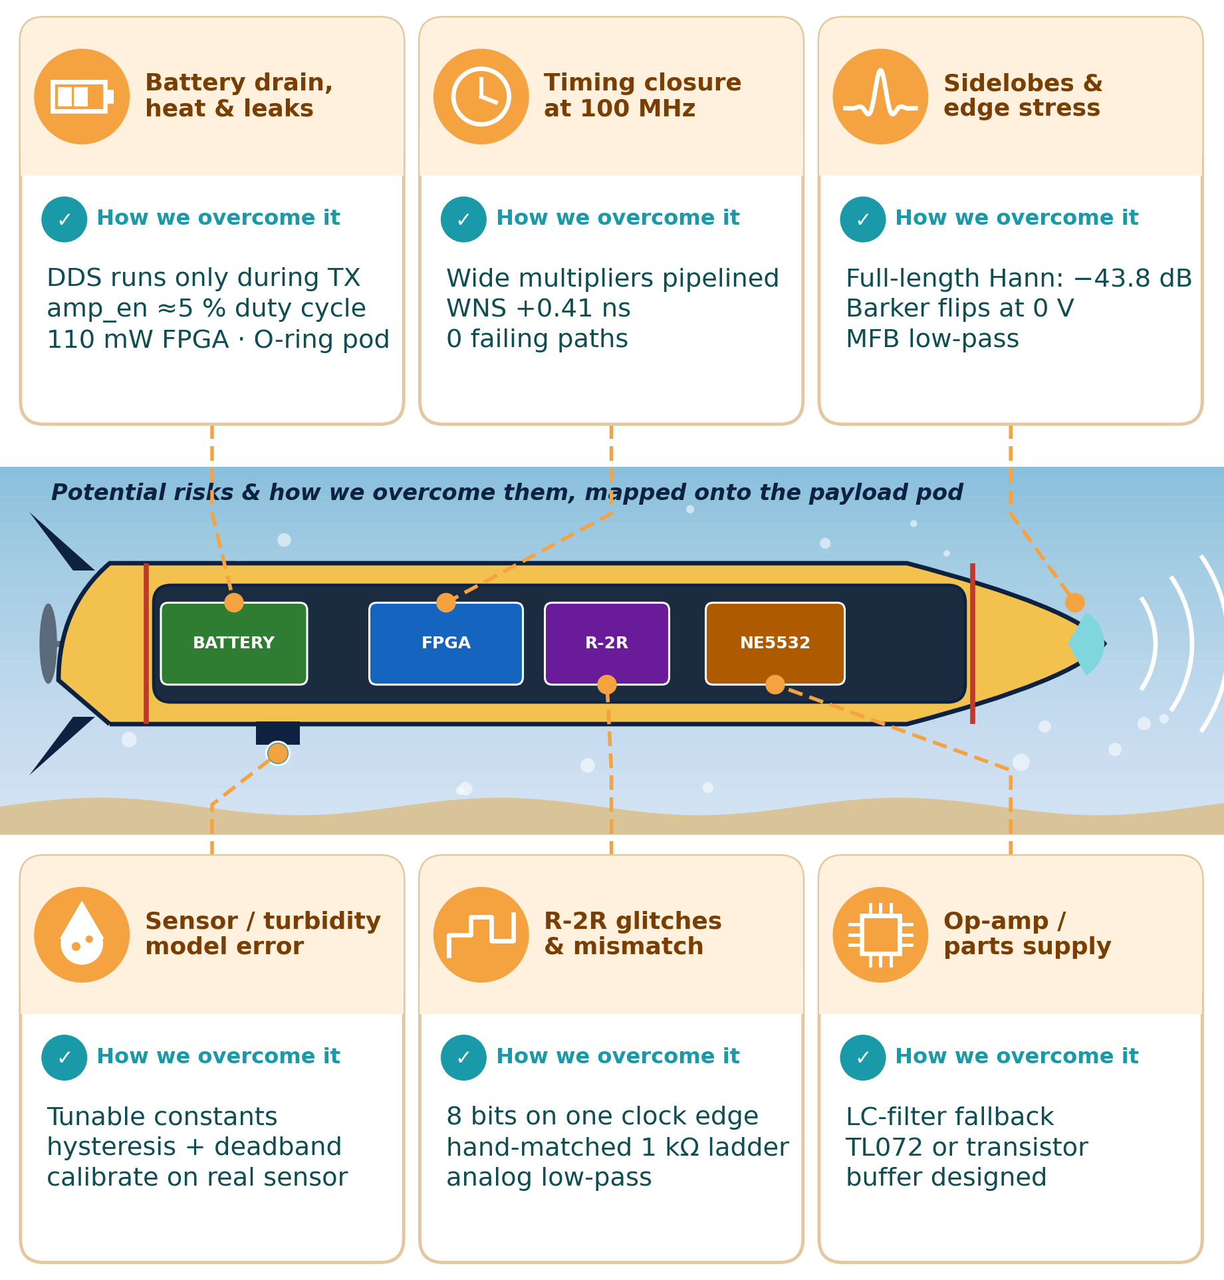
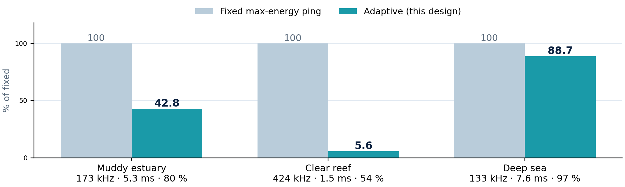
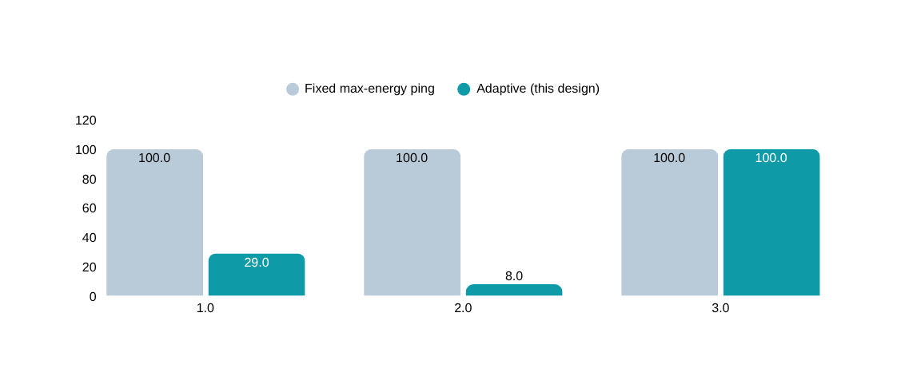
FEASIBILITY AND VIABILITY
Analysis of the feasibility of the idea
0
12.2 %
110
0.41
soft-core CPUs, pure RTL datapath
of XC7A35T LUTs used (2,538)
mW FPGA on-chip power (Vivado)
ns slack: timing met at 100 MHz
Adaptation results from the v3 RTL
Scenario | Frequency | Pulse | Amplitude
Muddy estuary | 173 kHz | 5.29 ms | 80 %
Clear shallow reef | 424 kHz | 1.55 ms | 54 %
Deep sea | 133 kHz | 7.56 ms | 97 %
Transmit energy per ping, adaptive vs a fixed max-energy ping (%)
Average saving across the three scenarios: 54 %. All parts are off-the-shelf; the prototype fits on a breadboard plus one EDGE Artix-7 board.
4
Notes:
4

Slide 5














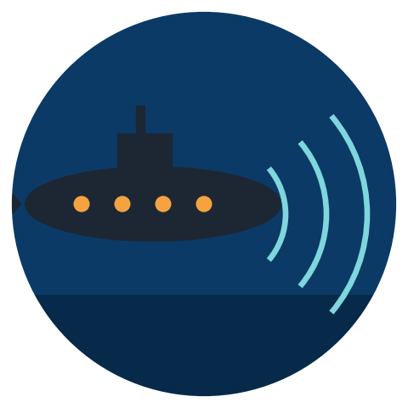

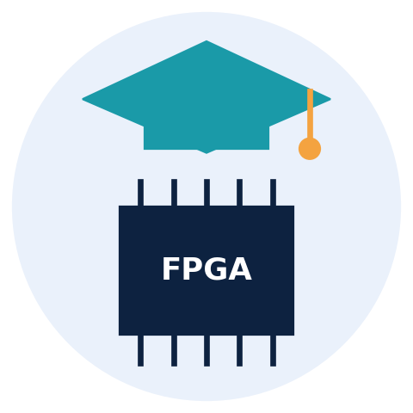
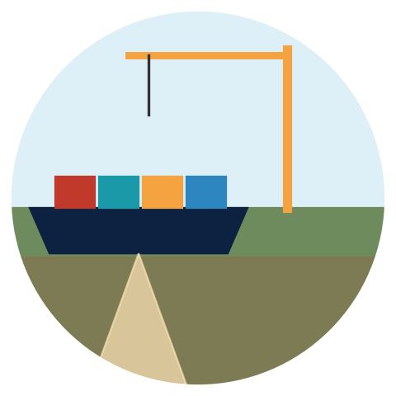

IMPACT AND BENEFITS
IMPACT AND BENEFITS
Potential impact on the target audience
Benefits of the solution (social, economic, environmental, etc.)
Economic
Social & strategic
One payload replaces several fixed-frequency sonars; more survey hours per battery charge.
Indigenous capability; faster, safer surveys for disaster response and search & rescue.
Navy & DRDO labs
Ocean research
Ports & hydrography
NPOL: mine-hunting, seabed survey
NIOT, NIO: coastal to deep sea
Muddy harbours, dredged channels
Environmental
Academic
Only the acoustic energy each ping needs: less noise for marine life, less battery waste.
Open reference design for teaching DSP, embedded systems and ocean acoustics.
Fisheries & environment
Startups & academia
Reef, habitat, pipeline checks
Open, indigenous reference design
Absorption rises steeply with frequency
Chirp pulse compression
Range resolution is c / 2B, independent of pulse length: long pulses give energy, wide sweeps give detail [5, 6].
94 %
Fixed max-energy ping: 100 %
So high-frequency pings fail in murky or long-range water [1, 2].
R = c / 2B
Windowing matters
Adaptive ping, clear reef: 5.6 %
38 → 130 dB/km, 101 → 495 kHz
Hann and Blackman windows cut sidelobes and edge transients [4].
less transmitted energy per ping on a clear reef
−13.9 → −43.8 dB sidelobes
Energy ∝ amplitude² × pulse length: 0.54² × 1.55 ms vs 1.0² × 8 ms. Averaged over the three test scenarios: 54 % lower.
5
Notes:
5

Slide 6
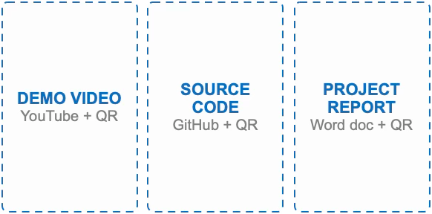
RESEARCH AND REFERENCES
References
[1] W. H. Thorp, “Analytic description of the low-frequency attenuation coefficient,” J. Acoust. Soc. Am., vol. 42, p. 270, 1967.
[2] R. E. Francois & G. R. Garrison, “Sound absorption based on ocean measurements, Part II,” J. Acoust. Soc. Am., vol. 72, pp. 1879–1890, 1982.
[3] H. Medwin, “Speed of sound in water: a simple equation for realistic parameters,” J. Acoust. Soc. Am., vol. 58, pp. 1318–1319, 1975.
[4] F. J. Harris, “On the use of windows for harmonic analysis with the discrete Fourier transform,” Proc. IEEE, vol. 66, no. 1, pp. 51–83, 1978.
[5] X. Lurton, An Introduction to Underwater Acoustics: Principles and Applications, 2nd ed., Springer, 2010.
[6] M. A. Richards, Fundamentals of Radar Signal Processing, 2nd ed., McGraw-Hill, 2014.
[7] R. H. Barker, “Group synchronizing of binary digital systems,” in Communication Theory, Butterworths, 1953.
[8] Xilinx (AMD), Artix-7 FPGAs Data Sheet (DS181) — xilinx.com
[9] Texas Instruments, NE5532 dual op-amp datasheet — ti.com
[10] Invent Logics, EDGE Artix-7 FPGA board manual — allaboutfpga.com
[11] Team prototype: Verilog RTL (v3), 159-check XSIM testbench, R-2R DAC and Python validation scripts built for this submission.
6
Notes:
6

