Slide 1
STATE OF THE ART
REVIEW

Slide 2
Predicting The Dutch Football Competition Using Public Data: A Machine Learning Approach (2015)
Niek Tax and Yme Joustra
APPROACH:
  Categorical prediction (W-D-L)
  Not Cross-Validation
    2000-2007 training
    2007-2013 evaluation (adding prev matches to training)
  McNemar’s test (0,05 significance level): test wether the model outperforms or not
  Statistical differences between leagues
    Home Advantage or manage hiring
    that’s why only Dutch league
DIM RED:
  PCA, Squential Forward Selection, ReliefF
DATA RETRIEVAL:
  Odds: https://www.football-data.co.uk/
  Coach info: https://www.transfermarkt.es/
  Distance between teams: Google Maps
  Missing players:
    Past info: https://www.elfvoetbal.nl/
    Current match: https://www.fcupdate.nl/

Slide 3
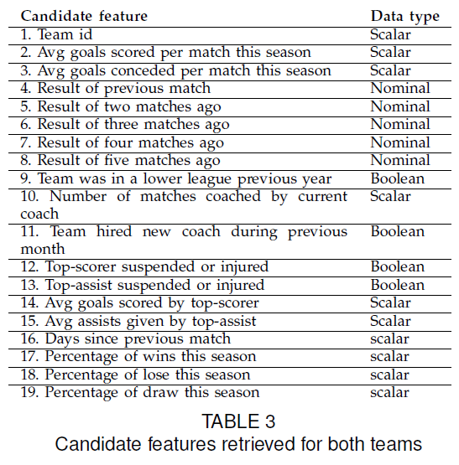
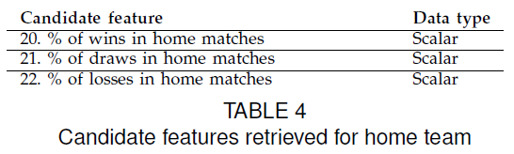
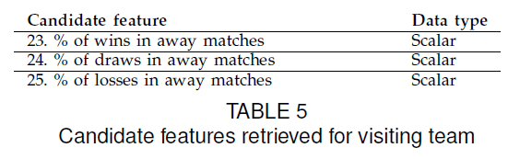
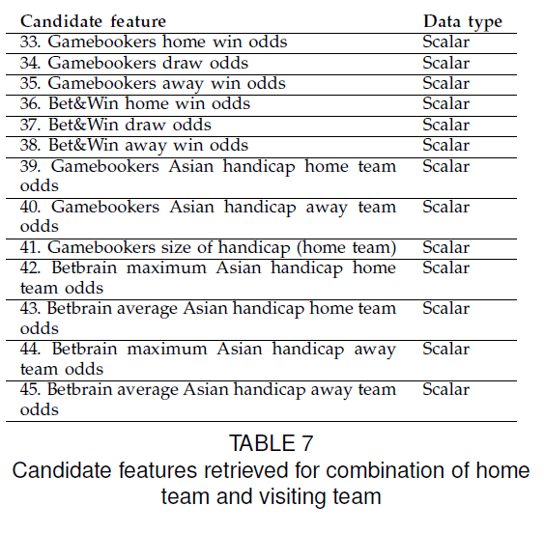
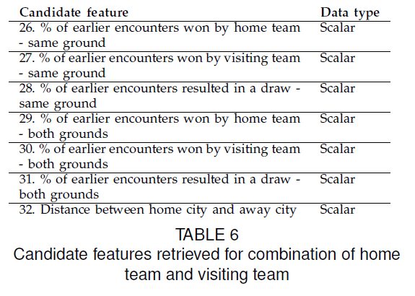
Predicting The Dutch Football Competition Using Public Data: A Machine Learning Approach (2015)
DATA

Slide 4
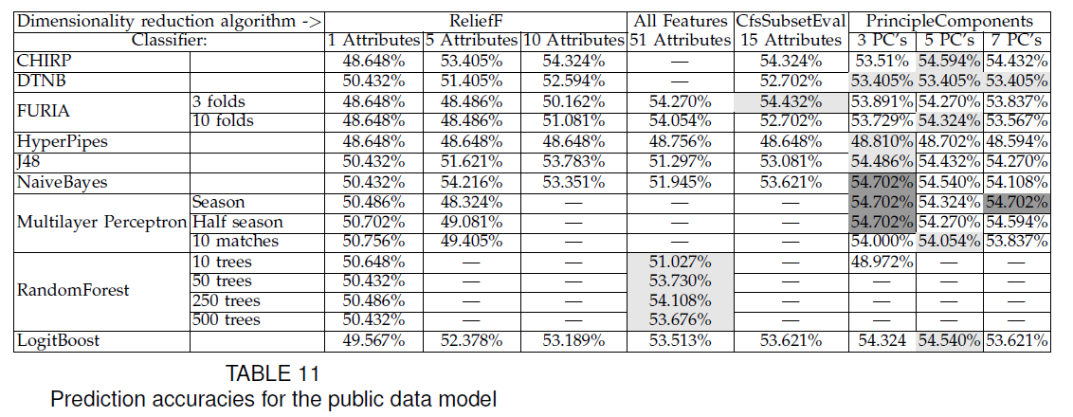
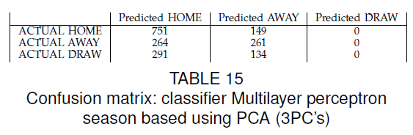
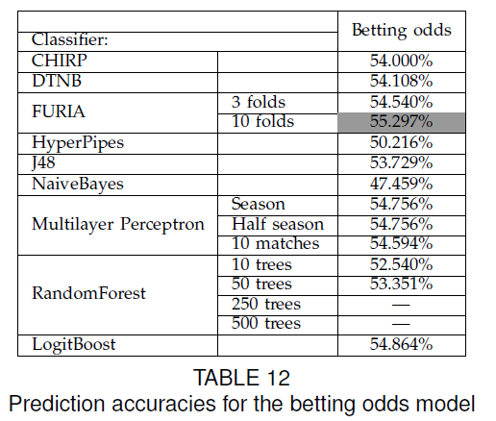
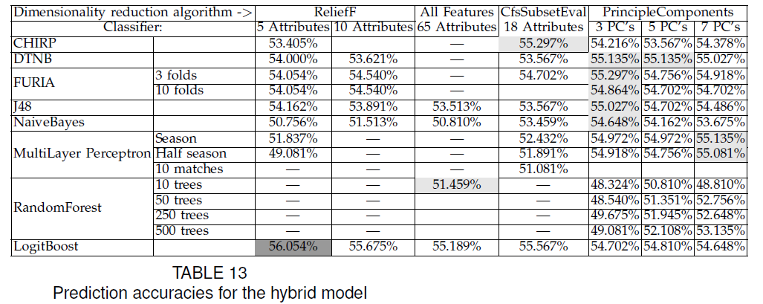
Predicting The Dutch Football Competition Using Public Data: A Machine Learning Approach (2015)
The training process of the Multilayer
Perceptron takes a lot of time for each match,
therefore we have retrained to classifier once per
season, once per half season and per 10 matches
RESULTS PUBLIC DATA MODEL
McNemar’s test: No statistically difference between the performance of the public data model and the betting one.

Slide 5
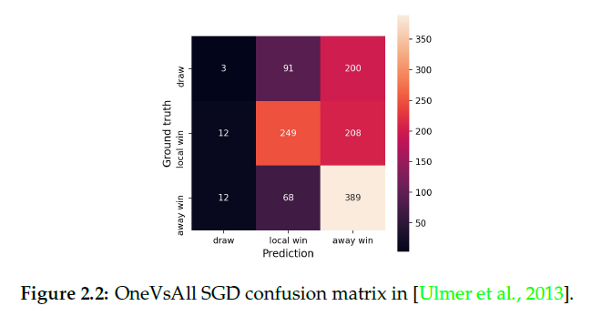
Predicting Soccer Match Results in the English
Premier League (2013)
Ben Ulmer & Matthew Fernandez
APPROACH:
  Under-predicted draws:
    Attempted to weight draws
    Detrimental accuracy in general accuracy
  One-vs-All Stochastic Gradient Descend
DATA:
  10 seasons Premier League:
    Training: 2002-2012 (3800 games)
    Test: 2012-2013 & 2013-2014 (760 games)
  Steaks: ignoring first n games of the season.
    n = 4 and 7
  Features:
    Team id, score, winner, goals.

Slide 6
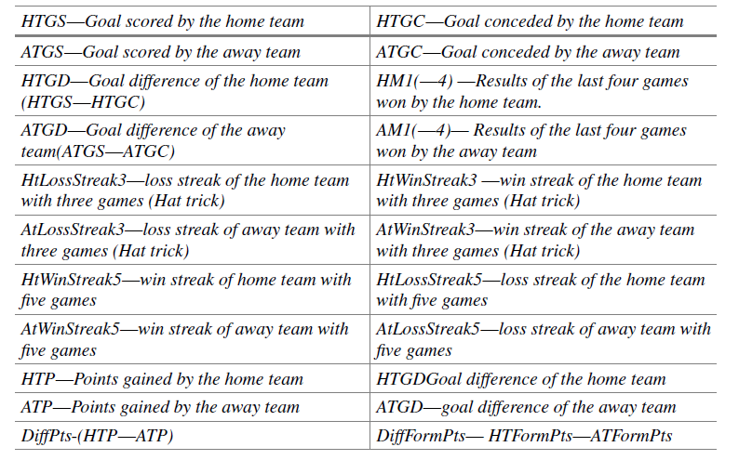
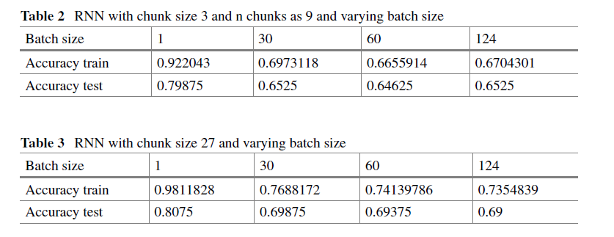
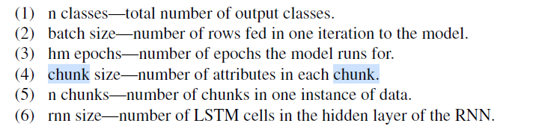
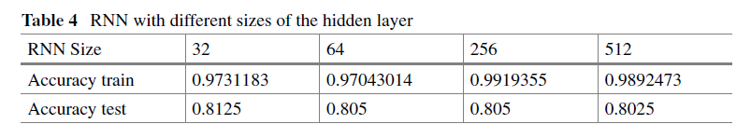
Soccer result prediction using deep learning and neural networks. (2021)
Sarika Jain, Ekansh Tiwari and Prasanjit Sardar
APPROACH:
  RNN LSTMs
  2 classes prediction (80%)
DATA:
  https://www.football-data.co.uk/
  8 seasons Premier League (2010-2018)
  Features calculated by summing over the attributes through all the rows.
  Streaks computed with One hot encoding

Slide 7


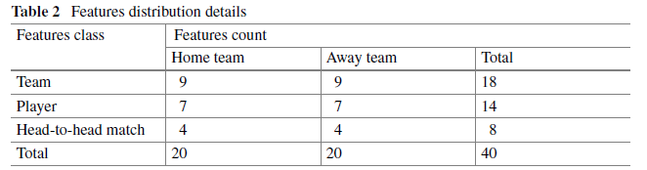
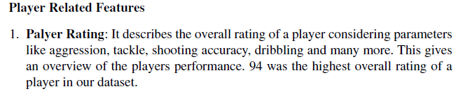
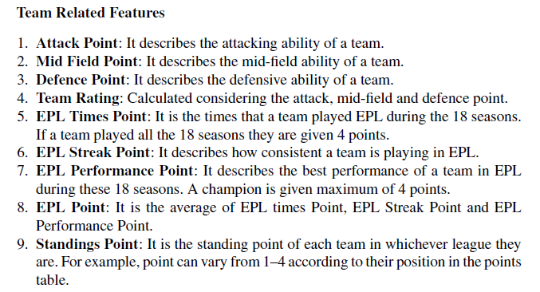
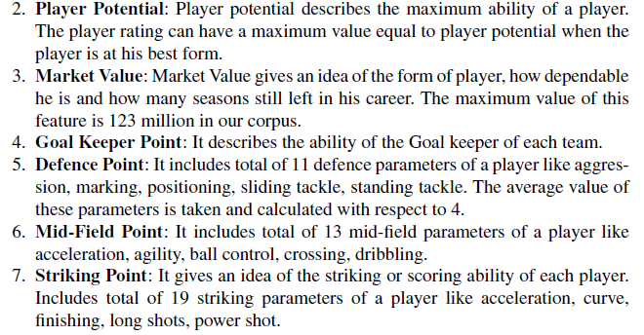
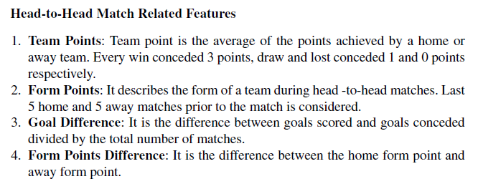
A deep learning approach to predict football match result (2020)
Sarika Jain, Ekansh Tiwari and Prasanjit Sardar
APPROACH:
  MLP w/ 2 classes prediction (73.6%)
  Mention Ulmer and Joustra works
DATA:
  16 seasons Premier League (2000-2016)

Slide 8
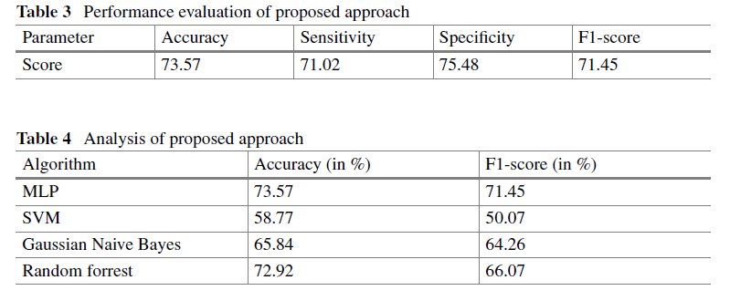
A deep learning approach to predict football match result (2020)
RESULTS:
  MLP 10 hidden states
  70% training - 30% test
ERROR ANALYSIS
  Only features for the starting lineup (11 players)
  Missing features (stadium attendance, referee, weather…)

Slide 9
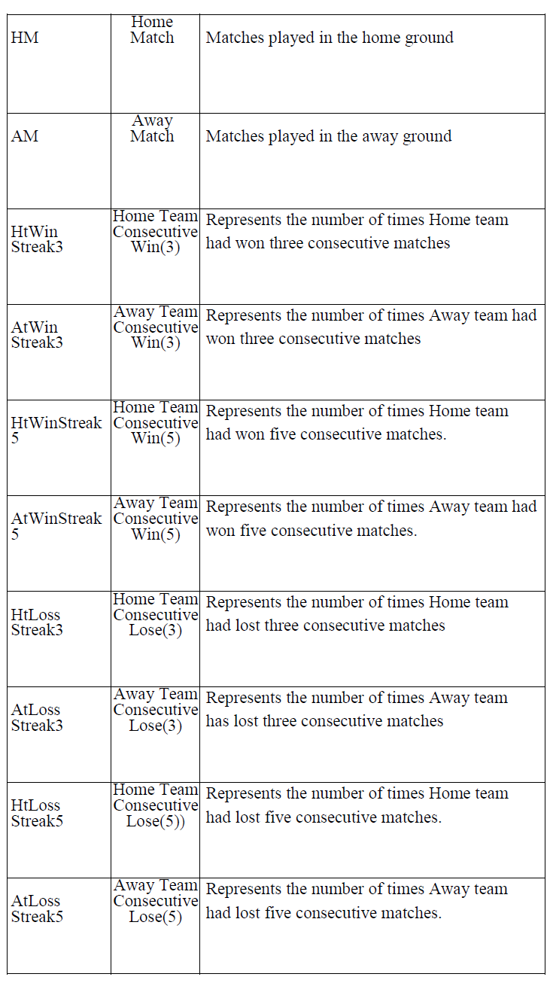
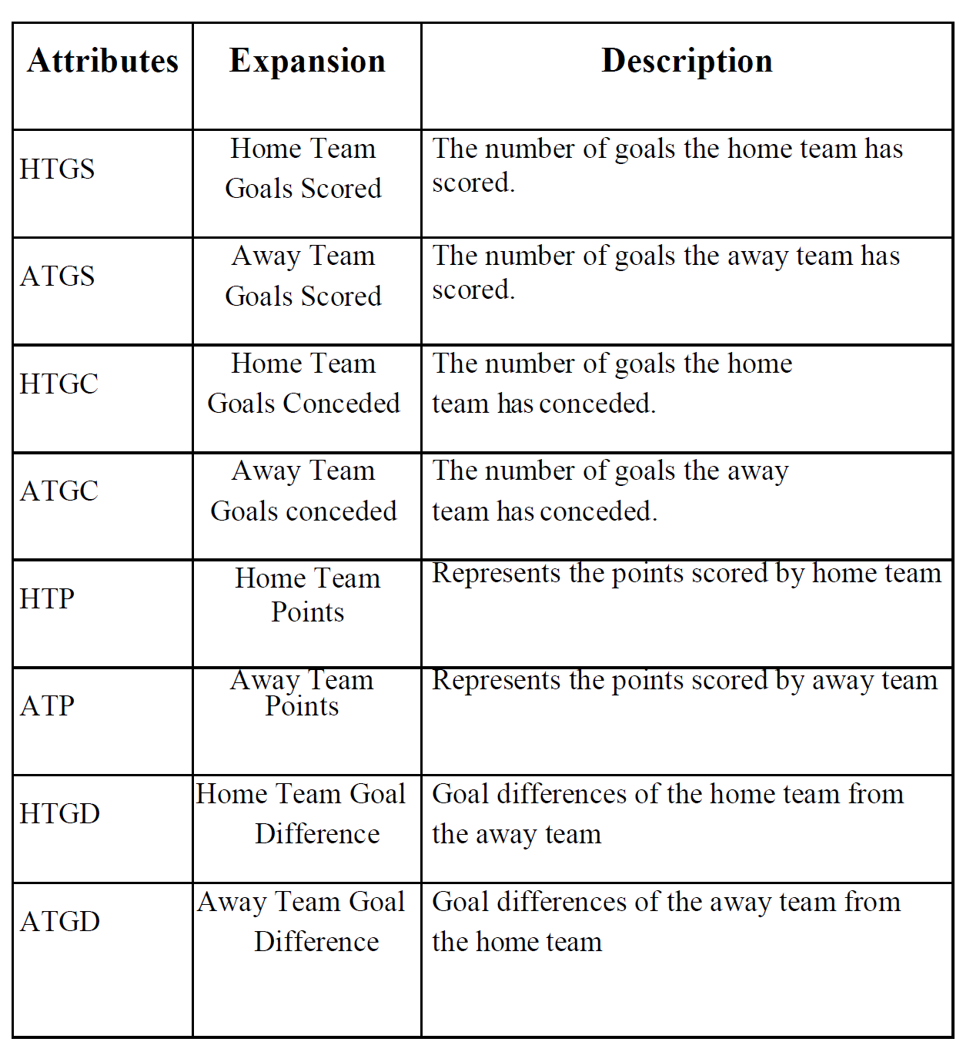
A Deep Learning Framework for Football Match Prediction (2022)
S.K. Nivetha; M. Geetha; R.C. Suganthe; R Manoj Prabakaran; S Madhuvanan; A Mohamed Sameer
APPROACH:
  LSTM with Batch Normalization
  One-vs-All Stochastic Gradient Descend
DATA:
  https://www.football-data.co.uk/
  Premier League (2009-2015)
    380 matches each season
  5 partidos anteriores (racha)
  Atributos como:
    Si ha tenido el equipo una racha de 3 o 5 partidos seguidos ganando.

Slide 10
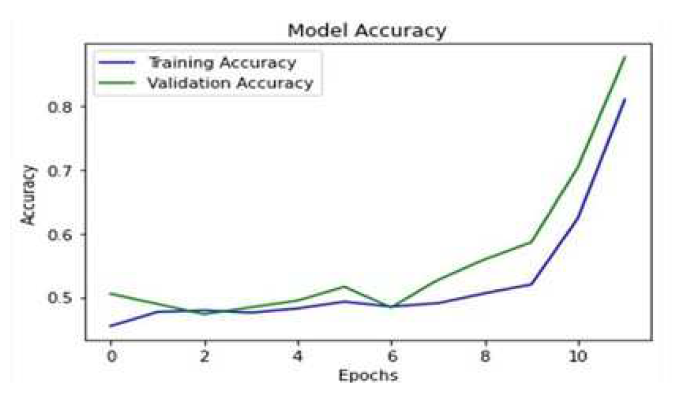
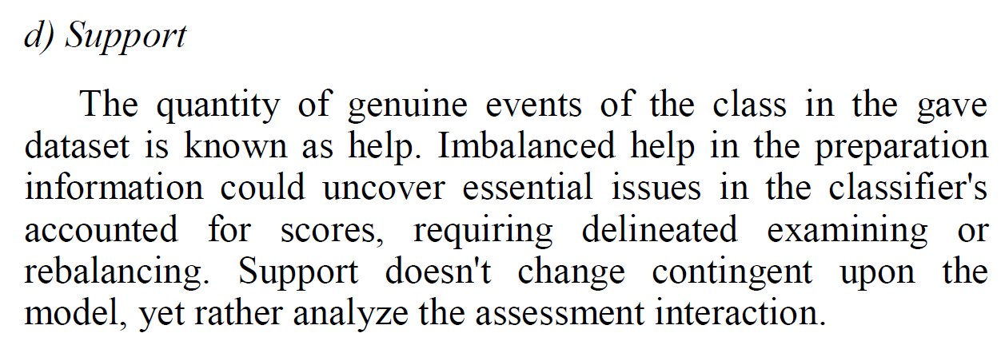
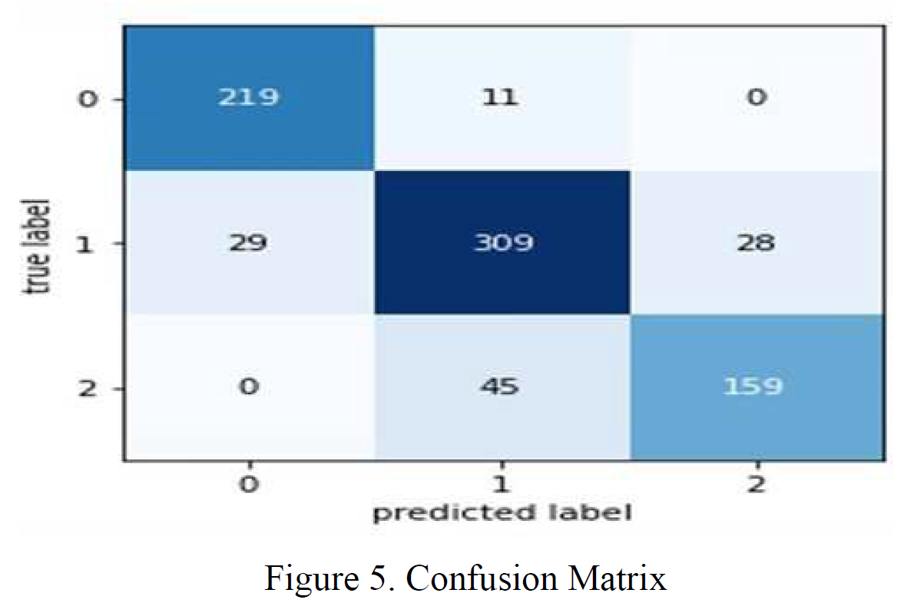
A Deep Learning Framework for Football Match Prediction (2022)
EVALUATION:
  Confusion matrix
  Precision-Recall-F1 score
  Support
  Macro average & weighted average
    Based on the proportion of labels in the dataset.
RESULTS:
  Win (0), Loss (1), Draw (2)

Slide 11
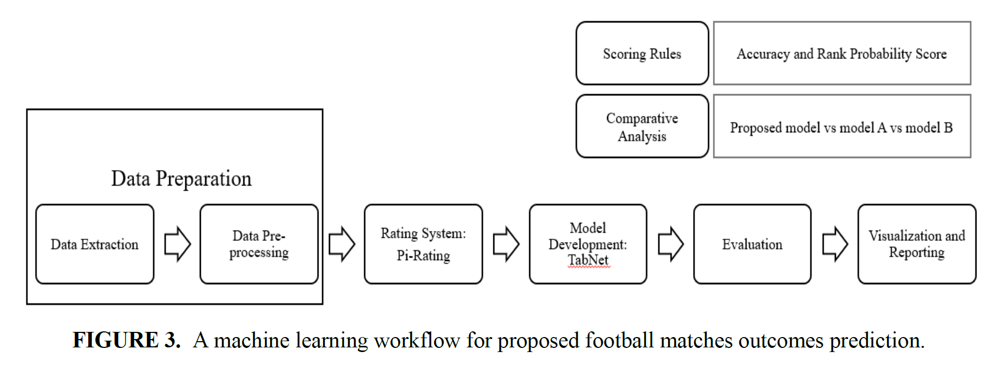
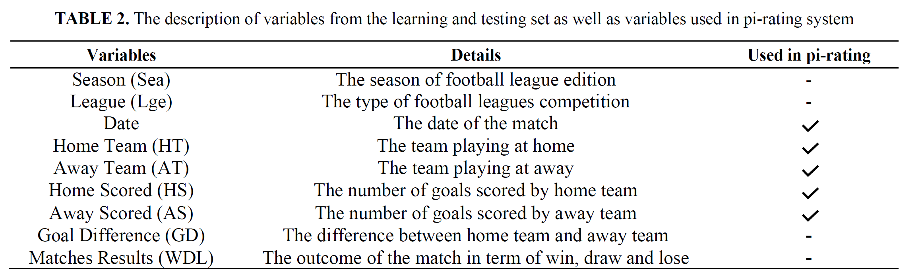
Deep learning for football outcomes prediction based on football rating system (2022)
APPROACH:
  Accuracy 55,82%
  Prediction of Win-Draw-Loss.
  Pi-rating system: usado por los dos primeros clasificados en el 2017 Soccer Prediction Challenge.
  TabNet: extension of DNN that has the advantage in data mining to learn tabular data.
DATA:
  216,743 matches
  17 seasons (2001-2018)
  35 countries
  206 matches for testing from 52 football leagues.
    Features: season, league, data, home and away team, scored, goal difference and matches result (W-D-L)
  RAW dataset transformed into pi-rating (home and away)

Slide 12
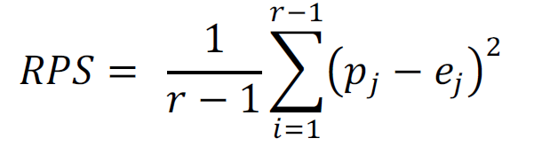
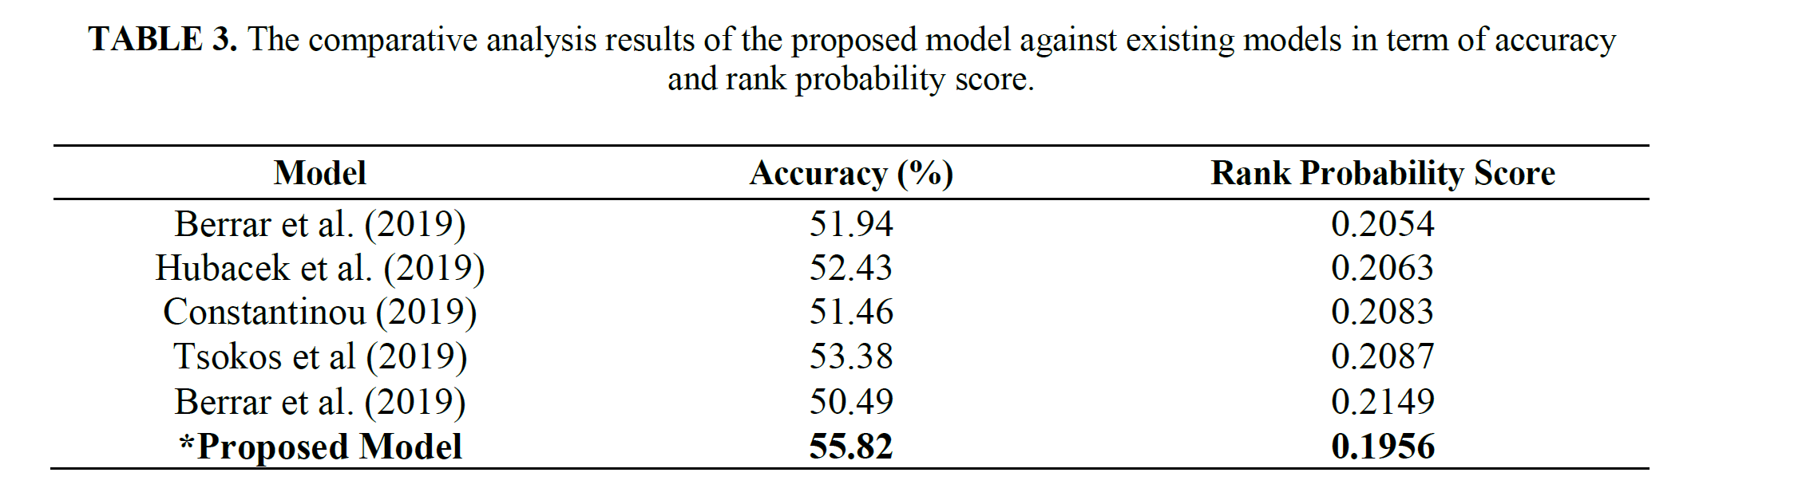
Deep learning for football outcomes prediction based on football rating system (2022)
EVALUATION:
  Accuracy
  Rank Probabiliy Scores (RPS)
    where r is the number of potential outcomes, 𝑝B is the forecasted probability of outcome j and 𝑝𝑒B is the actual probability of outcome j. The smaller value of score indicates better forecasts accuracy

Slide 13
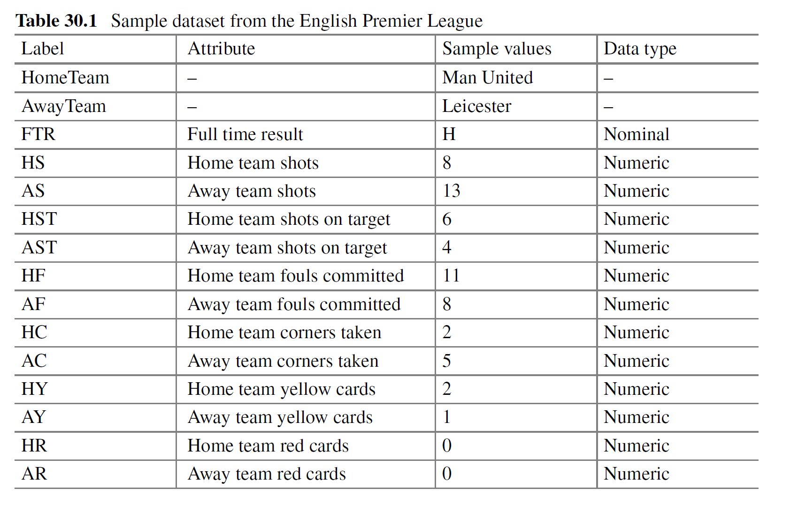
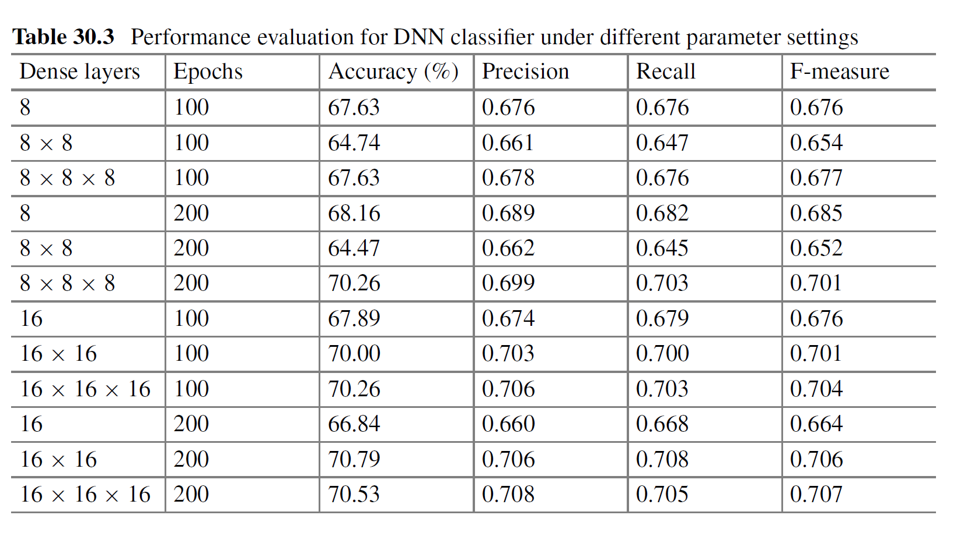
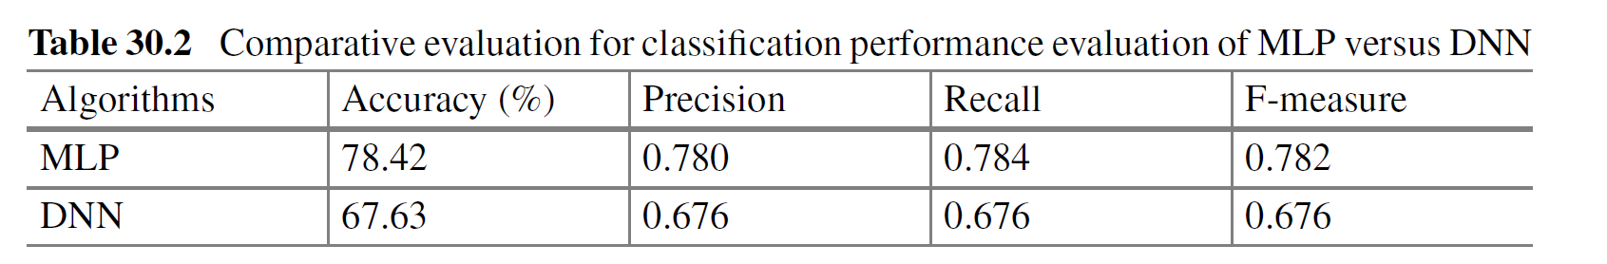
Deep Learning Approach for Football Match Classification of English Premier League (EPL) Based on Full-Time Results (2022)
APPROACH:
  Prediction of Win-Draw-Loss.
  Use of WEKA for MLP and DNN (WekaDeeplearning4j package)
    Basic experiment: single 8-node layer.
    16-node dense layers
  10 fold CV
DATA:
  https://www.football-data.co.uk/
  Premier League 2018-2019
    380 matches 62 attributes

Slide 14
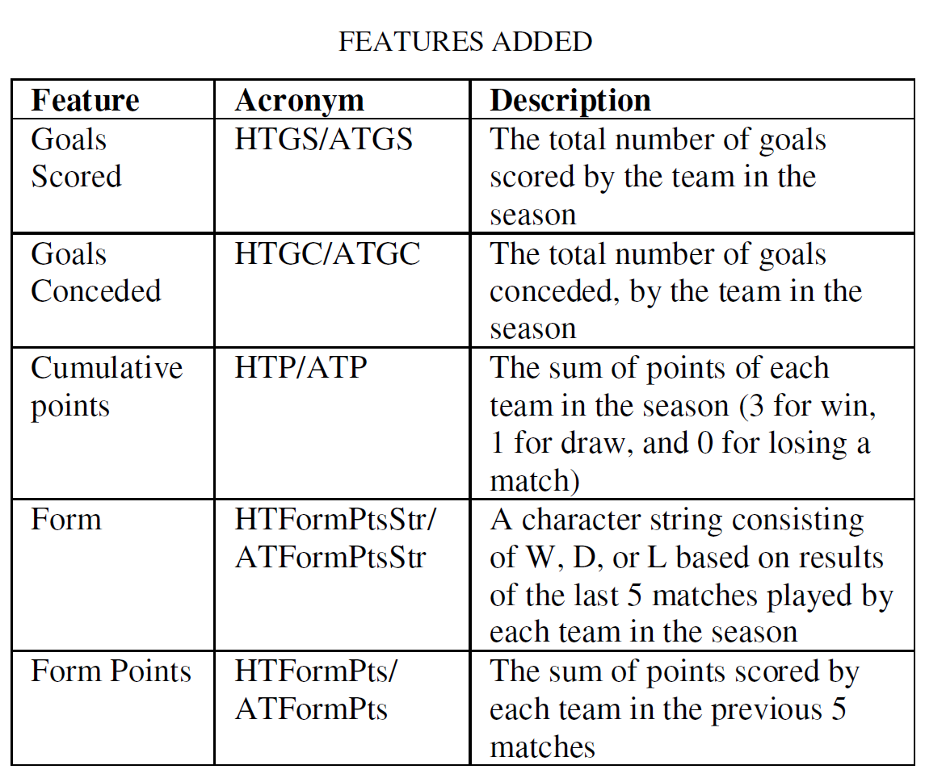
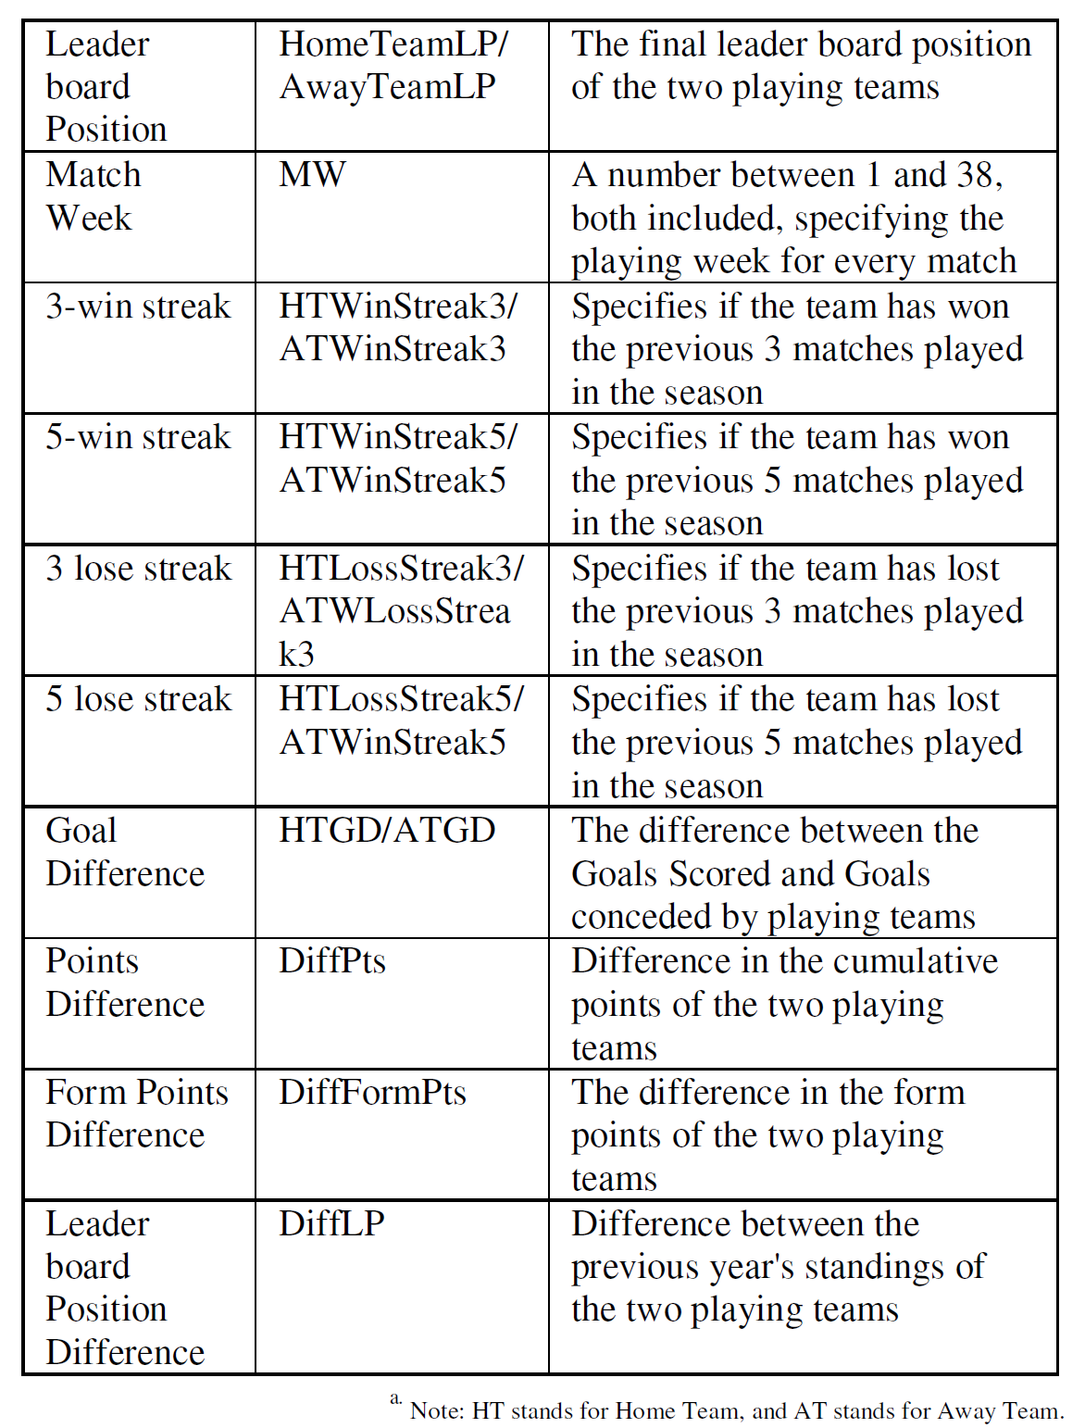
Machine Learning for Football Matches and Tournaments (2022)
APPROACH:
  Prediction of Win-Draw-Loss at half time (and the score at that time).
  Ensemble techniques
  Using historical and current performance of club and players
  Based on their previous work: “Full Time Result Prediction using Ensemble Techniques”.
    Added: independent features such as the form, form points, etc. and considered goals scored and conceded by teams in the current season.
  Train-test split in sequential order (time order)
DATA:
  https://www.football-data.co.uk/
  Premier League 2005-2020
    Training: 6060 matches 45 attributes
    Last 20 matches 2020-21 as validation
    Ongoing 2021-2022 season as test.
  Filtran los primeros partidos (contribución insignificante)
  Streaks: last 5 games (n depending on accuracy)
  Scale features according to their match week (to avoid bias, as some features increase linearly as the season goes on)

Slide 15
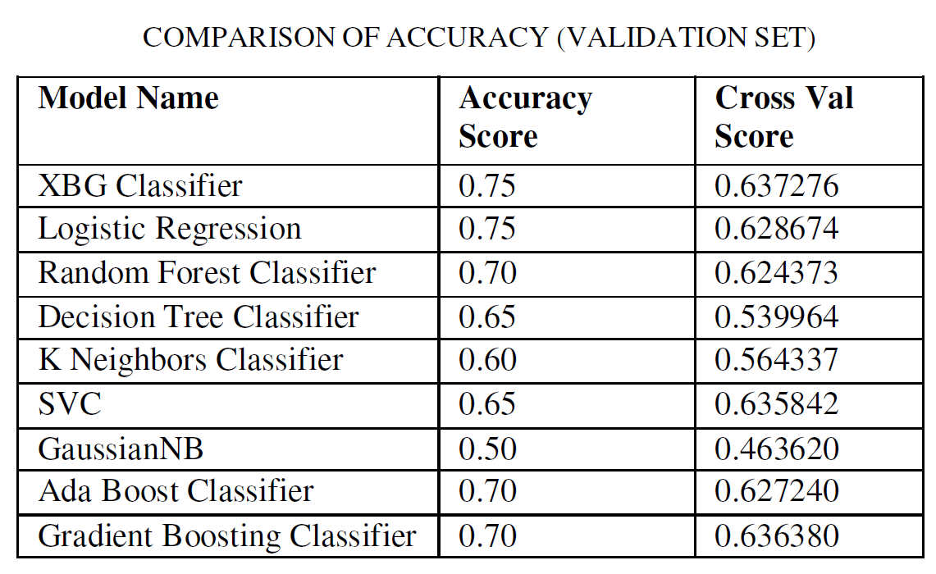
Machine Learning for Football Matches and Tournaments (2022)
RESULTS:
  Ensemble: Combining top 3 algorithms: Voting classifier (accuracy 80% on validation set)

Slide 16
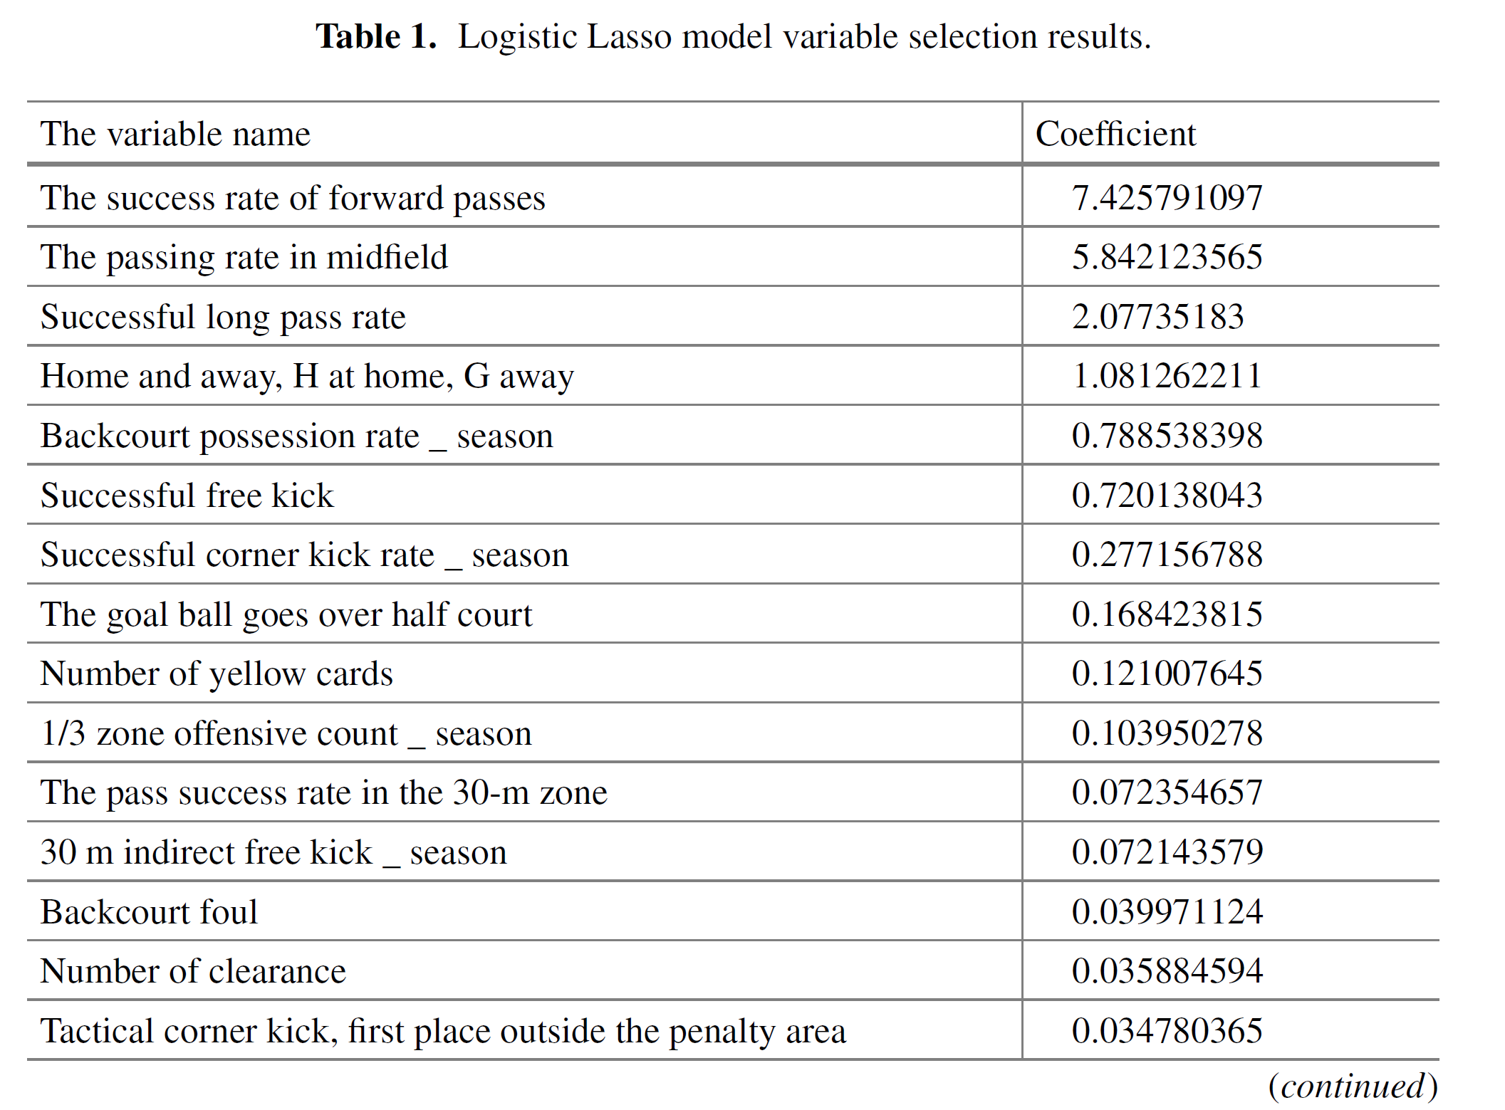
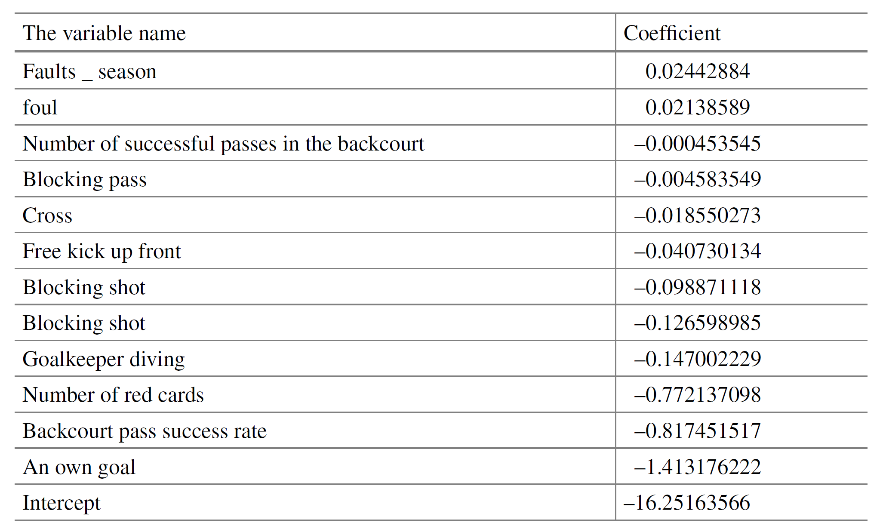
Prediction of Game Result in Chinese Football
Super League (2022)
APPROACH:
  SVM and LSTM
  Cross-validation
  Train 70% test 30%
DATA:
  Source data:
    by Champion Technology
    Player data: 26,288 simples w/ 101 variables
    Match data: 1,920 simples and 175 variables
  1920 matches of CSL (2014-2017)
    Each team plays 30 games per year
    64 features
DIM RED:
  Factor analysis: kind of PCA
  Logistic Lasso to fit the training data and select variables
    Selection of 64 variables according to the following dimensions: passing, set piece, attack, confrontation, defense, error and foul…
    Also from the 64 variables, new variables are created: average of each team in the season
    Standarization for continuous variables

Slide 17
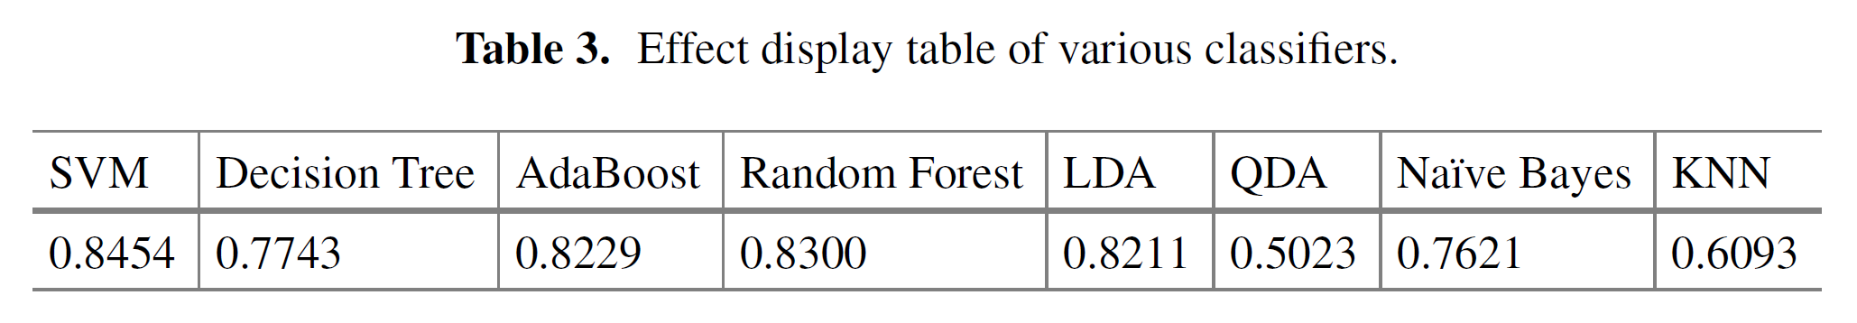
Prediction of Game Result in Chinese Football
Super League (2022)
RESULTS
  df

Slide 18
Football Match Result Prediction Using Neural Networks and Deep Learning (2020)
Ekansh Tiwari; Prasanjit Sardar; Sarika Jain
APPROACH:
  LSTM
DATA:
  https://www.football-data.co.uk/
  Premier League 2010-2018
    380 matches 62 attributes
  Features calculated by summing over the attributes through all the rows.
  Winning streaks: 5 or 3 wins in a row

Slide 19
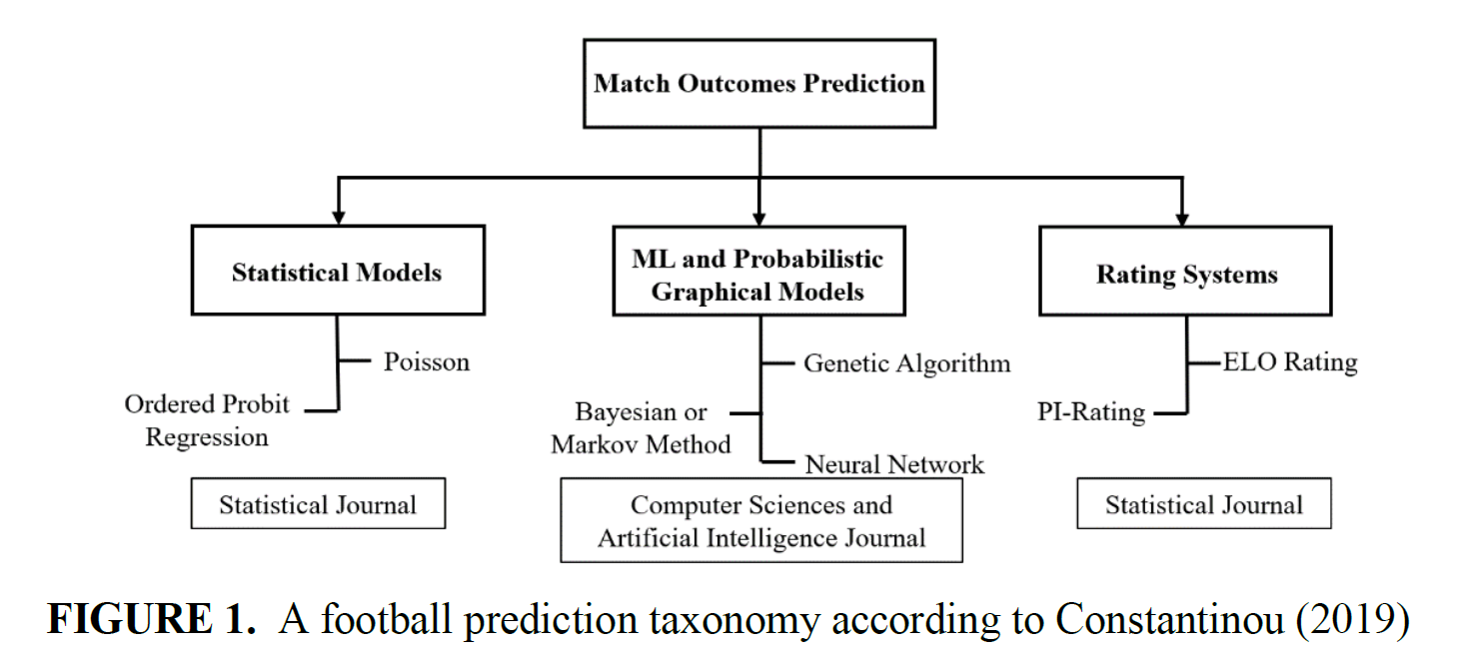
CONCLUSIONES
¿Podemos replicar estos experimentos?
  Algunos vienen de fuentes muy diferentes.
  Algunos modelos se salen del scope: LSTM
  Podemos aplicar dichos modelos a nuestros datos o aplicar nuestro modelo a los datos de dichos experimentos.
    En vez de replicar los datos de manera exacta, podemos coger los mismos partidos y realizar experimentos con nuestro modelo y evaluar ambos experimentos.

