Slide 1
Genetic Network Programming (GNP)-SARSA Algorithm to Trade US Equity Options
Pranav Rupireddy

Slide 2
Background

Slide 3
Project Motivation
Options Trading (Right to Buy/Sell) can be Profitable and be algorithmically-approached
However, I noticed that of the reinforcement algorithms used for options, it appeared as if SARSA was not really used [1, 9]

Slide 4
Choice of Algorithm/Why GNP-SARSA?
Decided to pursue GNP-SARSA because
1) SARSA-based algorithm
2) Works well for volatile options environment [1,2]
3) Extended version considered a seminal work in Reinforcement Learning for financial markets [3]

Slide 5
What is GNP-SARSA?
GNP = 1) GNP + 2) SARSA
1) GNP = Genetic Algorithm (Evolution) with each individual as a network with judgement and processing nodes
2) SARSA = RL Algorithm
History of GNP (+ RL/SARSA)
- Mainly one group from Japan (Professor Hirasawa)
- Multiple renditions of GNP (+ RL/SARSA) for financial trading, but also for Tileworld, and even elevator control [2,4,5,6,7,8]

Slide 6
GNP-SARSA Intuition [7]
GNP’s separate nodes allows for separate judging and processing
GNP’s Reusability has effects of
1) Memory
2) Compact Solution
3) Suitability for Dynamic Environments
GNP-SARSA:
1) Off-Policy and On-Policy
2) Exploration (Evading Local Minima) and Intensification

Slide 7
Objective
Project Goal: I am planning to use a GNP-SARSA reinforcement learning model to trade options on US equities.

Slide 8
Methods [2 *unless noted otherwise]

Slide 9
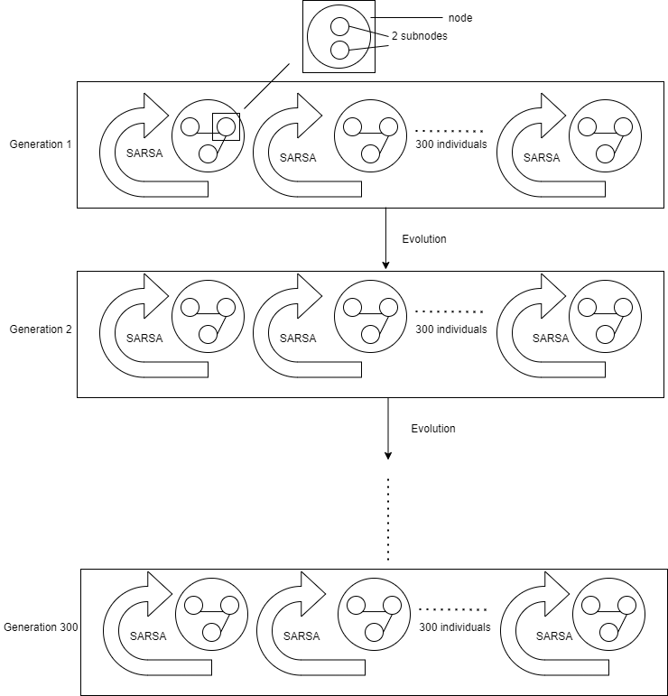
GNP-SARSA Overview

Slide 10

GNP-SARSA: More Overview + Traversal
Each individual is composed of 30 nodes
Two types of nodes: judgement node (20) and processing node (10)
Each node consists of subnodes of the same type
Node = state, Subnode = action
Traversal
Initial State (Node) kicked off with start node
Subnode chosen with epsilon-greedy strategy (node-subnode defines state-action pair)
Buy/Sell potentially if this is a processing subnode
Move to next node
Go back to #2 if you aren’t out of training data (and apply SARSA update potentially)

Slide 11
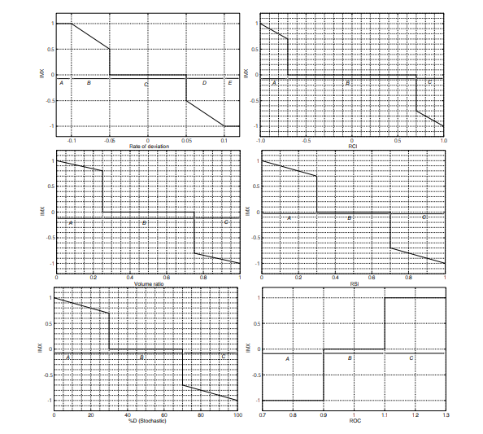
GNP-SARSA: Judgement (Sub)Node
Append IMX to IMX Values (Individual
Variable)
3 Variants x
Subnode
1 of 20 types
Select Next Node (3-5 choices)
MACD, Dead Cross/Golden Cross
Time Step
*Omitted Candlestick

Slide 12
Judgement (Sub)Node Representation (My Code)
[ <subnode1’s function>, <node1>, <node2>, <node3>, <node4>, <node5>,
<subnode2’s function>, <node1’>, <node2’>, <node3’>, <node4’>, <node5’>]
-node values are between 0 and 29 (30 total nodes)

Slide 13
GNP-SARSA: Processing (Sub)Node
If Average IMX >= Subnode’s Threshold and no Asset on hand
Type A (Buy):
Buy
Average IMX Value
Move to next node (only 1 option)
Subnode
[1,0,0,1]
Do Nothing
Otherwise
If Average IMX <= Subnode’s Threshold and Asset on hand
Type B (Sell):
Sell
Move to next node (only 1 option)
Average IMX Value
Subnode
[1,0,0,1]
Do Nothing
Otherwise

Slide 14
Processing (Sub)Node Representation (My Code)
[ <buy or sell>, <threshold (float between 0 and 1)>, <Q-Value>, <next_node>, 0, 0, <repeat for next subnode>]
Buy = 21
Sell = 22

Slide 15
Individual Representation
[ <subnode1’s function>, <node1>, <node2>, <node3>, <node4>, <node5>, <subnode2’s function>, <node1’>, <node2’>, <node3’>, <node4’>, <node5’>]
[ <subnode1’s function>, <node1>, <node2>, <node3>, <node4>, <node5>, <subnode2’s function>, <node1’>, <node2’>, <node3’>, <node4’>, <node5’>]
.
.
.
.
[ <buy or sell>, <threshold>, <Q-Value>, <next_node>, 0, 0, <buy or sell>, <threshold>, <Q-Value>, <next_node>, 0, 0,]
.
.
20 J
10 P

Slide 16
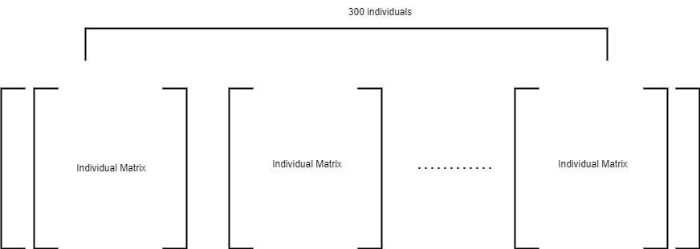
Full Generation Representation

Slide 17

GNP-SARSA: Evolution
*Tournament Select = Top Performing Individual
from a random subset (30 in my case)
300 individuals of next generation
60 (x2)
1 (x 1)
M
Crossover:
Tournament Select 2 individuals
Swap corresponding genes with probability .1
179 (x1)
Most fit individual from previous generation
M
Mutation:
1) Tournament Select an Individual
2) Modify every entry (outside of Q-values) with probability .02

Slide 18
Data
S&P 500 ETF (SPY)
S&P 500 is the largest 500 US companies (US equity)
ETF is just a basket that tracks an index
Train:
*2019-12-05 – 2022-11-07 (737 days)
Test:
*2022-11-08 – 2023-10-31 (246 days)

Slide 19
Results

Slide 20
Training

Slide 21
Testing
- Use Top Performer from Last Generation
- On an initial cash investment of 5 million dollars,
Buy and Hold makes 473,822
GNP-SARSA makes *618,402 (+2.89%)

Slide 22
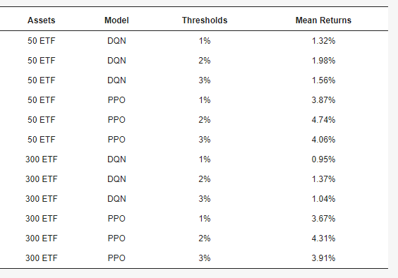
What about options?
Because ETF asset is similar to ETF option [9], we have actually trained an options trading algorithm!
Evaluation:
Cannot directly verify (relative) performance because options historical data is pricey
However, we can estimate it when we look at RL options trading algos on ETF test data [9]:
*2.89% is competitive

Slide 23
Conclusion
Given
Training Fitness Positive Trend
> *Buy & Hold Test Performance
*Comparable to top RL options trading algorithms
Improvements (next page),
we have not only built an ETF options-trading GNP-SARSA proof-of-concept, but a promising one at that.

Slide 24
Next Steps
Adding in accuracy-improving measures (early stopping, hyperparameter sweeping etc.)
Upgrading to full-fledged GNP-SARSA
Varying Position Size
Live-trading bot
Training/Testing over more assets

Slide 25
Citations
https://www.mdpi.com/2076-3417/11/23/11208
https://citeseerx.ist.psu.edu/document?repid=rep1&type=pdf&doi=276fb78e66c3646a67980d728d30ef5bad0dbfeb
https://www.researchgate.net/profile/Kyle-Hammerberg-2/publication/361160692_Deep_Reinforcement_Learning_in_Quantitative_Finance/links/629ffd7ac660ab61f86b47db/Deep-Reinforcement-Learning-in-Quantitative-Finance.pdf
https://ieeexplore.ieee.org/abstract/document/5642366
https://ieeexplore.ieee.org/abstract/document/6060592
https://www.jstage.jst.go.jp/article/sicetr1965/42/5/42_5_559/_article/-char/en
https://direct.mit.edu/evco/article-abstract/15/3/369/1274/A-Graph-Based-Evolutionary-Algorithm-Genetic?redirectedFrom=fulltext
https://ieeexplore.ieee.org/abstract/document/4108647
https://www.mdpi.com/2076-3417/11/23/11208

Slide 26
Thank You!

