Slide 1
Developing a model for monthly US employment
Pranav Rupireddy,
The University of Chicago

Slide 2
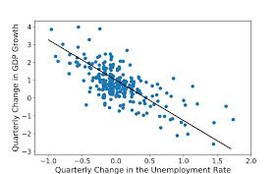
Motivation/Previous Approaches
Previous studies use –
Historical Time-Series Properties of Unemployment Rate Itself^{1,2} and/or
Real GDP Growth/Okun’s Law: Inverse Relationship between Real GDP Growth and Unemployment Rate^{2,3} and/or
Labor Force Flows^{1,2}
Okun’s Law (2)

Slide 3
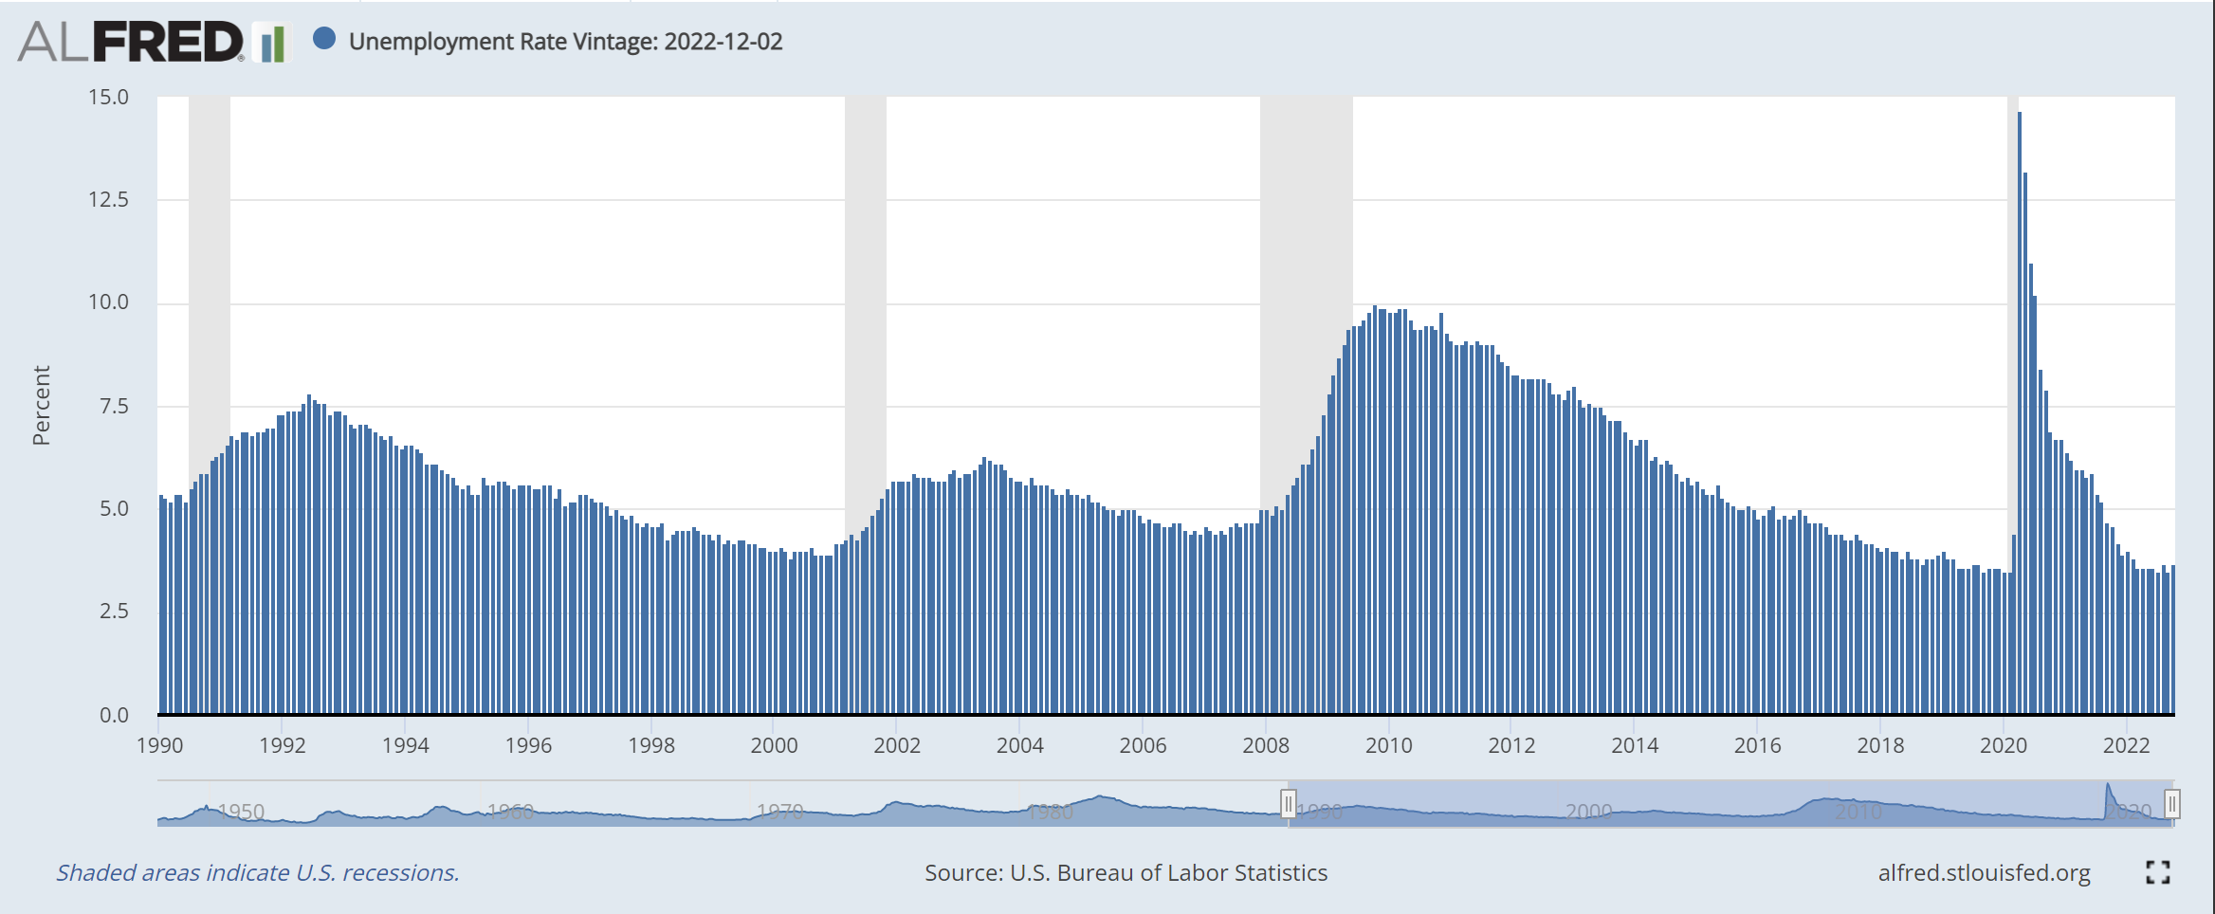
Data
Tested Several Model-Dataset Pairings
CPS = Community Population Survey, a monthly survey conducted by U.S. Census
Datasets (start of 1990 - end of 2022) some combination of:
Unemployment Rate⁴ (CPS)
Real GDP Growth
Quarterly⁵ (US BEA)
Monthly^{6,7} (Chicago Federal Reserve)
Labor Flow Rates^{1,8} (CPS)
Sample Data: 1990-2022 Unemployment Rate (1)

Slide 4
Models
1) “Naïve”
Previous Data Point
2) AR(6)
Univariate – One Variable
Autoregressive – Regression finds optimal coefficients with previous points (6 in this case) as the independent variables
Unemployment Rate Prediction Baseline Standard²
3) VAR
Multivariate Autoregressive Model
4) LSTM
Neural Network geared for time-series
Hyperparameter (Model Settings) Optimized Version and Non-Optimized Version

Slide 5
Testing Considerations
Test Statistic: Out-of-Sample RMSE
Out-of-Sample: Guarantees exclusion of test data from train data
RMSE^{1,2}
Root Mean Squared Error
Lower is Better
Choice of Tests
Theoretically, many pairings of Model-Data could be chosen
However, focused on unit testing incremental changes

Slide 6
Results
Model | Data | Out-of-Sample Root Mean Squared Error (RMSE)
“Naïve” | Unemployment Rate (UR) | .071
AR(6) | UR | .023
VAR | UR + Quarterly GDP Growth (Q) | .074
VAR | UR + Monthly GDP Growth (M) | .065
LSTM | UR + M | 1.84
Hyperparameter Optimized LSTM | UR + M | 2.25
VAR | UR + M + Labor Flow Rates | .285
Conclusion: Best performance is from AR(6) on just Unemployment Rate Data

Slide 7
References
https://www.brookings.edu/wp-content/uploads/2012/09/2012b_barnichon.pdf
https://www.atlantafed.org/-/media/documents/research/publications/wp/2015/01.pdf
https://www.investopedia.com/terms/o/okunslaw.asp
https://alfred.stlouisfed.org/series?seid=UNRATE
https://fred.stlouisfed.org/series/A191RL1Q225SBEA
https://fred.stlouisfed.org/series/BBKMGDP
https://www.chicagofed.org/publications/chicago-fed-letter/2019/422
https://fred.stlouisfed.org/categories/33502

