Slide 1
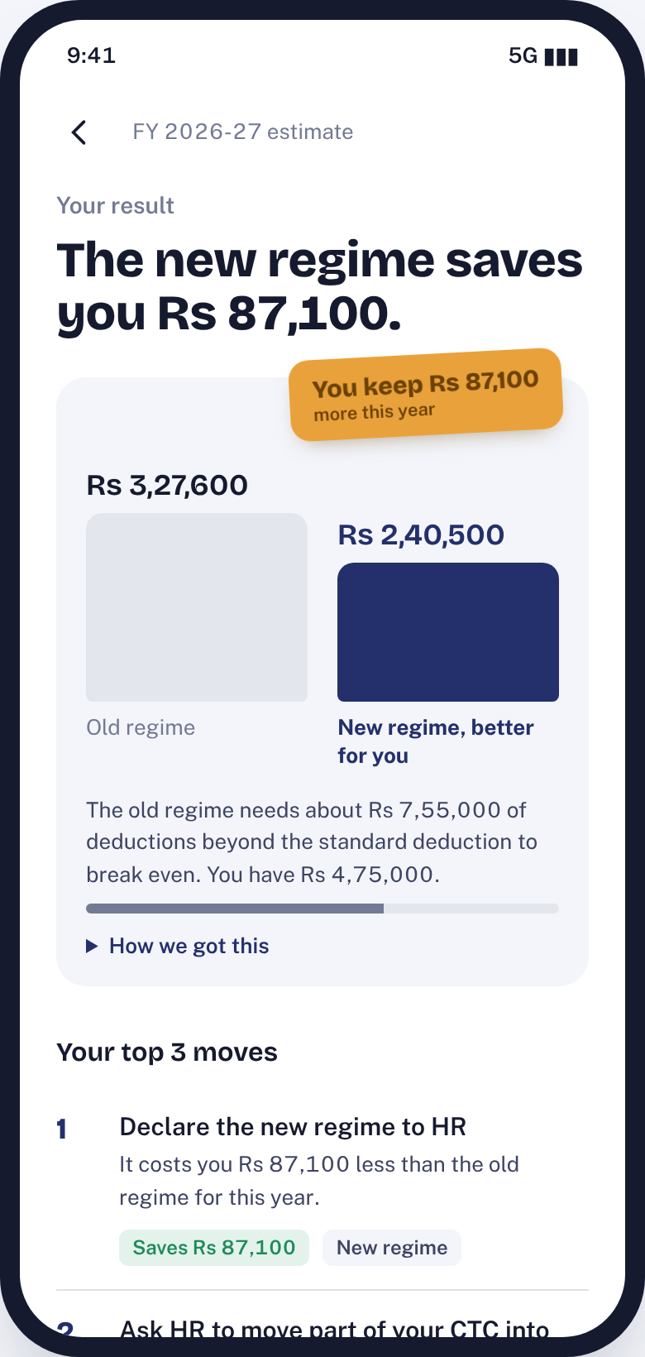
TaxIQ
Your better tax regime and your next three moves, in 2 minutes and with no documents
A tax-planning module for a fintech app: strategy, MVP, prototype and forecast
150K activations, ~2,700 sales
Season-1 forecast, Dec 2026 to Jul 2027
The Product Sprints capstone | Product Club, IIT Kanpur
Notes:
TaxIQ answers the one question salaried people bring to a tax module: which regime, and do I need to invest more? It does it in about two minutes, with no documents, and turns that answer into consented data and relevant cross-sell. Season-1 forecast: 150K activations and about 2,700 monetised conversions.

Slide 2
Users leave before they get a personal answer, and that one gap blocks all four goals
Problem hypothesis
5 Whys
Tools today are fast but generic (calculators, reels) or personal but slow (filing flows that need Form 16 and AIS). With no quick personal answer there is no trust moment, so users share no data and never see an offer that fits them.
1
Why do users leave without a plan? They never reach a result about them.
2
Why not? It takes many jargon-heavy inputs: HRA, 80C, 80D, home loan.
3
Why so many? Tools mirror the ITR form, not the user's decision.
72%
4
Why worse now? The right regime hinges on a break-even users can't compute.
5
Why does it matter? No answer, no trust, no consented data, no relevant offer.
of 7.28 crore filers already chose the new regime (AY 2024-25). The other 28%, and everyone who never checked, face a break-even calculation they cannot do in their head.
Root cause: a personalisation-speed gap
No tool gives a personal answer in under 2 minutes
Notes:
The brief asks us to acquire, engage, collect data and monetise. All four fail at the same point: the user never gets a personal answer fast. The 5 Whys take us from drop-off to the root cause, a personalisation-speed gap, which becomes our core differentiator. Source for 72%: Income Tax Department figures reported by Business Today, Aug 2024.

Slide 3
Start with salaried 22-to-45s: the biggest group facing the regime choice every year
7.28 cr
Ananya, 24
Rohit, 34
Meera, 29
ITRs filed by 31 Jul 2024 (AY 2024-25)
Fresher, Bengaluru, Rs 9 lakh
PM, Pune, Rs 22 lakh, home loan
Freelancer, Jaipur, Rs 14 lakh (Phase 3)
When HR asks for my regime declaration, I want a clear answer for my salary, so I can submit without second-guessing.
When the March deadline nears, I want to know exactly what to top up, so I don't overpay tax or lock money into the wrong product.
When a quarter ends, I want to know what tax I owe, so I avoid interest and filing stress.
3.34 cr
were ITR-1: salaried, simple income. Our beachhead
TaxIQ: new regime, Rs 0 tax, saves Rs 39,370
TaxIQ: new regime saves Rs 87,100
TaxIQ: new regime saves Rs 93,600
Rs 12.75L
Not for: traders and high earners with capital gains, F&O, crypto or foreign income. TaxIQ flags them and routes to assisted filing.
salary is now tax-free in the new regime, so the old regime needs big deductions to win
Notes:
Of 7.28 crore returns for AY 2024-25, 3.34 crore were ITR-1, the simple salaried return. That group faces the regime decision every April and the proof deadline every January, and can be served without documents. Each persona card shows the prototype's actual answer for that profile. Anti-persona: complex income goes to assisted filing.

Slide 4
Everyone trades speed for personalisation; fast and personal is empty
Value proposition
Personal but slow
Fast and personal
"Know your better regime and your next three moves in 2 minutes. No documents, no jargon."
ClearTax
Tax2win
TaxIQ
Under 2 minutes, no documents
TaxBuddy
A CA
Pain relievers
No Form 16 needed
Plain words, not section numbers
Break-even shown in rupees
Gain creators
A shareable result
Reminders before every deadline
Offers only when they close a gap
Filing-first; needs Form 16 or AIS
Personalisation
Slow and generic
Fast but generic
Income Tax portal calculator
Calculators
Finfluencer reels
Investing apps
Official, but no next step
Same answer for everyone
Speed to a personal answer
Notes:
Positioning map built from competitor feature pages and our own estimates of time to a personal answer (ClearTax and Tax2win 10 to 20 minutes, portal calculator 5 to 10, reels under a minute but not personal). Times are estimates to verify with timed walkthroughs. The top-right quadrant is empty: that is TaxIQ.

Slide 5
The MVP: a 4-step quiz that ends in an Old vs New comparator and three ranked moves
1
2
3
4
Result
Tax under each regime, saving, break-even, top 3 moves
About you
Income
What you have
What matters
Salaried or self-employed; age band
Salary slider; complex-income flag
Rent, 80C, health cover, home loan, NPS
Goals; how you file today
Worked example: Rohit, Rs 22 lakh salary
Prioritised with MoSCoW for Season 1
 | Old regime | New regime
Deductions beyond standard | Rs 4,75,000 | Rs 0
Taxable income | Rs 16,75,000 | Rs 21,25,000
Tax incl. 4% cess | Rs 3,27,600 | Rs 2,40,500
Break-even deductions | Rs 7.55 lakh | n/a
Must
Quiz, FY 2026-27 tax engine, comparator, top 3 moves, consent, reminders, offers, analytics
Should
Share card, 60-second explainers, Hindi + 2 languages, complexity router
Could
Tax-saving tracker, bank-data pre-fill, Form 16 upload, Ask-a-CA
Saves Rs 87,100
Won't
Full ITR filing in-module; capital-gains computation
Notes:
Only salary is mandatory; everything else has a smart default or can be left blank. The engine implements FY 2026-27 rules for both regimes, including the Rs 12 lakh rebate with marginal relief, and is tested against published worked examples. Rohit is the PRD persona: Rs 4.75 lakh of deductions is well short of the Rs 7.55 lakh the old regime needs, so the new regime saves him Rs 87,100.

Slide 6
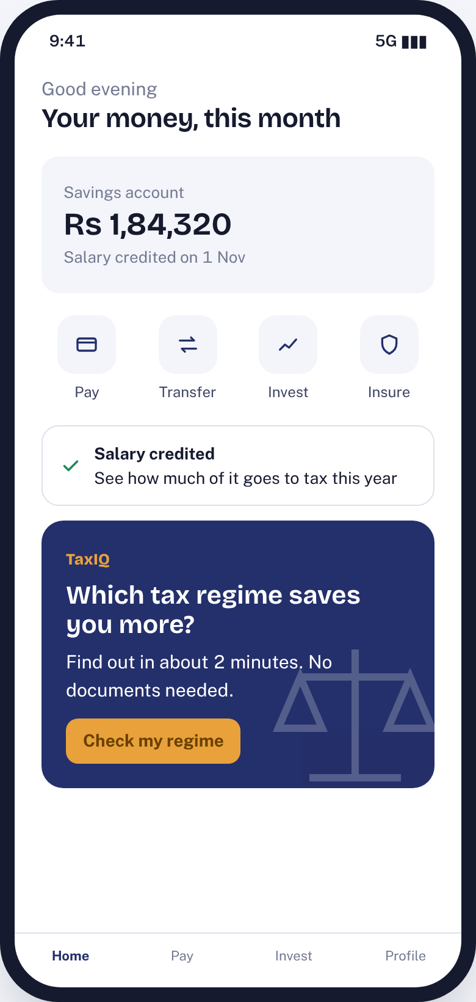
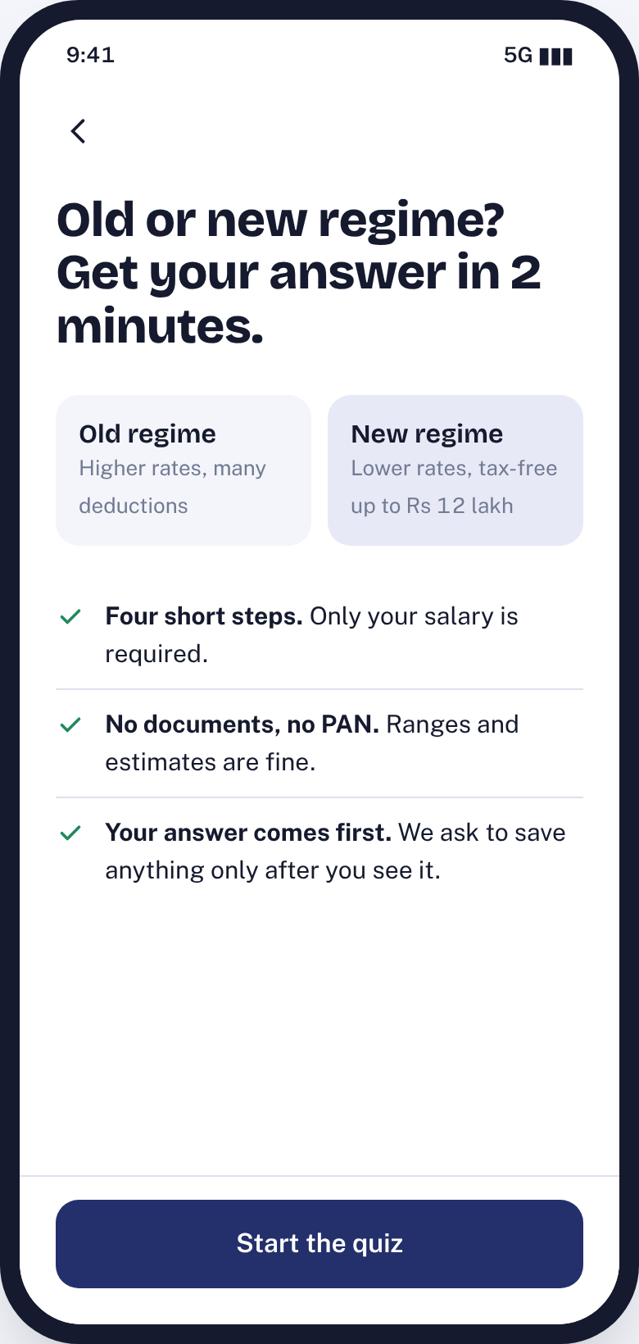
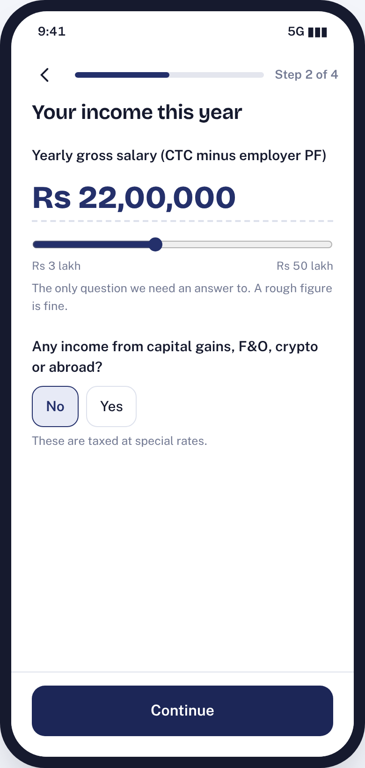
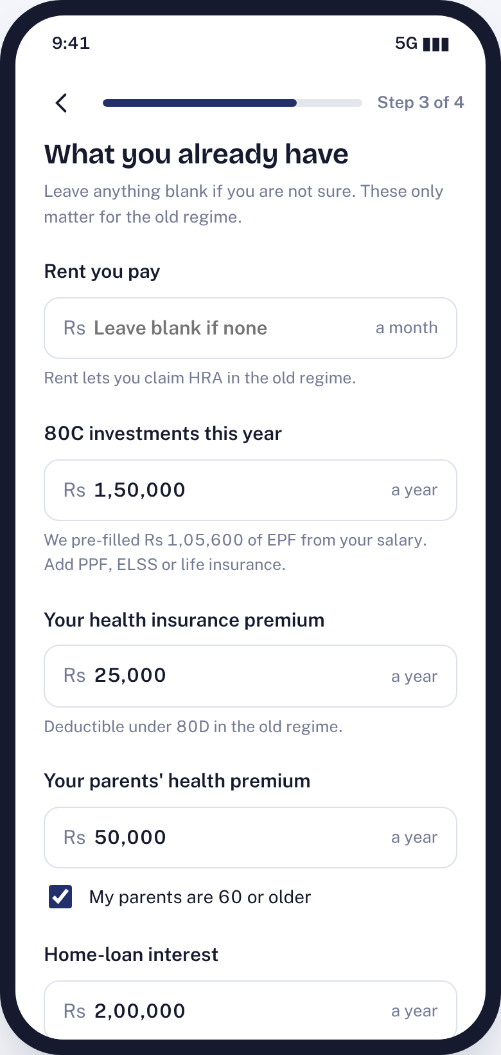
Prototype: from the home screen to the answer in four short steps
Entry: home banner and salary-day nudge
Landing: one question, no documents
Step 2: salary is the only required input
Step 3: EPF pre-filled; blanks allowed
Notes:
Clickable HTML prototype, in the repo under prototype/. Entry points come from the host app. The landing promises the answer first. The quiz needs only salary; EPF is estimated at 12% of basic and every other field can be left blank, which is how we collect data without friction.

Slide 7
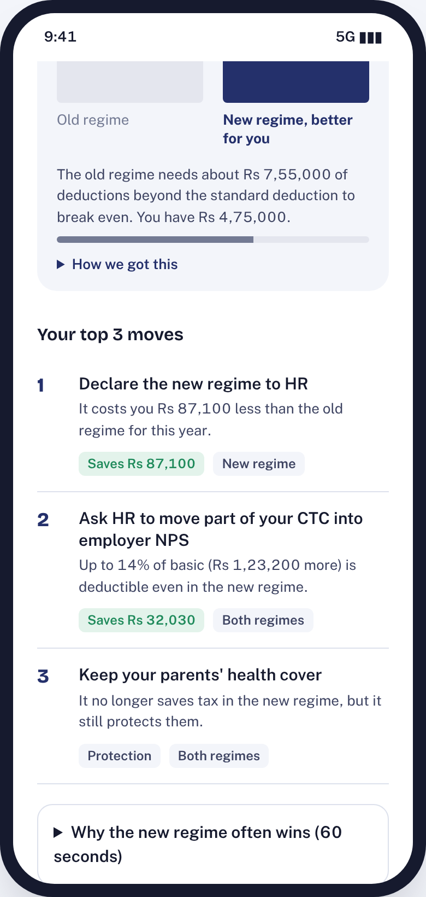
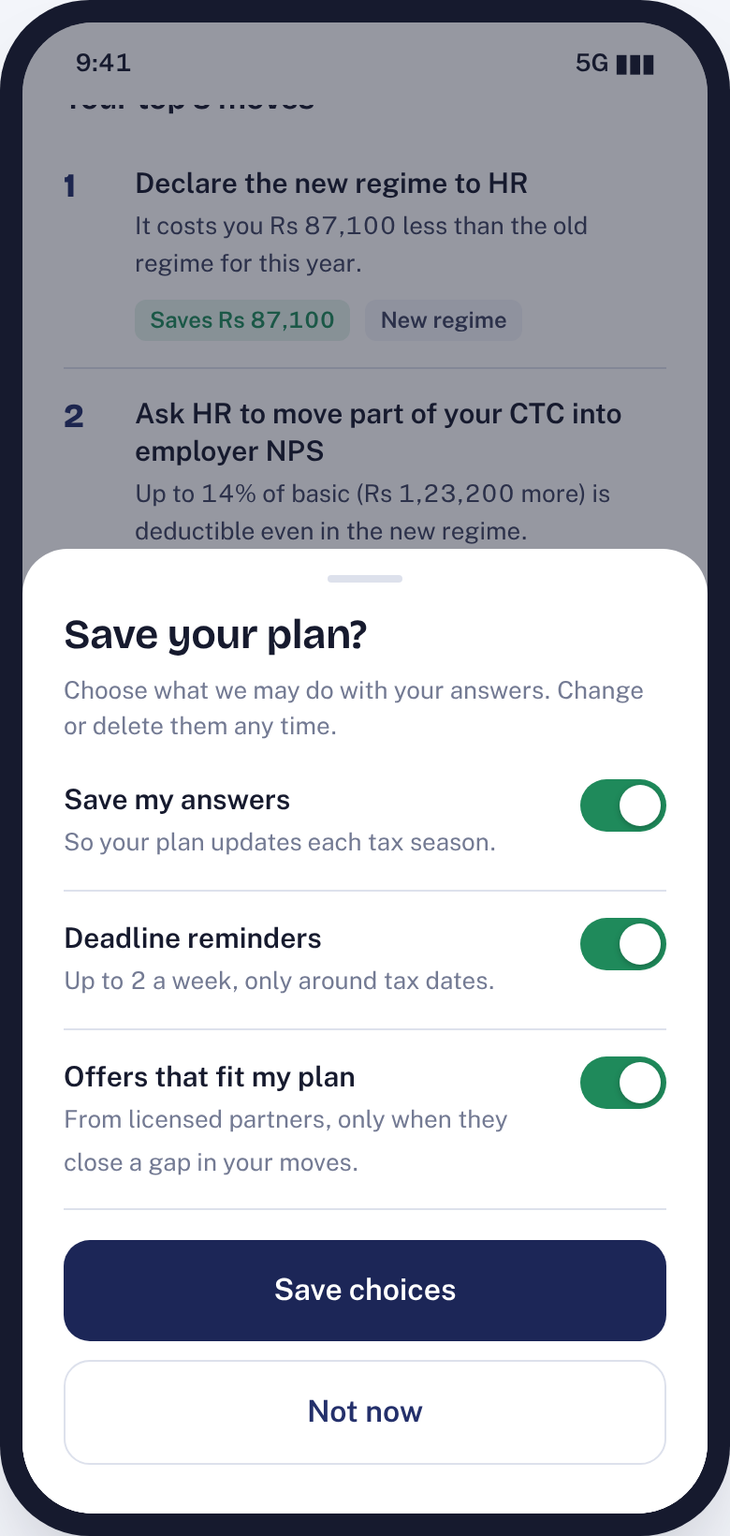
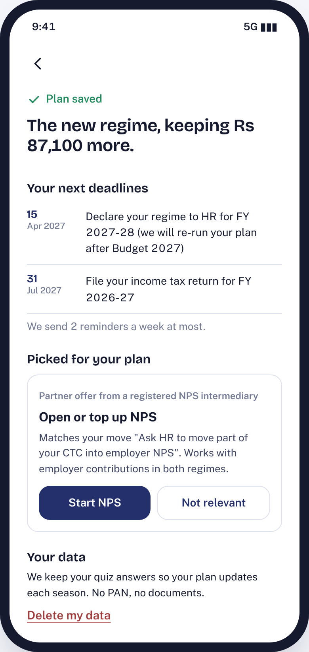
The answer comes first; consent, reminders and offers follow it
Comparator: tax under each regime and the saving
Top 3 moves, ranked by rupee impact
Consent per purpose, asked after the answer
Saved plan: deadlines and one matched offer
Notes:
The result screen is the North Star moment. Moves name product types, never products, to stay educational. Consent is separate for saving, reminders and offers, in line with the DPDP Act. The saved plan shows only deadlines still ahead and one partner offer tied to a move, with a Not relevant button. Every tap fires an analytics event, visible in the prototype side panel.

Slide 8
RICE sets the order, MoSCoW the scope: three gated phases climb the AARRR funnel
Feature | Reach (K) | Impact | Conf. | Effort (pw) | RICE
Quiz + comparator | 300 | 3 | 80% | 4 | 180
Deadline reminders | 90 | 2 | 80% | 1 | 144
60-second explainers | 600 | 0.5 | 80% | 2 | 120
Top 3 moves | 150 | 3 | 70% | 3 | 105
Share card | 150 | 1 | 50% | 1 | 75
Personalised offers | 90 | 2 | 70% | 3 | 42
Bank-data pre-fill | 100 | 2 | 50% | 6 | 16.7
Phase 1: Activate
Dec 2026 to Jan 2027 | Acquisition + Activation
Engine, quiz, comparator, top 3 moves, explainers, analytics, SEO pages
Gate 1: 50%+ completion, result in 120 s, engine passes all tests
Phase 2: Engage
Feb to Mar 2027 | Retention + Referral
Consent and saved profile, reminders, share card, languages, complexity router
Gate 2: 50%+ consent, 25%+ return within 30 days
Offers score 42 but are a Must: monetisation is a module goal. They ship last because they need consented data and partner contracts.
Phase 3: Monetise
Apr to Jul 2027 | Revenue
Personalised offers, filing-service handoff, tracker, pre-fill pilot
Notes:
RICE = Reach x Impact x Confidence / Effort; reach in thousands of users per season, effort in person-weeks. Each gate is a go/no-go: if Gate 1 misses, Phase 2 is spent fixing the quiz instead of adding reminders.

Slide 9
Forecast: 150K activations, then a 12% to 3% cross-sell funnel to ~2,700 conversions
North Star
Personalised plans delivered: quiz done and result seen
Activation
50% quiz completion; median result in 120 s or less
Data
60% consent after the answer
Retention
30% return within 30 days; 10% share their card
~Rs 27 lakh in Season 1
at an assumed Rs 1,000 per conversion
Notes:
Funnel: 1.5M landing visitors (about 5M MAU, 30% exposed), 20% start, 50% finish = 150K activations. 60% consent and see offers = 90K. 12% click = 10,800; 25% of clickers buy = 2,700, which is 3% of offer viewers. Sensitivity: 8% CTR gives 1,800; 50% consent gives 2,250. All rates are planning assumptions to validate.

Slide 10
Go-to-market: product-led first, content-led for reach, partners for scale
Product-led
In-app banner in proof (Jan) and declaration (Apr) seasons; salary-day nudge; entries inside invest and insure flows
Phase 1
Biggest risks
A wrong tax figure: CA-verified test suite, "report a wrong number"
72% already on the new regime: lead with protection, employer NPS and filing
Seasonality: advance-tax and Budget-day hooks, saved profile wakes each season
Content-led
"Old vs new regime calculator FY 2026-27" SEO pages that open into the quiz; 60-second explainers
Phase 1
Community
Two or three finfluencer collaborations around the comparator; college and alumni groups for first-jobbers
Phase 1-2
Referral loop
Share card with regime and savings band, never income; deep link back to the quiz
Phase 2
B2B2C pilot
HR partners link TaxIQ in regime-declaration emails
Phase 3
Next: 8-user test of the prototype and a landing A/B
Notes:
Paid acquisition is zero in Season 1: traffic is in-app, SEO and creators. Product-led and content-led channels launch in Phase 1 because the comparator itself is the marketing. Next steps: an 8-user usability test against the 120-second target, and a landing-copy A/B test to validate the 20% start rate.

