Slide 1
Medical Data History
Client Project Report
Institute: DataMites
Project ID: PRSQL - 02
Project Code: PTID – CDA- SEP – 25 - 741
Batch: 12 – MAY – CDA – BUN – 040 – WDM1130 - BAN
Prepared By: Pruthiraj Samal (pruthirajsamal8802@gmail.com)

Slide 2
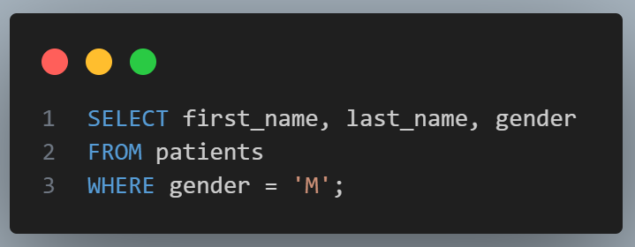
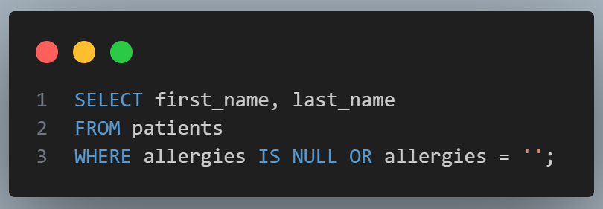
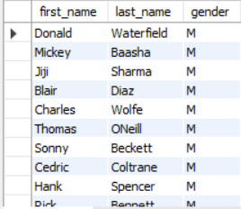
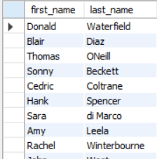
1. Show first name, last name, and gender of patients whose gender is 'M
2. Show first name and last name of patients who do not have allergies
O/P
O/P

Slide 3
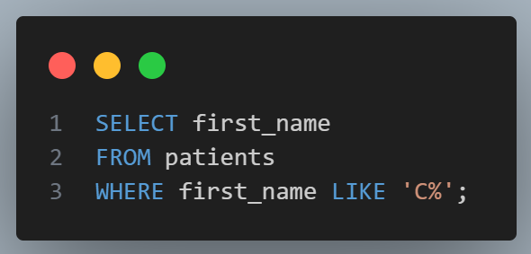
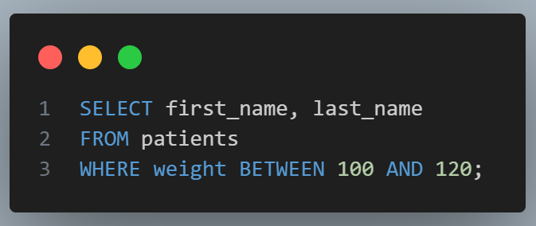
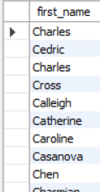
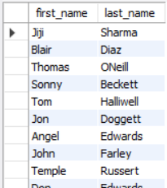
3. Show first name of patients that start with the letter 'C’
4. Show first name and last name of patients with weight between 100 and 120
O/P
O/P

Slide 4
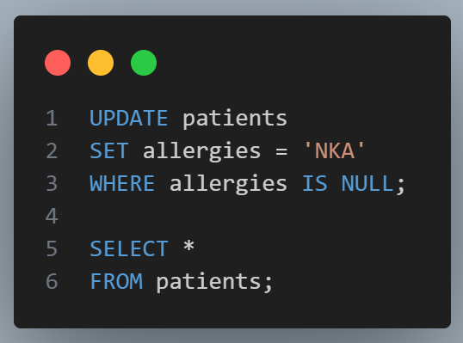
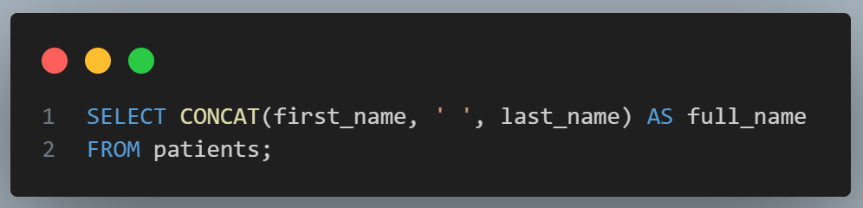
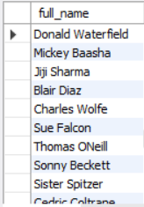
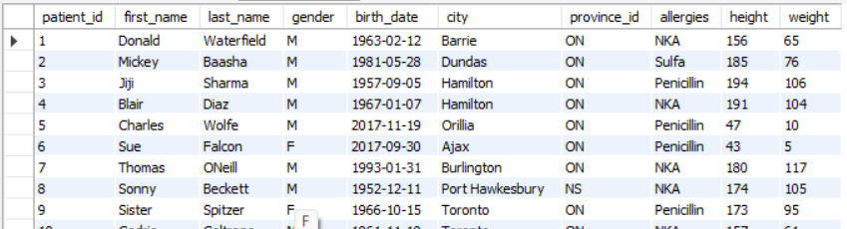
5. Update patients table for allergies column: replace NULL with 'NKA'
6. Show first name and last name concatenated into one column as full name
O/P
O/P

Slide 5
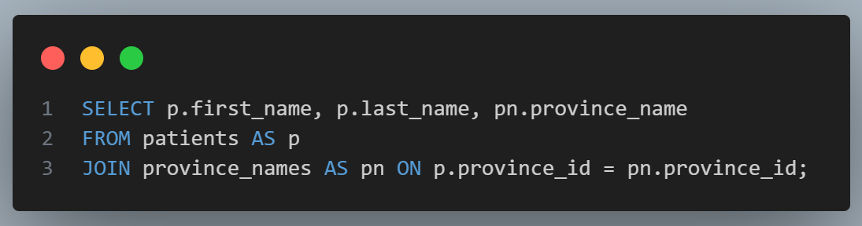
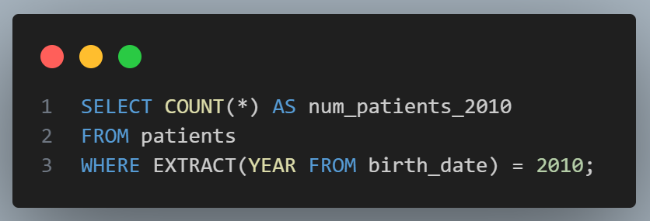
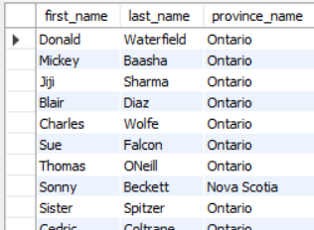

7. Show first name, last name, and full province name of each patient
8. Count of patients born in 2010
O/P
O/P

Slide 6
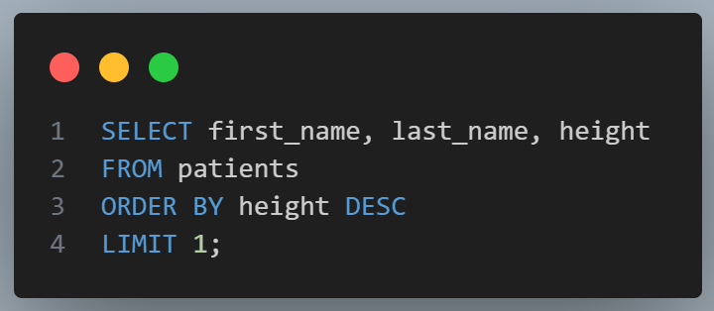
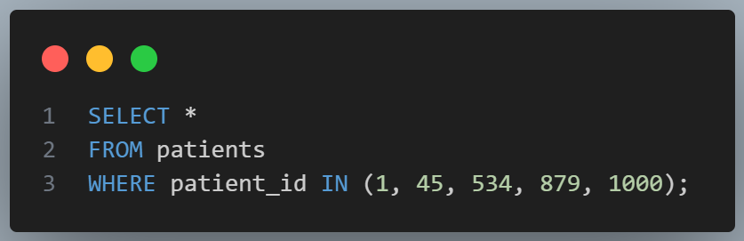

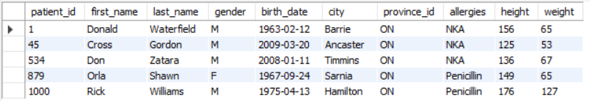
9. First_name, last_name, and height of the tallest patient
10. Show all columns for patients with patient_id 1, 45, 534, 879, 1000
O/P
O/P

Slide 7
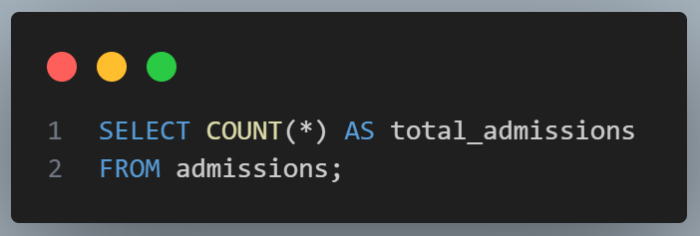
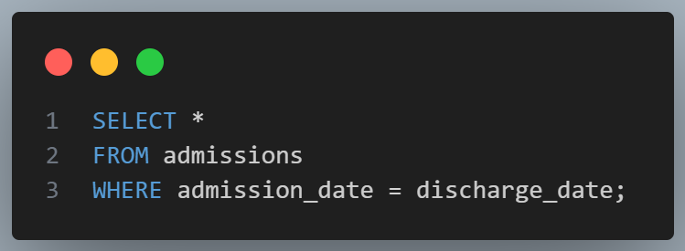
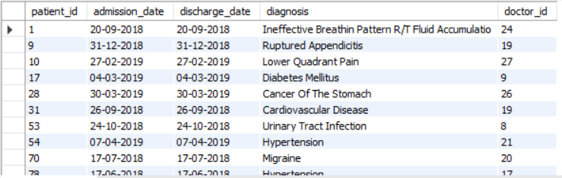

12. Admissions where patient was admitted and discharged the same day
11. Total number of admissions
O/P
O/P

Slide 8
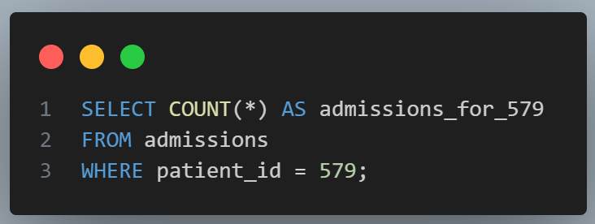
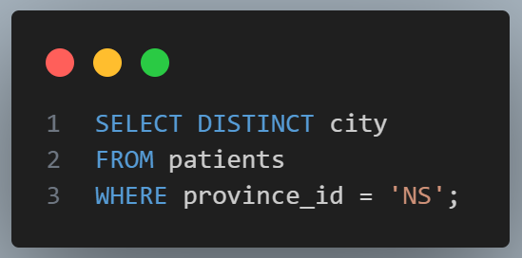


13. Total number of admissions for patient_id 579
14. Unique cities for province_id 'NS'
O/P
O/P

Slide 9
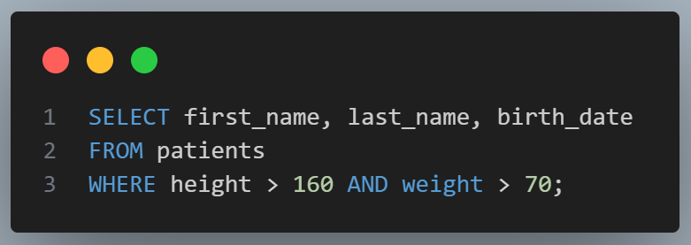
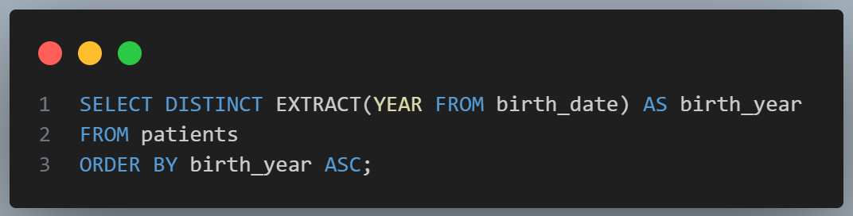
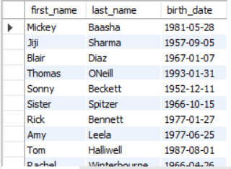
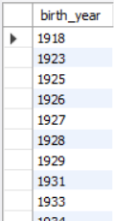
15. Patients with height > 160 and weight > 70
16. Unique birth years ordered ascending
O/P
O/P

Slide 10
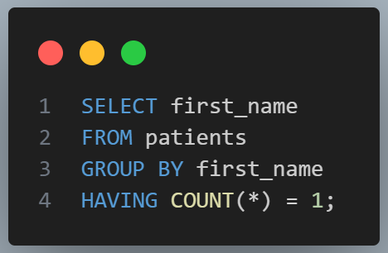
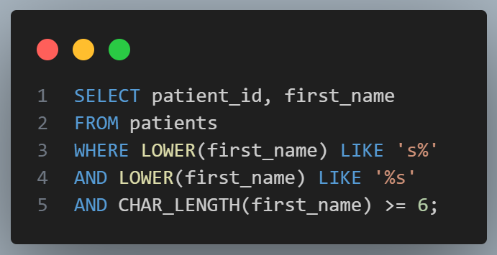
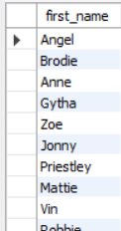
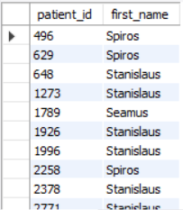
17. Unique first names that occur only once
18. Patients whose first_name starts and ends with 's' and is at least 6 characters
O/P
O/P

Slide 11
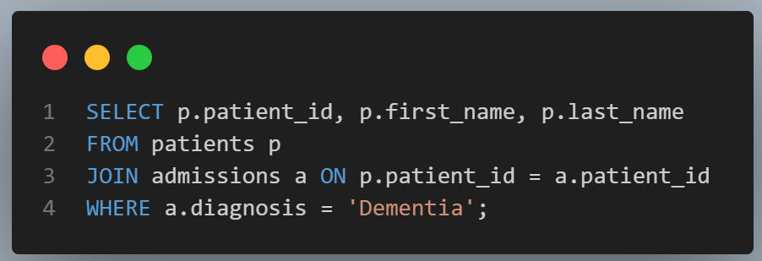
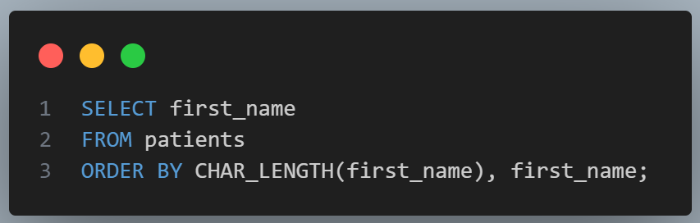
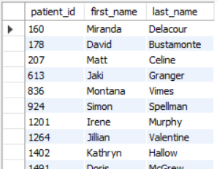
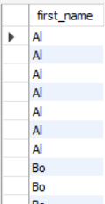
20. Every patient's first_name ordered by length and then alphabetically
19. Patients with diagnosis 'Dementia'
O/P
O/P

Slide 12
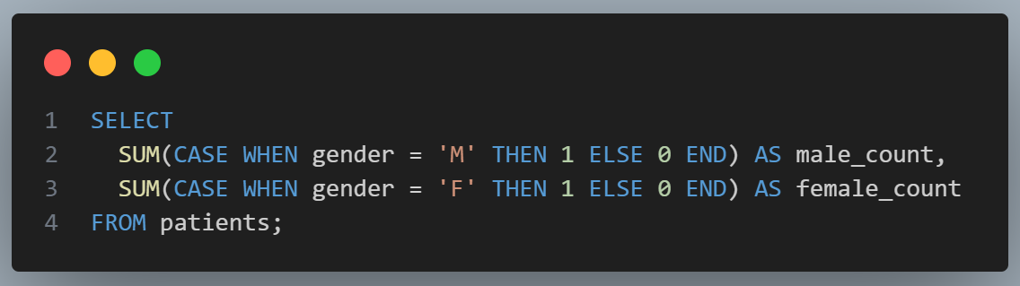
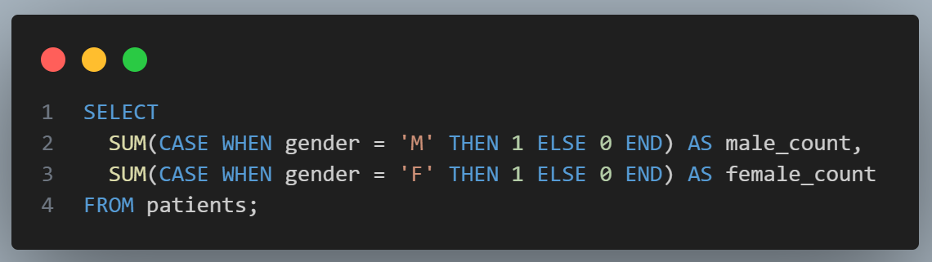


21. Total male and female patients (same row)
22. Same as 21 (total male & female patients)
O/P
O/P

Slide 13
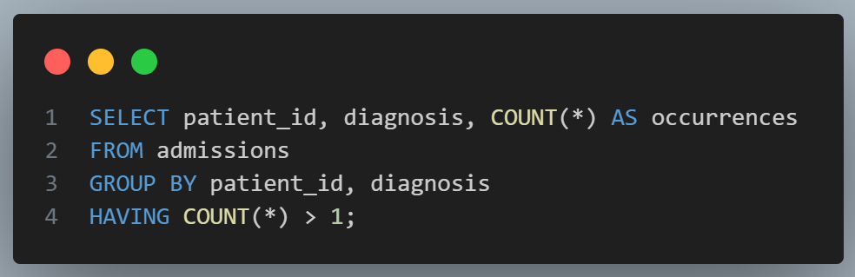
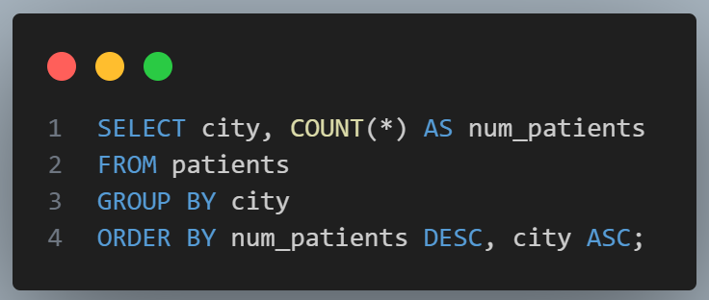
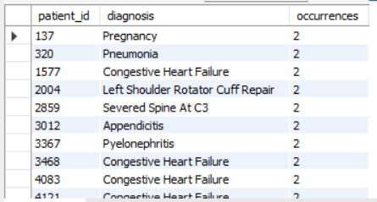
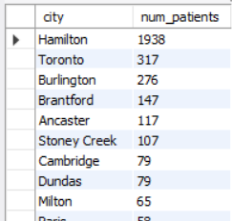
23. Patients admitted multiple times for the same diagnosis
24. City and total number of patients in each city
O/P
O/P

Slide 14
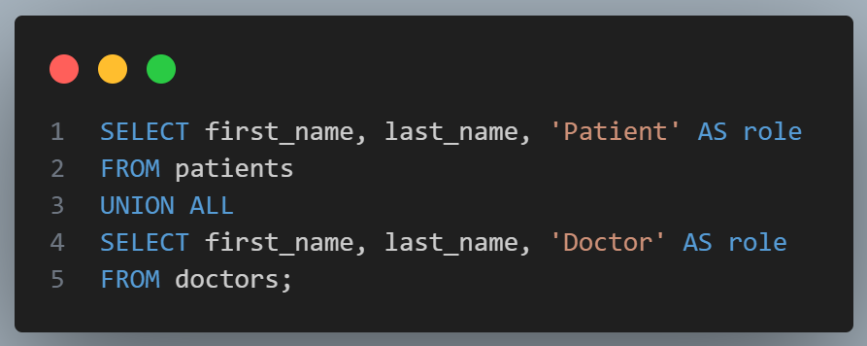
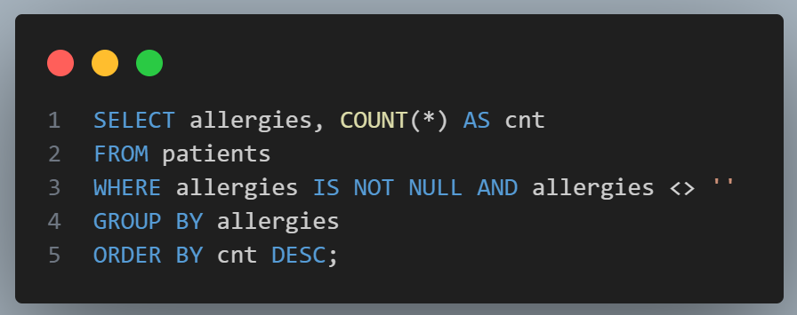
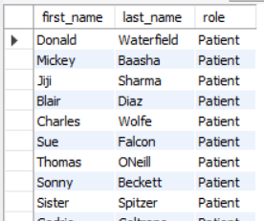
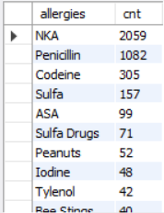
25. First name, last name, and role for patients and doctors
26. All allergies ordered by popularity (exclude NULLs)
O/P
O/P

Slide 15
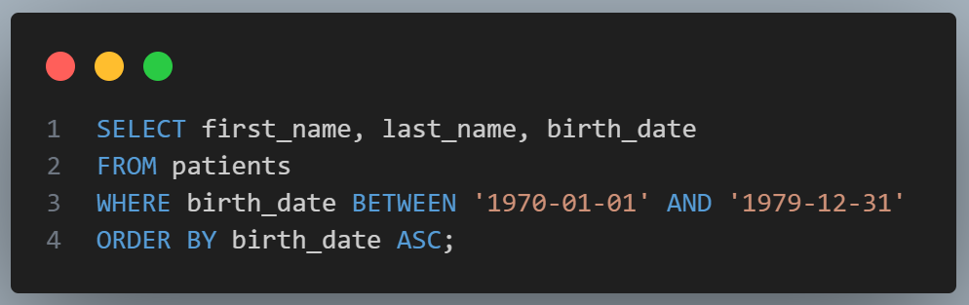
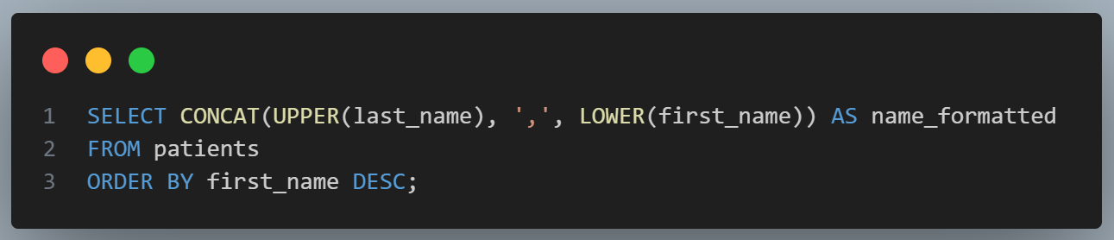
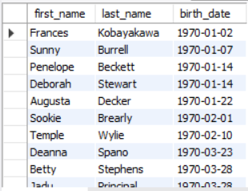
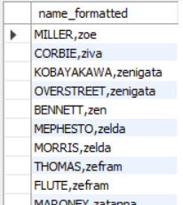
28. Full name with last_name uppercase first, first_name lowercase
27. Patients born in the 1970s
O/P
O/P

Slide 16
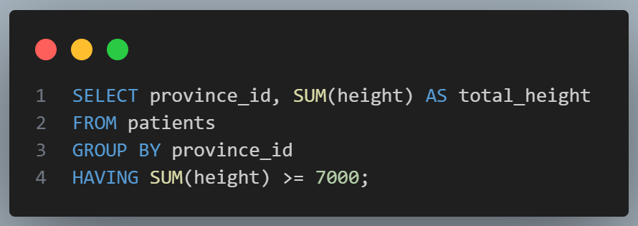



30. Difference between largest and smallest weight for last_name 'Maroni'
29. Province_id and sum of height ≥ 7000
O/P
O/P

Slide 17




31. Admissions by day of month
32. Patients grouped by weight groups (100s)
O/P
O/P

Slide 18




34. Patients with diagnosis 'Epilepsy' and doctor's first name 'Lisa'
33. Display patient_id, weight, height, and isObese
O/P
O/P

Slide 19
Thank You…

