Slide 1
Knee Osteoarthritis Classification Using Vibroarthrography
Presented by: Kanak Jyoti Pruthvi V Resmita Raju
Guided by: Shailendra Gupta

Slide 2
Table of Contents
Introduction
Problem Statement
What is Vibroarthrography (VAG)?
Dataset overview
Methodology
Model Implementation
Results and Evaluation
Challenges & Limitations
Future Work
Conclusion

Slide 3
Introduction
Osteoarthritis is a chronic joint disease causing pain, stiffness, reduced mobility.
Early detection is critical to prevent irreversible cartilage damage.
Vibroarthrography offers a non-invasive, low-cost alternative by analyzing knee joint sounds.

Slide 4
Problem Statement
Diagnosis often happens late → worsens patient outcomes.
Need for a machine learning-based tool to predict knee osteoarthritis using vibroarthrography signals.
Objective: Build a model + user interface for easy prediction.

Slide 5
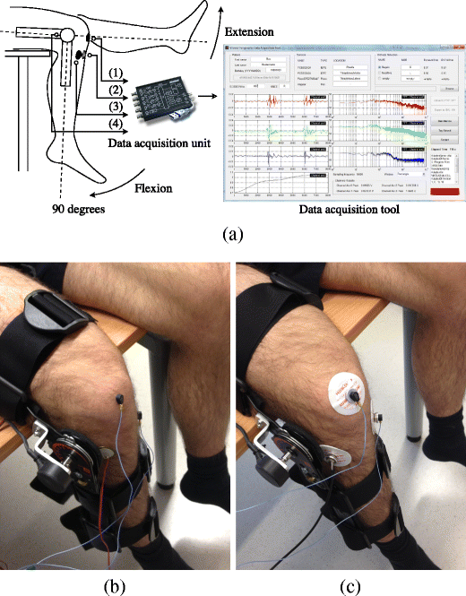
What is Vibroarthrography(VAG)?
A technique that records vibrations from knee joints during motion.
How it works:
Knee joint movement produces mechanical vibrations
Sensors capture these vibrations as signals
Signals are analyzed for abnormalities
Advantages over X-ray/MRI
Low-cost, portable
Real-time analysis possible
Befrui, N., Elsner, J., Flesser, A. et al. Vibroarthrography for early detection of knee osteoarthritis using normalized frequency features. Med Biol Eng Comput 56, 1499–1514 (2018)

Slide 6
Instruments commonly used:
Accelerometers (measure vibration intensity)
Contact microphones (capture acoustic signals)
Gyroscopes (sometimes for movement tracking)
Methodology:
A sensor is placed over the knee.
The subject performs controlled movements (e.g., sit-to-stand, squats).
The sensor records vibration signals during joint motion.
These signals are then analyzed for patterns that correlate with OA stages.

Slide 7
Dataset Overview
Source: Kaggle (Knee Health VAG Dataset)
Total samples: 2500
Features: rms_amplitude, peak_frequency, spectral_entropy, zero_crossing_rate, mean_frequency
Labels:
knee_condition (Normal / OA / Ligament Injury)
severity_level (None / Mild / Moderate / Severe)
treatment_advised (No Treatment / Physiotherapy / Surgery)

Slide 8
Data Preprocessing
Duplicate rows removed to ensure dataset integrity.
Missing values handled: severity_level replaced with "None".
Outlier detection performed using boxplots on key features (rms_amplitude, peak_frequency, spectral_entropy, zero_crossing_rate, mean_frequency).
Feature scaling applied (normalization/standardization) for consistent input to models.

Slide 9
Methodology
Step 1: Data Collection & Cleaning
Step 2: Feature Extraction & Selection
Step 3: Model Training • Machine learning models applied: KNN, SVM, Random Forest • Multi-output classification for knee condition, severity level, and treatment
Step 4: Evaluation • Accuracy, confusion matrix, classification report
Step 5: Deployment • Developed an interactive UI for real-time prediction

Slide 10
Model Implementation
Algorithms used:
KNN (k=5) → baseline performance.
SVM (linear kernel) → strong separation, better than KNN.
Random Forest → ensemble learning with feature importance analysis.
Multi-output classification • Predictions made for: Knee Condition, Severity Level, Treatment Advised
Training & Testing • 80% training, 20% testing split • StandardScaler used for feature normalization
Hyperparameter tuning performed via cross-validation and GridSearchCV to find the best settings for each model.
Feature importances analyzed to understand which vibration characteristics drive predictions

Slide 11
Results and Evaluation
KNN:
knee_condition → 0.87
severity_level → 0.51
treatment_advised → 0.74
SVM:
knee_condition → 0.88
severity_level → 0.55
treatment_advised → 0.77
Random Forest:
knee_condition → 0.88
severity_level → 0.54
treatment_advised → 0.77
Severity level prediction was challenging due to class overlap.

Slide 12
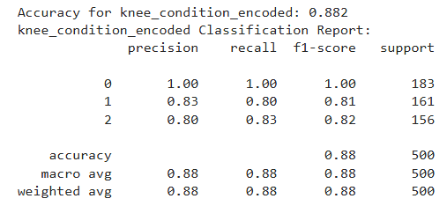
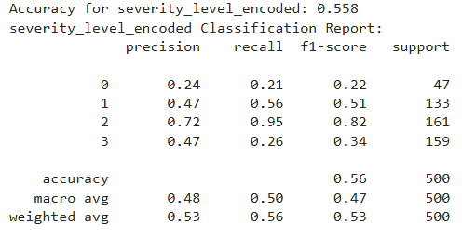
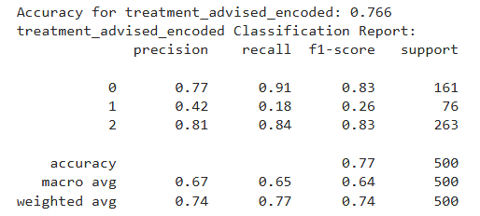

Slide 13
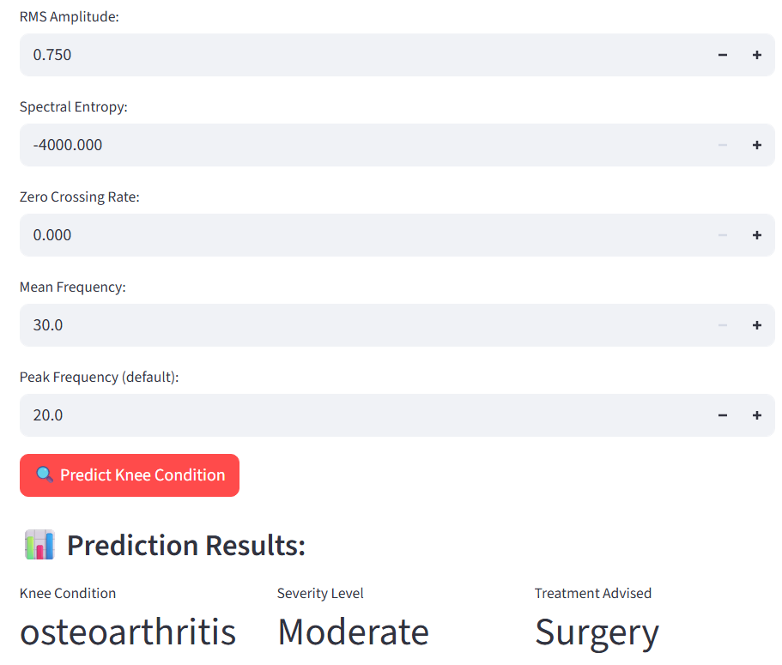
User Interface (UI) Showcase

Slide 14
Challenges & Limitations
Limited sample diversity (not all patient groups covered).
VAG signals sensitive to sensor placement and movement noise.
Severity levels hard to separate; prediction accuracy is lower.
Models need validation on independent data for reliability.
Vibroarthrography measures vibration, not tissue—may miss subtle disease.
Specialized equipment and expertise required for robust data collection.

Slide 15
Future Work
Larger Dataset: Collect more VAG data from a clinical setting to improve model generalizability.
Advanced Models: Explore deep learning models like CNNs or LSTMs that can learn features directly from the raw signal waveform, potentially improving accuracy.
Real-time Analysis: Develop a mobile app that can connect to a portable sensor and perform real-time analysis during a patient's examination.
Clinical Validation: Conduct a pilot study with orthopedic specialists to validate the tool's effectiveness in a real-world clinical environment.

Slide 16
Conclusion
Developed an automated system for knee osteoarthritis prediction using vibroarthrography signal features and machine learning.
Achieved robust performance in classifying knee condition and recommended treatment, with moderate results for severity levels.
Created a user-friendly interface for real-time prediction, demonstrating practical potential for screening and decision support.
Highlighted challenges such as signal variability, sample diversity, and the need for further clinical validation.
This work shows promise for affordable, non-invasive OA detection and lays a foundation for future enhancements and broader clinical application.

Slide 17
THANK YOU

