Slide 1
TAM Block diagrams Copy the elements to your drawing
[User role]
Agent’s Name
Agent’s Name
R
R
R
R
R
Protocol, Request type
R
R
R
Agent’s Name
Agent’s Name
Agent’s Name
Storage Name
Storage Name
Storage Name
...
...
Storage Name
Agent’s Name
Storage Name
Storage Name
Agent a
Agent b

Slide 2
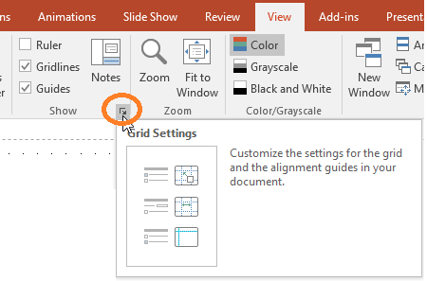
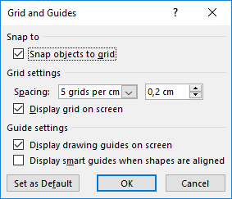
How to use the Template
Copy diagram element
Paste to new diagram
Align
to the grid
The following slides are intended to be used as copy templates. Select and copy the diagram elements you need to create your own TAM diagrams.
The grid of PowerPoint makes it much easier to align diagram elements, adjust size, etc. to harmonize the layout of your diagrams. To activate the grid, open the “Grid and Guides” dialogue, activate “Snap objects to grid” and “Display grid”. This copy template is designed for grid spacing of 5 grids per cm, i.e. 2mm spacing.
Use even numbers of grid spaces, e.g. 4, 8, 16 when (re-)sizing height and width of new diagram elements.
Benefit from being familiar with the connector and anchor points concept of PowerPoint. E.g. you will be able to move nodes like agents and storages without reconnecting all read/write arcs.
PowerPoint does not support rectangular connectors with rounded corners – connectors linked with small arcs provide a workaround. While cumbersome to create from scratch, the slides provide the most typical line patterns. Easily adjust the patterns by selecting one or multiple corners and moving them with the cursor keys to the right positions. Don’t forget to connect the end connection points with the corresponding diagram nodes.

Slide 3
Block diagram example
Customers
Notation Legend
 | Agents process information, communicate via channels, access storages
 | Storages contain information accessed by agents.
 | Channels are used to transport information between agents
 | Request-response Channels show the direction of the Request, indicating the triggering agent (=the Client)
 | Modifying Access: A can read and write storage content
 | Read-only Access: A can only read storage content
...
Agent
Register Edit Profile Browse Orders
Search Get Prod. Info Select Items
Place Order Cancel Order
Storage
R
R
R
A1
A2
Online Shop
Service Provider
Customer Account Maintenance
Product Presentation + Selection
Order Processing
Credit Card Institutions
Client
R
Server
R
Shipping
A
S
Customers’ product selection
A
S
...
Suppliers
ERP data
...
Customer data
Product Information
Product Availability
Orders

Slide 4
TAM Activity Diagram
Enter Shop
Customer
Order Processing
Payment Service Provider
Action
Add to Shopping Cart
Condition
Submit Order
Check Availability
Request Payment Check
Check Credit Limit
OK
Problem occurred
Send Order Confirmation
Send Problem Description
Trigger Delivery

Slide 5
TAM State Diagram
State
New
Condition
Event [Guard] / Action
Confirmation sent
Shipped to Customer [open positions] / Send Invoice
[open positions] / Send Invoice
Confirmed
Partially Delivered
Cancellation received
Shipped to Customer
Shipped to Customer [no open positions] / Send Invoice
[no open positions] / Send Invoice
Canceled
Fully Delivered
Payment received
Paid
Revocation period exceeded
Closed

Slide 6
TAM Sequence Diagram
Agent’s Name
Agent’s Name
Agent’s Name
Sync. call
Sync. call
Response
Response
Async. call
Async. call
Invisible helper to be placed on the lifelines with anchor points for the arrows. Usage can ease working with complex layouts like in the left diagram with a start point for the async. call somewhere between start and end of the gray activation area.

Slide 7
TAM Class Diagram
Class Name
Shipping by 
Logistics Company
Customer
⧫ placed by
Order
1
1
Class Name
Payment via 
Payment Service Prov.
attribute1
1
Method 1
▲
Can be shown to
Order Item
quantity
Association 
0..1
1
⧫ association
Catalog
presents
Product
Supplied by 
Supplier

Slide 8
TAM Deployment Diagram
Role
Node
Container
NW AS 7.01
NW AS ABAP 7.01
SAP Solution Manager
CRM
ABAP
Java
Solution Manager 4.0
Maintenance Optimizer/SLM
CRM Components
VM Container
IPC
Package
SLD (System Landsc. Dir.)
SolMan Diagnostics
SAP CRM 7.01
System
AS ABAP
AS Java
Browser (JS)
Java Runtime
.Net Runtime
DB Runtime (Stored Procedures)

