Slide 1
LOAN PREDICTION SYSTEM
GROUP MEMBERS:
B.PRUTHVI REDDY (19311A19C3)
SATYA LOHIT GOLI (19311A19D6)
K.ADHARSH KRUPAKAR (19311A19H4)
GUIDE NAME:
V.SOWMYA
ASSISTANT PROFESSOR

Slide 2
CONTENT
ABSTRACT
LITERATURE REVIEW
INTRODUCTION
REQUIREMENTS
EXISTING SYSTEM
PROPOSED SYSTEM
CONCLUSION
REFERENCES

Slide 3
ABSTRACT
With the enhancement in the banking sector lots of people are applying for bank loans but the bank has its limited assets which it has to grant to limited people only, so finding out to whom the loan can be granted which will be a safer option for the bank is a typical process. So in this paper we try to reduce this risk factor behind selecting the safe person so as to save lots of bank efforts and assets. This is done by mining the Big Data of the previous records of the people to whom the loan was granted before and on the basis of these records/experiences the machine was trained using the machine learning model which give the most accurate result. The main objective of this paper is to predict whether assigning the loan to particular person will be safe or not. This paper is divided into four sections (i)Data Collection (ii) Comparison of machine learning models on collected data (iii) Training of system on most promising model (iv) Testing

Slide 4
LITERATURE REVIEW
A prediction is a statement about what someone thinks will happen in the future. People make predictions all the time. Some are very serious and are based on scientific calculations, but many are just guesses. Prediction helps us in many things to guess what will happen after some time or after a year or after ten years.
Predictive analytics is a branch of advanced analytics that uses many techniques from data mining, statistics, modeling, machine learning, and artificial intelligence to analyze current data to make predictions. “Adyan Nur Alfiyatin, Hilman Taufiq and their friends work on the house price prediction. They use regression analysis and Particle Swarm Optimization (PSO) to predict house price”. One other similar work on the Mohamed El Mohadab, Belaid Bouikhalene and Said Safi to predict the rank for scientific research paper using supervised learning. Kumar Arun, Garg Ishan and Kaur Sanmeet work on bank loan prediction on how to bank approve a loan. They proposed a model with the help of SVM and Neural networks like machine learning algorithms.
This literature review helps us carry out our work and propose a reliable bank loan prediction model.

Slide 5
INTRODUCTION
The dataset consists of data related to bank customer like id, name, pay schedule, credit score, previous loans.
This data is used to verify if the customer is eligible to be granted for the loan or not.
Here we try to reduce risk factor behind selecting safe customer to reduce bank efforts.
This is done using the previous bank records of granted loans using which the machine is trained.

Slide 6
REQUIREMENTS
SOFTWARE
Language : Python, Google Collab /Jupiter Note book
Libraries : Pandas, NumPy, Sci-Kit .
HARDWARE
Ram : 2gb or more
Disk space : 50gb or more
Environment : Windows XP and above

Slide 7
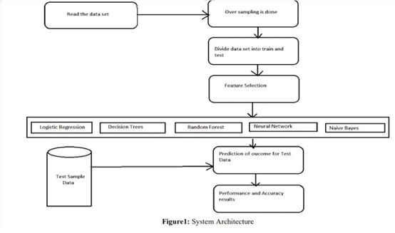
ARCHITECTURE

Slide 8
EXISTING SYSTEM
The existing system uses Support Vector Machine (SVM) one of the main issues with this is that it need the data to be linearly separable.
The system also does not provide enough preprocessing and visualization or Exploratory Data Analysis(EDA).

Slide 9
PROPOSED SYSTEM
We aim to build other classification models like logistic regression, Naïve Bayes, Decision Trees and others and also fine tune the parameters of the model.
These models would be trained on a dataset which will be engineered carefully after performing the feature engineering.

Slide 10
DESIGN
Random forests or random decision forests are an ensemble learning method for classification, regression and other tasks that operates by constructing a multitude of decision trees at training time.
Support Vector Machine(SVM) is a supervised machine learning algorithm used for both classification and regression.The objective of SVM algorithm is to find a hyperplane in an N-dimensional space that distinctly classifies the data points. The dimension of the hyperplane depends upon the number of features.
Logistic Regression is a Machine Learning algorithm which is used for the classification problems, it is a predictive analysis algorithm and based on the concept of probability. The hypothesis of logistic regression tends it to limit the cost function between 0 and 1 .

Slide 11
CONCLUSION
Machine learning technique like Logistic regression, SVM and Random forest ,xgboost, were used for loan prediction system. The accuracy and error rate are used to evaluate the performance for the proposed system.
The accuracy for logistic regression, SVM and random forest classifier are 0.57, o.56, and 0.64 respectively.
By comparing all the method, found that random forest classifier is better than the logistic regression and SVM.

Slide 12
REFERNCES
J.R. Quinlan, Induction of decision trees, Machine learning Springer, vol. 1, no. 1, pp. 81-106, 1086.
Arun Kumar, Ishan Garg and Sanmeer Kaur, Loan Approval Prediction based on Machine Learning Approach.
Nur Alfiyatin Adyan, Taufiq Hilman, Ema Febrita Ruth and Firdaus Mahmudy Wayan, "Modeling House Price Prediction using Regression Analysis and Particle Swarm Optimization", International Journal of Advanced Computer Science and Applications, vol. 8, no. 10, 2017.
S.S. Keerthi and E.G. Gilbert, Convergence of a generalize SMO algorithm for SVM classifier design, Machine Learning, Springer, vol. 46, no. 1, pp. 351-360, 2002.

