Slide 1







Python Programming
DR.PARKAVI.A ASSOCIATE PROFESSOR CSE DEPARTMENT
M S RAMAIAH INSTITUTE OF TECHNOLOGY
BANGALORE

Slide 2
Python Intro
2
Guido van Rossum in 1980
Amoeba OS for Exceptions Handle
Named after Monty Python
Open sourced
Python Software Foundation
Scripting language
Scalable, object oriented and functional
Used by Google from the beginning
GUI support, Portable, Integratable
Interpreted language, large Std library, Dynamically typed language

Slide 3
What can be done using Python?
3
Data Analysis and Plotting
GUIs
Website
Database Programming
Rapid Prototyping
Numeric and Scientific Programming
Natural Language
Make and remix music
Games, Images, AI, XML and more

Slide 4
IDEs for python
4
▶ IDLE
▶ PyCharm
▶ Atom
▶ VS
▶ Vim

Slide 5
Indentation
5
White space at the beginning of the line is important, is called indentation.
Leading whitespace (spaces and tabs) at the beginning
of the
logical line (which understand by python) is used to determine the indentation level of the logical line, which in turn is used to determine the grouping of statements.
Do not use
indentation.
It is strongly spaces
a mixture of tabs and spaces for the
recommend that use a single tab or four

Slide 6
Variables
6
A variable is a name (identifier) that is associated with a value
Example: fname="PARKAVI” fac_no=525 height=5.2
print(fname,fac_no,height)

Slide 7
Input
7
There is a built-in function in Python for getting input from the user:
Example:
cname = input("Please enter your college name ") print(cname)

Slide 8
Operators
8
An operator is a symbol that represents an operation that may
be performed on one or more operands.
print(-2) print(2/2) print(3//3) print(2+3) print(2-3) print(2/3) print(2%3) print(2**2)

Slide 9
Boolean values and expressions
9
A Boolean value is either true or false.
In Python, the two Boolean values are True and False.
type(True) type(true)

Slide 10
Boolean values and expressions
10
A Boolean expression is an expression that evaluates to produce a result which is a Boolean value.
print(5==4)
print(2==2) print("msr"=='ms')

Slide 11
11
Conditional execution
▶ There are three control flow statements in Python - if, for and while.

Slide 12
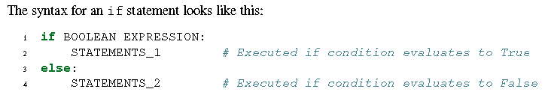
Conditional execution
12
The simplest form is the if statement:

Slide 13
Chained conditionals
13
marks= int(input("Please enter your marks")) if marks >39 and marks<50:
print("E grade")
elif marks >49 and marks<60: print("D grade")
elif marks >59 and marks<70: print("C grade")
else:
print("Pass")

Slide 14
Python for While Statements
14
while «expression»:
«block»
break
continue
n=int(input("enter a number value to find factorial of it"))
fact=1
i=1
while i <= n:
fact=fact*i i+=1
print(fact)

Slide 15
Range() in python
15
The range function has many versions.
range(a)
range(a, b, k)
The first number in the sequence is a.
b is the limit.
Each successive number in the sequence will increase by the step value k.

Slide 16
Python for Loop Statements
16
for “iterating_var” in sequence:
statements(s)
for x in range(55):
cnames = ["msrit", "hkbk", "bms"]
print(x)
key=input("enter college name")
flag=0
for i in range(10, 20):
print(i)
for x in cnames:
if key == x:
print("key is found in list")
flag=1
break
else:
for x in range(0, 20, 5):
print(x)
continue
if flag==0:
Dr.Parkavi.A-_{p}MS_{r}R_{i}I_{n}T, P_{t}y₍th"o_{k}n_{e}Pr_{y}ogra_{n}m_{o}m_{t}ing_{f}S_{o}es_{u}sio_{n}n i_{d}n S"T₎TP-HKBKCE
3-Sep-20

Slide 17
Nested Loops & Pass statement
17
sub = ["Data structure", "Oops", "DMS"] stud = ["Nithilan", "Harini", "Anjani"] print("Stud name","Sub name")
for x in stud:
for y in sub:
print(x, y)
for x in [0, 1, 2]: pass

Slide 18
Python Data Structures
18
▶ List is a collection which is ordered and changeable. Allows duplicate members.
▶ Tuple is a collection which is ordered and unchangeable.
Allows duplicate members.
▶ Set is a collection which is unordered and unindexed. No duplicate members.
▶ Dictionary is a collection which is unordered, changeable and
indexed. No duplicate members.

Slide 19
Lists
19
▶ A list is a data structure that holds an ordered collection of items (store a sequence of items in a list).
▶ The list of items should be enclosed in square brackets
▶ Once you have created a list, you can add, remove or search for items in the list. Since we can add and remove items, we say that a list is a mutable data type i.e. this type can be altered.

Slide 20
To create a list, changing list & accessing the list elements, looping through
20
The simplest is to enclose the elements in square brackets [ and ]:
studlist = ["Nithilan", "Harini", "Anjani","Shamma","Imma"] print(studlist)
print(studlist[-1]) print(studlist[:4]) print(studlist[4]) print(studlist[3:]) studlist[0]=“Nissi” print(studlist) print("Loop:")
for x in studlist:
print(x)

Slide 21
Check if Item Exists & Finding length of list
21
key=input("enter a name to search") if key in studlist:
print("Yes, key is in the list")
else:
print("Key is not found in the list")
print(len(studlist))

Slide 22
Add Items
22
studlist = ["Nithilan", "Harini", "Anjani","Shamma","Imma"] studlist.append("Anita")
print(studlist)
To add an item at the specified index, use the insert() method:
studlist.insert(1, "sini") print(studlist)

Slide 23
Remove , Pop, del & Clear
23
studlist.remove("Imma")
print(studlist)
studlist.clear() print(studlist)
studlist.pop()
print(studlist)
del studlist[2] print(studlist)

Slide 24
Remove elements from the list
24
▶ “remove” removes the first occurrence of a value from a list.
▶ If the value is not found in the list it raises an exception.
▶ Pop does two things: it removes the last element of the list, and it returns the value that it removed. Note that this is different from li[-1], which returns a value but does not change the list, and different from li.remove(value), which changes the list but does not return a value.

Slide 25
Copy a List
25
▶ Cannot copy a list simply by typing list2 = list1, because: list2 will only be a reference to list1, and changes made in list1 will automatically also be made in list2.
studlist = ["Nithilan", "Harini", "Anjani","Shamma","Imma"] studlist1 = studlist.copy()
print(studlist1)
studlist = ["Nithilan", "Harini", "Anjani","Shamma","Imma"] studlist1 = list(studlist)
print(studlist1)

Slide 26
Join Two Lists using + and append
26
studlist = ["Nithilan", "Harini", "Anjani","Shamma","Imma"] studlist1= ["Dharshana","Evangeline","Sini"] stud_new=studlist1+studlist
print(stud_new)
studlist = ["Nithilan", "Harini", "Anjani","Shamma","Imma"] studlist1= ["Dharshana","Evangeline","Sini"]
for x in studlist:
studlist1.append(x) print(studlist1)
studlist = ["Nithilan", "Harini", "Anjani","Shamma","Imma"] studlist1= ["Dharshana","Evangeline","Sini"] studlist1.extend(studlist)
print(studlist1)
studlist = ["Nithilan", "Harini", "Anjani","Shamma","Imma"]
studlist1= ["Dharshana","Evangeline","Sini"]
_{stu}Dr_{d}.Pa_{li}r_{s}ka_{t.}v_{a}i.A_{p}-M_{p}SR_{e}IT,_{n}Py_{d}tho₍n_{st}P_{u}rog_{d}ra_{li}m_{s}m_{t1}in₎g Session in STTP-HKBKCE
print(studlist)
3-Sep-20

Slide 27
The list() Constructor
27
▶ It is also possible to use the list() constructor to make a new list.
studlist = list(("Nithilan", "Harini", "Anjani","Shamma","Imma"))
print(studlist)

Slide 28
Python List sort() & List reverse() Method
28
studlist = list(("Nithilan", "Harini", "Anjani","Shamma","Imma")) studlist.sort()
print(studlist) studlist.reverse() print(studlist)

Slide 29
List Comprehensions
29
▶ List
comprehensions
provide
a concise way to create
containing expression
lists.
▶ It consists
of brackets
for clause, then
can
an
more for or if
followed clauses.
by a
The expressions
zero or
be anything, meaning
we can put in all kinds of objects in lists.
▶ The result will be a new list resulting from evaluating the expres
sion in the context of the for and if clauses which follow it.
▶ The list comprehension always returns a result list.

Slide 30
List Comprehensions Continued…
30
▶ The basic syntax is
[ expression for item in list if conditional ]
is equivalent to
for item in list:
if conditional:
expression

Slide 31
Example
31
rno = []
for x in range(55): rno.append(x)
print("Using loop",rno) rno1=[ x for x in range(50) ]
print("using list compre",rno1)

Slide 32
Tuples-Introduction
32
▶ A tuple is a sequence of immutable Python objects.
▶ Tuples are sequences, just like lists. The only difference is that tuples can't be
changed ie. tuples are immutable
▶ Tuples use parentheses and lists use square brackets.

Slide 33
Example on Tuples
33
studtuple = ("Nithilan", "Harini", "Anjani","Shamma","Imma")
print(studtuple)

Slide 34
Access Tuple Items, Range of Indexes & Negative Indexes
34
studtuple = ("Nithilan", "Harini", "Anjani","Shamma","Imma")
print(studtuple) print(studtuple[2]) print(studtuple[-2]) print(studtuple[2:5])
print(studtuple[-4:-1])

Slide 35
Change Tuple Values
35
▶ Once a tuple is created, you cannot change its values. Tuples are
unchangeable, or immutable as it also is called.
▶ But there is a workaround. You can convert the tuple into a list, change the list, and convert the list back into a tuple.
studtuple = ("Nithilan", "Harini", "Anjani","Shamma","Imma") print(studtuple) s=list(studtuple)
s[1]="Nutun" studtuple=tuple(s) print(studtuple)
studtuple = ("Nithilan", "Harini", "Anjani","Shamma","Imma")
print(studtuple)
studtuple[1]="Nutun"

Slide 36
Loop Through a Tuple
36
studtuple = ("Nithilan", "Harini", "Anjani","Shamma","Imma") print(studtuple)
for x in studtuple:
print(x)

Slide 37
Check if Item Exists
37
studtuple = ("Nithilan", "Harini", "Anjani","Shamma","Imma") print(studtuple)
key=input("enter a name to search") if key in studtuple:
print("Yes, key is in the tuple")
else:
print("Key is not found in the tuple")

Slide 38
38
Tuple Length
studtuple = ("Nithilan", "Harini", "Anjani","Shamma","Imma") print(len(studtuple))

Slide 39
Add Items
39
# error
studtuple = ("Nithilan", "Harini", "Anjani","Shamma","Imma")
studtuple[5]="kavitha"
print(len(studtuple))

Slide 40
Create Tuple With One Item
40
▶ To create a tuple with only one item, you have to add a comma after the item, otherwise Python will not recognize it as a tuple.
studtuple = ("Nissi",) print(type(studtuple))
studtuple = ("Nissi") print(type(studtuple))

Slide 41
Remove Items
41
▶ Tuples are unchangeable, so you cannot remove items from it, but you can delete the tuple completely:
studtuple = ("Nithilan", "Harini", "Anjani","Shamma","Imma") print(studtuple)
del studtuple
print(studtuple) # error

Slide 42
Join Two Tuples
42
studtup = ("Nithilan", "Harini", "Anjani","Shamma","Imma") studtup1= ("Dharshana","Evangeline","Sini","Sowmya") stud_new=studtup+studtup1
print(stud_new)

Slide 43
The tuple() Constructor
43
studtup = tuple(("Nithilan", "Harini", "Anjani","Shamma","Imma"))
print(studtup)

Slide 44
Tuple Methods()
44
▶ Python Tuple count() Method
studtup = tuple(("Nithilan","Imma", "Harini", "Anjani","Shamma","Imma")) print(studtup.count("Imma"))

Slide 45
Python Tuple index() Method
45
studtup = tuple(("Nithilan","Imma", "Harini", "Anjani","Shamma","Imma"))
print(studtup.index("Shamma"))

Slide 46
Python Dictionary
46
▶ A dictionary is mutable and is another container type that can store any
number of Python objects, including other container types.
their
Dictionaries consist of pairs (called items) of keys and
corresponding values.
▶ Python dictionaries are also known as associative arrays or hash tables.
The general syntax of a dictionary is as follows:
▶ Keys are unique within a dictionary while values may not be. The values of a dictionary can be of any type, but the keys must be of an immutable data type such as strings, numbers, or tuples.

Slide 47



What Is a Dictionary?
47
The syntax for declaring dictionaries in Python is
given below.
daily_temps = {'sun': 68.8, 'mon': 70.2, 'tue': 67.2, 'wed': 71.8}
Key
Value
The syntax for accessing an element of a dictionary is the same as for accessing elements of sequence types, except that a key value is used within the square brackets instead of an index
value:
daily_temps['sun']
Key

Slide 48
Dictionary
48
studdict ={
"Branch":"CSE",
"USN":"1MS19CS001",
"Name":"Nithilan"
}
print(studdict)

Slide 49
Accessing Items
49
studdict ={
"Branch":"CSE",
"USN":"1MS19CS001",
"Name":"Nithilan"
}
print(studdict["Branch"]) print(studdict.get("Branch"))

Slide 50
Change Values
50
studdict ={
"Branch":"CSE",
"USN":"1MS19CS001",
"Name":"Nithilan"
}
studdict["Branch"]="ECE" print(studdict["Branch"])

Slide 51
Loop Through a Dictionary
51
▶ When looping through a dictionary, the return value are the keys of the dictionary, but there are methods to return the values as well.
studdict ={
"Branch":"CSE",
"USN":"1MS19CS001",
"Name":"Nithilan"
}
Print all values in the dictionary, one by one:
studdict ={
"Branch":"CSE",
"USN":"1MS19CS001",
"Name":"Nithilan"
}
for x in studdict:
print(x)
for x in studdict: print(studdict[x])

Slide 52
Dictionary
52
▶ Use the values() method to return values of a dictionary:
Loop through both keys and values, by using the items() method:
studdict ={
"Branch":"CSE",
"USN":"1MS19CS001",
"Name":"Nithilan"
}
studdict ={ "Branch":"CSE",
"USN":"1MS19CS001",
"Name":"Nithilan"
}
for x,y in studdict.items(): print(x,y)
for x in studdict.values():
print(x)

Slide 53
Check if Key Exists
53
studdict ={ "Branch":"CSE",
"USN":"1MS19CS001",
"Name":"Nithilan“
}
if "USN" in studdict:
print("Yes, USN is one of the keys in the studdict dictionary")

Slide 54
Dictionary Length
54
studdict ={ "Branch":"CSE", "USN":"1MS19CS001",
"Name":"Nithilan"
}
print(len(studdict))

Slide 55
Adding Items
55
studdict ={ "Branch":"CSE",
"USN":"1MS19CS001",
"Name":"Nithilan“
}
studdict["Blood group"] ="O+“ print(studdict)

Slide 56
Removing Items
56
studdict ={ "Branch":"CSE",
"USN":"1MS19CS001",
"Name":"Nithilan"
}
studdict.pop("Branch") print(studdict)
studdict ={
"Branch":"CSE",
"USN":"1MS19CS001",
"Name":"Nithilan"
}
studdict.popitem() print(studdict)

Slide 57
The del keyword removes the item with the specified key name
57
studdict ={ "Branch":"CSE",
"USN":"1MS19CS001",
"Name":"Nithilan"
}
del studdict["USN"] print(studdict)

Slide 58
The del keyword can also delete the dictionary completely:
58
studdict ={ "Branch":"CSE",
"USN":"1MS19CS001",
"Name":"Nithilan"
}
del studdict print(studdict) # error

Slide 59
The clear() method empties the dictionary
59
studdict ={ "Branch":"CSE",
"USN":"1MS19CS001",
"Name":"Nithilan"
}
studdict.clear() print(studdict)

Slide 60
Copy a Dictionary
60
studdict ={ "Branch":"CSE",
"USN":"1MS19CS001",
"Name":"Nithilan"
}
s1=studdict.copy() print(s1)
studdict ={
"Branch":"CSE",
"USN":"1MS19CS001",
"Name":"Nithilan"
}
s1=dict(studdict) print(s1)

Slide 61
Nested Dictionaries
61
▶ A dictionary can also contain many dictionaries, this is called
nested dictionaries.
students = {
"stud1": {"Branch":"CSE","USN":"1MS19CS001","Name":"Nithilan"},
"stud2": {"Branch":"EEE","USN":"1MS19CS002","Name":"Dinesh"},
"stud3": {"Branch":"CV","USN":"1MS19CS003","Name":"Shammy"}
}
print(students)

Slide 62
Nested Dictionaries
62
▶ Create three dictionaries, then create one dictionary that will contain the other three dictionaries:
stud1= {"Branch":"CSE","USN":"1MS19CS001","Name":"Nithilan"}
stud2= {"Branch":"EEE","USN":"1MS19CS002","Name":"Dinesh"}
stud3= {"Branch":"CV","USN":"1MS19CS003","Name":"Shammy"} students = {
"S1" : stud1,
"S2" : stud2, "S3" : stud3
}
print(students)

Slide 63
The dict() Constructor
63
▶ Use the dict() constructor to make a new dictionary
stud1=dict(Branch="CSE",USN="1MS19CS001",Name="Nithilan") print(stud1)
# note that keywords are not string literals
# note the use of equals rather than colon for the assignment

Slide 64
Dictionary Methods
64

Slide 65
Python Dictionary fromkeys() Method
65
▶ The fromkeys() method returns a dictionary with the specified keys and the specified value.
x = ('USN','Name')
y =0
s = dict.fromkeys(x, y) print(s)

Slide 66
Python Dictionary keys() Method
66
▶ Return the keys:
studdict ={ "Branch":"CSE",
"USN":"1MS19CS001",
"Name":"Nithilan"
}
x = studdict.keys() print(x)

Slide 67
Dictionary pop() Method
67
studdict ={ "Branch":"CSE",
"USN":"1MS19CS001",
"Name":"Nithilan"
}
studdict.pop("Branch") print(studdict)

Slide 68
Dictionary popitem() Method
68
▶ Remove the last item from the dictionary:
studdict ={ "Branch":"CSE",
"USN":"1MS19CS001",
"Name":"Nithilan"
}
studdict.popitem() print(studdict)

Slide 69
Dictionary setdefault() Method
69
studdict ={ "Branch":"CSE",
"USN":"1MS19CS001",
"Name":"Nithilan"
}
studdict.setdefault("Bloodgroup","O+") print(studdict)

Slide 70
Dictionary update() Method
70
▶ Insert an item to the dictionary:
studdict ={ "Branch":"CSE",
"USN":"1MS19CS001",
"Name":"Nithilan"
}
studdict.update({"Bloodgroup":"O+"}) print(studdict)

Slide 71
Dictionary values() Method
71
▶ Return the values:
studdict ={ "Branch":"CSE",
"USN":"1MS19CS001",
"Name":"Nithilan"
}
x = studdict.values()
print(x)

Slide 72
Python Functions

Slide 73
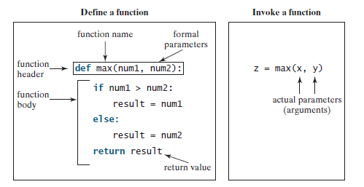
Defining Functions
73
You can define a function and invoke it with arguments

Slide 74
Creating a Function
74
def add():
print("addition function")

Slide 75
Calling a Function
75
def add():
print("addition function") add()

Slide 76
Arguments
76
def add(a,b):
print("addition function result:",a+b) add(1,2)

Slide 77
Number of Arguments
77
def add(a,b):
print("addition function result:",a+b,"this is for demo") add(1,2)

Slide 78
If you try to call the function with 1 or 3 arguments, you will get an error:
78
def add(a,b):
print("addition function result:",a+b,"this is for demo")
add(1)

Slide 79
Arbitrary Arguments, *args
79
▶ If we do not know how many arguments that will be passed into our function, add a * before the parameter name in the function definition.
▶ This way the function will receive a tuple of arguments, and can access the items accordingly:
def arb_arg_fun(*nums):
print("The third number is ", nums[2]) arb_arg_fun(23,34,45)

Slide 80
Keyword Arguments
80
▶ We can
also send arguments with
the key = value syntax.
▶ This way the order of the arguments does not matter.
def key_arg_fun(n1,n2,n3): print("The third number is ", n3)
key_arg_fun(n3=23,n1=34,n2=45)

Slide 81
Arbitrary Keyword Arguments, **kwargs
81
▶ If w do not know how many keyword arguments that will be passed into our function, add two asterisk: ** before the parameter name in the function definition.
▶ This way the function will receive a dictionary of arguments, and can
access the items accordingly:
def arb_key_arg_fun(**nums):
print("The third number is ", nums["n1"])
arb_key_arg_fun(n3=23,n1=34,n2=45)

Slide 82
Default Parameter Value
82
▶ If we call the function without argument, it uses the default value:
def def_fun(num=350): print("The number is ", num)
def_fun(23) def_fun(34) def_fun()

Slide 83
Passing a List as an Argument
83
def rno(nums):
print("The roll numbers ", nums)
sno=[34,45,23]
rno(sno)

Slide 84
Return Values
84
def gracemarks(num): return 2+num
n=gracemarks(34)
print(n)

Slide 85
The pass Statement
85
▶ Function definitions cannot be empty, but if you for some reason have a function definition with no content, put in the pass statement to avoid getting an error.
def function(): pass

Slide 86
Recursion
86
def fact(num):
if num ==1 : return 1
else: return num*fact(num-1)
n=fact(4) print(n)

Slide 87
References
87
▶ When we create an object and assign it to a variable, the variable only refers to the object and does not represent the object itself
▶ The variable name points to that part of our computer's memory where the object is stored. This is called as binding of the name to the object.

Slide 88
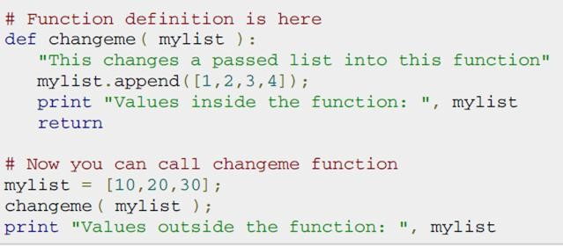

Pass by reference vs value
88
▶ All parameters (arguments) in the Python language are passed by reference. It means if we change what a parameter refers to within a function, the change also reflects back in the calling function.

Slide 89
Python Strings

Slide 90
Strings-Introduction
90
▶ Strings are amongst the most popular types in Python.
▶ We can create them simply by enclosing characters in quotes.
▶ Python treats single quotes the same as double quotes.
▶ Creating strings is as simple as assigning a value to a
variable. For example: var1 = 'Hello World!'
var2 = "Python Programming"

Slide 91
String Literals
91
▶ String literals in python are surrounded by either single quotation marks, or double quotation marks.
print("Hello") print('Hello')

Slide 92
92
Assign String to a Variable
name="rit“ print(name)

Slide 93
Multiline Strings
93
Assign a multiline string to a variable by using three quotes Or three
single quotes:
a = """M S Ramaiah Institute
of Technology Bangalore""" print(a)
a = '''M S Ramaiah Institute
of Technology Bangalore''' print(a)

Slide 94
Strings are Arrays
94
▶ Like many other popular programming languages, strings in Python are arrays of bytes representing unicode characters.
▶ However, Python does not have a character data type, a single character is simply a string with a length of 1.
▶ Square brackets can be used to access elements of the
string.

Slide 95
Strings are Arrays
95
name="rit“
print(name[1])

Slide 96
Slicing
96
▶ We can return a range of characters by using the slice syntax.
▶ Specify the start index and the end index, separated by a colon, to return a part of the string.
a = """M S Ramaiah Institute
of Technology Bangalore""" print(a[3:11])

Slide 97
Negative Indexing
97
▶ Use negative indexes to start the slice from the end of the string:
a = """M S Ramaiah Institute
of Technology Bangalore""" print(a[-9:-1])

Slide 98
String Length
98
▶ Len()
a = """M S Ramaiah Institute
of Technology Bangalore""" print(len(a))

Slide 99
String Methods
99
▶ The strip() method removes any whitespace from the beginning or the end
a = """ M S Ramaiah Institute
of Technology
Bangalore """
print(a.strip())
▶ The lower() method returns the string in lower
case:
a = """M S Ramaiah Institute
of Technology
Bangalore"""
Dr.Parkavi.A-MSRIT, Python Program_{p}m_{r}i_{i}n_{n}g S_{t}e₍s_{a}si.o_{l}n_{o}in_{w}ST_{e}TP_{r}-₍H₎K₎BKCE
3-Sep-20

Slide 100
String Methods
100
▶ The upper() method returns the string in upper case:
a = """M S Ramaiah Institute
of Technology Bangalore""" print(a.upper())
▶ The replace() method replaces a string with another string:
a = """M S Ramaiah
Institute
of Technology
Bangalore"""
Dr.Parkavi.A-MSRIT, _{p}Py_{r}th_{i}o_{n}n_{t}P₍r_{a}og_{.r}ra_{e}m_{p}m_{l}i_{a}ng_{c}S_{e}e₍ss"io_{M}n in _{S}STT"P,-"HK"BK₎C₎E
3-Sep-20

Slide 101
String Methods
101
▶ The split() method splits the string into substrings if it finds instances of the separator:
a = """Nithilan,Dinesh, Shamma""" print(a.split(","))

Slide 102
Check String
102
▶ To check if a certain phrase or character is present in a string, we can use the keywords in or not in.
Students = """Nithilan,Dinesh, Shamma""" x ="Dinesh" in Students
print(x)

Slide 103
String Concatenation
103
▶ To concatenate, or combine, two strings you can use the + operator.
f="Nithilan" l="Nathan" fn=f+" "+l print(fn)
▶ To add a space between them, add a " ":

Slide 104
String Format
104
▶ As we learned in the Python Variables chapter, we cannot combine strings and numbers like this:
▶ But we can combine strings and numbers by using the format() method!
▶ The format() method takes the passed arguments, formats them, and places
f="Nithilan" l="Nathan" age=9 fn=f+" "+l fn=fn + age print(fn)
f="Nithilan" l="Nathan" age=9 fn=f+" "+l
txt=" Student name is {} , {} yrs old"
print(txt.format(fn,age))
them in the string where
Dr.P_{t}a_{h}rka_{e}vi.A_{p}-M_{l}S_{a}RIT_{c}, P_{e}yth_{h}on_{o}Pr_{l}og_{d}ra_{e}m_{r}m_{s}ing {Se}ssion_{a}in_{r}S_{e}TTP:-HKBKCE
3-Sep-20

Slide 105
105
String format()
▶ The format() method takes unlimited number of arguments, and are placed into the respective placeholders

Slide 106
String Format()
106
▶ Use index arguments placeholders:
numbers
{0} to be sure the in the
are placed
correct
f="Nithilan" l="Nathan" age=9 fn=f+" "+l
txt=" Student name is {1} , {0} yrs old" print(txt.format(age,fn))

Slide 107
Escape Character
107
▶ Error
college="This STTP is hosted by "MSRIT" "
▶ To fix this problem, use the escape character \":
msg="This STTP is hosted by \"hkbk\" "print(msg)

Slide 108
Built-in Strings methods
108

Slide 109
String conversions
109
rno="34“ print(type(rno)) rno1=int(rno) print(type(rno1)) f=float("5.2") # height print(f) print(eval("5.2"))
n="345“
print(type(n)) n1=int(n) print(type(n1))
▶ Convert data types using functions ‘str’, ‘int’, ‘float’
▶ ‘repr’ is a variant of ‘str’
▶ The repr() function returns a printable representation.
▶ ‘str’ usually gives nicer-looking representation
▶ Function ‘eval’ interprets a string as a Python expression

Slide 110
Strings and Secret Codes
110
▶ The ord function returns the numeric (ordinal) code of a single character.
▶ The chr function converts a numeric code to the corresponding character.
print(ord("A"))
print(ord("a")) print(chr(65))

Slide 111
Strings and Secret Codes
111
▶ How can we convert a string containing digits into a number?
▶ Use a function called ‘eval’.
n=eval(input("enter student age:"))
print(n)
print(type(n))

Slide 112
Python string “center” method
112
▶ The method center() returns centered in a string of length width. Padding is done using the specifiedfillchar. Default filler is a space.
txt ="This sttp is hosted by Hkbk"
x = txt.center(100," ")
print(x)

Slide 113
String endswith function
113
▶ The method endswith() returns True if the string ends with the specified suffix, otherwise return False optionally restricting the matching with the given indices start and end.
txt ="This sttp is hosted by Hkbk" x = txt.endswith(".")
print(x)

Slide 114
Python string find method
114
The method find() determines if string str occurs in string, or in a substring of string if starting index beg and ending index end are given.
This method returns index if found and -1 otherwise.
txt ="This sttp is hosted by Hkbk" x = txt.find("sttp")
print(x)

Slide 115
String replace method
115
▶ The method replace() returns a copy of the string in which the occurrences of old have been replaced with new, optionally restricting the number of replacements to max.
txt ="This sttp is hosted by Hkbk" x = txt.replace("sttp","Conference") print(x)

Slide 116
Python File Handling

Slide 117
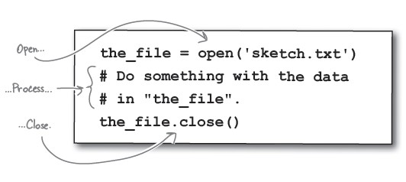
File Handling in Python
117
▶ Python provides basic functions and methods necessary to manipulate files by
default. We can do our most of the file manipulation using a file object.
▶ Before we can read or write a file, we have to open it using Python's built-in open() function. This function creates a file object which would be utilized to call other support methods associated with it.
▶ Syntax:

Slide 118
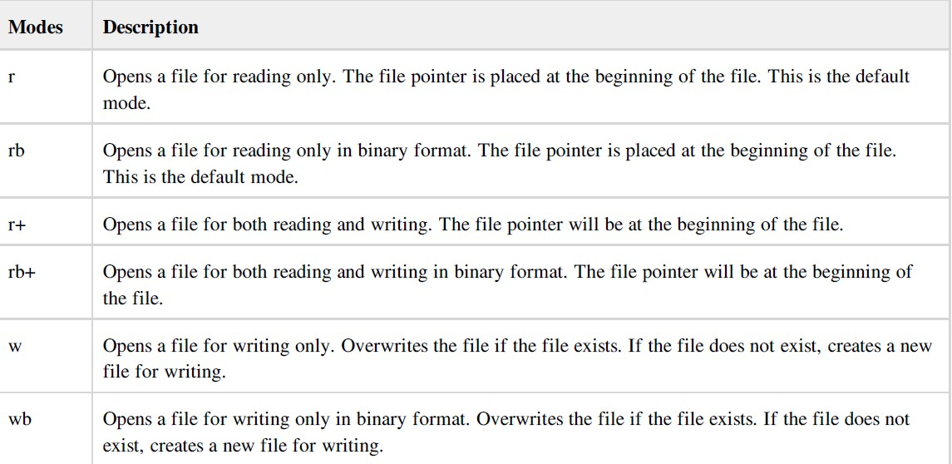
File modes
118

Slide 119
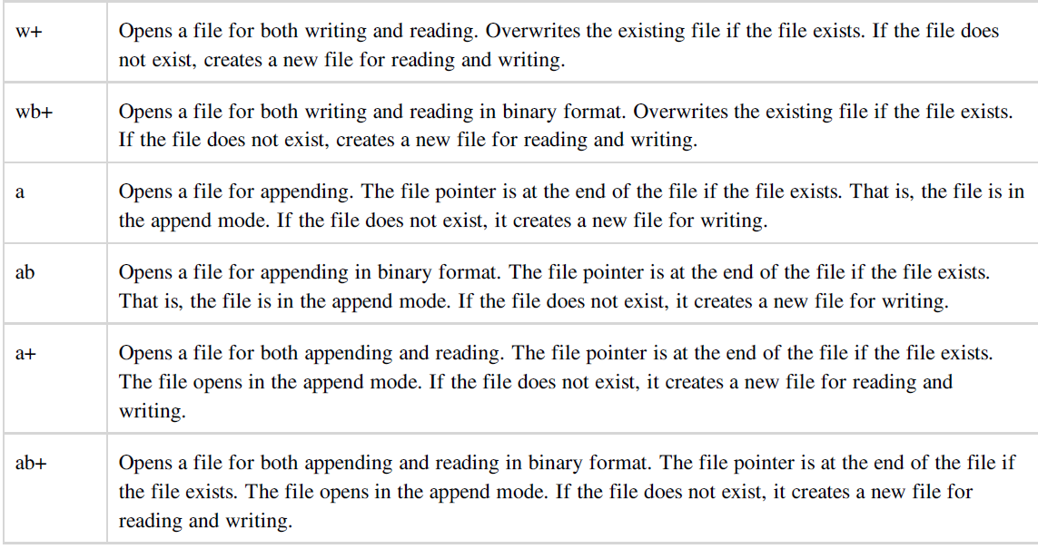
File modes
119

Slide 120
File Handling in Python- Open in W and R mode
120
f = open("stud.txt",'w') x="y"
while (x=="y") : name=input("enter name") f.write(name)
f.write("\n")
x=input("do u wish to contiue?(y/n)")
f = open("stud.txt",'r') print(f.read())
f = open("stud.txt",'r')
print(f.read(15))

Slide 121
121
Read Lines
f = open("stud.txt",'r') print(f.readline())

Slide 122
Close Files
122
f.close()

Slide 123
Write to an Existing File
123
f = open("stud.txt",'a') x="y“
while (x=="y") :
name=input("enter name") f.write(name)
f.write("\n")
x=input("do u wish to contiue?(y/n)")

Slide 124
124
Delete a File
import os os.remove("stud.txt") f = open("stud.txt",'r')

Slide 125
Delete Folder
125
import os os.rmdir(“students-data")

Slide 126
Python Objects and Classes

Slide 127
Overview of OOPS
127
▶ Class: A user-defined prototype for an object that defines a set of attributes that characterize any object of the class. The attributes are data members (class variables and instance variables) and methods, accessed via dot notation.
▶ Data member: A class variable or instance variable that holds data associated with a class and its objects.
▶ Function overloading: The assignment of more than one behavior to a particular function.
The operation performed varies by the types of objects (arguments) involved.
▶ Inheritance : The transfer of the characteristics of a class to other classes that are derived from it.
▶ Instance: An individual object of a certain class. An object obj that belongs to a class Circle, for example, is an instance of the class Circle.
▶ Method : A special kind of function that is defined in a class definition.
▶ Object : A unique instance of a data structure that's defined by its class. An object comprises both data members (class variables and instance variables) and methods.
▶ Operator overloading: The assignment of more than one function to a particular operator.

Slide 128
Defining a Class
128
▶ A class is a special data type which defines how to build a certain kind of object.
▶ The ‘class’ also stores some data items that are shared by all the
instances of this class.
▶ ‘Instances’ are objects that are created which follow the definition given inside of the class.
▶ Python doesn’t use separate class interface definitions as in some languages. We can just define the class and then use it.

Slide 129
Create a Class & Create Object
129
class StudClass:
rno =input("entr rno")
o1 = StudClass()
print(o1.rno)

Slide 130
Methods in Classes
130
▶ You can define a method in a class by including function definitions within the scope of the class block.
▶ Note that there is a special first argument self in all
of the method definitions.
▶ Note that there is usually a special method called
init in most classes.

Slide 131
Definition of a class
131
class StudClass:
def init (self, name, rno):
self.name = name
self.rno = rno o1 = StudClass("Nithilan",20) print(o1.rno,o1.name)

Slide 132
Instantiating Objects
132
▶ There is no “new” keyword as in Java.
▶ Merely use the class name with () notation and assign the result to a variable.
▶ The arguments you pass to the class name are actually given to its
. init () method.
class StudClass:
def init (self, name, rno):
self.name = name self.rno = rno
def print_name(self):
print("stud name : "+self.name)
o1 = StudClass("Nithilan",20)
print(o1.rno,o1.name)
o1.print_name()

Slide 133
No Need to “free”
133
▶ When you are done with an object, don’t have to delete or free it explicitly.
▶ Python has automatic garbage collection.
▶ Python will automatically detect when all of the references to a piece of memory have gone out of scope. Automatically frees that memory.
▶ Generally works well, few memory leaks.

Slide 134
del method
134
▶ Class can implement the special method del (), called a destructor, that is invoked when the instance is about to be destroyed.
▶ This method might be used to clean up any nonmemory resources used by an instance.

Slide 135
Modify, Delete Object & Object Properties and Pass stmt
135
o1.rno=34 print(o1.rno,o1.name)
del o1.rno
del o1
class Person: pass

Slide 136
Inheritance(Subclasses)
136
▶ A class can extend the definition of another class in order to use (or redefine) methods and attributes already defined in the previous one.
▶ New class: “subclass.” Original: “parent” or “ancestor.”
▶ When defining a subclass, put the name of the parent in parentheses
after the subclass’s name on the first line of the definition.
class ai_student(student):
▶ Python has no ‘extends’ keyword like Java.
▶ Multiple inheritance is supported.

Slide 137
Create a Parent Class
137
class StudClass:
def init (self, name, rno): self.name = name
self.rno = rno
def print_name(self): print("stud name : "+self.name)
o1 = StudClass("Nithilan",20)
print(o1.rno,o1.name)
o1.print_name()

Slide 138
Create a Child Class
138
class StudClass:
def init (self, name, rno):
self.name = name self.rno = rno
def print_name(self):
print("stud name : "+self.name)
o1 = StudClass("Nithilan",20) print(o1.rno,o1.name) o1.print_name()
class UGStudClass(StudClass):
pass
x = UGStudClass("Dinesh","45")
Dr.Parkavi.A-MSRIT, PythonxPr.opgrraimnmt_ingnSaemssioen(in)STTP-HKBKCE
3-Sep-20

Slide 139
Add the init () Function
139
class UGStudClass(StudClass):
def init (self, name, rno):
StudClass. init (self,name,rno)

Slide 140
Use the super() Function
140
super() function that will make the child class inherit all the methods and properties from its parent
class UGStudClass(StudClass):
def init (self,name,rno):
super(). init (name,rno)

Slide 141
Add Properties
141
class UGStudClass(StudClass):
def init (self,name,rno,std):
super(). init (name,rno) self.std=4
x = UGStudClass("Dinesh","45",3) x.print_name()

Slide 142
Add Methods
142
class UGStudClass(StudClass):
def init (self,name,rno,std):
super(). init (name,rno)
self.std=4
def print_all(self):
print(self.name,"studies in std:",self.std)
x = UGStudClass("Dinesh","45",3) x.print_all()

Slide 143
Overriding Methods
143
class StudClass:
def init (self,name,rno):
self.name = name self.rno = rno
def print_all(self):
print("stud name : "+self.name) o1 = StudClass("Nithilan",20) print(o1.rno,o1.name)
o1.print_all()
class UGStudClass(StudClass):
def init (self,name,rno,std):
super(). init (name,rno) self.std=4
def print_all(self):
print(self.name,"studies in std:",self.std)
Dr.Parkxavi=.A-MUSRGIT, SPytthuodn CProlgarasmsm("inDg Siensseiosn hin"S,TT"P4-H5KB"K,C3E)
x.print_all()
3-Sep-20

Slide 144
Python Modules

Slide 145
Python module
145
▶ A module is a file containing Python definitions and statements. The file name is the module name with the suffix .py appended.
▶ Within a module, the module’s name (as a string) is available as the value
of the global variable name .
▶ A module allows you to logically organize your Python code. Grouping related code into a module makes the code easier to understand and use.
▶ The import Statement Syntax
import module1[, module2[,... moduleN]
▶ A module can contain executable statements as well as function definitions. These statements are intended to initialize the module. They are executed only the first time the module is imported somewhere.

Slide 146
Create & Use a Module
146
▶ To create a module just save the code you want in a file with the file extension .py:
def add(a,b):
print("result ",a+b)
import addition
addition.add(2,4)

Slide 147
Variables in Module & importing them
147
▶ The module can contain functions, as already described, but also variables of all types (arrays, dictionaries, objects etc):
person1 = { "name": "John", "age": 36,
"country": "Norway"
}
import mymodule
a = mymodule.person1["age"]
print(a)

Slide 148
Naming & Re-naming a Module a Module
148
import mymodule as mx
a = mx.person1["age"]
print(a)

Slide 149
Built-in Modules
149
import platform
x = platform.system() print(x)

Slide 150
Using the dir() Function
150
▶ There is a built-in function to list all the function names (or variable names) in a module. The dir() function:
import platform x = dir(platform)
print(x)

Slide 151
Import From Module
151
▶ We can choose to import only parts from a module, by using the from keyword.
def greeting(name):
print("Hello, " + name)
from mymodule import person1
print (person1["age"])
person1 = { "name": "John", "age": 36,
"country": "Norway"
}

Slide 152
from ….import* statement
152
▶ It is also possible to import all names from a module into the current namespace by using the following import statement:
from modname import *
▶ This provides an easy way to import all the items from a module into the current namespace; however, this statement should be used sparingly.

Slide 153
import vs from import statement
153
▶ ‘import’ gives a name that refers to the whole module object. We must go through the module name to fetch its attribute.
▶ ‘from import’ copies names from one file over to another scope also it allows to use the copied names directly in the script without module name.

Slide 154

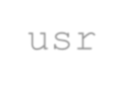
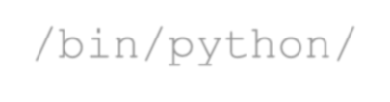
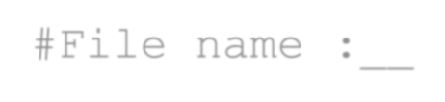
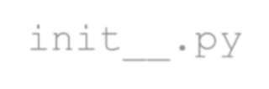
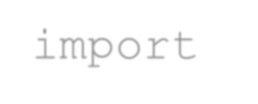
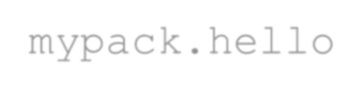
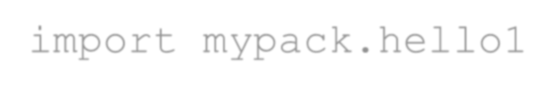
Steps to create a package
154
▶ Create a directory as package name. eg
#/home/lab1/mkdir mypack
▶ Copy the .py files (modules which you want to keep under package) to mypack directory. Eg. Hello.py, Hello1.py
▶ Cretae init .py file in mypack directory and import all the modules which
we want to keep in package eg
#cd mypack and create the file with the following code
#/!usr/bin/python/
#File name : init .py
import mypack.hello import mypack.hello1
▶ Create another python file to run the package in home directory (eg. packex.py)

Slide 155

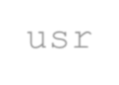
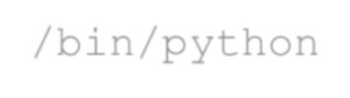
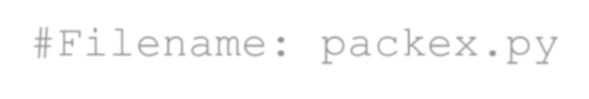
Steps to create a package
#! #F
 |  | Type-1 | Type-2 | Type-3
 |  | import mypack mypack.hello.fun1() mypack.hello1.fun2() | from mypack import * hello.fun1() hello1.fun2() | x= import ('mypack') x.hello.fun1() x.hello1.fun2()
Ex #l |  | ecute the package to run the modules in the package ab11> python packex.py
155
▶ #cd ..
▶ #lab1>
/usr/bin/python ilename: packex.py
# The packex.py can be written in any of the following types
_{Wi}D_{l}r_{l}.Pa_{e}rk_{x}a_{e}vi_{c}.A_{u}-M_{t}S_{e}RIT_{a}, _{l}P_{l}yth_{t}o_{h}n_{e}Pro_{m}gra_{o}m_{d}m_{u}in_{l}g_{e}S_{s}es₍si_{H}on_{e}in_{l}S_{l}T_{o}TP.-_{p}HK_{y}B,K_{H}CE_{ello1.py)}
3-Sep-20

Slide 156
Regular Expressions

Slide 157
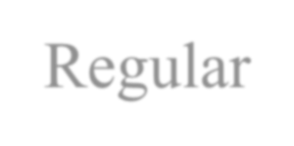

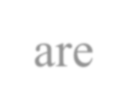
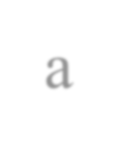


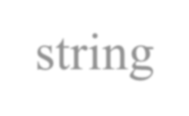





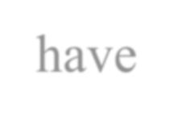
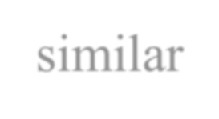



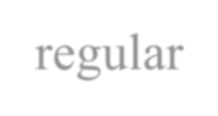
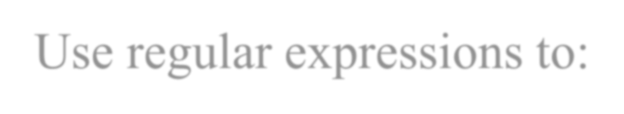

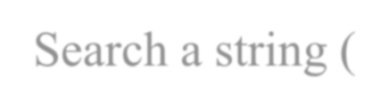

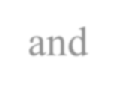
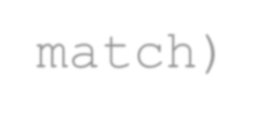
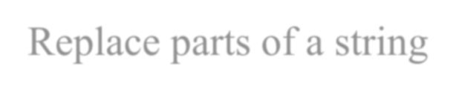
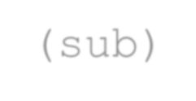

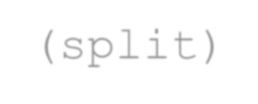
Regular Expressions
157
▶ Regular expressions are a powerful string manipulation tool
▶ All modern
languages have similar library packages for
regular expressions
▶ Use regular expressions to:
▶ Search a string (search and match)
▶ Replace parts of a string (sub)
▶ Break strings into smaller piece (split)

Slide 158
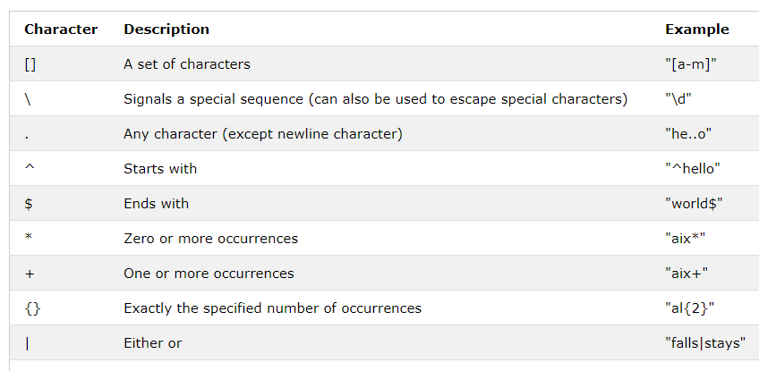
Regular Expression Meta characters
158

Slide 159
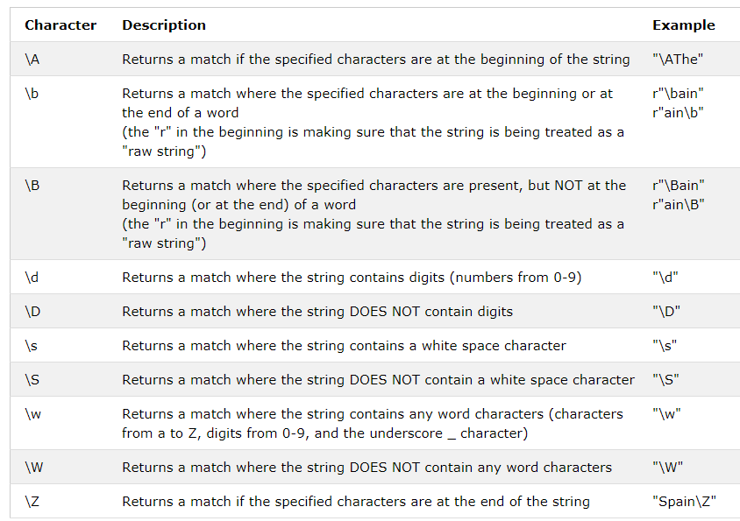
Regular Expression Special Sequences
159

Slide 160
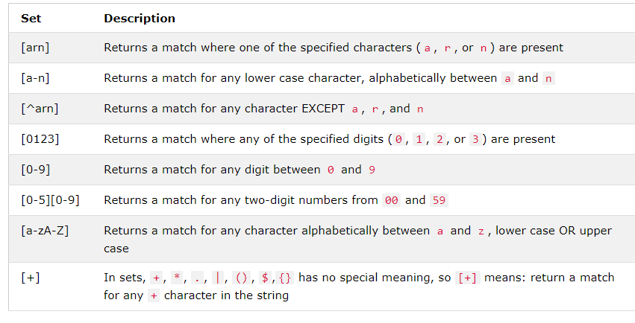
Sets
160

Slide 161
RegEx Module &
Search for strings
161
import re
txt = "The rain in Spain“
x = re.search("^The.*Spain$", txt) print(x)
Search the string to see if it starts with "The" and ends with "Spain“.

Slide 162
RegEx Functions
162

Slide 163
The findall() Function
163
▶ The findall() function returns a list containing all matches.
import re
txt ="The rain in Spain“ x = re.findall("ai",txt) print(x)
x = re.findall("Portugal",txt) print(x)

Slide 164
The search() Function
164
▶ The search() function searches the string for a match, and returns a Match object if there is a match.
▶ If there is more than one match, only the first occurrence of the
match will be returned
import retxt ="The rain in Spain“ x = re.search("\s",txt)
print("The first white-space character is located in position:",x.start())

Slide 165
Search with result (no match)
165
import re
txt = "The rain in Spain"
x = re.search("Portugal", txt) print(x)

Slide 166
The split() Function
166
▶ The split() function returns a list where the string has been split at each match
import re
txt = "The rain in Spain" x = re.split("\s", txt) print(x)

Slide 167
The sub() Function
167
▶ The sub() function replaces the matches with the text of our choice
import re
txt = "The rain in Spain" x = re.sub("\s", "9", txt) print(x)

Slide 168
References
168
▶ | https://sites.google.com/a/msrit.edu/python_lab/
▶ | https://en.wikipedia.org/wiki/History_of_Python
▶ | https://www.geeksforgeeks.org/python-features/
▶ | https://www.python.org/doc/essays/blurb/
▶ | https://www.educative.io/edpresso/what-is-a-scripting-language
▶ | https://flylib.com/books/en/2.725.1.24/1/
▶ | https://www.fullstackpython.com/development-environments.html
▶ | https://realpython.com/what-can-i-do-with-python/
▶ | https://www.programiz.com/python-programming/online-compiler/
▶ | https://www.w3schools.com/python/python_for_loops.asp
▶ | https://www.programiz.com/python-programming/list-comprehension
▶ | https://www.tutorialspoint.com/python/python_tuples.htm
▶ | https://www.onlinegdb.com/online_python_compiler
▶ | https://repl.it/languages/python3

