Slide 1
Distributional Reduction: Unifying Dimensionality Reduction and Clustering
Name: Pruthvik Sheth
Short Story Assignment
CMPE – 255 Data Mining

Slide 2
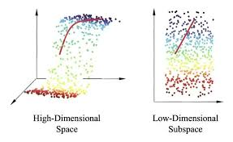
Problem Statement
Challenge: Making sense of high-dimensional data
Two traditional approaches:
Dimensionality Reduction (DR).
Clustering.
Need for unified approach.

Slide 3
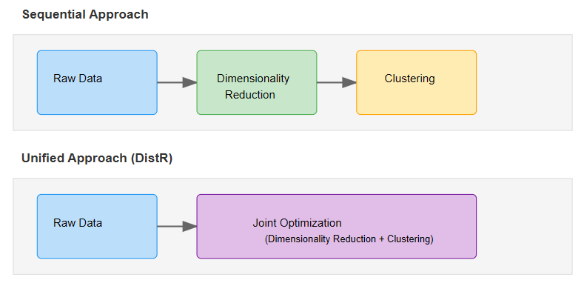
Traditional Methods Limitations
DR and clustering typically used separately
Sequential processing can lose information
No unified mathematical framework
Missed opportunities for joint optimization

Slide 4
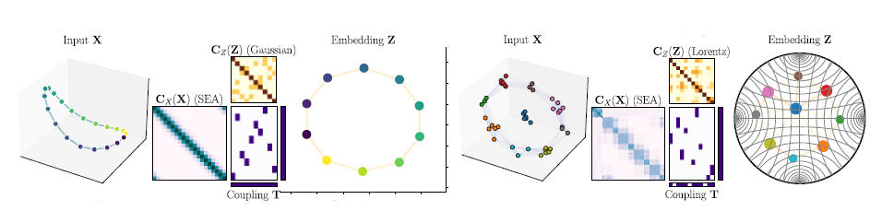
Introducing DistR
Novel unified framework using optimal transport
Key innovation: Uses Gromov-Wasserstein framework
Handles both tasks simultaneously

Slide 5
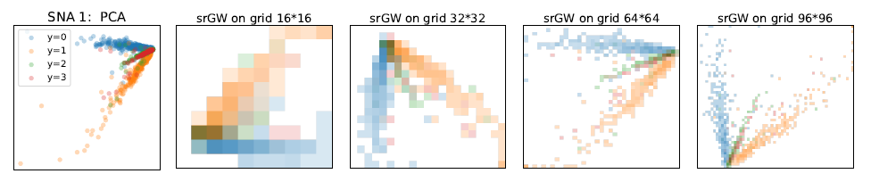
How DistR Works
Data as probability distributions.
Optimal transport for comparing distributions.
Joint optimization of:
Dimensionality reduction
Clustering

Slide 6
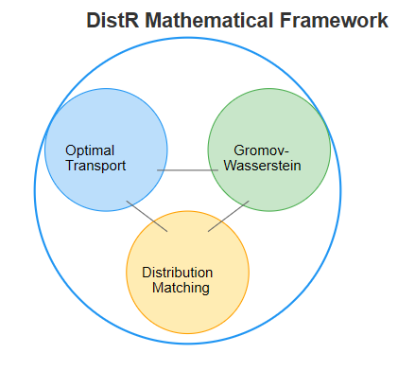
Technical Framework
Gromov-Wasserstein distance.
Semi-relaxed GW divergence.
Flexible similarity measures.

Slide 7
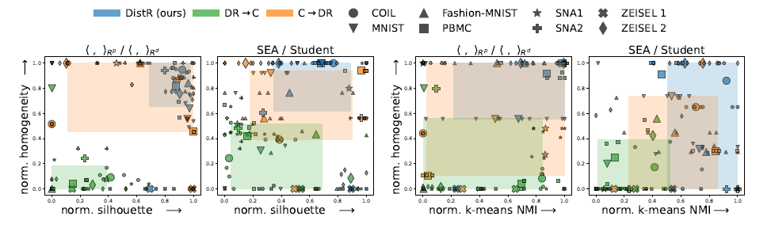
Key Advantages
Unified Processing.
Better structure preservation.
Automatic adaptation to data.
Flexible geometry support.

Slide 8
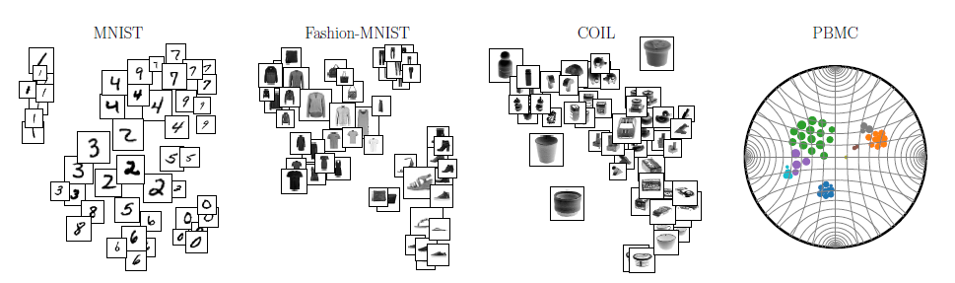
Real-World Applications
Image Analysis (MNIST, Fashion-MNIST)
Genomic Data (PBMC)
General Data Mining.

Slide 9
Results & Performance
Quantitative Improvements:
Higher clustering quality:
Better homogeneity scores.
Improved silhouette coefficients.
DR Quality:
Better structure preservation.
More meaningful embeddings.
Consistency:
Stable across different datasets.
Robust to parameter changes.

Slide 10
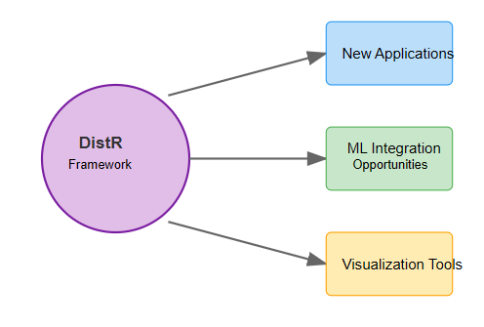
Future Implications
Extended applications in bioinformatics.
Integration with other ML techniques.
Potential for new visualization tools.

Slide 11
Conclusion
First unified framework for DR and clustering
Superior performance over sequential approaches
Theoretical soundness with practical utility
Opens new research directions Impact:
Improved data analysis tools
Better understanding of complex datasets
More efficient processing pipeline

Slide 12
References
Main Paper
Van Assel, H., Vincent-Cuaz, C., et al. (2024). "Distributional Reduction: Unifying Dimensionality Reduction and Clustering with Gromov-Wasserstein." arXiv:2402.02239v2

Slide 13
Thank you

