Slide 1
Divide and Conquer Sorting

Slide 2
What is Divide and Conquer ?
The Divide and Conquer is a strategy of solving large problems by:
- Breaking the problem into smaller sub-problems.
Solving the sub-problems , and
Combining them to get the desired output.

Slide 3
How Divide and Conquer works?
1. Divide: Divide the given problem into sub-problems using recursion.
2. Conquer: Solve the smaller sub-problems recursively. If the subproblem is small enough, then solve it directly.
3. Combine: Combine the solutions of the sub-problems that are part of the recursive process to solve the actual problem.

Slide 4
Quick-sort
Quick-Sort uses Divide and conquer strategy . It picks an element as a pivot and partitions the given array around the picked pivot. There are many different versions of quick-Sort that pick pivot in different ways.
Always pick the first element as a pivot.
Always pick the last element as a pivot.
Pick a random element as a pivot.
Pick median as the pivot.
But we picked 1st element as pivot in our case.

Slide 5
How does Quick-Sort works?
An array is divided into subarrays by selecting a pivot element (element selected from the array). While dividing the array, arrange the elements other than pivot element in such a way that elements less than pivot are kept on the left side and elements greater than pivot are on the right side of the pivot.
The left and right subarrays are also divided using the same approach. This process continues until each subarray contains a single element.
At this point, elements are already sorted. Finally, elements are combined to form a sorted array.

Slide 6
ALGORITHM OF QUICKSORT
STEP 0: START
STEP 1: PRINT THE UNSORTED ARRAY OR GIVEN ARRAY
STEP 2: READ THE VARIABES i, j, pivot, temp, count, array ,first ele, last ele
STEP 3: IF FIRST ELE LESS THAN LAST ELE, THEN
PIVOT IS ASSIGNED BY FIRST ELE
I IS ASSIGNED BY FIRST ELE
J IS ASSIGNED BY LAST ELE
STEP 4: WHILE(I LESS THAN J), THEN
WHILE(NUMBER[I] LESS THAN OR EQUAL TO NUMBER[PIVOT] LOGICAL AND I LESS THAN LAST), THEN
INCREMENT I BY 1
WHILE(NUMBER[J] GREATER THAN NUMBER[PIVOT]),THEN
DECREMENT J BY 1
STEP 5: REPEAT STEP 4 FOR THE CONDITION
IF (I LESS THAN J), THEN
SWAP I AND J,
ELSE,
SWAP J AND PIVOT
STEP 6: REPEAT STEP 5 UNTIL THE ELEMENTS ARE SORTED IN ARRAY
STEP 7: PRINT THE SORTED ARRAY
STEP 8: STOP

Slide 7
‘C’ PROGRAM OF QUICKSORT
#include <stdio.h>
void quicksort (int number[25],int first, int last)
{
int i, j, pivot, temp;
if(first<last)
{
pivot= first;
i= first;
j= last;
while(i<j)
{
while(number[i]<=number[pivot]&&i<last)
i++;
while(number[j]>number[pivot])
j--;
if(i<j)
{
temp=number[i];
number[i]=number[j];
number[j]=temp;
}
}
temp=number[pivot];
number[pivot]=number[j];
number[j]=temp;
quicksort (number, first, j-1);
quicksort (number, j+1, last);
}
}
int main()
{
int i,count,number[25];
printf("How many elements are u going to enter?: ");
scanf("%d",&count);
printf("Enter %d elements: ", count);
for(i=0;i<count;i++)
scanf("%d",&number[i]);
quicksort(number,0,count-1);
printf("Order of Sorted elements: ");
for(i=0;i<count;i++)
printf(" %d",number[i]);
return 0;
}

Slide 8
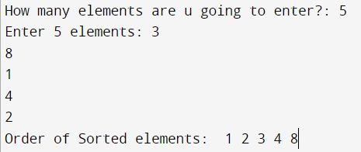
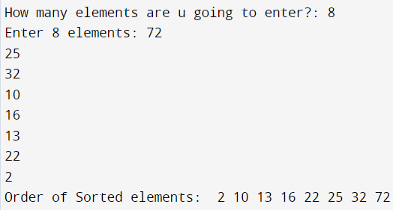
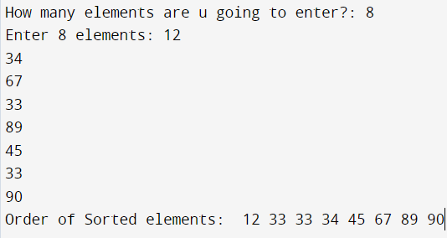
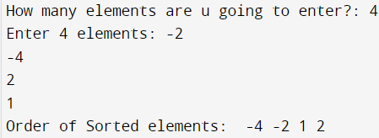
OUTPUT OF QUICK-SORT

Slide 9
Decrease and conquer Sorting

Slide 10
What is Decrease and Conquer
Decrease and conquer is a technique used to solve problems by reducing the size of the input data at each step of the solution process.
Decrease or reduce problem instance to smaller instance of the same problem and extend solution. Conquer the problem by solving smaller instance of the problem.

Slide 11
How does Decrease and Conquer work?
It also include following steps:
Decrease or reduce problem instance to smaller instance of the same problem and extend solution.
Conquer the problem by solving smaller instance of the problem.
Extend solution of smaller instance to obtain solution to original problem.
Basic idea of the decrease-and-conquer technique is based on exploiting the relationship between a solution to a given instance of a problem and a solution to its smaller instance.

Slide 12
INSERTION SORT
Insertion Sort uses decrease and conquer method. In which an element is picked and compared with next elements and arranged according to it.
One of the advantages of insertion sort is that it is an in-place sorting algorithm, which means that it does not require any additional storage space other than the original list.
Insertion sort is a simple, yet effective sorting algorithm that can be used for small datasets.

Slide 13
How does INSERTION SORT works?
Initially, the sorted part contains only the first element of the list, while the rest of the list is in the unsorted part. The algorithm then iterates through each element in the unsorted part, picking one at a time, and inserts it into its correct position in the sorted part.
To do this, the algorithm compares the current element with each element in the sorted part, starting from the rightmost element. It continues to move to the left until it finds an element that is smaller (if sorting in ascending order) or larger (if sorting in descending order) than the current element.
Once the correct position has been found, the algorithm shifts all the elements to the right of that position to make room for the current element, and then inserts the current element into its correct position.
This process continues until all the elements in the unsorted part have been inserted into their correct positions in the sorted part, resulting in a fully sorted list.

Slide 14
ALGORITHM FOR INSERTION SORT
STEP 0: START
STEP 1: GIVE THE ARRAY ELEMENTS
STEP 2: READ THE VARIABLES n, I, j, temp, a[100]
STEP 3: FOR i = FIRST ELEMENT TO LAST ELEMENT
J ASSIGNED BY I
WHILE (A[j-1] IS GREATER THEN A[j])
SWAP A[j] AND A[j-1]
DECREMENT j BY 1
STEP 4: INCREMENT i VALUE BY 1
STEP 5: REPEAT STEP 3 AND STEP 4 UNTIL TERMINATION
STEP 6: PRINT THE SORTED ARRAY
STEP 7: STOP

Slide 15
‘C’ PROGRAM OF INSERTION SORT
#include <stdio.h>
int main()
{
int n, i, j, temp, a[100];
printf("Enter number of elements \n");
scanf("%d", &n);
printf("Enter %d integers \n", n);
for (i = 0; i < n; i++)
{
scanf("%d", &a[i]);
}
for (i = 1 ; i <= n - 1; i++)
{
j = i;
while (a[j-1] > a[j])
{
temp = a[j];
a[j] = a[j-1];
a[j-1] = temp;
j--;
}
}
printf("Sorted list in ascending order:\n");
for (i = 0; i <= n - 1; i++)
printf("%d ", a[i]);
return 0;
}

Slide 16
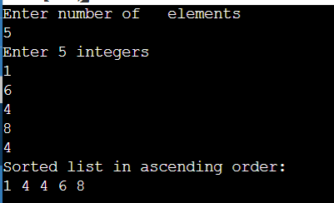
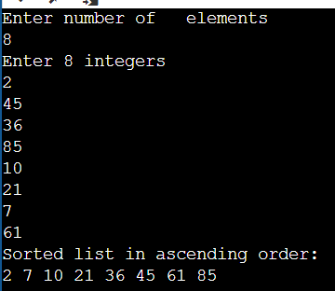
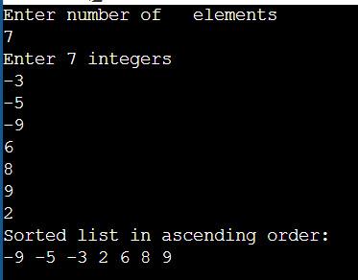
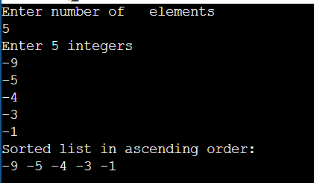
OUTPUT OF INSERTION SORT

Slide 17
DIVIDE AND CONQURE vs DECREASE AND CONQURE
DIVIDE AND CONQURE
DECREASE AND CONQURE
It is a strategy which divides the main problem into a several smaller subproblems.
It uses ‘Divide’ , ’conquer’ and ‘Combine’ strategy.
We combine all the Solved subproblems to yield the desired output.
Mainly used in solving larger data.
It is a strategy which decreases the complexity of the main problem into a single simpler problem.
It uses ‘Decrease’ , ’Conquer’ strategy.
No point in combining because we have only one reduced problem which to be solved to yield the desired output.
Mainly used in solving smaller data.

Slide 18
DIVIDE AND CONQURE vs DECREASE AND CONQURE
DIVIDE AND CONQURE
DECREASE AND CONQURE
Complexity of the problem remains same , but the length of the problem is reduced.
Examples which follow Divide and conquer strategy:
Quick-sort
Merge-sort
Length of the problem remains same , but the complexity of the problem is reduced.
Examples which follow Decrease and conquer strategy.
Insertion-sort
BFS AND DFS

Slide 19
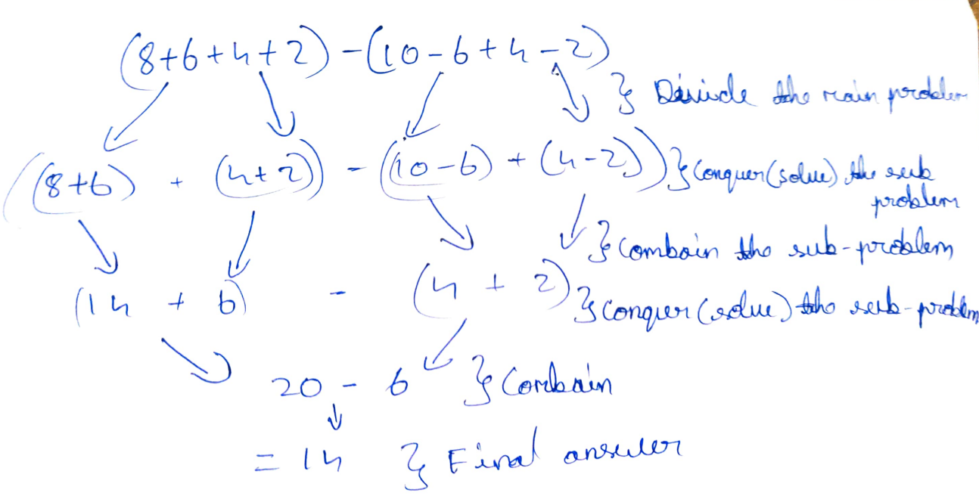
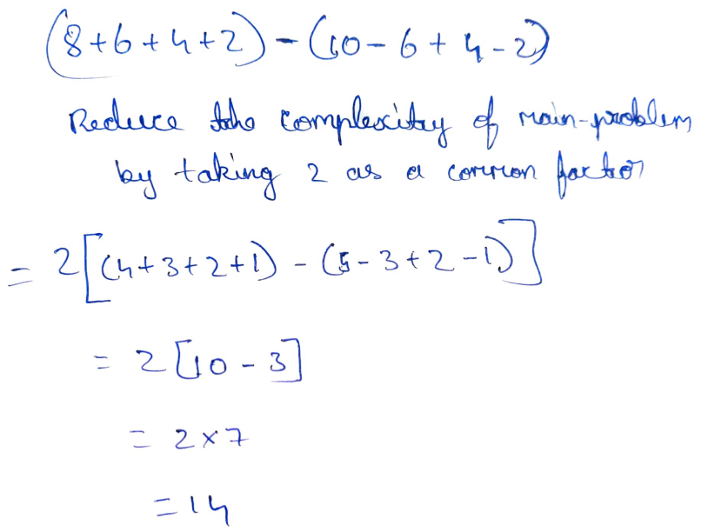
DIVIDE AND CONQURE vs DECREASE AND CONQURE
DIVIDE AND CONQURE
DECREASE AND CONQURE
Here is a simple math example:
Here is a simple math example:

Slide 20
THANK YOU!!
Group Members:
1) V Sai Kishan (1NT21AD056)
2) Pruthvi Krishna T S (1NT21AD037)
3) Avin H R (1NT21AD013)
4) Vignesh S (1NT21AD059)
5) Venesh (1NT21AD061)

