Slide 1
Package Pricing at Mission Hospital
PRUTHVINATH JERIPITY VENKATA

Slide 2
INTRODUCTION
Problem: to predict the total costs based on various variables.
Goal:
Obesity related to length of stay in hospital
Obesity related to total costs incurred
Obesity associated with other medical conditions
Hyper or hypotension related to the length of stay
Develop prediction model to estimate total cost incurred by the hospital
Software used: Microsoft Excel

Slide 3
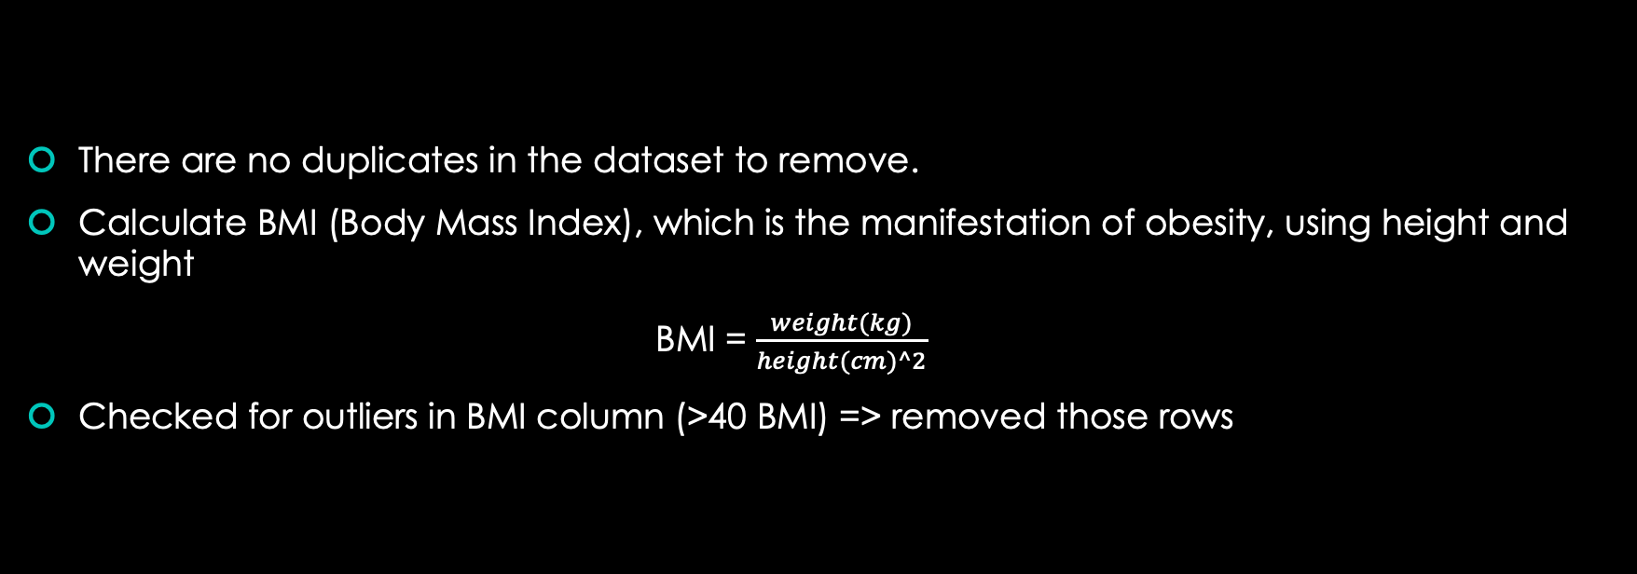
PROCESS
There are no duplicates in the dataset to remove.
Calculate BMI (Body Mass Index), which is the manifestation of obesity, using height and weight
BMI = $\frac{weight(kg)}{height(cm)^2}$
Checked for outliers in BMI column (>40 BMI) => removed those rows

Slide 4
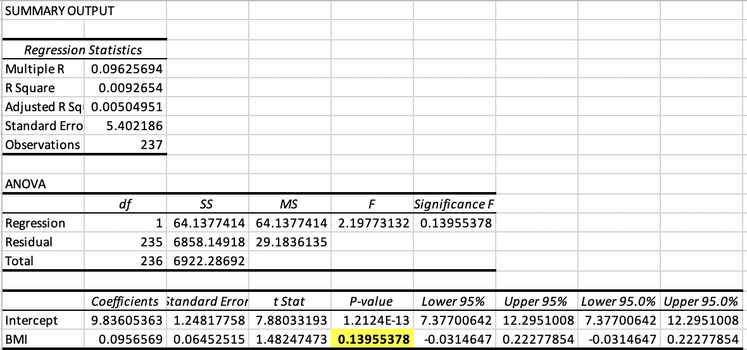
Total length of the stay Vs. BMI
Then applied the linear regression on BMI and Total length of stay to find the relation between both.
Conclusion: p-value is 13.95% which is greater than 5% => no strong relation can be established.

Slide 5
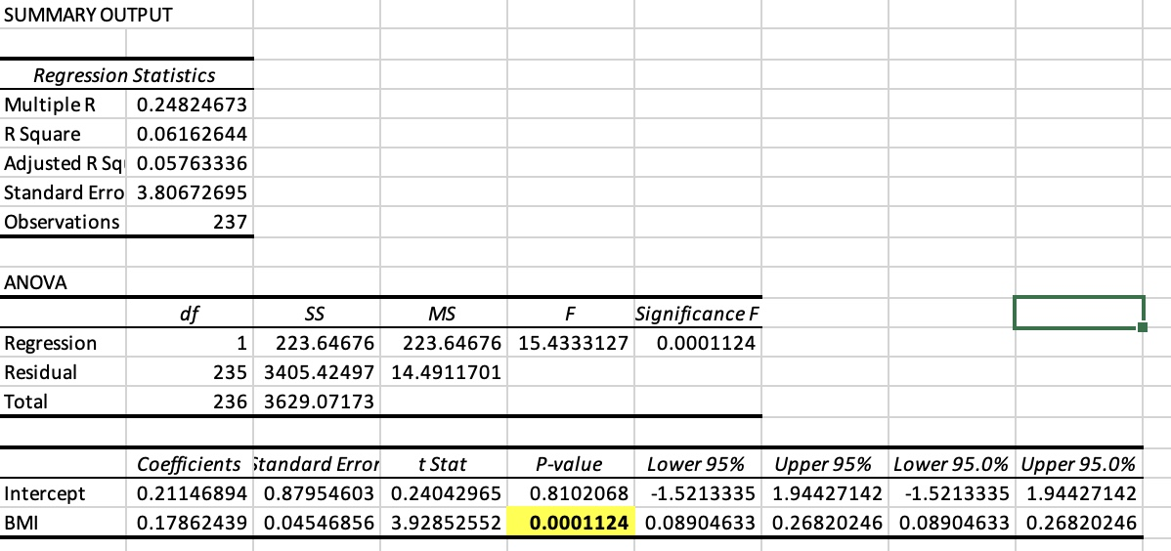
Length of stay in ICU Vs. BMI
But tried linear regression on Length of stay in ICU and BMI.
P-value is 0.011% which establishes a strong relation between ICU stay and BMI.
Conclusion: As BMI increases (obesity increases), length of stay in ICU also increases.

Slide 7
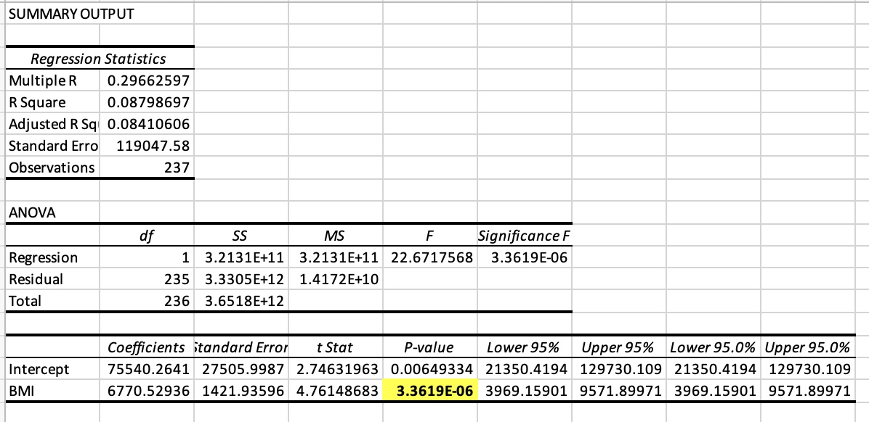
Total cost borne by hospital Vs. BMI
P-value is 0.00036% which very trivial => establishes a very strong relation between total cost and BMI.
Conclusion: As BMI increases, total cost to be borne by the hospital also increases.

Slide 9
Binary regression model between Medical condition (Y/N) Vs BMI
 | Scenario Summary
 |  |  | Current Values: | Binary
 | Changing Cells:
 |  | $AJ$6 | 0.001 | -2889.742267
 |  | $AJ$7 | 0.001 | -53687.0902
 | Result Cells:
 |  | $AF$6 | -166.6064132 | 0
 | Notes: Current Values column represents values of changing cells at
 | time Scenario Summary Report was created. Changing cells for each
 | scenario are highlighted in gray.
Probability: e^(-2889.74 – 53687.09*BMI)
Probability for every case, irrespective of previous medical condition, is 1.
Conclusion: there is no relation between previous medical condition and BMI (Obesity).

Slide 10
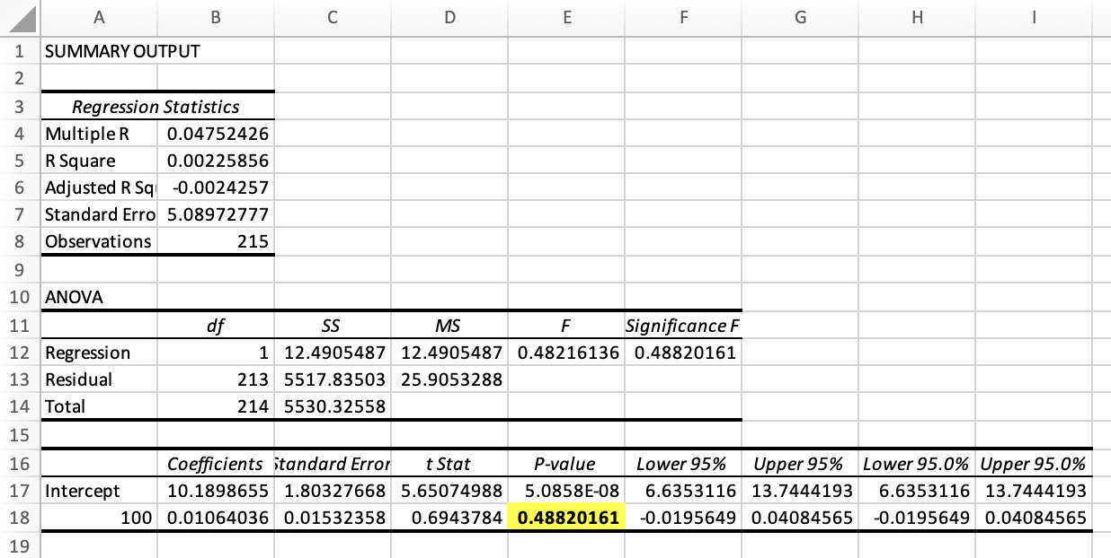
Hypertension Vs Total len of stay
Removed blank cells and then applied linear regression model.
P-value is 48.8% => no relation can be established.

Slide 11
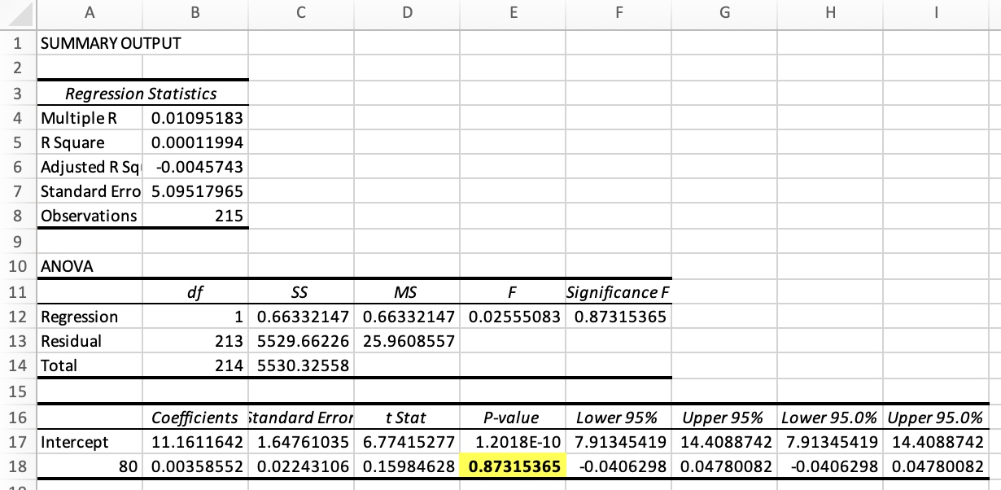
Hypotension Vs Total len of stay
P-value is 87% => no relation can be established.

Slide 12
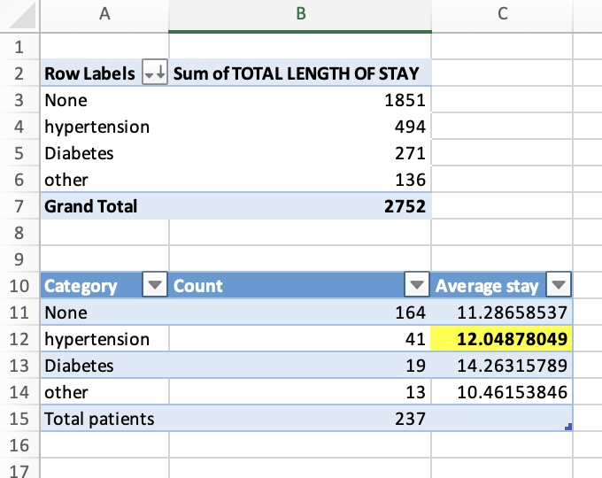
Relation between prior med condition and length of stay
Initially, prior health conditions are categorized into 4:
Diabetes
Hypertension
Other
None.
Method should be used to find relation: ANOVA (Don’t know how to do ANOVA method in Excel => so found the average length of stay for each category => more average represents more relation)
Conclusion: average length of stay with Diabetes > Hypertension > None > Other. But we can’t establish a relation between prior med condition and total cost with this conclusion.

Slide 14
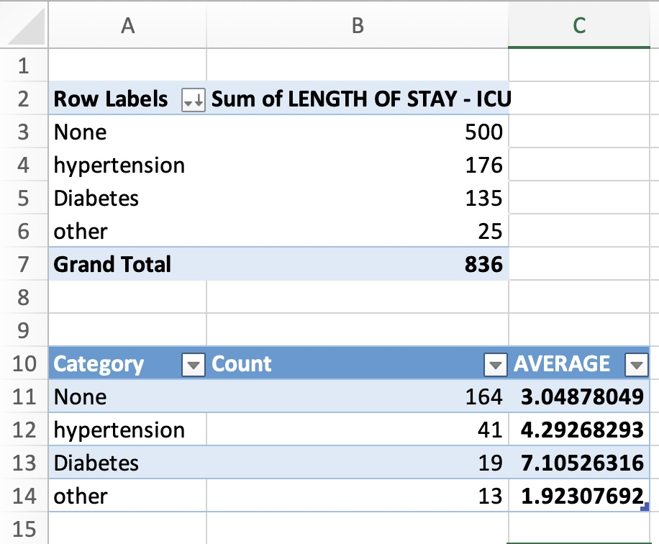
Average length of stay in ICU Vs Med Condition
Same order of average length of stay in ICU: Diabetes > Hypertension > None > Other.
We can establish a relation between prior med condition and total cost to hospital.

Slide 15
Relation between Hypertension and individual’s Age & Gender
It is Category Versus Category
Method should be used: Chi Square test.

Slide 16
CONCLUSION
No relation between Total length of the stay and Obesity (BMI).
But strong positive relation between Length of stay in ICU and Obesity.
Strong positive relation between Total cost to be borne by hospital and Obesity => a bit more package price to be quoted for obese patient than less obese for the same disease.
No relation between prior medical conditions and Obesity => irrespective of patient’s obesity, prior medical conditions may or may not exist.
Total Length of stay is more for patients with Diabetes > Hypertension > None > Other.
Length of stay in ICU is more for patients with Diabetes > Hypertension > None > Other. As we have established strong relation between Length of stay in ICU and Total cost to be borne by hospital => a bit more cost to be quoted for diabetic patients than others and so on.

