Slide 1

A
Domain specific mini project on
ON
“V-JEWELLERY”
PRESENTED BY ROLL NO.
Kochikar Atikraja Amanulla 53
Kulkarni Rushikesh Prasad 54
Makandar Tanveerhasan Sadiknawaj 55
Makandar Muddasar Jameer 60
Potwar Tanmay Narendra 70
Under the Guidance of
Prof.S.D.BHOPALE.
Department of Computer Science and Engineering
Dr. D. Y. Patil Pratishthan’s College of Engineering
Shivaji University, Kolhapur
2021-2022

Slide 2
CONTENT
CONTENT | PAGE NO.
INTRODUCTION | 3-4
PROBLEM STATEMENT | 5-6
PROPOSED SYSTEM | 7-8
OBJECTIVES | 9
REQUIREMENTS | 10-12
PROJECT PHASES | 13
DFD AND DESIGNS | 14-18
IMPLEMENTATION | 19-23
FUTURE ENHANCEMENT | 24
CONCLUSION | 25
REFERENCE | 26

Slide 3
Introduction
V-Jewelers refers to service as e-commerce jewelry shop.
It is which used to provide customers jewelries by using modern computer technology.
It replaces the paperwork and overcome the outcomes of traditional way of shopping.
It is web based platform can be used by Admin at any remote location.

Slide 4
V-jewelers is fully developed automated system is to efficiently generate the stock and sale report that not only save the time of shopkeeper but also provides fast selling.
The customer can login through any computer or mobile with their mobile number or email provided within database, then they can shop through site. New customer can sign up the site through their mobile number or email.

Slide 5
Problem Statement The whole process of stock and sale report, was done manually till date. Taking down materials remaining on paper i.e. checking and distributing respective jewelry used to take time when the software was not installed.

Slide 6
Disadvantages of current system - The current system is very time consuming. It is very difficult to analyze the sale manually. To sale and store more workers are required. Calculation of money and reporting are done manually. The selling ratio is not much due to less workers.

Slide 7
Proposed System
The main objective of the V-Jewellers is that it is developed to provide more efficiency in the jewellery marketing to the shopkeeper of v-jewellers.
The customers now can order their favourite jewellery through this web application. Also the admin can handle the web app remotely through admin login. The admin can add new items and can also remove items. Also can add new categories and handle the customers.
The V-Jewellers customer can shop through log in the webapp reportly. They can add items to cart as favourite. Customers can make online payment.
In brief the V-Jewellers will make more sale in less time with less workers. And will make tracing
of stock and sale to make report easier.

Slide 8
Advantages of Proposed System – •Shopping: The application provides multiple jewelry categories such as diamond ,gold ,silver platinum etc. •Email Confirmation: The Email will provided to the customer after the transaction , so he will get the exact confirmation of order •Easy Access: The application is easy to access through its web address. •Performance: The application handles multiple users in ease. •Security: The secure architecture is provided in application with the log in and log out password is mandatory to for the shopping.

Slide 9
Objectives
The main objective of this webapp is to create online communication.
Sanwaad webapp system is software which provides more privacy while sharing media and documents.
The system contains more security comparing to other messaging app.
This webapp is very beneficial for professional work .
So we can say the core purpose of this system is create to both private and
professional conversation between two parties without any hesitation .

Slide 10
Requirement Analysis
A lot of paper is needlessly wasted in the traditional evaluation process. Wasting such a valuable environmental resource often goes against the institution’s ‘green’ initiatives and university Wide goals.
Many times to the customers they don’t have computers , so they could face problem buying online , we come up to this with solution of mobile purchase ,as now days everyone has mobile phones so they can purchase through it.

Slide 11
In most shops all the sales are manually handled by shopkeepers. This procedure is time consuming. Each and everything related to shop or related to customer is stored manually and if the paper stored is lost by mistake then there is loss of record and also wastage of papers. All this work is very tedious to all the workers. In some shops online sale can be taken for short manner. But there is a risk of server hack. Or the lack of knowledge of the computer system. This is online shopping system so customer think that they can buy the products from computer. So from home , workplace or any other remote place they can buy or search for product.

Slide 12
Software requirements
Languages Used :-
HTML, CSS, Javascript, php,Bootstrap.
Hardware specification:-
Processor: intel core duo
RAM: 1 GB
Hard disk:20 GB
software specification:-
Browser: javascript enabled
OS: windows 7 or higher, linux

Slide 13
Projrct Phases
Literature survey
Design and Devlopment
Implementation
Testing
Result and discussion

Slide 14
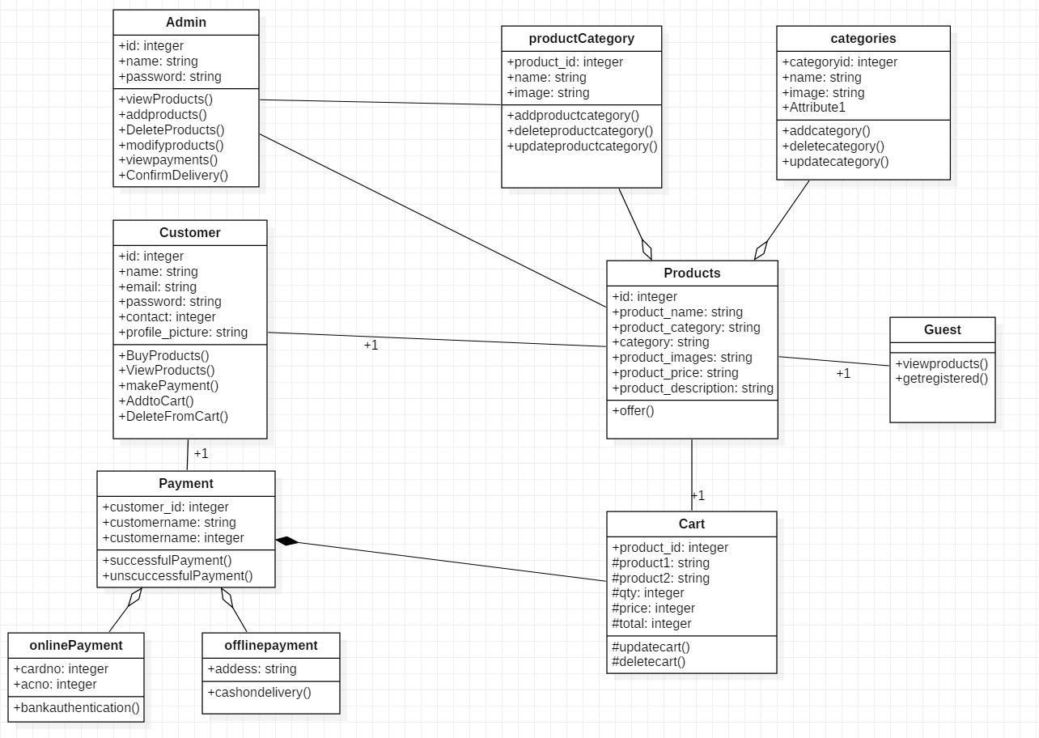
DESIGN
Fig-Class Diagram

Slide 15
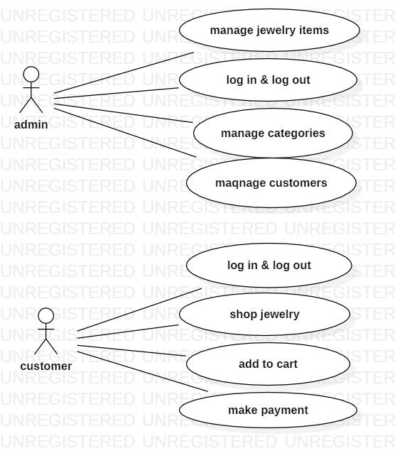
Usecase Diagram

Slide 16
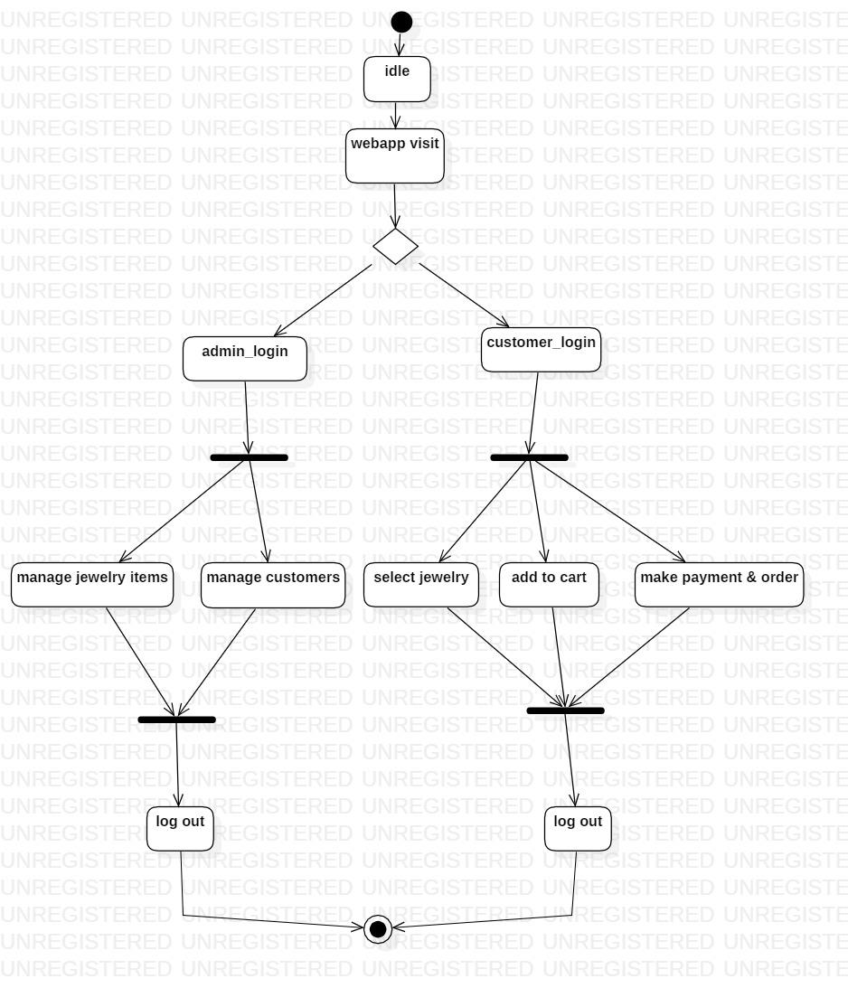
State Diagram

Slide 17
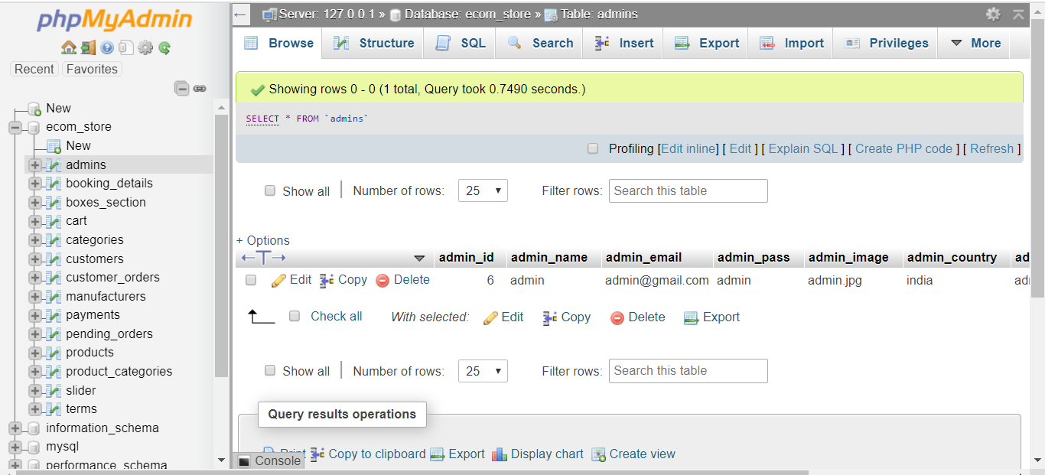

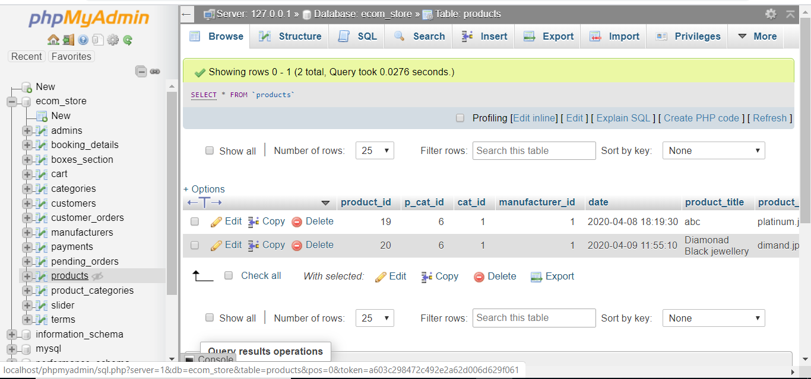
Database (table design):

Slide 18

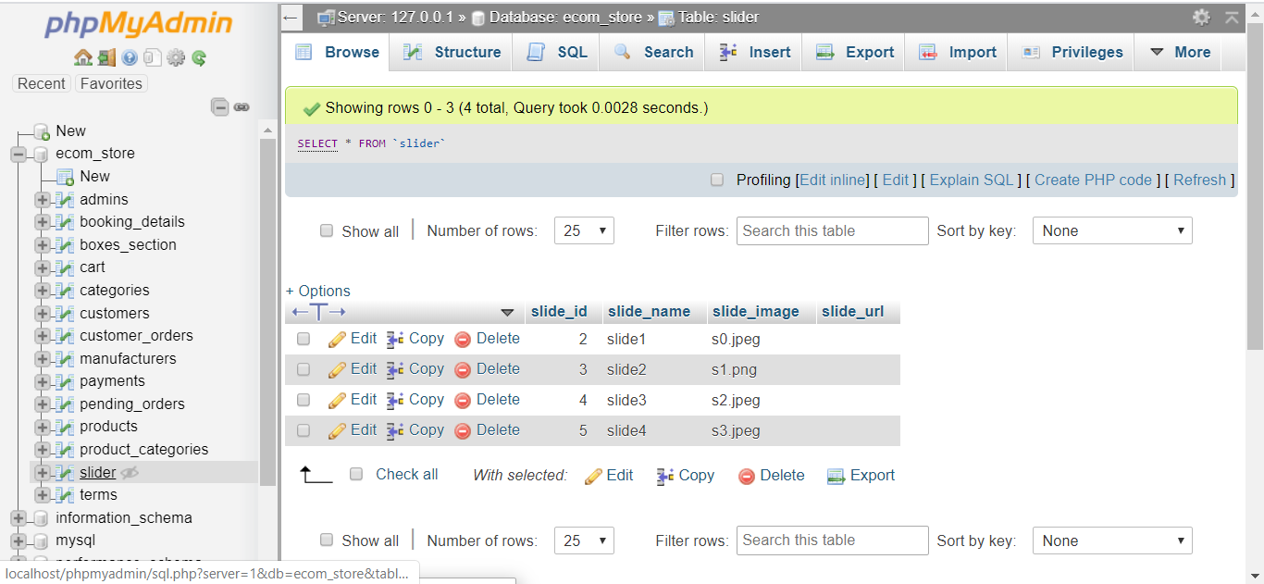
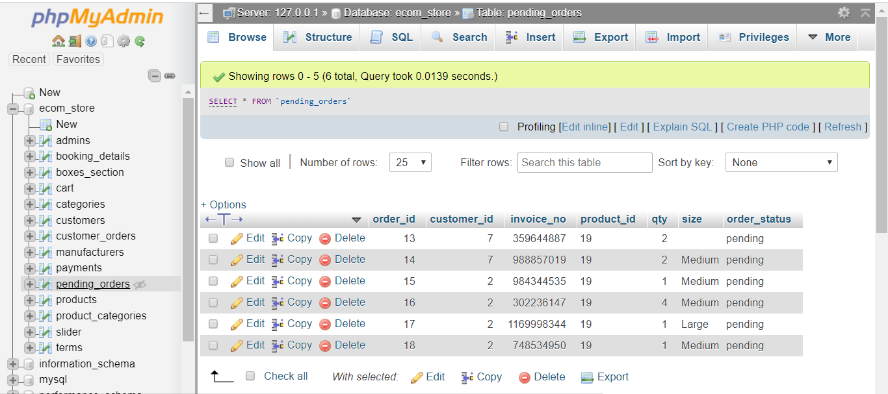


Slide 19
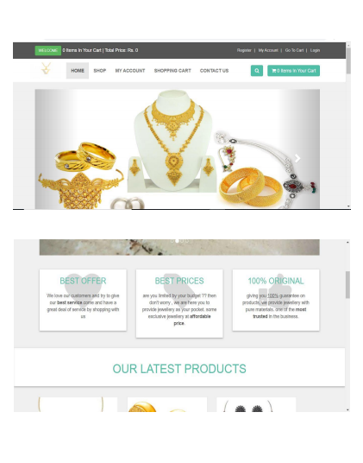
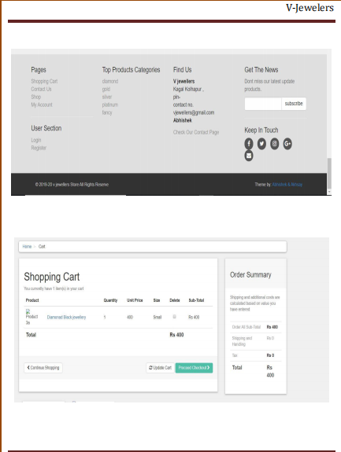
IMPLEMENTATION

Slide 20
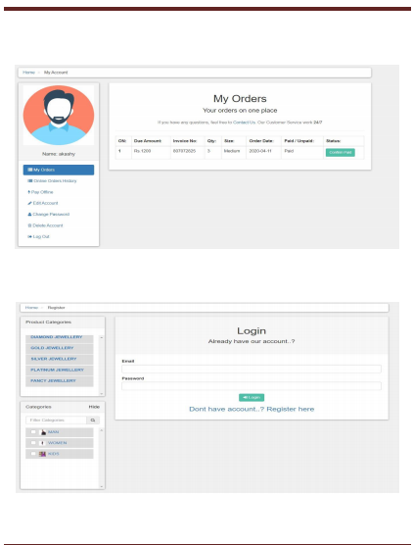
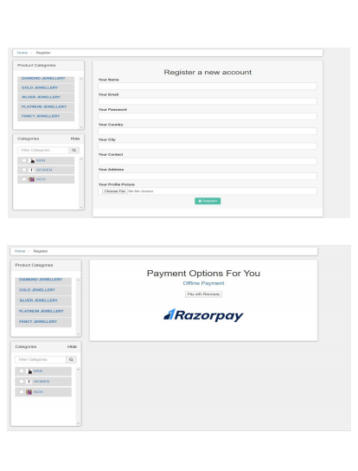

Slide 21
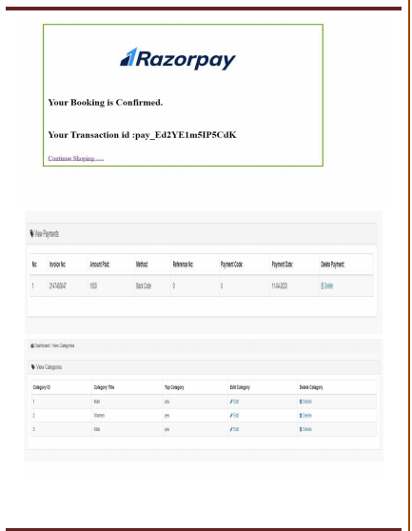
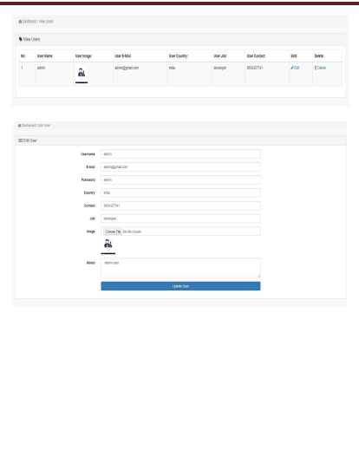

Slide 22
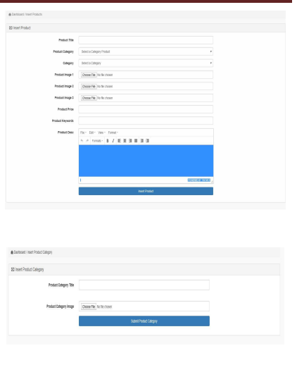
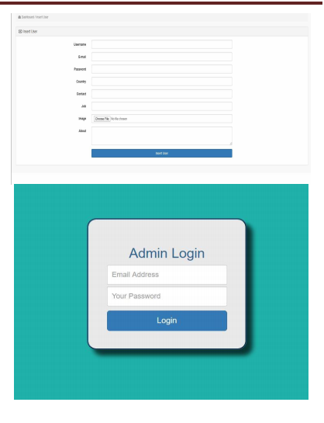

Slide 23
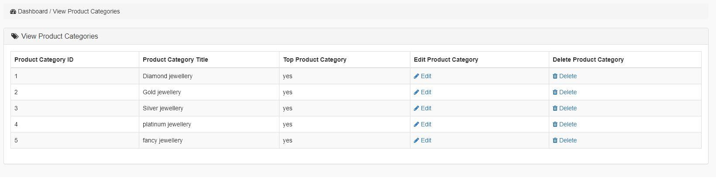

Slide 24
Future enhancement
Pre order for custom jewellery by customer
Multiple admins for chain of shop.
Implementation for different types of jewelleres such as
hand made and machine casting.
To make WebApplication more securely.

Slide 25
Conclusion
V-Jewelers system leads to a better organized structure since the shoppingmanagement of the customer and shopkeeper is well structure and also leads to better as well as efficient utilization of resources. V-Jewelers system can be used by shop to organize and handle online easily. Achieving the objectives is difficulties using a manual system as the V_x0002_jewelers can provide security, and may be very time consuming. All these problems are solved using this project.
Our project V-Jewelers system was developed by two of us. We will take a step by step approach in order to reach our goal.

Slide 26
References:
1. www.stackoverflow.com
2. www.php.net
3. www.webgradiant.com
4. www.w3school.com
5. www.wikiped

Slide 27
THANK YOU

