Slide 1
RTL MINI PROJECT
Traffic Light Controller
A Synchronous Moore FSM-Based RTL Design for a Four-Way Intersection
[Pruthviraj Kalashetty]
[USN :- 3LA24EC036] • 5th Semester, ECE
[LAEC, Bidar / Visvesvaraya Technological University]

Slide 2
INTRODUCTION
Problem Statement & Objectives
1
Synchronous, parameterizable Moore FSM in fully synthesizable Verilog
PROBLEM
Design and verify a synthesizable Verilog controller for a four-way road intersection, operating two opposing traffic flows — North/South and East/West — such that conflicting flows are never simultaneously granted right-of-way.
2
Cycle-accurate timing via an internal counter
3
Latch-free, glitch-free (Moore) output behavior
4
Explicit, verified safety invariants
Traffic Light Controller — RTL Mini Project
02

Slide 3
INTRODUCTION
Scope — Version 1
IN SCOPE
OUT OF SCOPE
Synchronous FSM, single clock, sync. reset
Parameterized green / yellow / all-red timing
One-hot NS and EW light outputs
Testbench verifying sequence, timing, safety
Pedestrian crossing requests
Vehicle sensors / adaptive timing
Emergency-vehicle pre-emption, flashing mode
Separate left-turn phases
Traffic Light Controller — RTL Mini Project
03

Slide 4
REQUIREMENTS
Functional & Safety Requirements
ID | Requirement
FR-01/02 | Reset to NS_GREEN; strict cyclic sequence NS→EW→NS
FR-03–05 | Green / Yellow / All-Red durations are parameterized
FR-06/07 | Opposing flow stays RED during green/yellow/all-red
SR-01/02 | NS and EW never simultaneously GREEN or YELLOW
SR-03/04 | Every hand-off passes through all-red; invalid states recover safely
Traffic Light Controller — RTL Mini Project
04

Slide 5
REQUIREMENTS
Interface Specification
Signal | Dir | Width | Description
clk | Input | 1 | System clock, positive-edge triggered
reset | Input | 1 | Synchronous, active-high
north_south | Output | 3 | NS light indication (one-hot)
east_west | Output | 3 | EW light indication (one-hot)
LIGHT ENCODING (ONE-HOT)
RED
3'b100
YELLOW
3'b010
GREEN
3'b001
Traffic Light Controller — RTL Mini Project
05

Slide 6
SYSTEM DESIGN
FSM State Definition — Six-State Moore FSM
State | NS | EW | Duration | Next
NS_GREEN | GREEN | RED | GREEN_CYCLES | NS_YELLOW
NS_YELLOW | YELLOW | RED | YELLOW_CYCLES | ALL_RED_TO_EW
ALL_RED_TO_EW | RED | RED | ALL_RED_CYCLES | EW_GREEN
EW_GREEN | RED | GREEN | GREEN_CYCLES | EW_YELLOW
EW_YELLOW | RED | YELLOW | YELLOW_CYCLES | ALL_RED_TO_NS
ALL_RED_TO_NS | RED | RED | ALL_RED_CYCLES | NS_GREEN
Traffic Light Controller — RTL Mini Project
06

Slide 7
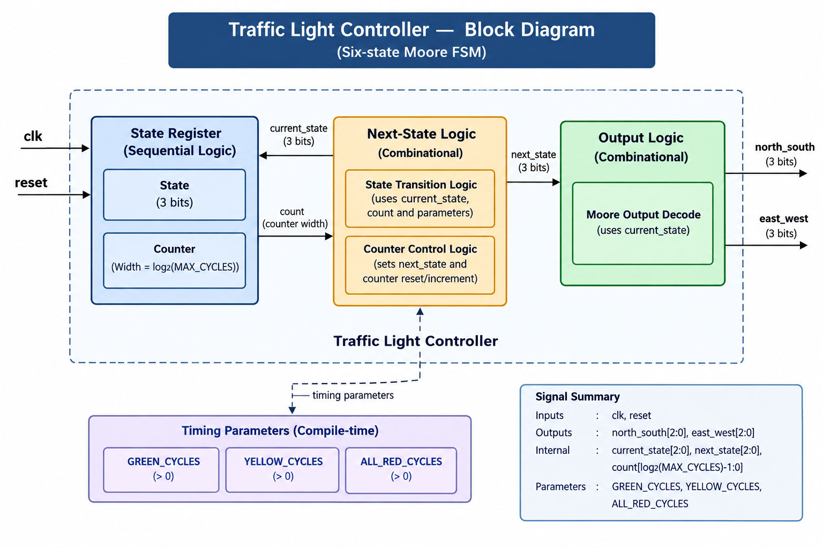
SYSTEM DESIGN
Block Diagram
Traffic Light Controller — RTL Mini Project
07

Slide 8
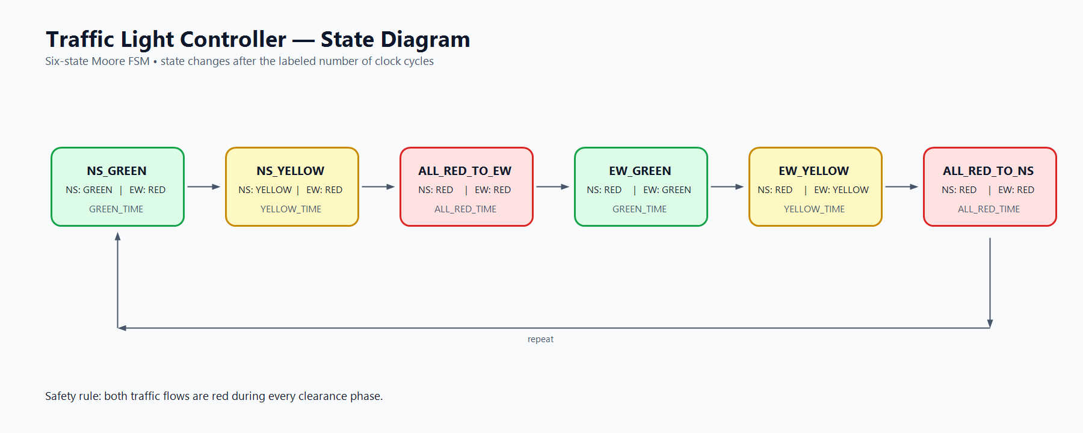
SYSTEM DESIGN
State Diagram
Traffic Light Controller — RTL Mini Project
08

Slide 9
SYSTEM DESIGN
Design Approach — Three-Process FSM
1
2
3
State Register
Next-State Logic
Output Logic
Sequential (@posedge clk): holds current state + elapsed-cycle counter
Combinational: computes next state from current state, counter, and timing parameters
Combinational: decodes current state into NS / EW light outputs (Moore — no input dependency)
Moore FSM: outputs depend only on state — no combinational glitches on input/counter transitions.
Traffic Light Controller — RTL Mini Project
09

Slide 10
SYSTEM DESIGN
Timing Model
5
2
1
160
GREEN_CYCLES
YELLOW_CYCLES
ALL_RED_CYCLES
ns / full cycle*
* one full FSM cycle = 16 clock cycles × 10 ns clock period = 160 ns; all durations expressed in clock cycles, not real-world seconds.
Each state has a dwell counter that increments every clock edge; when it reaches the configured duration, the FSM advances and the counter resets.
Traffic Light Controller — RTL Mini Project
10

Slide 11
IMPLEMENTATION
RTL Implementation — Highlights
// FSM State Encoding (localparam — fixed internally)
localparam [2:0] NS_GREEN = 3'd0;
localparam [2:0] ALL_RED_TO_EW = 3'd2;
// Sequential: state + counter
always @(posedge clk) begin
if (reset) begin
state <= NS_GREEN; count <= 0;
end else begin
state <= next_state;
...
end
end
default: next_state = ALL_RED_TO_EW; // safe recovery
Two-process combinational logic, blocking assignments, default in every case → latch-free
parameter for user-configurable timing; localparam for fixed state/light encoding
Synchronous active-high reset, single clock domain
Invalid states recover through ALL_RED_TO_EW, not directly to green (SR-04)
Traffic Light Controller — RTL Mini Project
11

Slide 12
VERIFICATION
Verification Approach & Test Cases
Icarus Verilog simulation • GTKWave waveform inspection • continuous self-checking testbench for safety invariants
Test Case | Verifies | Checks
TC-01 | FR-01 | Reset → NS_GREEN, counter = 0
TC-02 – 05 | FR-02–05 | Green / yellow / all-red timing, first hand-off
TC-06 – 08 | FR-02, FR-04/05 | EW yellow, second all-red, full-cycle wraparound
TC-09 / 10 | SR-01 / SR-02 | No simultaneous green / yellow (continuous check)
Traffic Light Controller — RTL Mini Project
12

Slide 13
RESULTS
Verification Results — Status
7 / 10
3 / 10
Test cases PASS
Pending extended-run confirmation
Reset behavior
NS green / yellow timing
First all-red clearance
No simultaneous green/yellow (continuous)
EW yellow timing (TC-06)
Second all-red clearance (TC-07)
Full-cycle wraparound to NS_GREEN (TC-08)
Confirmed by extending simulation to 300 ns (one full 160 ns cycle + margin).
Traffic Light Controller — RTL Mini Project
13

Slide 14
DESIGN DECISIONS
Key Design Decisions
Decision | Chosen | Why
FSM style | Moore | No external inputs beyond clk/reset — glitch-free outputs
State encoding | Binary (3 bits) | 6 states fit in 3 bits; more compact than one-hot
Output encoding | One-hot | Each bit maps directly to one physical lamp
Reset | Synchronous | Single clean clock domain, simpler timing closure
All-red states | Two (EW / NS) | Preserves direction context for future extensions
Traffic Light Controller — RTL Mini Project
14

Slide 15
CONCLUSION
Conclusion & Future Scope
A fully synthesizable, synchronous Traffic Light Controller was designed and verified end-to-end — requirements, FSM specification, RTL implementation, and testbench-based verification against explicit safety invariants.
FUTURE SCOPE
Pedestrian crossing phase
Independent NS / EW green durations
Sensor-triggered adaptive timing
Emergency-vehicle pre-emption
Multi-intersection coordination
Thank you

