Slide 1

Detailed Project Report 400 kW Grid-Connected Rooftop Solar PV System Pandit Nehru Bus Stand (PNBS), Vijayawada
Submitted by: Eminent Consultancy Services
Sk. Sharukh Md
(CEO & PROPRIETOR)

Slide 2

Project Overview
Project: 400 kW Grid-Connected Rooftop Solar PV System at PNBS, Vijayawada
Objectives:
Reduce dependence on conventional electricity
Lower operational electricity costs
Promote clean and sustainable energy in line with government initiatives
Summary: A grid-connected rooftop solar system with Net/CT metering aimed at reducing electricity consumption and supporting energy efficiency.

Slide 3
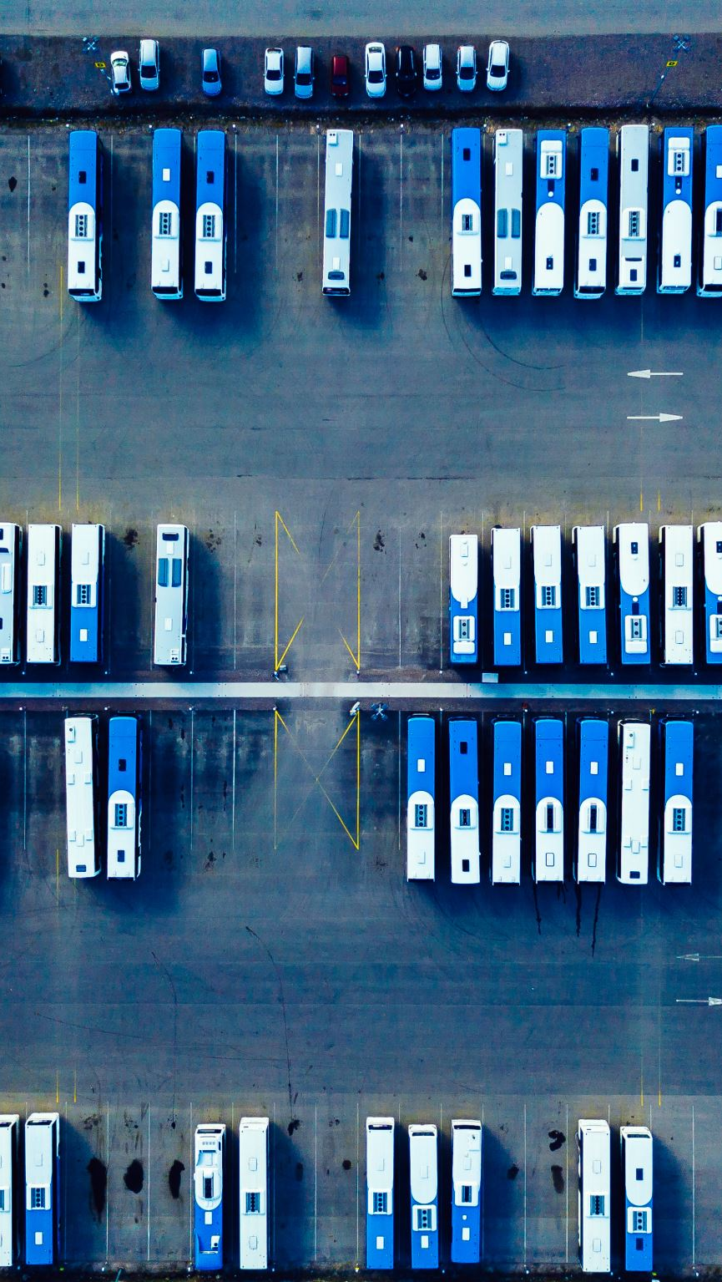
Need for Solar at PNBS
Pandit Nehru Bus Stand (PNBS) is one of the busiest transport hubs in Andhra Pradesh
High energy consumption due to continuous, round-the-clock operations
Solar energy offers a cost-effective and sustainable alternative
The project delivers significant cost savings and enhances environmental credibility (green credentials)

Slide 4
Scope of Work
Inclusions
Site survey and feasibility assessment
Engineering, Procurement, and Construction (EPC)
Grid synchronization and net metering compliance
Operation & Maintenance (O&M) for 5 years
Exclusions
Major structural retrofitting beyond minor modifications
Energy storage systems (batteries)

Slide 5
Site Details
Location: Pandit Nehru Bus Stand (PNBS), Vijayawada
Available Area: Approx. 28 acres
Roof Type: RCC (Reinforced Cement Concrete) rooftops
Solar Potential: Excellent — 300+ sunny days per year

Slide 6
Technical Details
System Capacity: 400 kW
Solar Modules: Mono-crystalline, 635 Wp (approx. 630+ panels)
Inverters: String inverters with MPPT technology
Mounting Structure: Hot-dip galvanized iron for corrosion resistance
Expected Annual Generation: 5.5 – 6.0 lakh units
System Lifespan: ~25 years

Slide 7
Project Cost Estimate
Component-wise Estimate (INR):
• Solar Modules: ₹84,67,200
• Inverters: ₹17,92,000
• Structure Works: ₹37,76,000
• Civil Works: ₹4,72,000
• Wiring & BOS: ₹19,21,630
• Installation & Labor: ₹23,60,000
• Misc. & Contingency: ₹30,08,000
• Total: ₹2,17,96,830
• Cost per KW: ₹54,492.075

Slide 8
ROI
Annual Energy Generation
Estimated Generation: 5.5 to 6.0 lakh units/year
(i.e., 5,50,000 to 6,00,000 kWh)
Annual Savings
Lower Estimate: 5,50,000 kWh × ₹8.00/kWh = ₹44,00,000
Upper Estimate: 6,00,000 kWh × ₹8.00/kWh = ₹48,00,000
Total Investment
₹2,17,96,830
ROI Calculation
Lower Estimate: (₹44,00,000 / ₹2,17,96,830) × 100 ≈ 20.2%
Upper Estimate: (₹48,00,000 / ₹2,17,96,830) × 100 ≈ 22.0%
Payback Period
Lower Estimate: ₹2,17,96,830 / ₹44,00,000 ≈ 4.9 years
Upper Estimate: ₹2,17,96,830 / ₹48,00,000 ≈ 4.5 years

Slide 9
Implementation Plan
• Site Survey & Design: 1 week
• Material Procurement: 2 weeks
• Installation: 5 weeks
• Commissioning & Testing: 2 weeks
• Total Duration: 10 weeks

Slide 10
Financial Analysis
• Annual Savings:
Lower Estimate: 5,50,000 kWh × ₹8.00 = ₹44,00,000
Upper Estimate: 6,00,000 kWh × ₹8.00 = ₹48,00,000
• Payback Period: 5 to 6 years

Slide 11
Environmental & Social Impact
• Carbon Emission Reduction: 400+ tons/year
• Improved air quality & sustainability
• Promotes public awareness of renewable energy

Slide 12
Legal & Regulatory Approvals
• Net Metering Permission (APSPDCL)
• Electrical Safety Clearance
• DISCOM agreement for grid tie-in
• No land conversion required (rooftop installation)

Slide 13
Risk Assessment
• Regulatory Delay – Mitigation: Pre Approval Planning
• Equipment Delivery – Mitigation: Use Reputed Vendors
• Generation Variance – Mitigation: Conservative Design

Slide 14
Monitoring & Evaluation
• Online Monitoring via Web & Mobile App
• Daily and Monthly Performance Reporting
• Annual Maintenance Reviews

Slide 15
Terms & Conditions
• Final billing based on actual execution
• Quoted prices include manpower and basic materials
• Extra materials/transport quoted separately if needed
• All work to follow safety and quality protocols

Slide 16
Thank You
Eminent Consultancy Services
Phone: +91 94933 93059, +91 94417 41706
Email: eminentconsultancyservices2024@gmail.com
Address: R.S. NO: 91/2, PLOT NO: 34,
Vikram Ramaswamy Street, Ambapuram, Vijayawada - 520012
GST: 37ECKPS9922P1ZE
GEM ID: X5MI240012601309

