Slide 1
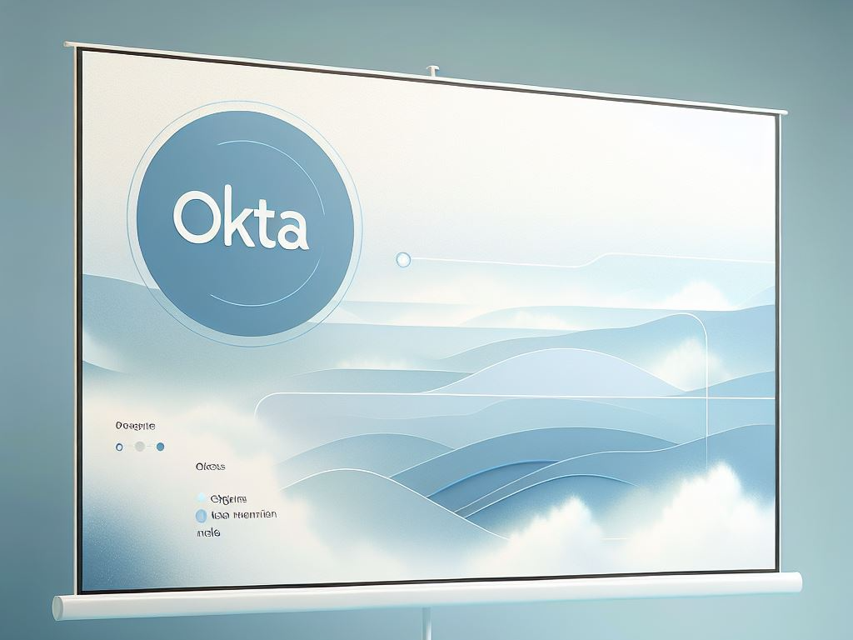
Okta and Office 365 Federation Demo
Technical Challenge Presentation
By
Pruthvi Raj

Slide 2
Introduction
This presentation demonstrates the integration of Okta with Office 365, including federation configuration and automation scripts for user lifecycle management.

Slide 3

Agenda
Okta + Office365: Federation Overview
User Provisioning: Setup & Workflow
Automation Script: Purpose & Demo
Q&A

Slide 4
Federation Overview Goal: Enable SSO and provisioning from Okta to Office 365
Steps Taken:
Created Microsoft 365 Developer tenant Andy did this step for me.
Connected Office 365 app in Okta (WS-Fed )
Enabled automatic provisioning (API)
Tested successful login from Okta → O365
Visual: Simple flow diagram: User → Okta (Login) → Office 365 (Federated Access)

Slide 5

User Provisioning Flow Provisioning Setup:
Okta pushes users to Entra ID
Custom password set during creation
Status: Active immediately
Office 365 license assignment to enable login
Tested with test users
Visual: Screenshot from Okta → Office365 app → Assignments tab

Slide 6

Automation Script Objective: Automate user creation + reset to allow quick re-use in demos
Tech Stack: Powershell+Python + Okta API + REST callsFunctionality:
Creates users in Okta & Azure AD (test email/password)
Assigns Office 365 application
Activates user (no email sent)
Fully ready to login to O365

Slide 7
Conclusion Q&A
This solution demonstrates a complete integration between Okta and Microsoft 365, with automation to manage user lifecycle. It enables fast, repeatable demos for presales scenarios, showcasing the power of identity federation and automation.

Slide 8

Thank you

