Slide 1
Amazon Products Sales Analysis
Power BI Dashboard & Data Analysis Project
Analysis of product sales, categories, weekly/monthly trends, product performance and customer reviews.
$2.18M
2022 YTD Sales
27.75K
Products Sold
19.42M
YTD Reviews
Prepared from the supplied Amazon_Combined_Data.xlsx and Power BI dashboard screenshot

Slide 2
1. Project Overview
Purpose, source data and analysis scope
• Business objective: understand Amazon product sales performance and identify important category and product trends.
• Source workbook: Amazon_Combined_Data.xlsx with 89,082 records and 6 fields.
• Dataset period: 3 January 2019 to 31 December 2022.
• Dashboard focus: 2022 YTD performance, with Q4 used for the QTD view.
• Key dimensions: Product Category, Product Description, Price, Reviews, Shipment and Order Date.
89,082
Records
6
Fields
8
Categories
67,942
Products
0
Missing Values
2019–2022
Years
Source: Amazon_Combined_Data.xlsx | Dashboard focus: 2022

Slide 3
2. Data Preparation & Transformation
Steps used to make the dataset analysis-ready
• Loaded the Excel dataset into the analysis workflow.
• Converted Order Date into a date field for year, month, quarter and week analysis.
• Validated missing values: no missing values were found in the six source columns.
• Filtered the analysis year to 2022 to align with the dashboard's YTD metrics.
• Created grouped calculations for sales, product count and review totals.
• Derived category, monthly, weekly and top-product summaries for dashboard visuals.
Field | Type
Product Category | Text
Product Description | Text
Price(Dollar) | Integer
Number of reviews | Integer
Shipment | Text
Order Date | Date
Source: Amazon_Combined_Data.xlsx | Dashboard focus: 2022

Slide 4
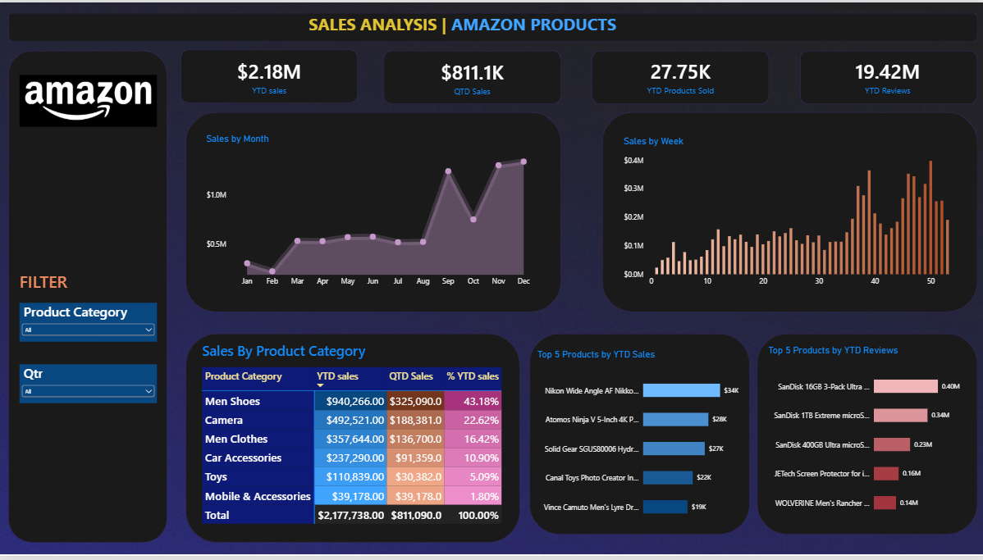
3. Power BI Dashboard
Interactive one-page view of 2022 Amazon product performance
Dashboard image supplied in the conversation | Metrics cross-checked against the Excel source

Slide 5
4. KPI Summary
Headline metrics shown on the dashboard
$2.18M
YTD Sales (2022)
$811.09K
QTD Sales (Q4 2022)
27.75K
YTD Products Sold
19.42M
YTD Reviews
• 2022 generated $2,177,738 in recorded product-price value.
• Q4 contributed $811,090, approximately 37.2% of 2022 sales.
• The dataset contains 27,747 2022 records, represented as about 27.75K products sold on the dashboard.
• Recorded 2022 review volume totals 19,418,698, shown as approximately 19.42M.
Source: Amazon_Combined_Data.xlsx | Dashboard focus: 2022

Slide 6
5. Sales Trend Analysis
Monthly and yearly patterns from the source data
2022 sales peaked in November at $310,156; September and December were also strong months.
Source: Amazon_Combined_Data.xlsx | Dashboard focus: 2022

Slide 7
6. Product Category Analysis
2022 YTD sales contribution by category
Category | YTD Sales | Share
Men Shoes | $940,266 | 43.18%
Camera | $492,521 | 22.62%
Men Clothes | $357,644 | 16.42%
Car Accessories | $237,290 | 10.90%
Toys | $110,839 | 5.09%
Mobile & Accessories | $39,178 | 1.80%
Men Shoes contributed 43.18% of 2022 sales, followed by Camera at 22.62%.
Source: Amazon_Combined_Data.xlsx | Dashboard focus: 2022

Slide 8
7. Top Product Performance
Products ranked by 2022 sales and review volume
Source: Amazon_Combined_Data.xlsx | Dashboard focus: 2022

Slide 9
8. Key Findings
Insights directly supported by the 2022 calculations
Men Shoes
Top Category
November
Top Month
Nikon Lens
Top Sales Product
SanDisk 16GB
Top Review Product
• Men Shoes generated $940,266, the largest category contribution in 2022.
• Camera generated $492,521, making it the second-largest category.
• November recorded the highest monthly sales at $310,156.
• The top-selling individual product was the Nikon Wide Angle AF Nikkor 24mm lens with $33,550 in 2022 sales.
• The highest review total among individual products was the SanDisk 16GB 3-Pack with 402,828 reviews.
• Q4 sales were $811,090, representing 37.2% of 2022 sales.
Source: Amazon_Combined_Data.xlsx | Dashboard focus: 2022

Slide 10
9. Dashboard Features
How the report supports exploration and presentation
• KPI cards provide a quick view of YTD sales, QTD sales, products sold and reviews.
• Monthly line chart highlights changes in sales across the year.
• Weekly column chart shows week-by-week sales movement.
• Category table compares YTD sales, QTD sales and percentage contribution.
• Top-5 visuals identify leading products by sales and review volume.
• Product Category and Quarter slicers allow the user to interact with the report.
Source: Amazon_Combined_Data.xlsx | Dashboard focus: 2022

Slide 11
10. Tools & Skills Demonstrated
Technical skills applied in the project
Excel
— Source data handling and workbook-based analysis
Power BI
— Interactive dashboard development and visual reporting
Power Query
— Data loading, cleaning and transformation
DAX
— Measures, KPIs and analytical calculations
Data Analysis
— Trend, category and product performance analysis
Data Visualization
— Charts, KPI cards, tables and slicers
Source: Amazon_Combined_Data.xlsx | Dashboard focus: 2022

Slide 12
11. Conclusion
Summary of the completed Amazon Products Sales Analysis project
• The analysis covers 89,082 records from 2019–2022, with the dashboard focused on 2022.
• 2022 recorded $2,177,738 in sales and 27,747 product records.
• Men Shoes was the largest sales category, contributing 43.18% of 2022 sales.
• The dashboard combines KPI monitoring, time-series analysis, category comparison and top-product analysis in one page.
• The project demonstrates an end-to-end workflow from Excel source data to Power BI dashboard and business-focused insights.
Thank you
Source: Amazon_Combined_Data.xlsx | Dashboard focus: 2022

