Slide 1

Data Analysis Essentials
Cornerstone project
sleep health and lifestyle analysis
Sample Presentation Format – Exploratory Data Analysis
Presented by
M. pruthviraj Srinivas (25B11CS534)
E. Tejeshwanth (25B11CS254)
S. Bhavitha (25B11CS868)
K.Arun kumar (26B12CS104)
Guide: Mr. K. Ashok Teja, Assistant Professor, CSE Dept.
Department of computer science and engineering

Slide 2

Contents
Problem Understanding
Introduction
Current Approach & Limitations
Proposed Approach
Dataset Description
Requirements
Methodology
Data Visualization
Key Insights & Analysis
Implementation Workflow
Conclusion

Slide 3
PROBLEM UNDERSTANDING
Why is Sleep Health Important?
Sleep is not determined by a single factor. It can be influenced by several interconnected lifestyle, occupational, and health-related factors.
Our project focuses on understanding:
How does stress affect sleep duration?
Does greater physical activity relate to better sleep quality?
Does occupation influence sleep patterns?
Which groups show a higher occurrence of sleep disorders?
Can lifestyle factors be used to predict sleep duration?
Core Problem
Identify meaningful relationships between lifestyle factors and sleep health using data-driven analysis rather than relying only on assumptions or manual observation.

Slide 4
Introduction
Sleep is an essential part of a healthy lifestyle.
Poor sleep can affect physical and mental well-being.
Different lifestyle and health factors can influence sleep.
Data analysis helps us identify relationships between these factors.
Our project uses Python-based Exploratory Data Analysis (EDA) and statistical techniques.
From Lifestyle Data to Sleep Insights
Sleep health is influenced by multiple factors such as:
Stress → Sleep Duration
Physical Activity → Sleep Quality
Occupation → Lifestyle & Sleep Pattern
Health Factors → Sleep Disorders
Our Approach
Raw Data → Clean Data → Explore → Analyse → Visualize → Interpret

Slide 5
Current / manual Approach
Current Approach:
Traditionally, sleep-related information may be studied manually using:
Surveys
Health records
Spreadsheets
Basic comparisons
Manual observation
Problem with this approach:
Large datasets are difficult to analyse manually, and identifying relationships between multiple health and lifestyle factors can be time-consuming.
Our Observation
A relationship may not be obvious when looking at individual records.
For example:
A person with high stress may not always have short sleep, but analysing hundreds of records can reveal whether high stress is generally associated with shorter sleep.

Slide 6
Limitations of Manual Analysis
Limitations :
Time-consuming for large datasets.
Difficult to identify hidden patterns.
Manual calculations may lead to errors.
Difficult to compare multiple variables simultaneously.
Limited visualization capabilities.
Difficult to perform advanced statistical analysis manually.

Slide 7
Proposed Approach
Data-Driven Sleep Health Analysis
We proposed a systematic analytical pipeline:
1. Dataset Collection
Obtain the Sleep Health and Lifestyle Dataset.
2. Data Cleaning
Handle missing values, duplicates, inconsistent categories and data formats.
3. Exploratory Data Analysis
Understand distributions and relationships.
4. Statistical Analysis
Use correlation, ANOVA, t-test and regression.
5. Visualization
Represent important relationships using meaningful charts.
6. Interpretation
Convert statistical results into understandable health and lifestyle insights.
7. Conclusion
Identify major patterns and possible future improvements.
Dataset
↓
Data Cleaning
↓
EDA
↓
Statistical Analysis
↓
Visualization
↓
Insights
↓
Conclusion

Slide 8
DATASET DESCRIPTION
Dataset: Sleep Health and Lifestyle Dataset
Source :AI generated
Records: 396
Columns: 13
Target Variables
Sleep Duration
Quality of Sleep
Sleep Disorder
Important Features
Age
Gender
Occupation
Stress Level
Physical Activity Level
Heart Rate
BMI Category
Blood Pressure
Daily Steps

Slide 9
REQUIREMENTS
Technology Stack
Programming : Python
Data Processing
Pandas
NumPy
Visualization
Matplotlib
Seaborn
Plotly
Statistical Analysis
SciPy
Statsmodels
Development Environment
Google Colab
What Each Tool Did :
Tool | Purpose
Pandas | Data loading, cleaning & manipulation
NumPy | Numerical operations
Matplotlib | Basic visualizations
Seaborn | Statistical charts & heatmaps
Plotly | Interactive visualizations
SciPy | Statistical tests
Statsmodels | Regression analysis
Google Colab | Running and managing Python analysis

Slide 10
METHODOLOGY
Our Analytical Pipeline:
Three Levels of Analysis
Level 1 – Descriptive
Understand distributions and basic patterns.
Level 2 – Relationship Analysis
Study relationships between variables using correlation and visualizations.
Level 3 – Statistical Modelling
Use hypothesis testing and Linear Regression to investigate relationships quantitatively.
Dataset
↓
Data Exploration
↓
Data Cleaning
↓
Preprocessing
↓
Eda
↓
Statistical Analysis
↓
Visualization
↓
Insights
↓
Conclusion

Slide 11
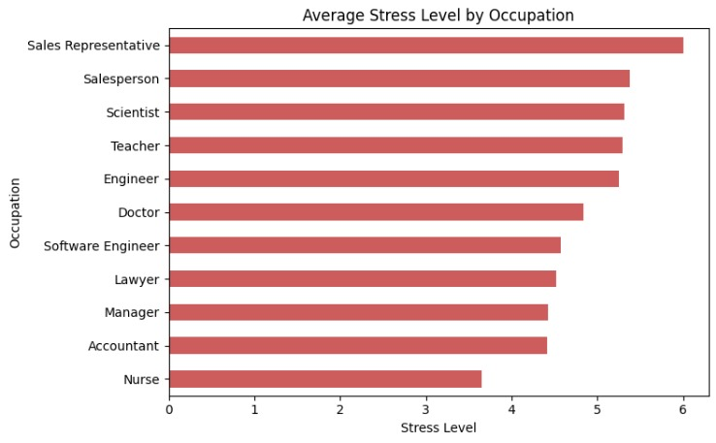
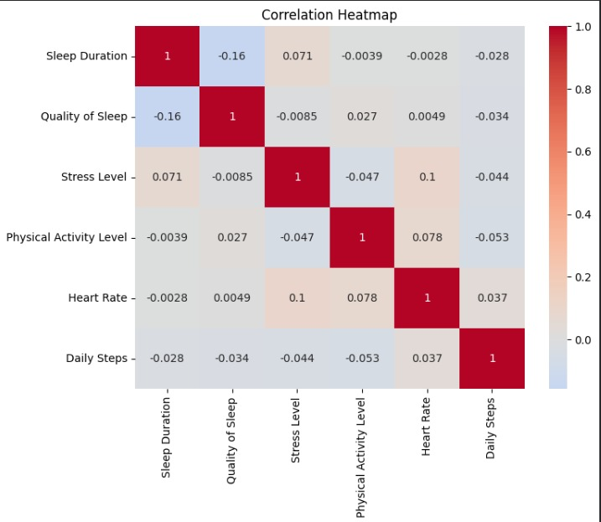
Data Visualization
We created different visualizations to understand the dataset:
Correlation Heatmap
Boxplots
Scatter Plots
Regression Plots
Bar Charts
Stacked Bar Charts
Interactive Plotly Charts
These visualizations help us understand relationships between sleep, stress, physical activity, occupation, and sleep disorders.

Slide 12
Key Insights & Analysis
Main Findings:
Higher stress is associated with shorter sleep duration.
Increased physical activity generally improves sleep quality.
Sleep duration varies across different occupations.
Sleep disorders are more common among high-stress groups.
Statistical techniques used:
Pearson Correlation
Spearman Correlation
ANOVA
t-Test
Linear Regression

Slide 13
Implementation workflow
Implementation Workflow:
Current Progress:
Dataset collected
Data cleaning completed
EDA completed
Statistical analysis completed
Visualization completed
Final report & PPT preparation
Dataset Collection
↓
Data Loading
↓
Initial Exploration
↓
Data Cleaning
↓
Data Preprocessing
↓
Exploratory Data Analysis
↓
Statistical Analysis
↓
Data Visualization
↓
Insights & Conclusion

Slide 14
Conclusion
What Did We Learn?
Our analysis indicates that:
Stress
Shows a strong negative association with sleep duration and sleep quality.
Physical Activity
Shows a generally positive relationship with sleep quality.
Occupation
Sleep patterns vary across occupational groups.
Sleep Disorders
Show different occurrence patterns across groups, including higher occurrence among high-stress groups in this dataset.
Overall
Sleep health is influenced by a combination of lifestyle, occupational and health-related factors.
Through Python, EDA, statistical analysis and visualization, we transformed raw records into meaningful insights.

Slide 15
THANK YOU

