Slide 1


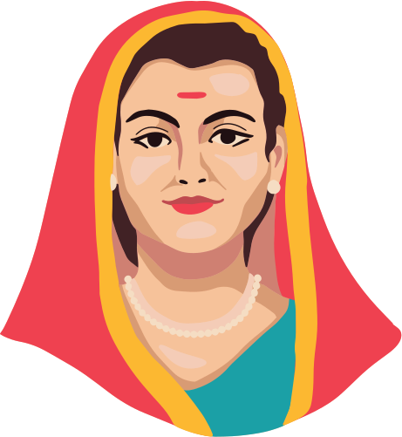

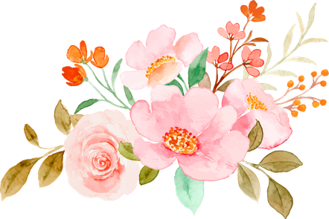
Savitribai Phule
Jayanti
Honoring the revolutionary, Savitribai Phule, on her Jayanti.

