Slide 1

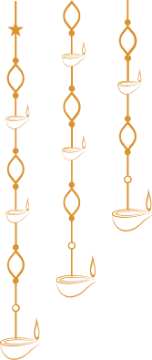

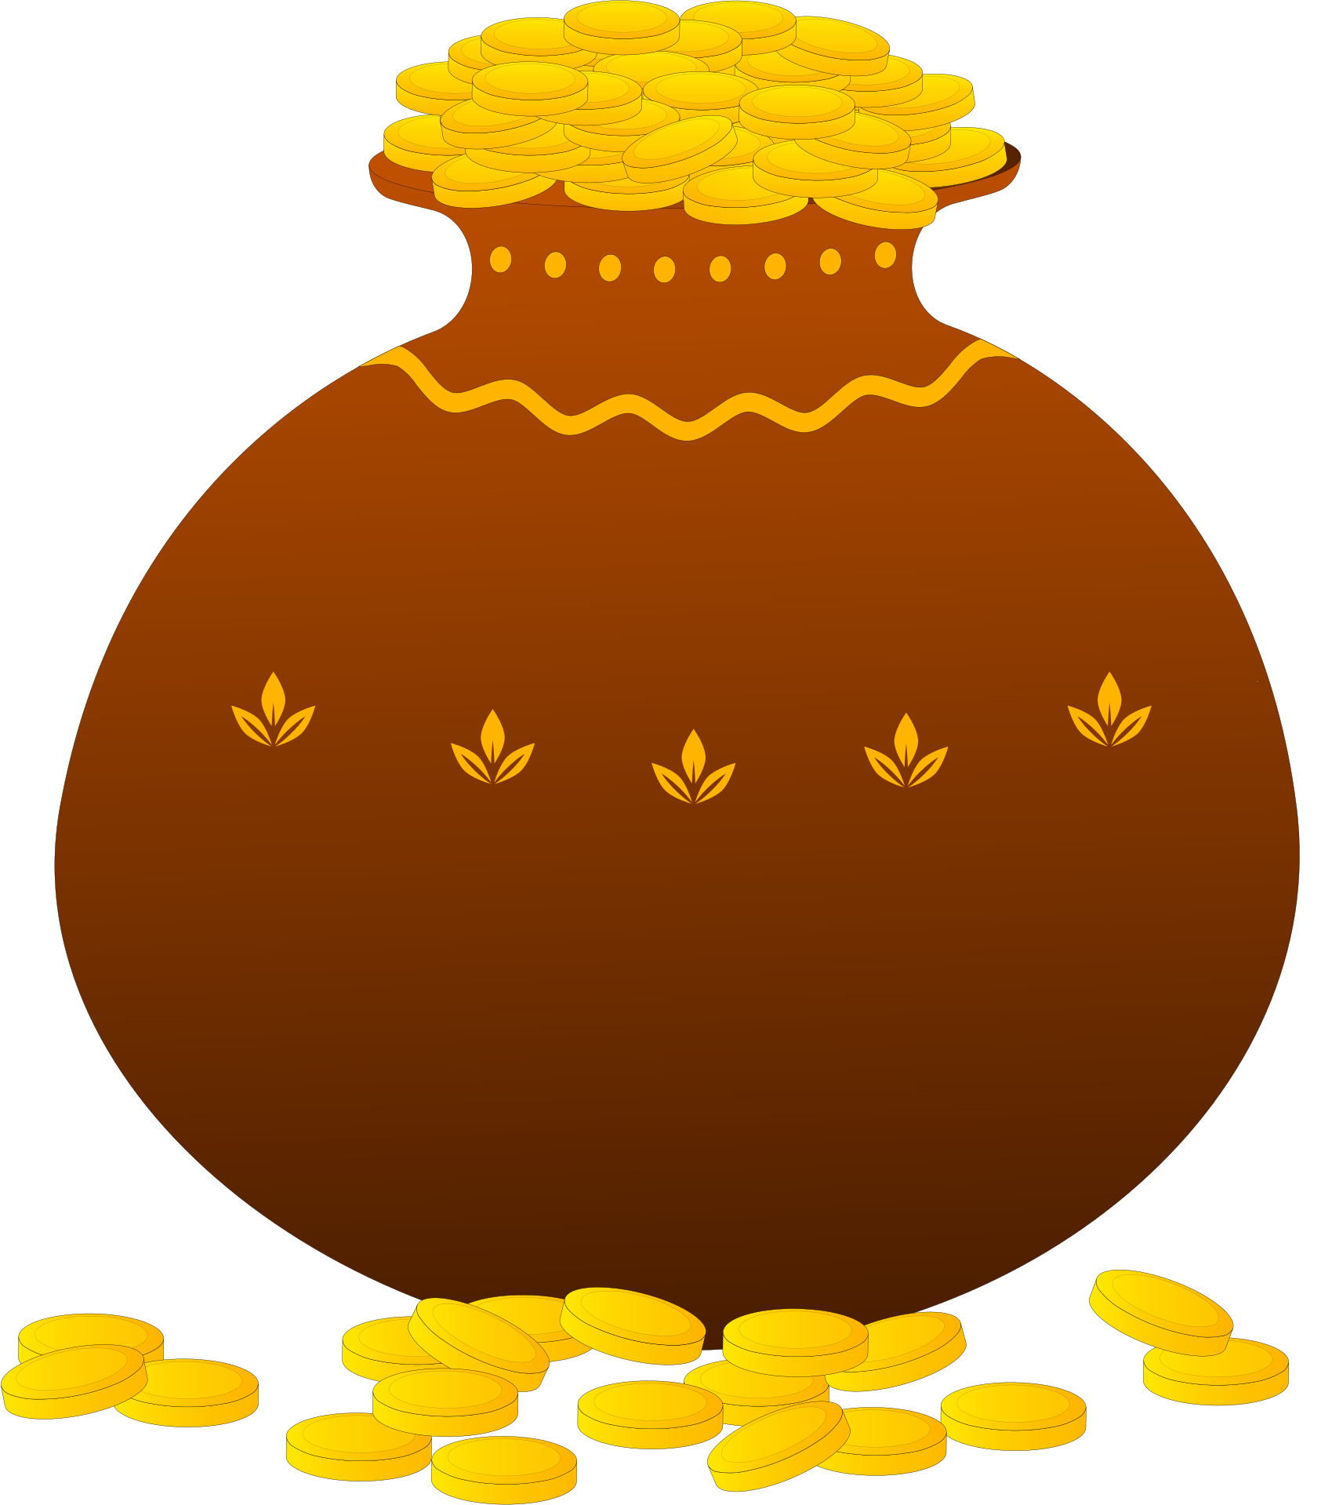

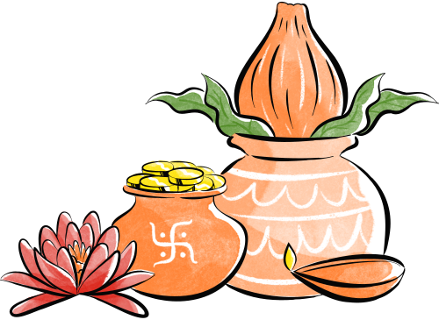

HAPPY
Dhanteras
May this Dhanteras bring golden moments and beautiful new beginnings into your life

