Slide 1



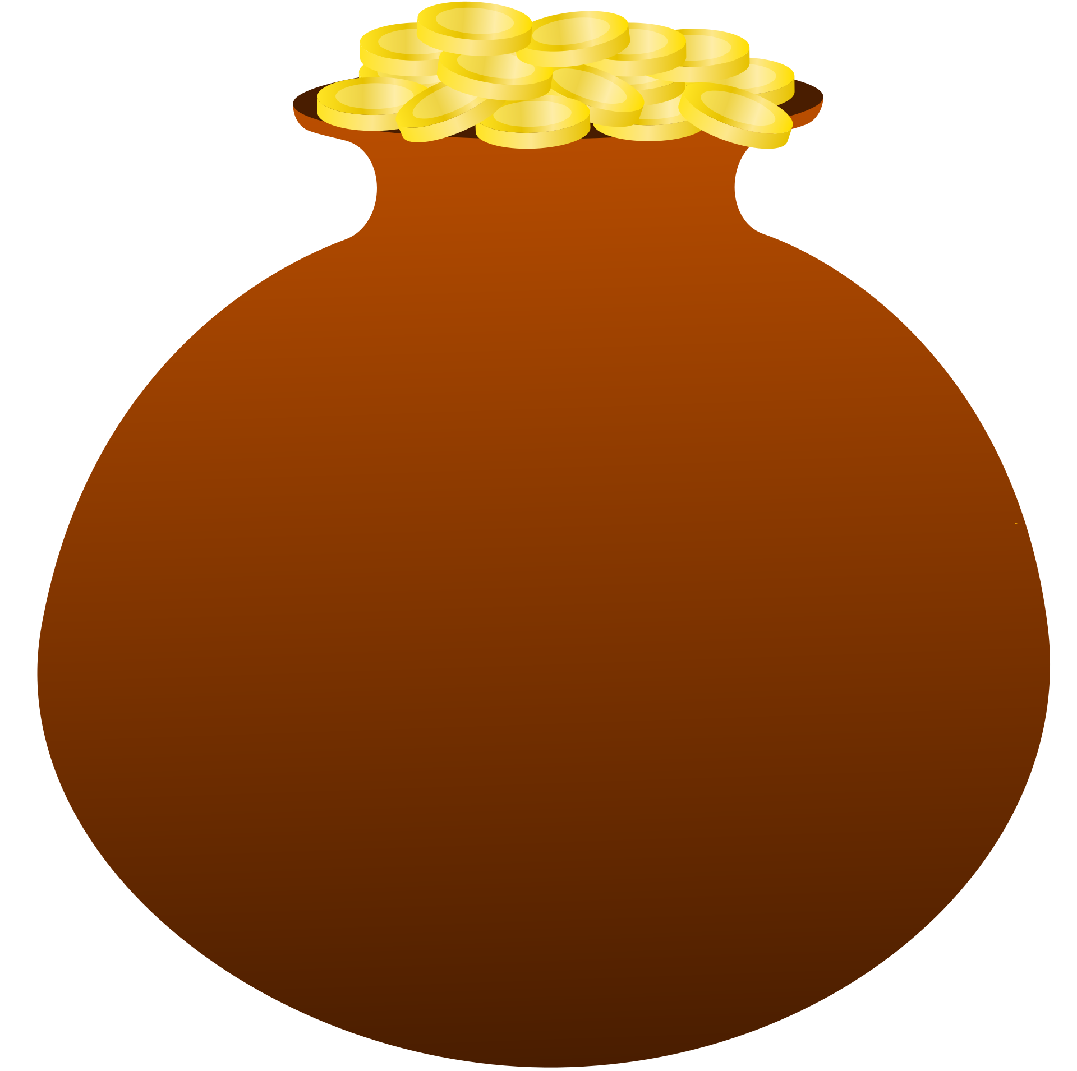

Happy Dhanteras
May Dhanteras bring prosperity, health, happiness, and endless blessings to every home and heart.
@reallygreatsite

