Slide 1




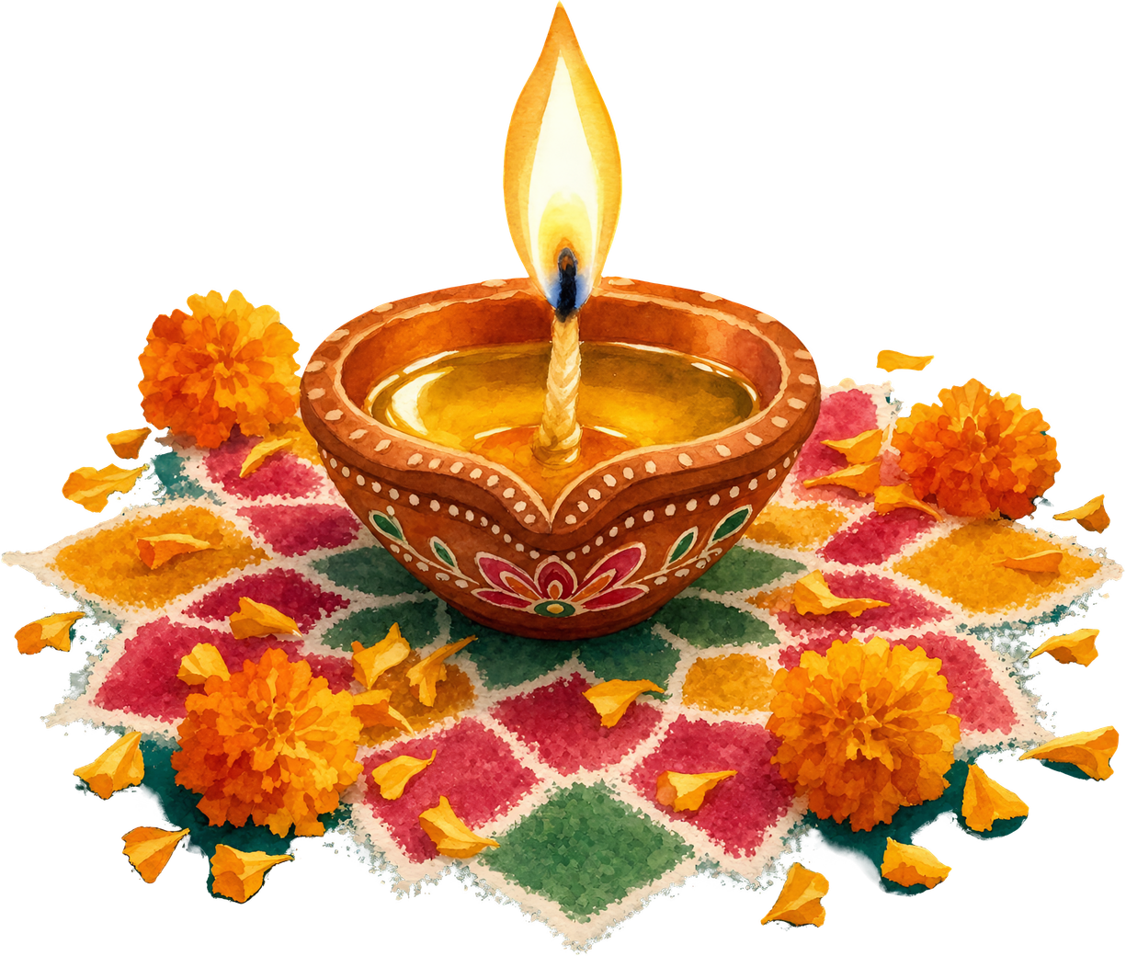

Happy
Diwali
May this Diwali bring new hope, beautiful beginnings, and abundant happiness into your life. Happy Diwali!

