Slide 1









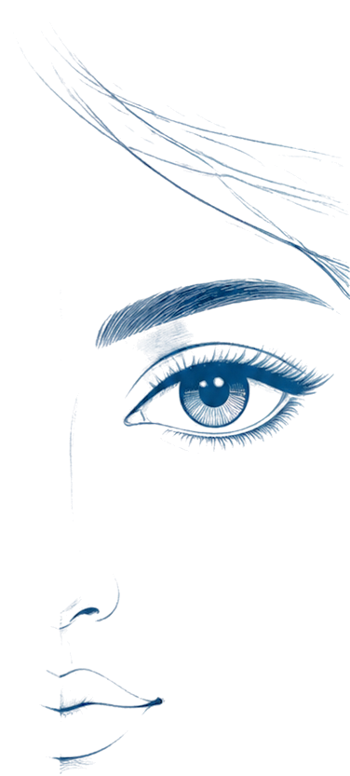





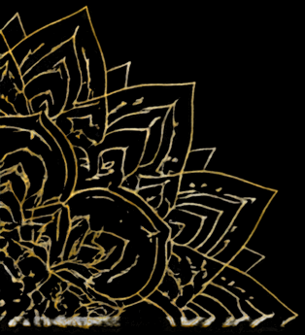



SUNRISE INTERNATIONAL SCHOOL
ACCREDITATION
SCHOOL
LOGO HERE
LOGO HERE
HAPPY
Navratri
Let’s welcome Maa Durga into our lives with faith, love, and devotion
this Navratri.
[WEBSITE] | [CONTACT]
TOLL-FREE: [NUMBER]

