Slide 1


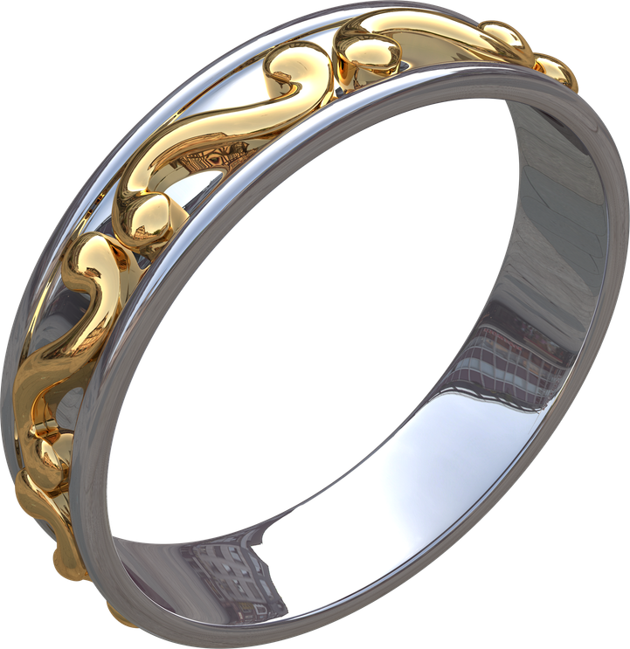
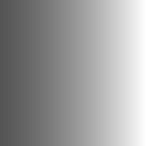
ELEGANT RING
Limited Edition
An elegant ring with an attractive and simple design, weighing 10 mg so it is suitable for everyday use

