Slide 1


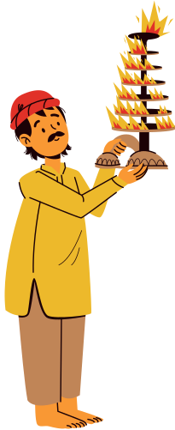


Happy
Makar
Sankranti
May your life be filled with joy, warmth, and sweet moments. Celebrate and soar high!

