Slide 1








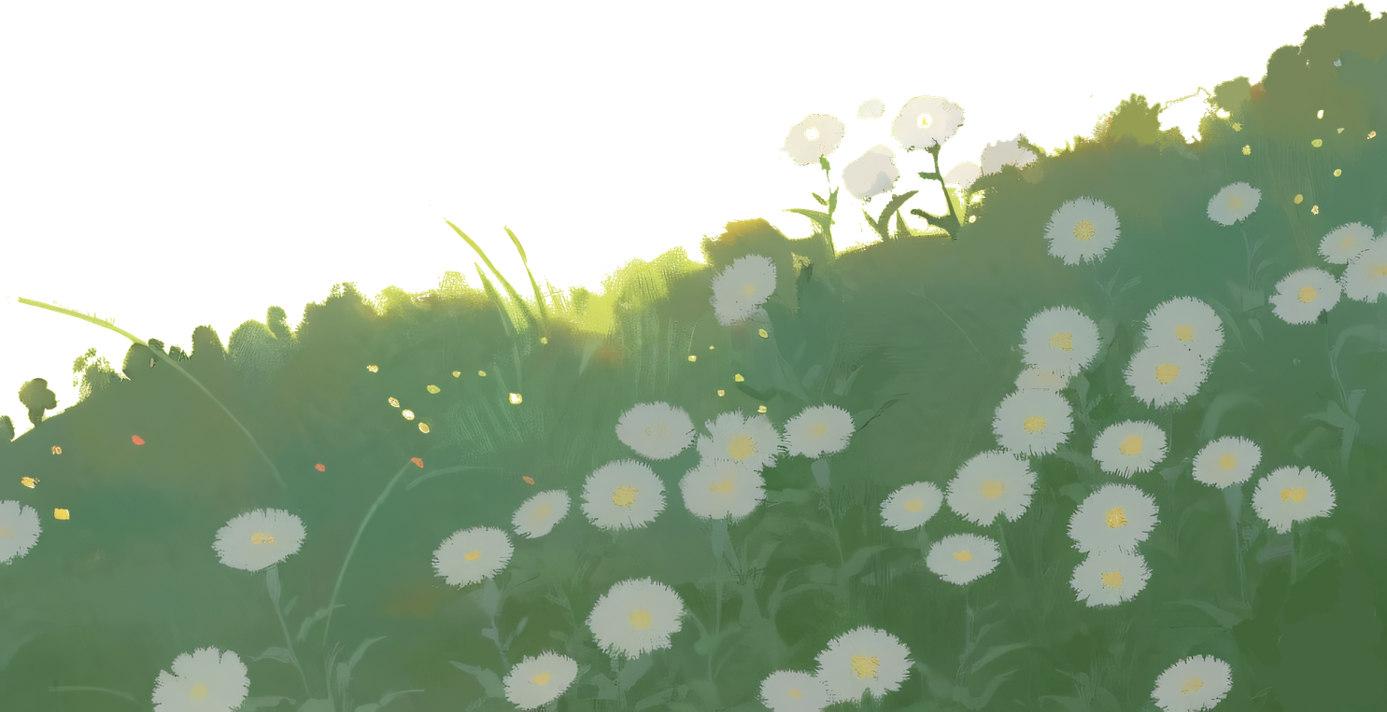
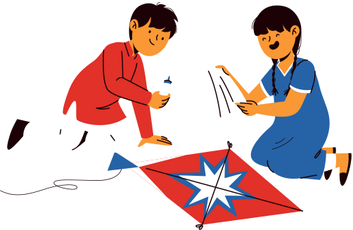


HAPPY
Makar
Sankranti
Under the winter sun and open sky, may your dreams rise freely like kites this Sankranti.

