Slide 1


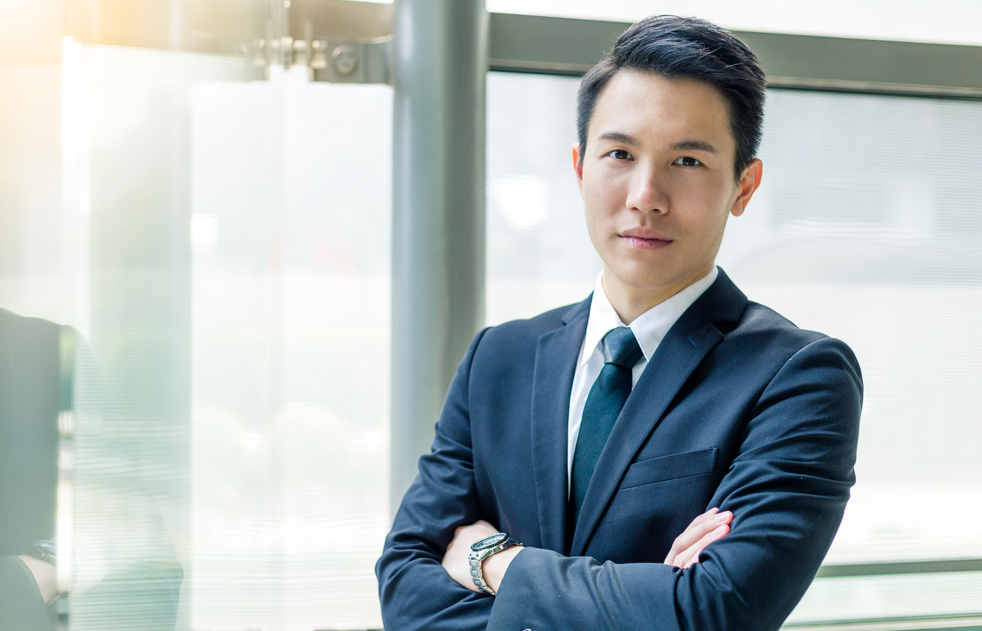


BEST EMPLOYEE
OF THE MONTH
PEDRO FERNANDES
Congratulations on your success as the top employee this month. We take this award as a token of our gratitude for your performance this month.

