Slide 1
Module 2: The Data Lab
Transforming Messy Data into Actionable Insights

Slide 2

Data is the New Concrete
Every construction, agricultural, and industrial project runs on data.
The Challenge: Finding anomalies in thousands of rows manually takes hours.
The Solution: AI Data Analysts clean and organize data in seconds.
Activity: How long would it take you to manually find the 5 budget overruns here?

Slide 3
Welcome to the Data Lab
Step 1: Upload your dataset (e.g., procurement_demo.csv).
Step 2: Write your first AI cleaning prompt.
Step 3: Watch the AI fix inconsistent vendor names and messy dates instantly!

Slide 4

The Great Reconciliation Challenge
Scenario: Your Invoice doesn't match the Goods Received Note.
The Mission: Use the AI Reconciliation Engine to find the missing ₹5 Lakhs.
The Rules: The first 3 people to find the discrepancy win!

Slide 5

From Data to Visual Storytelling
Clean data is only half the battle. Presenting it is the other half.
Generate automated visual reports for management.
Instantly create comparison charts (e.g., Expenditure vs. Budgeted BOQ).

Slide 6
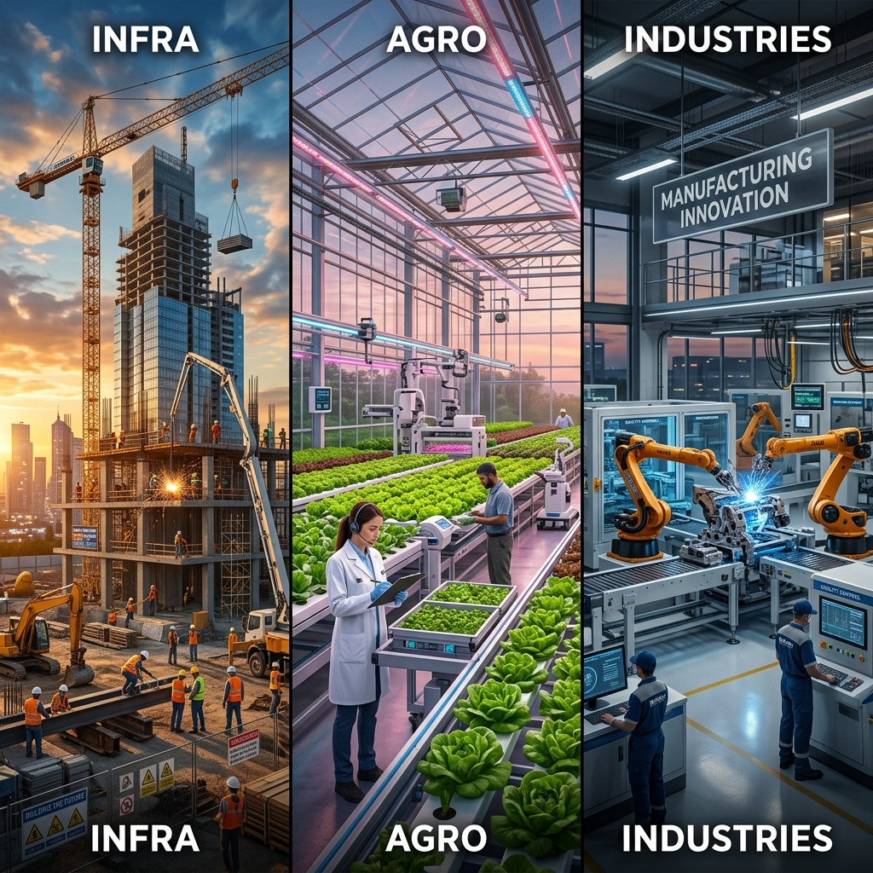
Real-World Application by Department
DEC Infra: Analyze Safety Audits & Construction Timelines.
DEC Agro: Analyze Cold Chain Temperatures & Crop Yield Data.
DEC Industries: Analyze Equipment Downtime & Manufacturing Efficiency.

Slide 7
Key Takeaways & What's Next
What was your biggest surprise today?
How will this change your workflow tomorrow?
Coming Up Next: Module 3 - Safe AI Usage (Security & Ethics).

