Slide 1
Day -3: LATEX Course Report, Article, Chapter and Thesis & Relevant packages
Sabarathinam Srinivasan
Postdoc, Aragon Institute of Engineering Research
University of Zaragoza
Spain.
saba.cnld@unizar.es

Slide 2
Contents
How to write a Short report? (Assignment, Letters, Agenda’s, Etc.)
Article (Short, Long and Review).
Chapters (For book and Thesis)
Full Thesis.
Conclusion.

Slide 3
Writing with LaTeX
Introduction
Front Ends
Source of Information's
Setting up
Standard Features
Common Problems

Slide 4

Front ends
pdflatex will produce PDF files directly, and accepts JPG, PNG and PDF graphics files (but not encapsulated postscript files). latex will produce DVI files and only copes with encapsulated postscript files. A few facilities (ever fewer) are only available with latex.

Slide 5

Sources of Information
The help system's LaTeX page is quite extensive (and is read over 120k times a year). It includes information on:
LaTeX in General - LaTeX: An introduction and Advanced LaTeX are short, locally produced documents. The Not So Short Introduction to LaTeX2e is more extensive. Formatting information by Peter Flynn is good. LaTeX for Word Processor Users introduces LaTeX to those already proficient with Word. Instructions for Preparation of Papers and Monographs looks useful.
Maths - Try LaTeX Maths and Graphics Math into LaTeX (by G. Grätzer).
Graphics - Try LaTeX Maths and Graphics or Using Imported Graphics in LaTeX2e Documents (by Keith Reckdahl).
Packages - The TeX and LaTeX Catalogue describes packages available elsewhere.
LaTeX in depth - LaTeXe help is an extensive indexed reference.
and there's also a keyword search of the LaTeX documents on this server.

Slide 6
Setting Up
The document class specified in the "\documentclass" line determines the basic appearance of the document (rather in the way that templates or Master Pages do in other programs). Packages (loaded in using the "\usepackage" command) are add-ons that augment or change the standard LaTeX features. Both classes and packages can be given options by using square brackets (see the use of the graphicx package below as an example).
Classes - Standard LaTeX has few standard classes of document. The most relevant for longer documents are article, report, and book. The differences are minor
book - can contain parts and chapters. subparagraphs possible. New chapters begin on a right page. Supports \frontmatter, \mainmatter and \backmatter commands.
report - can contain chapters. Numbering starts at 0. New chapters begin on a right page.
article - no parts. Numbering begins at 1.

Slide 7
Journals sometimes have class files for you to use. Use them whenever you can. We have a few of these installed (e.g. the Royal Society's rs class, Elsevier's elsart class and some IEEE material), but many others exist (see, for example, CUP's LaTeX support).
There are several thesis-related classes around. Most are university-specific. Some have been designed for easy customisation. One that's often mentioned is ucthesis from the University of California.

Slide 8
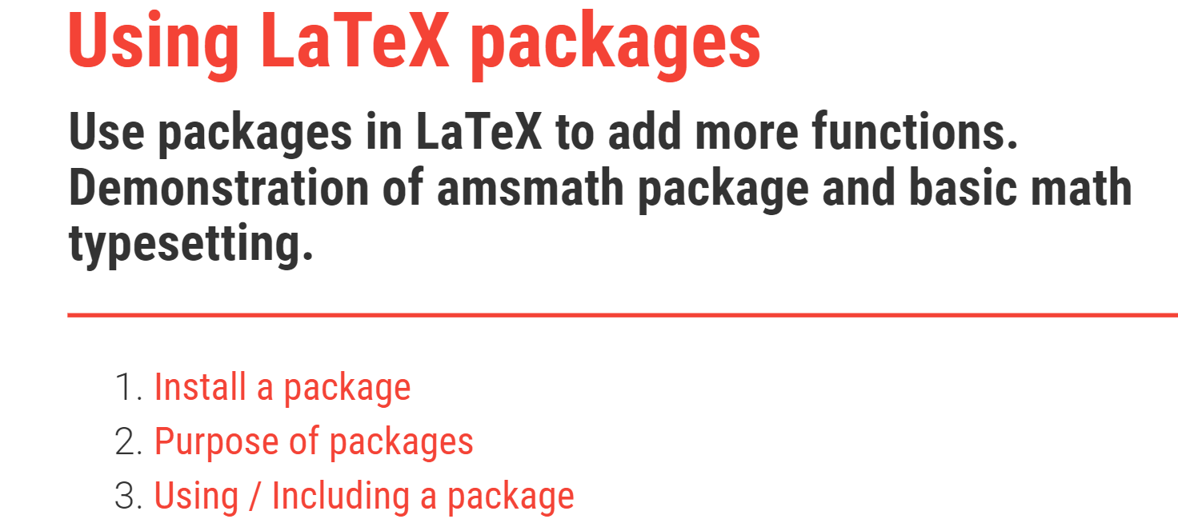
pACKAGES

Slide 9
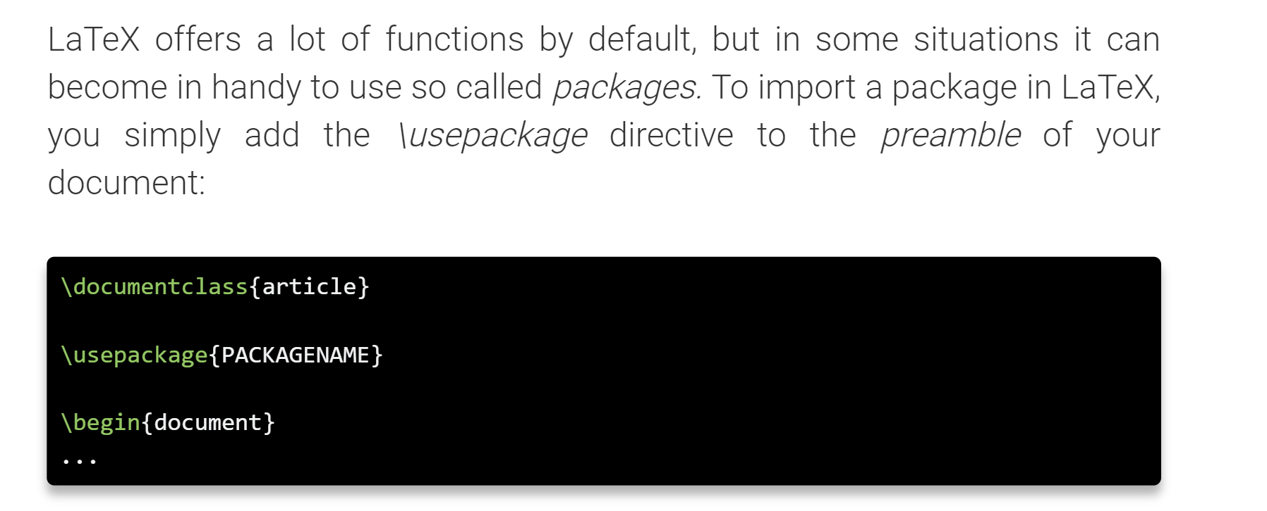
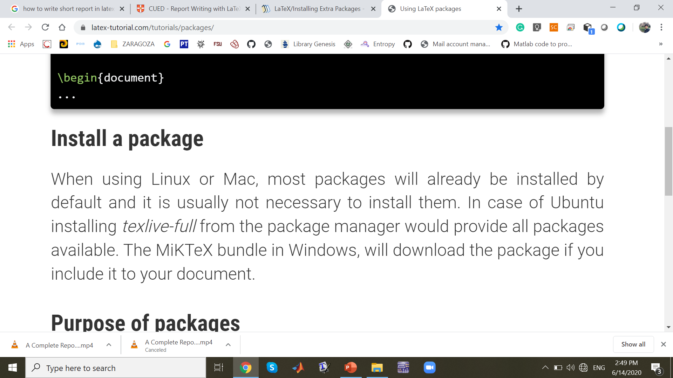
Install Packages

Slide 10
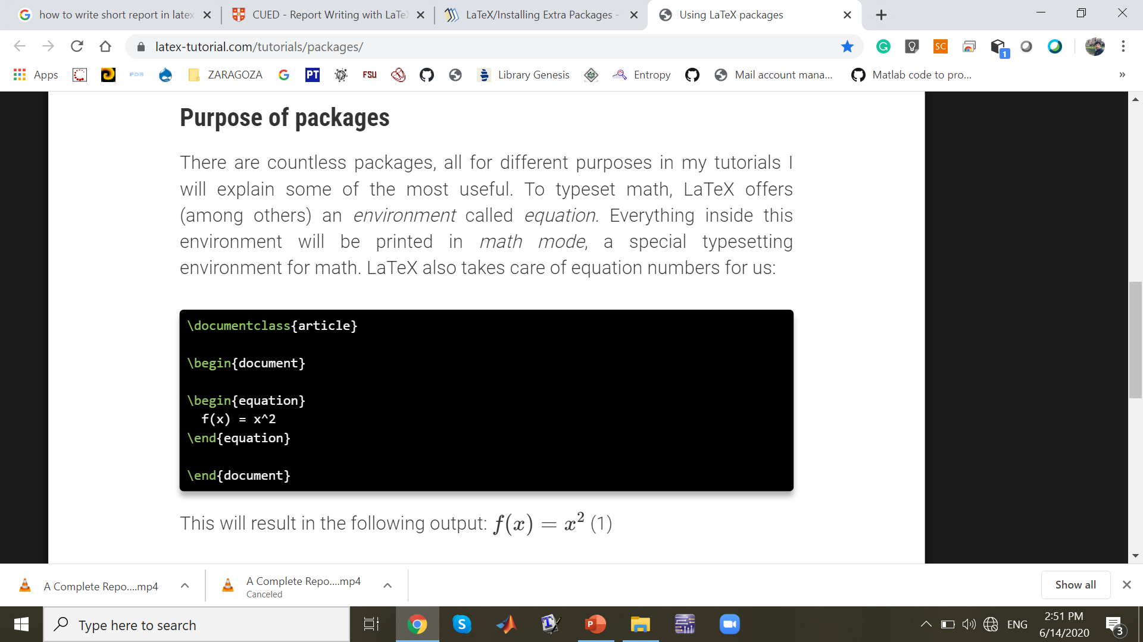

Slide 11
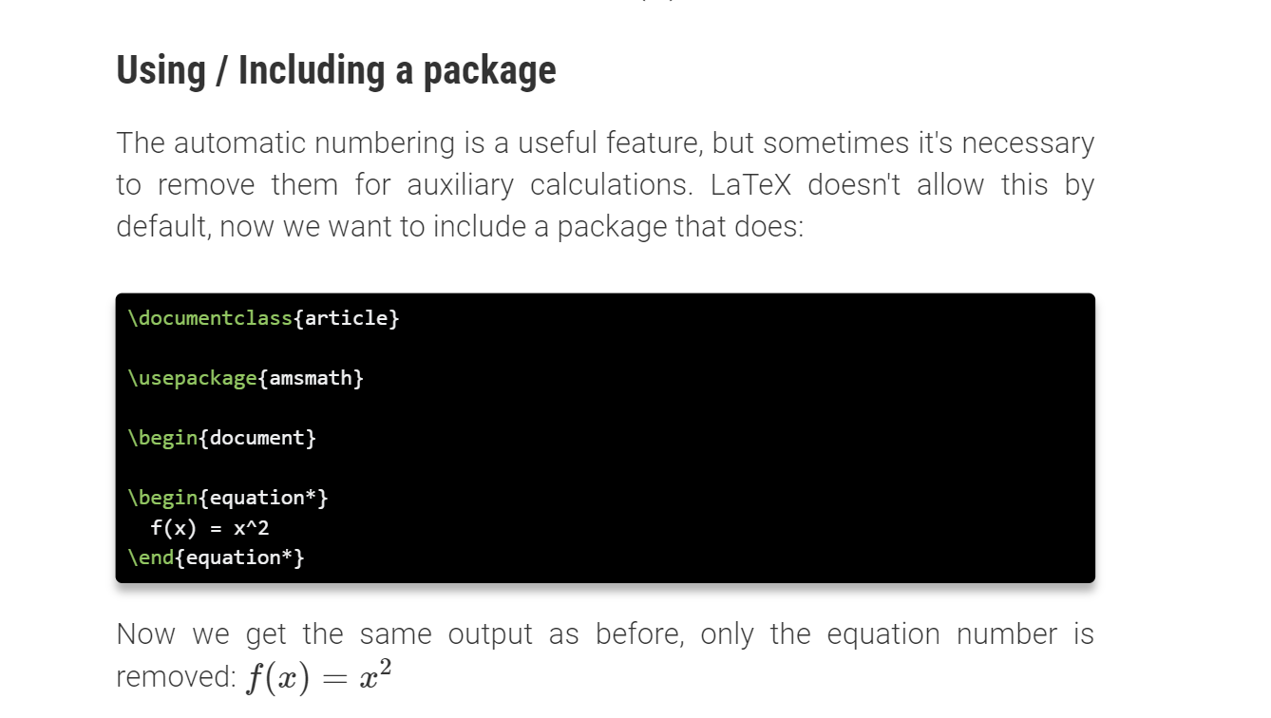

Slide 12
Structures

Slide 13
Standard Features
Cross referencing - Use the \label command to set places you want to reference. Use \ref to refer by section and \pageref to refer by pagenumber. If you put a label after or in a figure's caption, then a \ref to that label will give the figure number, otherwise it will give the section number.
Footnotes - use \footnote. The footnotes are numbered in a single sequence through the whole document. \usepackage[perpage]{footmisc} gives per-page numbering. \usepackage{endnotes} puts all the 'footnotes' at the end of the document.
Floats - 2 types: table and figure. I always use [htbp] as placement parameters. By default LaTeX doesn't add text to a page that is over 70% covered with graphics. See the float hints for how to override this. Use the endfloat package to put all figures at the end of a document.
Graphics - easy enough. See the local LaTeX Maths and Graphics guide or the definitive Using Imported Graphics in LaTeX2e Documents (by Keith Reckdahl).
Screen dumps - on CUED's teaching system use KSnapshot or Gimp in the applications panel. Typing import foo.eps offers similar facilities.
Tables - Many options. Try to keep it simple. The general guides provide enough information for most situations. For details, see Tables in LaTeX: packages and methods
Maths - if standard LaTeX maths isn't sufficient you can always use the AMS-LaTeX package.

Slide 14
Numbering - With bigger documents you may want to have per-section figure and equation numbering. The class sometimes provides this. Alternatively, you can use
\usepackage{chngcntr}
\counterwithin{figure}{section}
\counterwithin{equation}{section}
\begin{document} ...

Slide 15
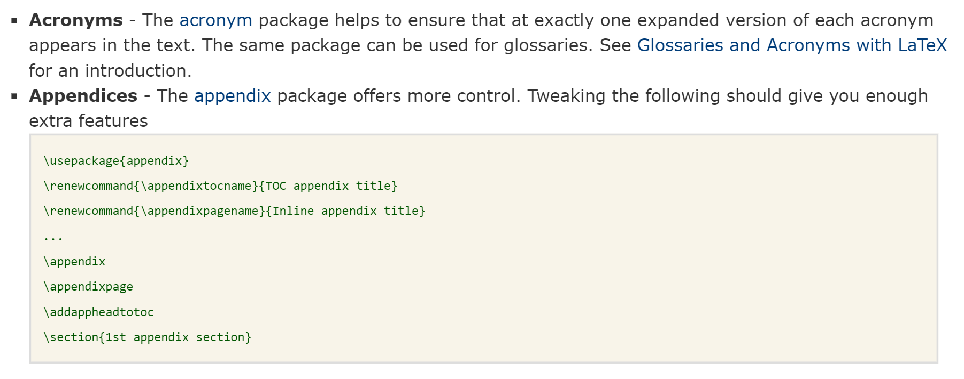

Slide 16
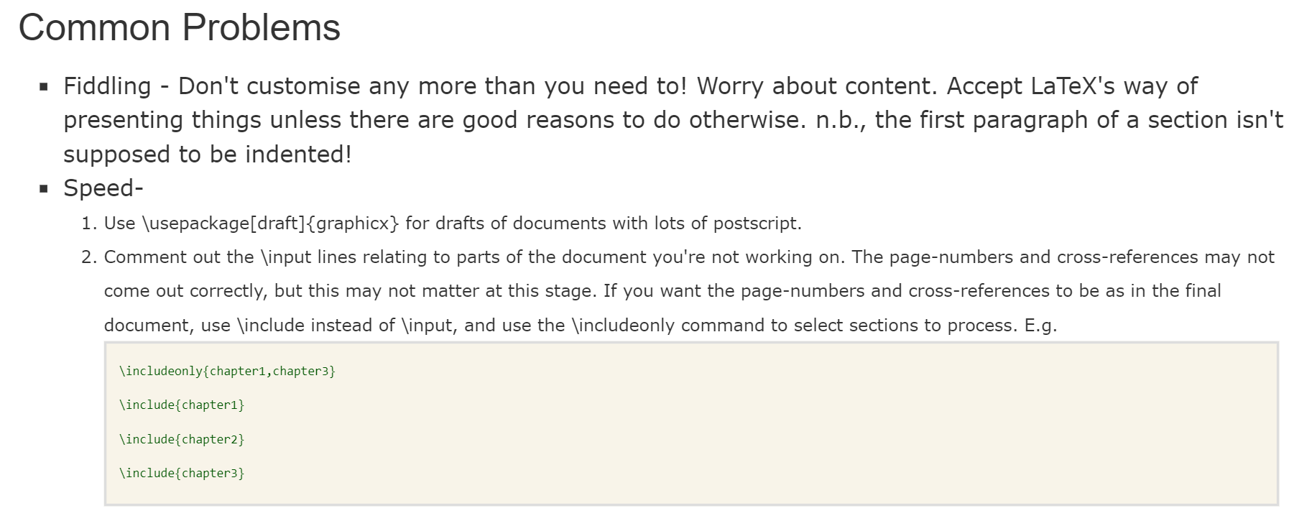
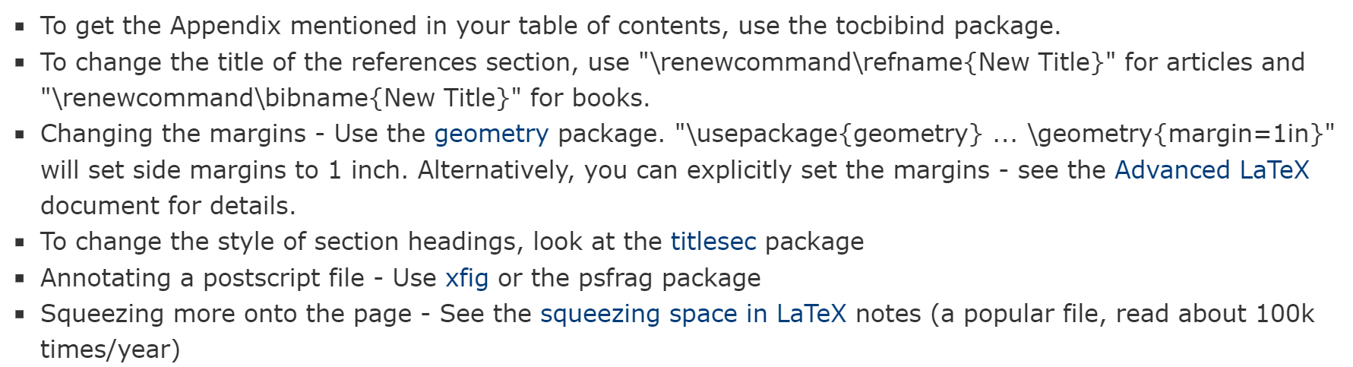

Slide 17
THanks

