Slide 1


Unlocking the Power of Domain Sales Analytics
In the fast-paced world of online commerce, the art of domain sales has become a crucial piece of the puzzle. Through our "Domain Sale" process, we empower potential buyers to acquire the domain they desire swiftly and seamlessly, eliminating the hassle of direct seller contact. This project delves into the intricacies of domain sales data, leveraging advanced analytics to uncover key insights, trends, and opportunities that can drive strategic decision-making and maximize business success.

Slide 2
Decoding the Domain Sales Landscape
Sales Insights
Budget Analysis
Variance Exploration
By analyzing the sales data, we can uncover valuable insights into the ebb and flow of domain transactions. This includes identifying top-selling domains, understanding pricing patterns, and detecting seasonal fluctuations. These insights can help businesses optimize their domain portfolios, tailor their pricing strategies, and capitalize on emerging market trends.
Examining the budget data associated with domain purchases provides a glimpse into the financial decision-making process of buyers. This information can inform pricing strategies, identify high-value customer segments, and guide targeted marketing efforts to attract the most lucrative prospects.
Delving into the variance between sales and budgets can reveal significant discrepancies, highlighting areas for further investigation. This analysis can uncover potential pricing inefficiencies, identify undervalued domains, and guide negotiations to ensure both buyers and sellers achieve favorable outcomes.

Slide 3
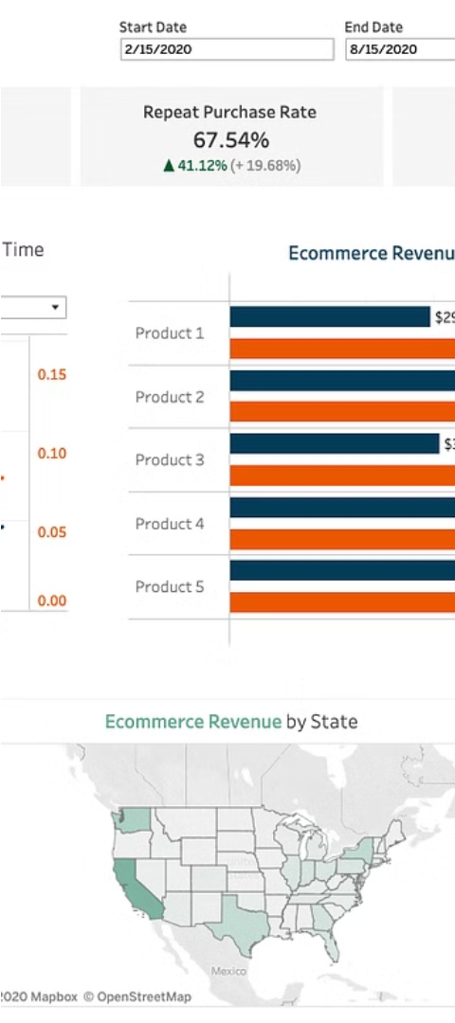
Uncovering Product and Customer Insights
1
Product Analysis
Examining the product data, such as the types of domains available, their characteristics, and their performance, can provide valuable insights. This analysis can help businesses identify high-demand domains, optimize their product portfolios, and strategically acquire or develop new domain assets.
2
Customer Profiling
Understanding the customer base, their purchasing behaviors, and their preferences is crucial for tailoring marketing strategies and enhancing the user experience. By analyzing customer data, businesses can segment their audience, create targeted campaigns, and cultivate long-term customer relationships.
3
Identifying Key Factors
Exploring the relationships between various attributes, such as sales, budgets, product features, and customer demographics, can uncover critical factors influencing domain sales. These insights can guide decision-making, inform product development, and optimize marketing efforts to drive business growth.

Slide 4
Visualizing the Domain Sales Landscape
1
Interactive Dashboards
2
Customizable Reporting
Leveraging the power of data visualization, we can create interactive dashboards that provide a comprehensive and intuitive view of the domain sales ecosystem. These dashboards can integrate various data sources, enabling users to explore trends, identify patterns, and derive actionable insights with ease.
The dashboard should offer flexible reporting options, allowing users to customize the data presentation and analysis to suit their specific needs. This level of customization ensures that decision-makers can access the most relevant information, tailored to their unique business requirements.
3
Predictive Analytics
4
Data-Driven Insights
By leveraging advanced analytical techniques, the dashboard can incorporate predictive analytics capabilities. This can help businesses anticipate market shifts, forecast demand, and identify growth opportunities, enabling them to make more informed strategic decisions.
The dashboard should seamlessly blend data, analytics, and visualization to uncover meaningful insights that drive business strategy. These insights can inform pricing strategies, guide domain portfolio management, and support the development of targeted marketing campaigns.

Slide 5
Mastering the Art of Domain Sales Optimization
Pricing Strategies
Portfolio Management
Leveraging data-driven insights, businesses can develop sophisticated pricing strategies that balance market demand, competitor analysis, and revenue optimization. This can involve dynamic pricing models, tiered pricing structures, and personalized pricing options to cater to the diverse needs of domain buyers.
Effective domain portfolio management is crucial for maximizing the value of a business's domain assets. By analyzing sales data, market trends, and customer preferences, businesses can strategically acquire, develop, and optimize their domain portfolio to capture new market opportunities and maintain a competitive edge.
Marketing Optimization
Operational Efficiency
Data-driven marketing strategies can help businesses effectively reach and engage with their target audience. This can involve leveraging customer insights to create personalized campaigns, optimizing marketing channels, and developing targeted content to attract and retain domain buyers.
Analyzing the domain sales process can uncover opportunities for operational improvements, such as streamlining transaction workflows, enhancing customer experience, and optimizing internal processes. This can lead to increased efficiency, reduced costs, and a more seamless domain sales experience for both buyers and sellers.

Slide 6




Uncovering Marketplace Trends and Opportunities
Market Growth
Innovative Solutions
Customer Insights
Strategic Partnerships
Analyzing market trends and growth patterns can help businesses identify emerging opportunities and capitalize on the expanding domain sales landscape. This can involve tracking industry benchmarks, monitoring competitor activity, and anticipating shifts in customer preferences.
Deeper understanding of customer preferences, pain points, and buying behaviors can guide the development of targeted solutions and personalized experiences. This customer-centric approach can help businesses build stronger relationships, increase customer loyalty, and drive long-term growth.
Staying at the forefront of domain sales innovation can provide businesses with a significant competitive advantage. By embracing new technologies, automation tools, and data-driven strategies, businesses can streamline their operations, enhance the customer experience, and differentiate themselves in the market.
Forging strategic partnerships with industry peers, technology providers, and domain experts can unlock new avenues for growth. These collaborations can facilitate knowledge sharing, technology integration, and access to complementary resources, ultimately strengthening a business's domain sales capabilities.

Slide 7
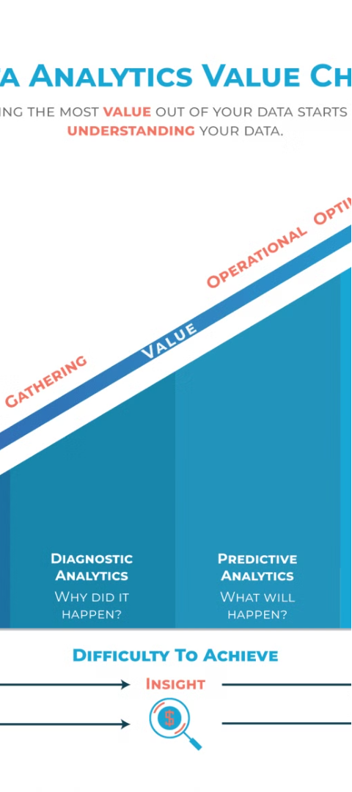



Unlocking the Value of Domain Sales Analytics
Data-Driven Insights
By harnessing the power of domain sales data, businesses can uncover valuable insights that inform strategic decision-making, optimize operations, and drive business growth.
Competitive Advantage
Leveraging data-driven strategies and analytics-powered solutions can help businesses differentiate themselves in the domain sales market, outpacing their competitors and capturing a larger share of the market.
Improved Profitability
Applying data-driven insights to pricing strategies, portfolio management, and operational optimization can lead to increased revenue, reduced costs, and enhanced profitability for domain sales businesses.

Slide 8
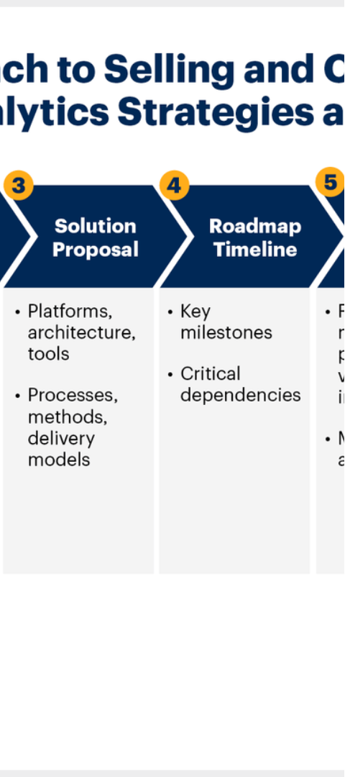
Conclusion: Embracing the Power of Domain Sales Analytics
1
Actionable Insights
2
Competitive Edge
The domain sales analytics framework presented in this project provides businesses with a comprehensive set of tools and strategies to transform raw data into actionable insights that drive strategic decision-making and operational excellence.
By leveraging data-driven approaches to pricing, portfolio management, and marketing, businesses can gain a competitive edge in the dynamic domain sales landscape, positioning themselves for long-term success and growth.
3
Continuous Optimization
The power of domain sales analytics lies in its ability to enable continuous improvement, allowing businesses to adapt to changing market conditions, capitalize on emerging trends, and refine their strategies to maximize revenue and profitability.

